Slide 1
COMP30810 Intro to Text Analytics
Dr. Binh Thanh Le
thanhbinh.le@ucd.ie
Insight Centre for Data Analytics
School of Computer Science
University College Dublin

Slide 2


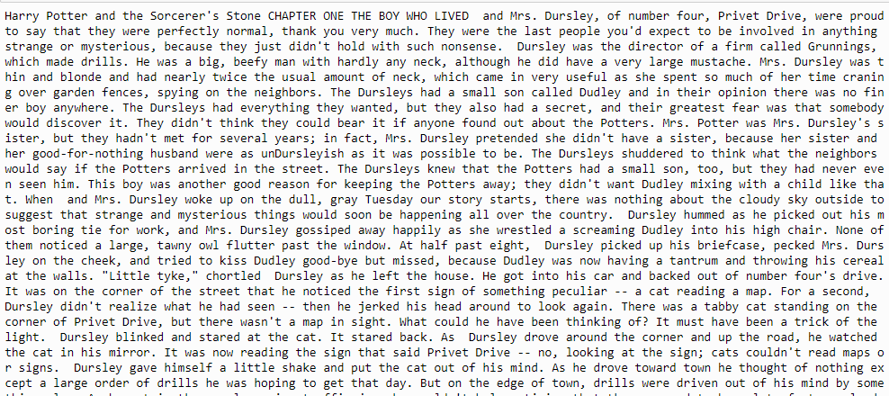
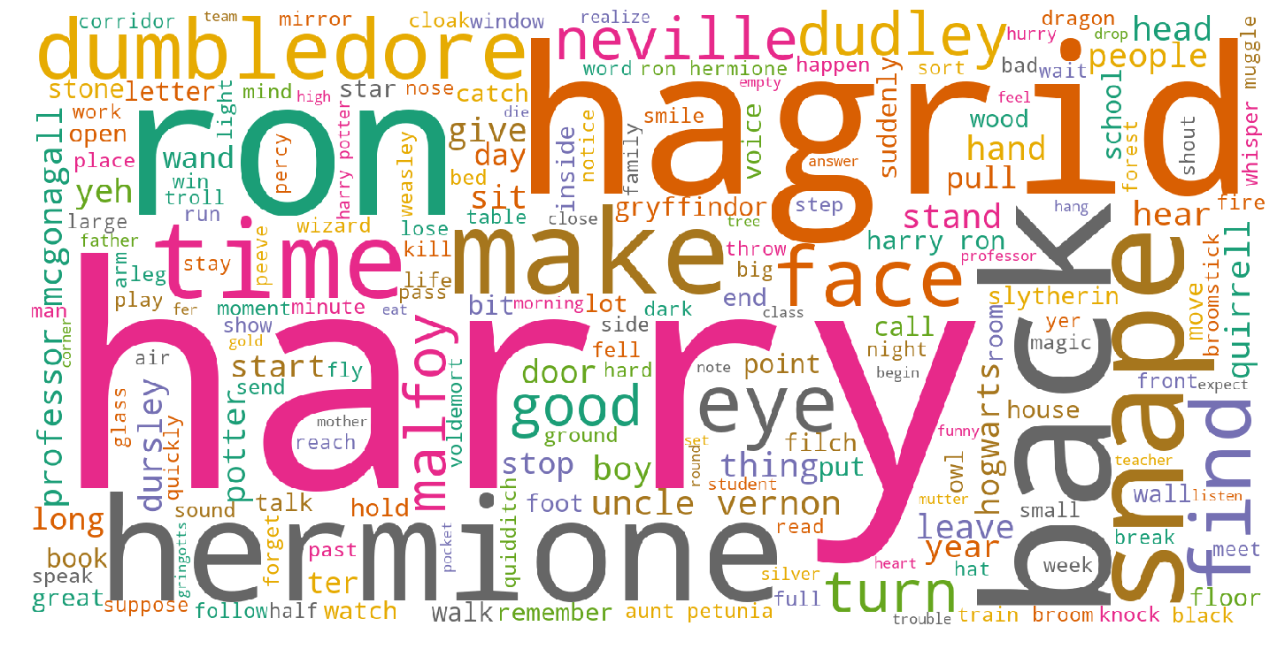
Recap of previous lecture
Document
Raw text
Corpus
Most common words
Document
Summarization
Frequency
N-gram
<Meaning>
POS
wordlist

Slide 3
Today Goals:
Understanding TF-IDF
Understanding ranking
Understanding distance and similarity measurement
Document summarization

Slide 4
Example
Given the corpus of 4 documents as:
Doc1: "The sky is blue."
Doc2: "The sun is bright today."
Doc3: "The sun in the sky is bright.“
Doc4: "We can see the shining sun, the bright sun."
Our task: return the analysis for this corpus

Slide 5
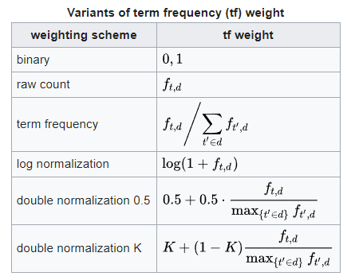
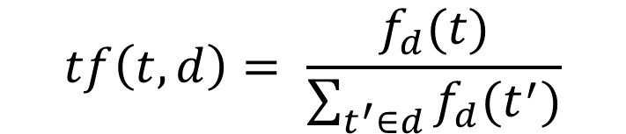
1) TF-IDF
Term Frequency–Inverse Document Frequency
Term Frequency
: gives us the frequency of the word in each document in the corpus.
It is the ratio of number of times the word appears in a document compared to the total number of words in that document.
term
document
$$tf\left(t,d\right)= \frac{f_{d}(t)}{\sum_{t^{′}∈d}{f_{d}(t^{′})}}$$
Note:
It increases as the number of occurrences of that word within the document increases.
Each document has its own tf.

Slide 6
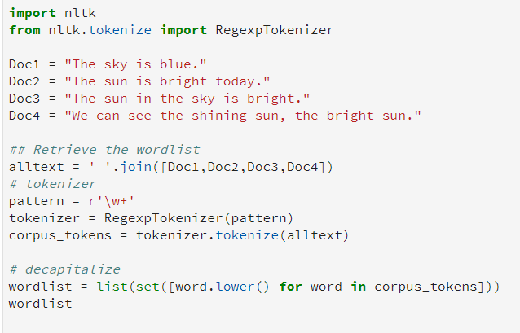
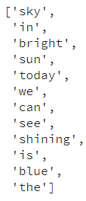
1) TF-IDF
Python code
First: build the wordlist for corpus:
bag-of-words

Slide 7
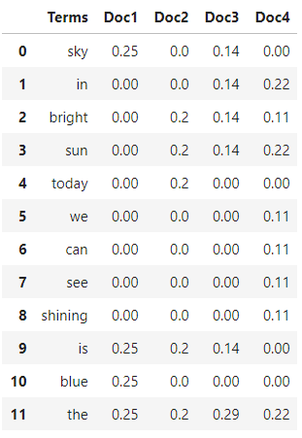
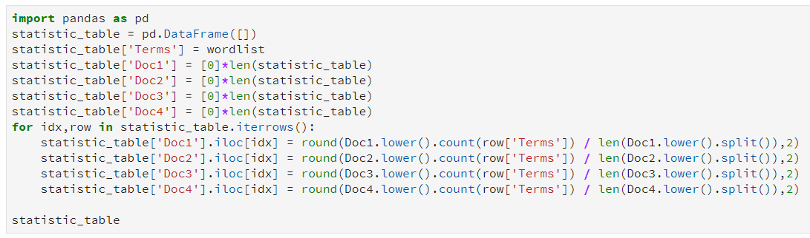


1) TF-IDF
Python code
<Term Frequency>
Easy code for understanding:

Slide 8
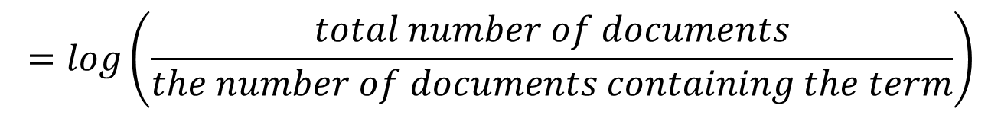
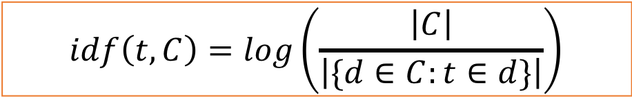
1) TF-IDF
Inverse Document Frequency
used to calculate the weight of rare words across all documents in the corpus.
The words that occur rarely in the corpus have a high IDF score.
$$idf\left(t,C\right)=log\left(\frac{\left|C\right|}{\left|\{d∈C:t∈d\}\right|}\right)$$
$$=log\left(\frac{total number of documents}{the number of documents containing the term}\right)$$

Slide 9
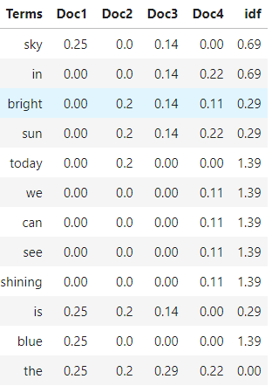
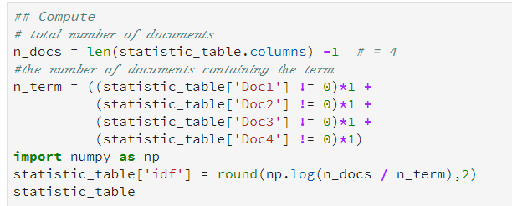

1) TF-IDF
Python code
< Inverse Document Frequency >
TF
Or

Slide 10
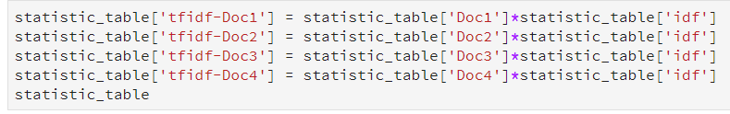

1) TF-IDF
Combining these two we come up with the TF-IDF score for a word in a document in the corpus. It is the product of TF and IDF
TF-IDF
$$tfidf\left(t,d,C\right)=tf\left(t,d\right)×idf(t,C)$$
Python code

Slide 11
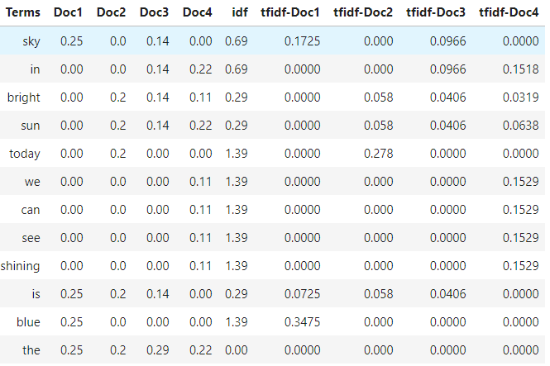
1) TF-IDF
TF
IDF
TF-IDF
Doc1: "The sky is blue"

Slide 12
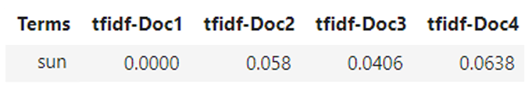
2) Information Retrieval (IR)
What is the document having a good description for the “sun”?
TF-IDF
Doc1: "The sky is blue."
Doc2: "The sun is bright today."
Doc3: "The sun in the sky is bright.“
Doc4: "We can see the shining sun, the bright sun."
Word
vector
Query: “sun”
Document vector

Slide 13
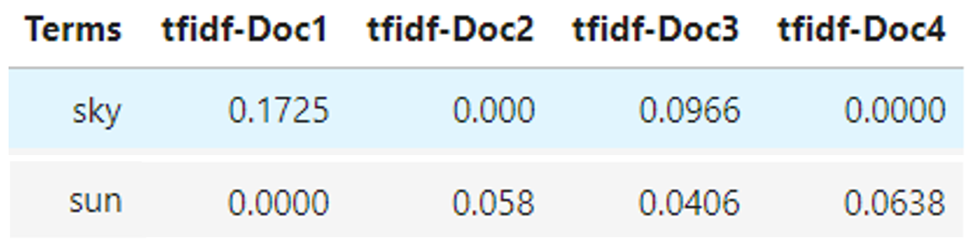
2) Information Retrieval (IR)
What is the document having a good description for the “sun”?
What is the document having a good description for the “sun” or “sky”?
Doc1: "The sky is blue."
Doc2: "The sun is bright today."
Doc3: "The sun in the sky is bright.“
Doc4: "We can see the shining sun, the bright sun."
Query: “sun” or “sky”
Query: “sun”
0.1725 0.058 0.1372 0.0638
Why?: the description is stronger in Doc1,
because the word “blue” has high
information content.

Slide 14
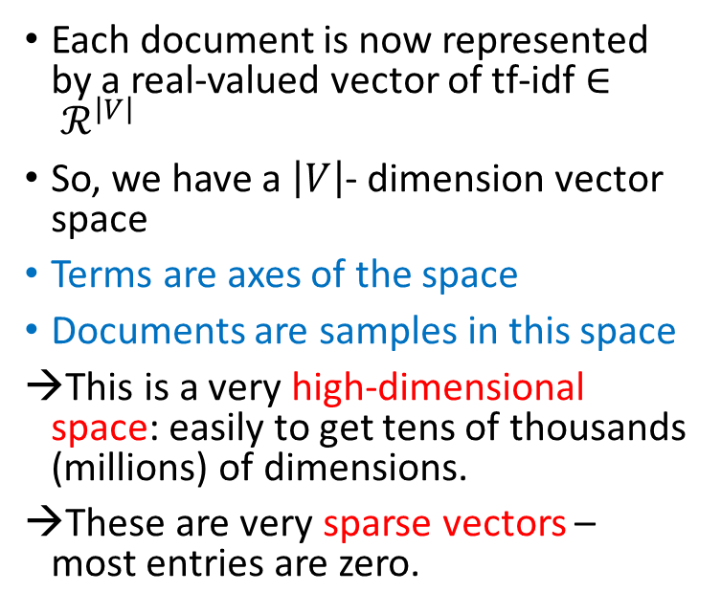

3) Documents as vectors
TF-IDF
Each document is now represented by a real-valued vector of tf-idf $∈ ℛ^{\left|V\right|}$
So, we have a $\left|V\right|$- dimension vector space
Terms are axes of the space
Documents are samples in this space
This is a very high-dimensional space: easily to get tens of thousands (millions) of dimensions.
These are very sparse vectors – most entries are zero.
Word
vector
Document vector
$\left|V\right|$ : size of terms (=12)

Slide 15
4) What can we do with vectors?
Assume we have a story (book) → corpus
Task: get the most informative sentence and word in that story
Book is a corpus
Sentences are documents
Document
Summarization
Document
Ranking
 | Word 1 | Word 2 | Word 3 | SUM
Sentence 1 | tf-idf | tf-idf | tf-idf | 0.124
Sentence 2 | tf-idf | tf-idf | tf-idf | 0.235
Sentence 3 | tf-idf | tf-idf | tf-idf | 0.254
Sentence 4 | tf-idf | tf-idf | tf-idf | 0.568
…
SUM | 0.256 | 1.568 | 1.245
This is the most informative sentence
This is the most informative word in story

Slide 16
5) Improvement for ranking
To rank each sentence ➔ use the tf-idf values.
However, rather than simply taking the summation of all the values for a given sentence, it will be useful when using some additional techniques as follow:
Only summing tf-idf values where the underling word is a noun.
Add an additional value to a given sentence if it has any words that are included in the title of the document (title can be the first sentence of document).
Apply a position weighting. For example if there are 10 sentences in a document, sentence nine’s “position weighting” would be 0.9. This weighting is then multiplied by the value calculated in point 2.
Apply n-gram to check the tf-idf of multiword in sentence.
https://medium.com/@acrosson/summarize-documents-using-tf-idf-bdee8f60b71

Slide 17
6) Distance and Similarity
We will cover three basic distance measurements in Text Mining:
Euclidean Distance
Cosine Similarity
Jaccard Similarity
Consider these three sentences:
s1 = “David loves dogs” s2 = “Dogs are ok with David” s3 = “Cats love rain”

Slide 18
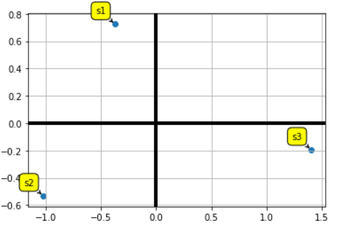
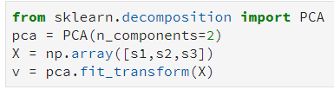
6) Distance
We generate tokens for sentences:
We build a vocabulary with all the words in our corpus.
Then, we generate the vectors (6-dimensional space) by using counting
Reduce 6-d to 2-d for visualization (using PCA)
s1 = (“david”, “love”, “dog”)
s2 = (“dog”,”ok”,”david”)
s3 = (“cat”,”love”,”rain”)
bag-of-words
{'cat': 0, 'david': 1, 'dog': 2, 'love': 3, 'ok': 4, 'rain': 5}
In here, you can use tf-idf vectors, but for the example, I simply use counting
s1 = [0, 1, 1, 1, 0, 0]
s2 = [0, 1, 1, 0, 1, 0]
s3 = [1, 0, 0, 1, 0, 1]

Slide 19
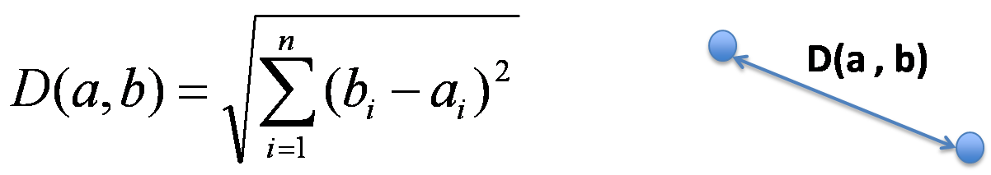
6) Distance
So, the Euclidean distance is good in this case

Slide 20
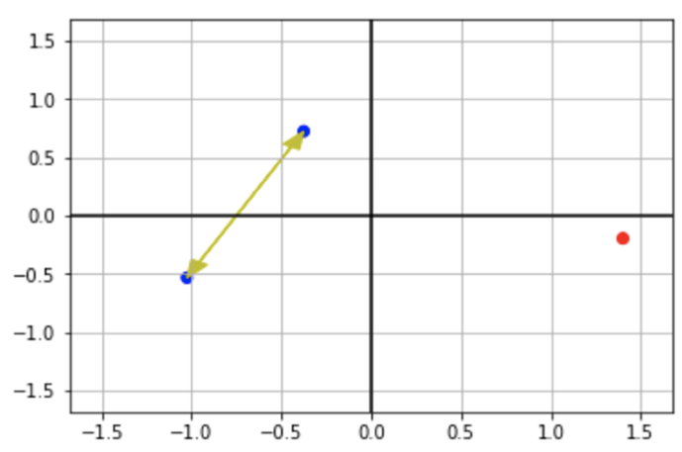
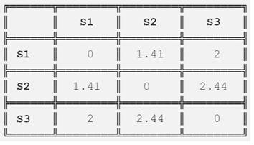
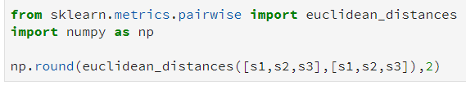
6) Distance
So, the Euclidean distance is good in this case
Euclidean distance matrix
S1 to S2 are closer
than S1 to S3, or S2 to S3

Slide 21
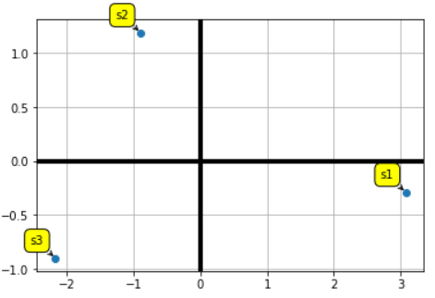

6) Distance
Now, consider these sentences:
s1 = “David loves dogs dogs dogs dogs dogs”
s2 = “Dogs are ok with David”
s3 = “Cats love rain”
Let’s plot those vectors using PCA again
Euclidean distance matrix
{'cat': 0, 'david': 1, 'dog': 2, 'love': 3, 'ok': 4, 'rain': 5}
s1 = [0, 1, 5, 1, 0, 0]
s2 = [0, 1, 1, 0, 1, 0]
s3 = [1, 0, 0, 1, 0, 1]
See what happened: now, Sentence 2 and 3 are closer than 1 and 2.
This is bad

Slide 22
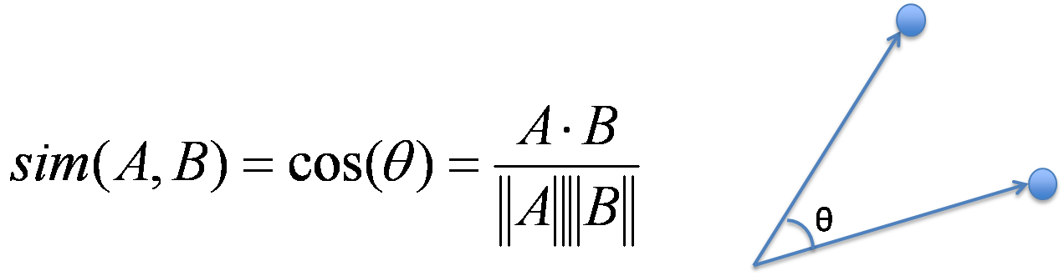


6) Similarity
Cosine Similarity
http://blog.christianperone.com/2013/09/machine-learning-cosine-similarity-for-vector-space-models-part-iii/

Slide 23
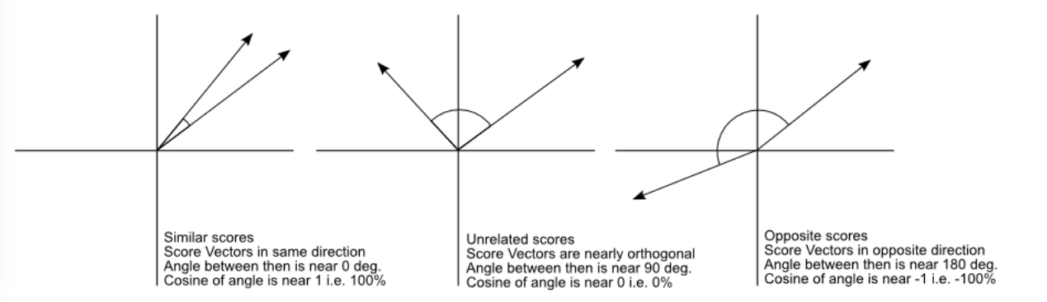
6) Similarity
Cosine Similarity
Similar
Unrelated
Opposite

Slide 24



6) Similarity
Cosine Similarity
S1 S2 S3
93º
S1 S2 S3
360º- 93º
S1 to S2 are more similar
than S1 to S3, or S2 to S3

Slide 25
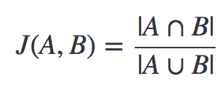
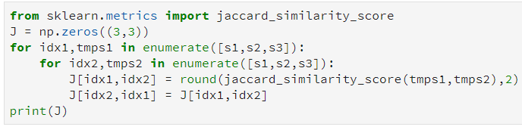


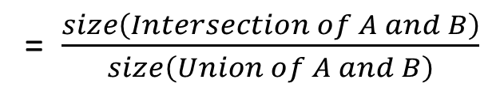

6) Similarity
Jaccard Similarity
= $\frac{size\left(Intersection of A and B\right)}{size\left(Union of A and B\right)}$
➔ $J(s1,s2)= \frac{3}{6}=0.5$
S1 S2 S3
S1 S2 S3
S1 to S2 are more similar
than S1 to S3, or S2 to S3

Slide 26
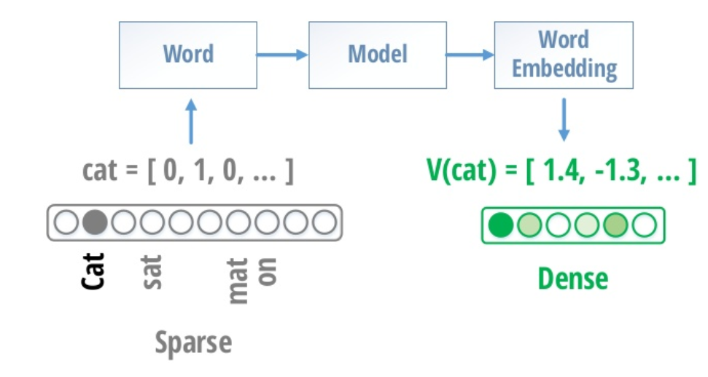
7) Conclusion
The techniques are simple for finding the similarity of two documents if having common words
Advantage: text is represented as a vector of numbers
Limitation:
The techniques do not cover the synonym scenario (e.g. [dog, puppy] , [buy, purchase], [funny, amusing], etc. )
The vectors of documents are sparse vectors (many zeros)
Advanced Text Analytics

Slide 27
Summary
Corpus
Document
Raw text
Most common words
Text → Vector
Frequency
N-gram
TF-IDF
Information Retrieval
POS
wordlist
Ranking
Distance & Similarity

