Slide 1
COMP30810 Intro to Text Analytics
Dr. Binh Thanh Le
thanhbinh.le@ucd.ie
Insight Centre for Data Analytics
School of Computer Science
University College Dublin

Slide 2
Today goals
Understand the KNN classifier
Apply KNN to text

Slide 3
What is KNN?
KNN is the short name of K-Nearest-Neighbour classifier.
It is very simple, easy to understand, versatile and one of the topmost Supervised Learning algorithms.
KNN is a non-parametric learning algorithm.
➔ It does not make any assumptions on the underlying data distribution.
KNN classifier is also an instance-based learning algorithm
➔ does not use the training data points to do any generalization.
Minimal training but expensive testing.

Slide 4
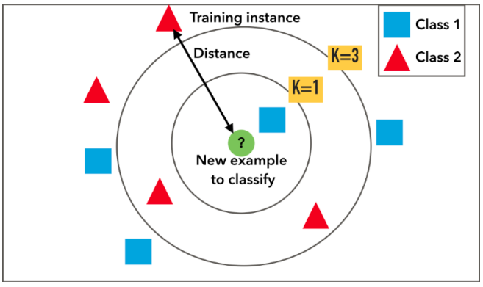
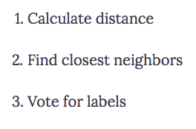
The KNN algorithm

Slide 5
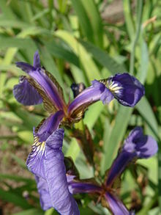
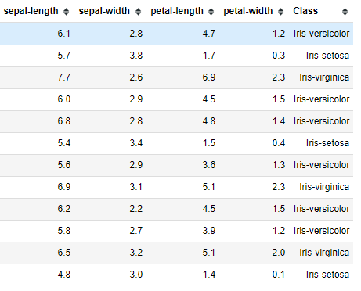
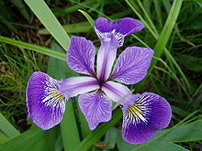
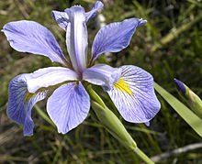

Training data
Iris Setosa
Iris versicolor
Test data
?
Iris virginica

Slide 6

Training data
Euclidean
distances
KNN with K = 1
Iris-setosa
Test data

Slide 7
Training data
Euclidean
distances
KNN with K = 3
Iris-setosa
Test data

Slide 8

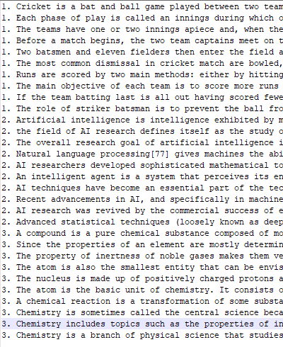


Example for Text Analytics
Cricket
Artificial Intelligence
Chemistry
?
?
?

Slide 9
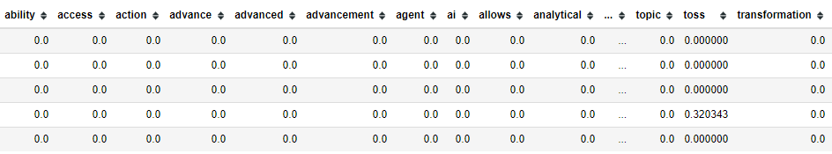
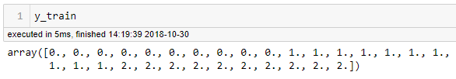

Example for Text Analytics
Texts
==> Stop words removal
==> Punctuation removal
==> Word Lemmatization
==> Digit removal
==> Feature Extraction (Tf-Idf)
X
==> Model training

Slide 10
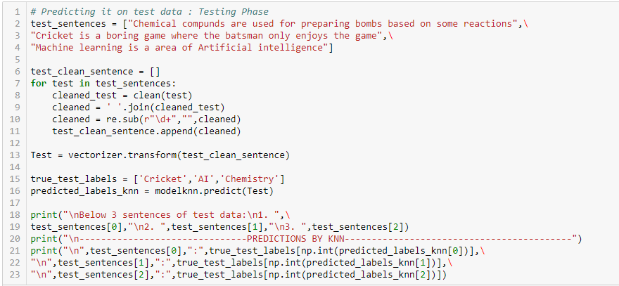
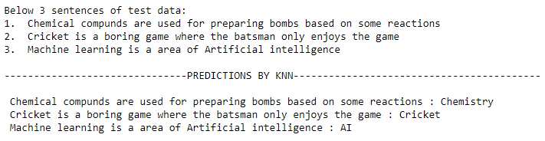

Slide 11
Pros and Cons
Pros
No assumptions about data — useful, for example, for nonlinear data
Simple algorithm — to explain and understand/interpret
High accuracy (relatively) — it is pretty high but not competitive in comparison to better supervised learning models
Versatile — useful for classification or regression
Cons
Computationally expensive
High memory requirement
Stores all (or almost all) of the training data
Prediction stage might be slow
Sensitive to irrelevant features and the scale of the data

