Slide 1
COMP30810 Intro to Text Analytics
Dr. Binh Thanh Le
thanhbinh.le@ucd.ie
Insight Centre for Data Analytics
School of Computer Science
University College Dublin

Slide 2
Today goals
Regression Model:
Linear Regression for predicting a numeric target
feature (can also be used for categorical target
feature); looks for linear relationship between
descriptive and target feature
Classification Model:
Logistic Regression for predicting a categorical target
feature; looks for linear separation between classes

Slide 3
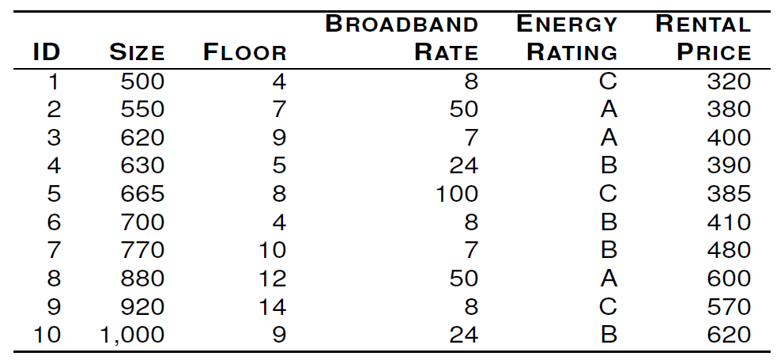
Example
Table: The office rentals dataset: a dataset that includes office rental prices and several descriptive features for 10 Dublin city-centre offices.
Can we predict the rental price (target outcome), given the descriptive features for an office?

Slide 4
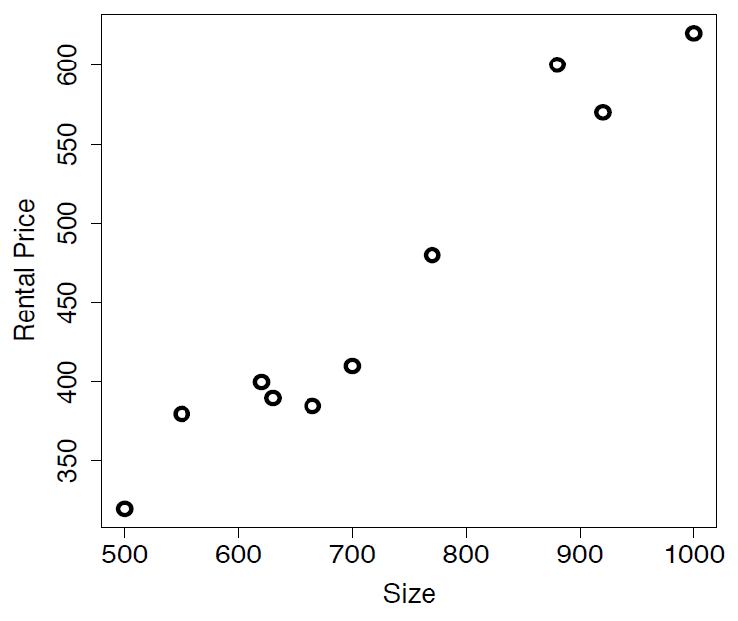
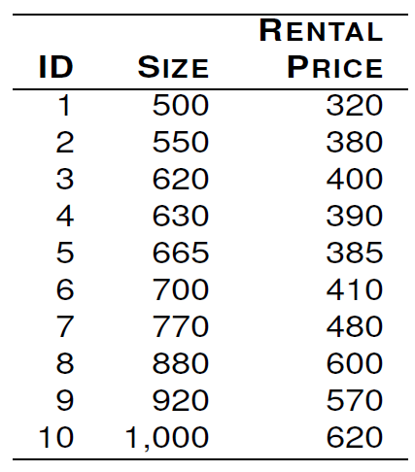
Simple Example
Table: The office rentals dataset: a dataset that includes office rental prices and Size features for 10 Dublin city-centre offices.

Slide 5
Regression VS Classification
Regression: Predict the RentalPrice given the Size of an office
Classification: Predict if the RentalPrice is High or Low given the Size of office
(the focus is on predicting the Probability(RentalPrice=High| Size))
We typically work with two classes and code one class with 0 and the other class with 1.
If more than 2 classes, we can use the one-vs-all formulation to create n binary classification problems (where n is the number of classes).

Slide 6
Regression VS Classification

Slide 7
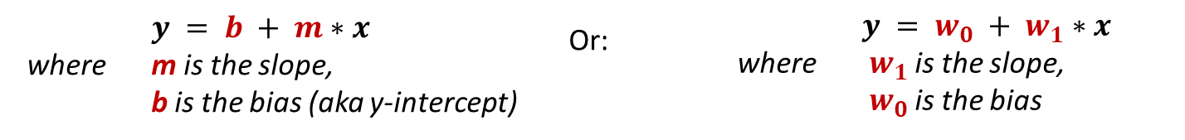
Linear Regression: Linear Model
Scatter plot shows linear relationship between SIZE and RENTAL PRICE
This relationship can be approximately captured via a parameterized line
The equation of a line can be written as:

Slide 8
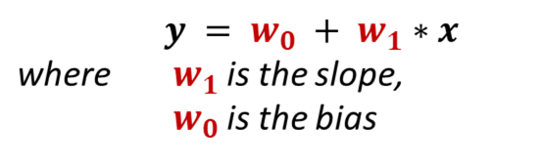
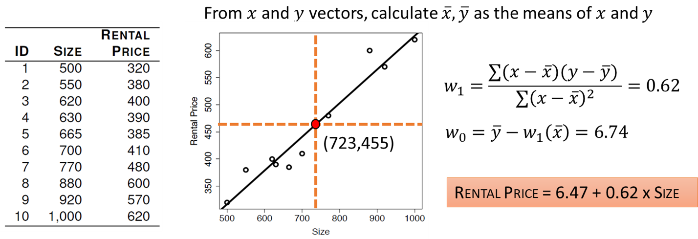
Linear Regression: Linear Model

Slide 9

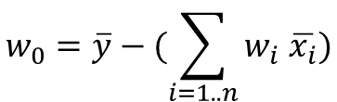
Linear Regression: Linear Model
What is the expected Rental Price for a new/test 730 square foot office?
RENTAL PRICE = 6.47 + 0.62 x SIZE
RENTAL PRICE = 6.47 + 0.62 x 730
= 459.07
This model is known as simple linear regression (1 descriptive feature, 1 target feature)
This allows us to extend the model to use more features

Slide 10
Linear Regression: Assumptions
When you want to apply the LR for your data, you should check the five key assumptions:
Linear relationship
Multivariate normality
No or little multicollinearity
No auto-correlation
Homoscedasticity
Read more:
https://www.statisticssolutions.com/assumptions-of-linear-regression/
https://github.com/justmarkham/DAT4/blob/master/notebooks/08_linear_regression.ipynb

Slide 11
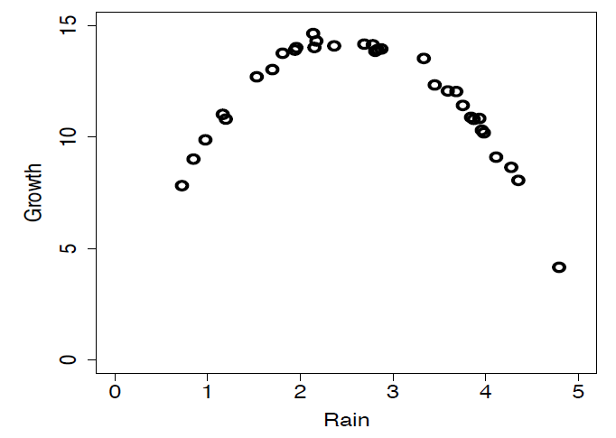
What if the relationship is not linear?
Solution1:
Create new features that capture nonlinear
polynomials of original features
– E.g., original descriptive feature: RAIN. Create a new feature (quadratic polynomial): RAIN²
GROWTH = w0 + w1*RAIN + w2*RAIN²
Solution2:
Create feature interactions
– E.g., original descriptive features: SALARY, HOUSE_PRICE. Create a new feature: the ratio of the two features SALARY/HOUSE_PRICE
Finally:
Build linear regression model with original features + new (derived) features that aim to capture non-linear behavior

Slide 12
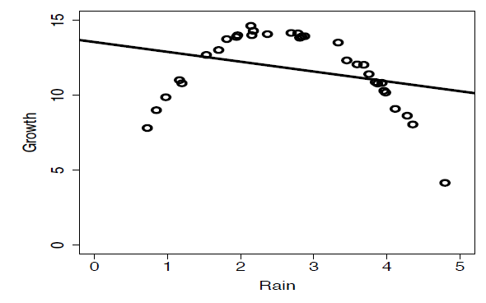
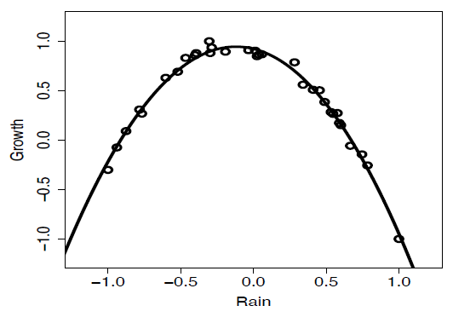
What if the relationship is not linear?
A linear model using original features:
13.510 - 0.667 * RAIN
(This model has a large error!)
A linear model using original features and quadratic features:
0.3707 + 0.8475 * RAIN + 1.717 * RAIN²
(This model fits the data better and has lower error)

Slide 13
Logistic Regression
We assume only 2 classes (binary classification); can extend to many classes with one-vs-all approach
We model the probability of class membership, e.g., if p(PriceClass = High| Size) > 0.5, then predict class High, else predict class Low
We use a logistic function to make sure predictions are in the [0,1] interval (proper probabilities)
Linear regression:
$$p(PriceClass=High| Size)= w_0 + w_1 ∗ Size$$
Logistic regression:
$$p(PriceClass=High| Size)= logistic(w_0 + w_1 ∗ Size)$$

Slide 14
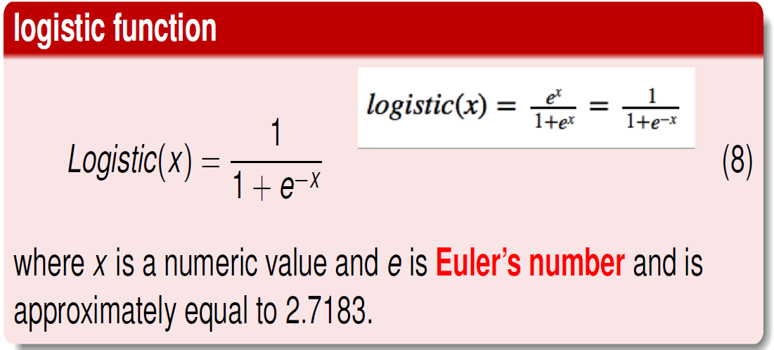
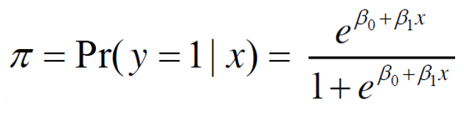
Logistic Regression
When performing logistic regression, we use the following form:

Slide 15
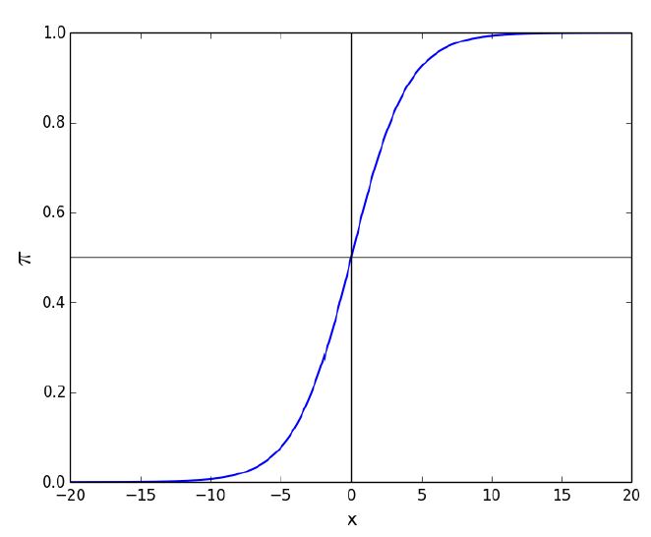
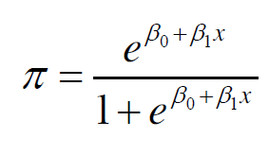
Logistic Regression
The logistic function takes on an “S” shape, where y is bounded by [0,1]

Slide 16
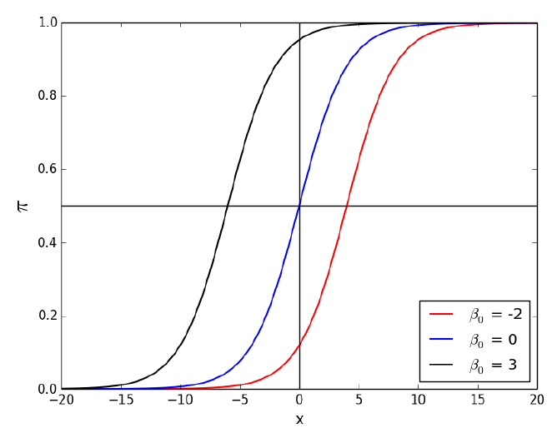
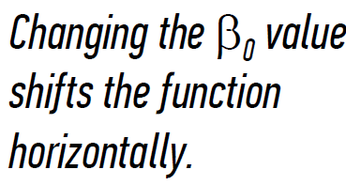
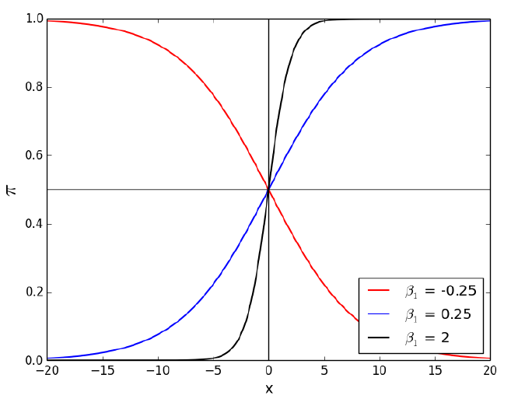
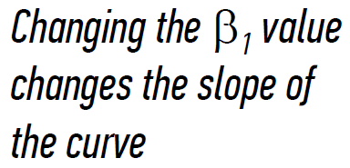

Slide 17
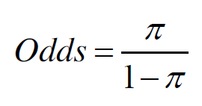

Logistic Regression - Odds Ratio
In order to interpret the outputs of a logistic function we must understand the difference between probability and odds
The odds of an event are given by the ratio of the probability of the event by its complement:
Let's compare the odds ratio with probability for a case of getting "1" for dice roll

Slide 18
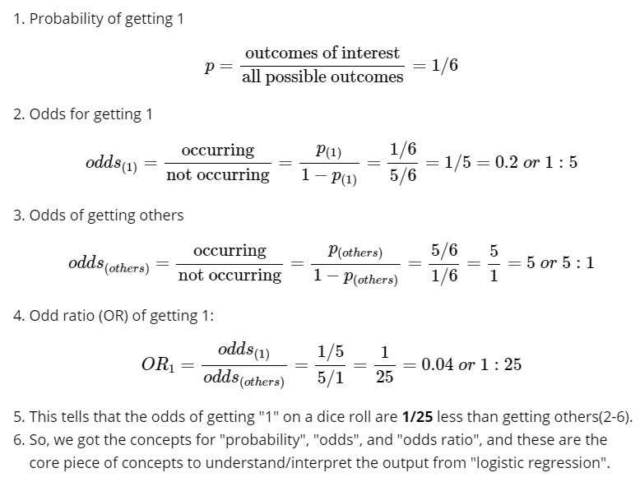
Logistic Regression - Odds Ratio

Slide 19
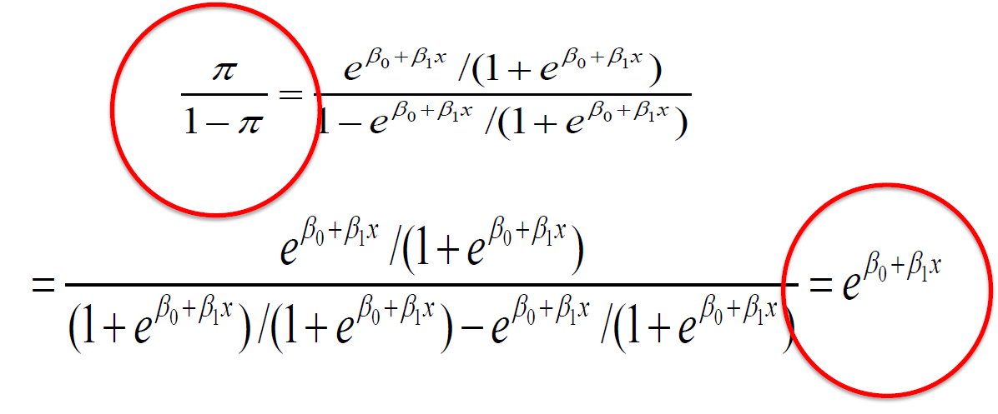
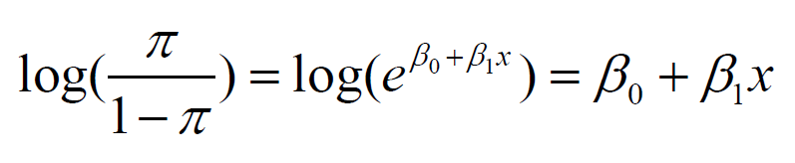
Logistic Regression - Odds Ratio
What would happen if we took the odds of the logistic function?
So:
logarithm of the odds
linear equation
the logit transformation or the log-odds function

Slide 20


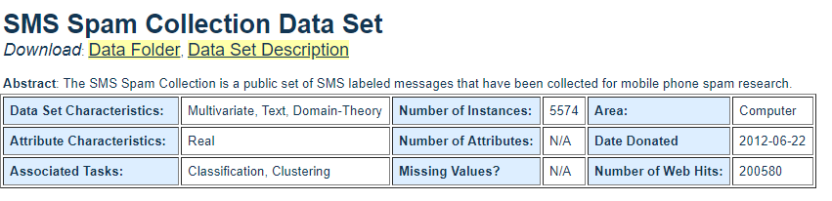
Example for Text Analytics – Ham/Spam SMS
Download at:
https://archive.ics.uci.edu/ml/datasets/SMS+Spam+Collection

Slide 21
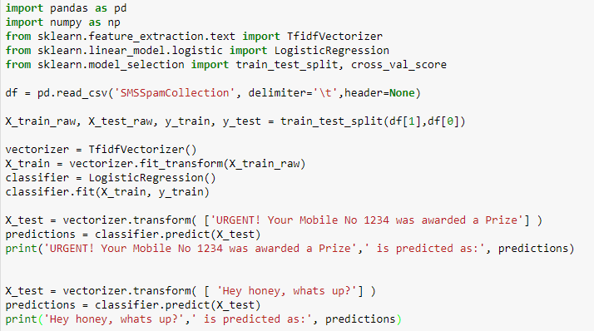
Example for Text Analytics – Ham/Spam SMS

Slide 22
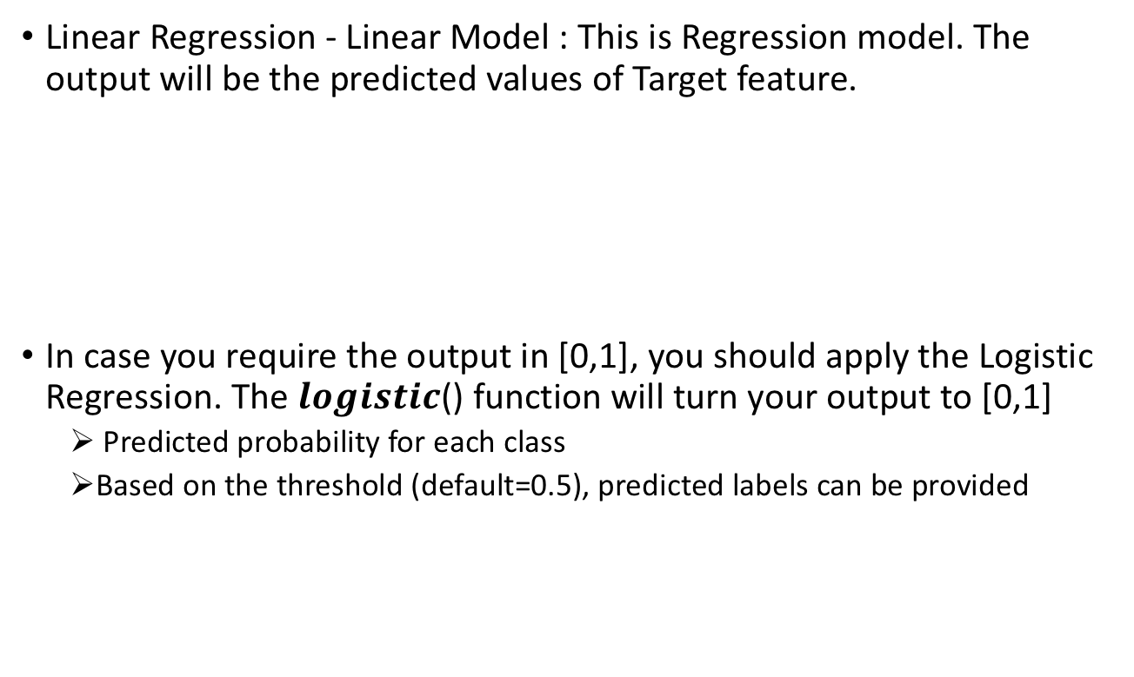
Summary
Linear Regression - Linear Model : This is Regression model. The output will be the predicted values of Target feature.
In case you require the output in [0,1], you should apply the Logistic Regression. The $logistic$() function will turn your output to [0,1]
Predicted probability for each class
Based on the threshold (default=0.5), predicted labels can be provided

