Slide 1
COMP30810 Intro to Text Analytics
Dr. Binh Thanh Le
thanhbinh.le@ucd.ie
Insight Centre for Data Analytics
School of Computer Science
University College Dublin

Slide 2
Today goals
Understand Random Forest
Understand how to apply RF in Text Analytics

Slide 3
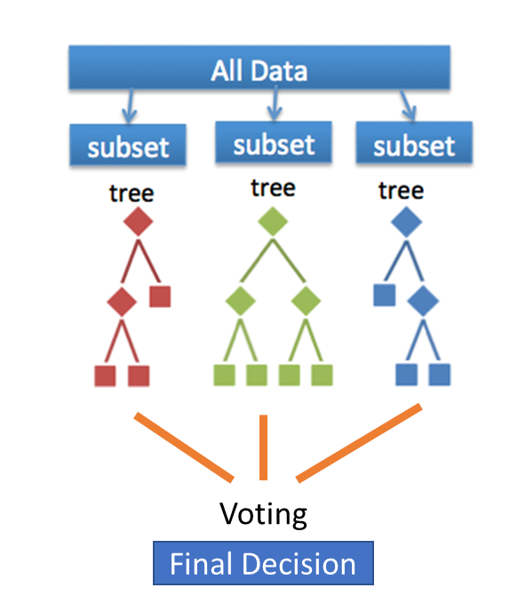
What is Random Forest?
Random forest = learning ensemble consisting of a bagging of un- pruned decision tree learners with a randomized selection of features at each split.
The term came from random decision forests that was first proposed by Tin Kam Ho of Bell Labs in 1995.
The method combines Breiman's "bagging" idea and the random selection of features.

Slide 4
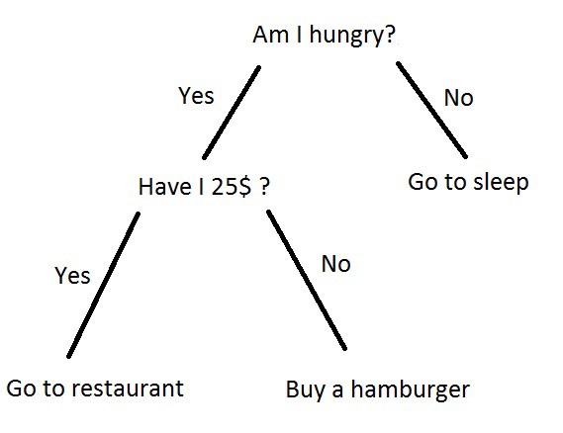
What is Decision Tree?
Decision trees … one of most popular learning methods commonly used for data exploration
A decision tree is a tree where each node represents a feature(attribute), each link(branch) represents a decision(rule) and each leaf represents an outcome(categorical or continues value).
A decision tree is drawn upside down with its root at the top
Why Decision trees?
Decision tress often mimic the human level thinking so its so simple to understand the data and make some good interpretations.
➔ Interpretability

Slide 5
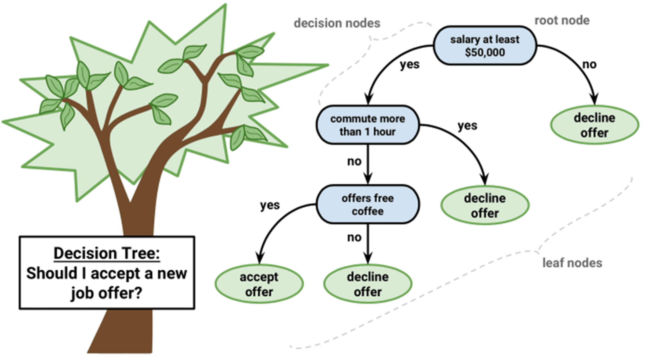
Example of a tree

Slide 6
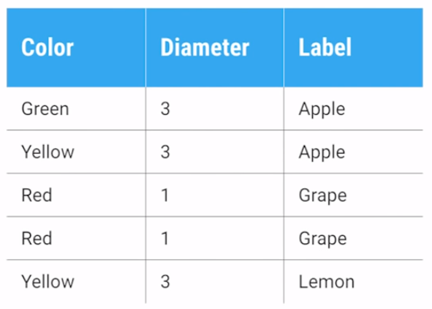
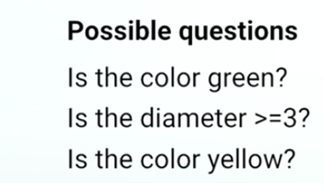
How to build the tree?
There are couple of algorithms there to build a decision tree
ID3
C4.5
C5.0
CART
Let’s take an example:
Classification And Regression Tree
First question: What is the ROOT?
…

Slide 7
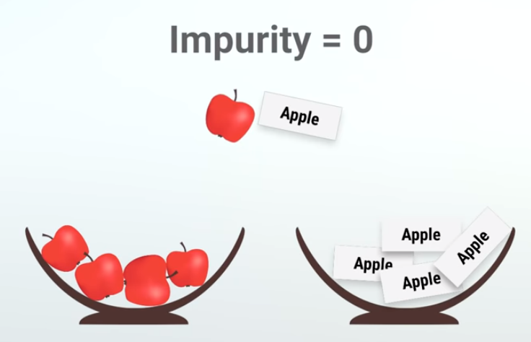
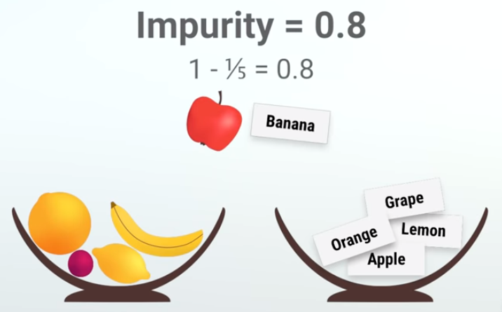
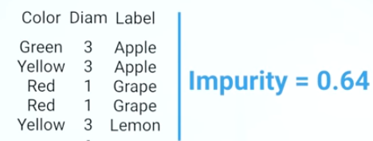
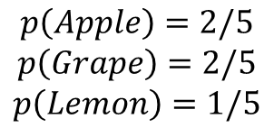
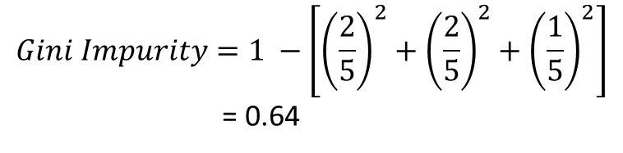

Gini Impurity - Gini Index

Slide 8
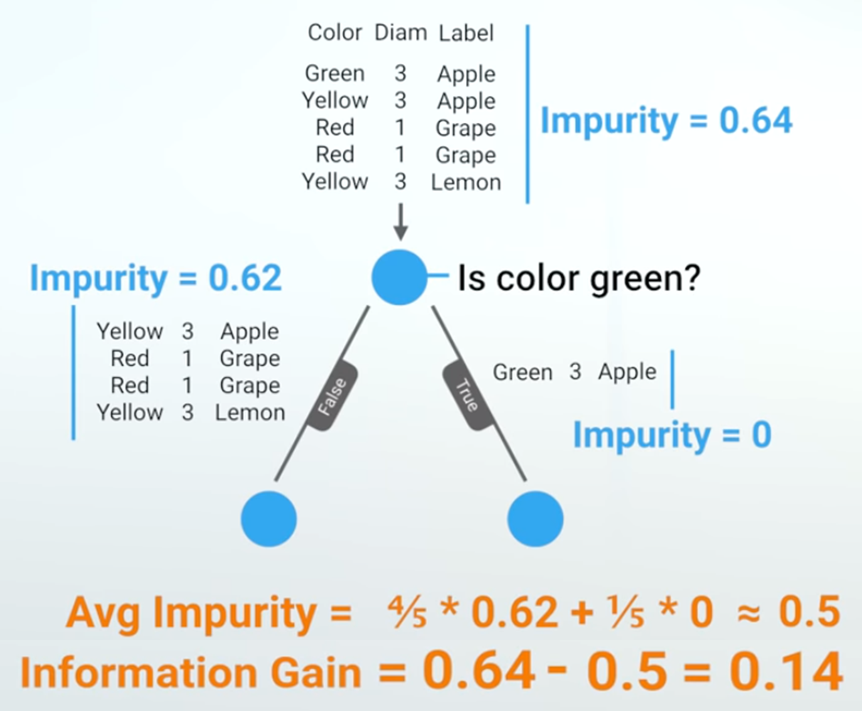
Information Gain

Slide 9
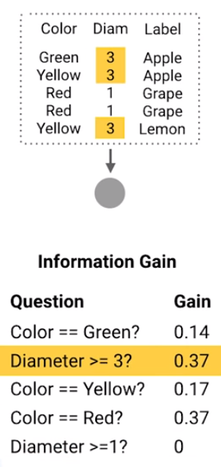
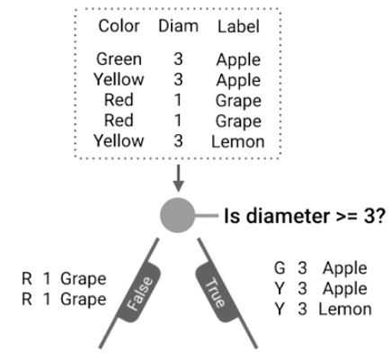
This is the ROOT
Repeat
Previous
Steps

Slide 10
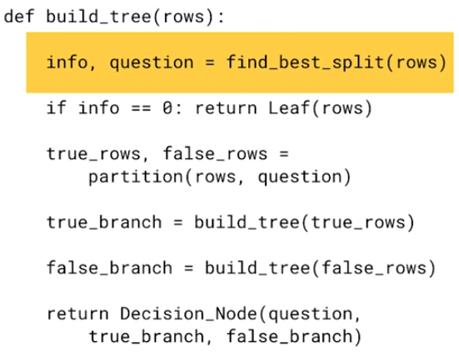
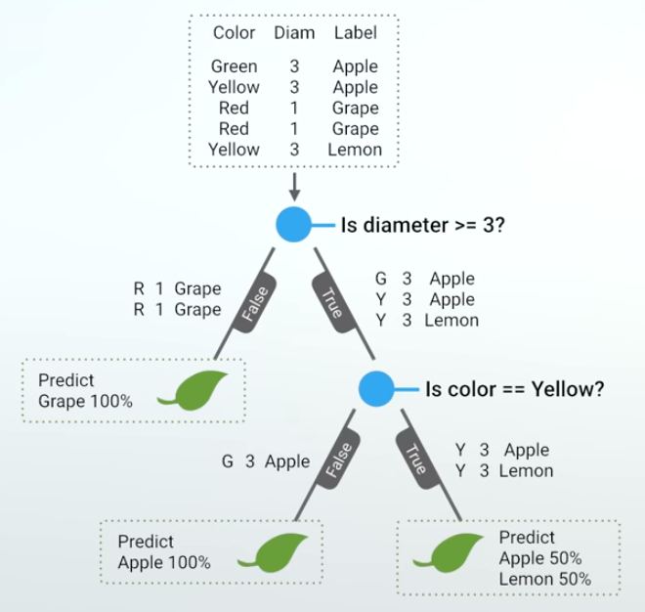
If the child node is “pure” (has instances from only one class) tag it as a leaf and return.

Slide 11
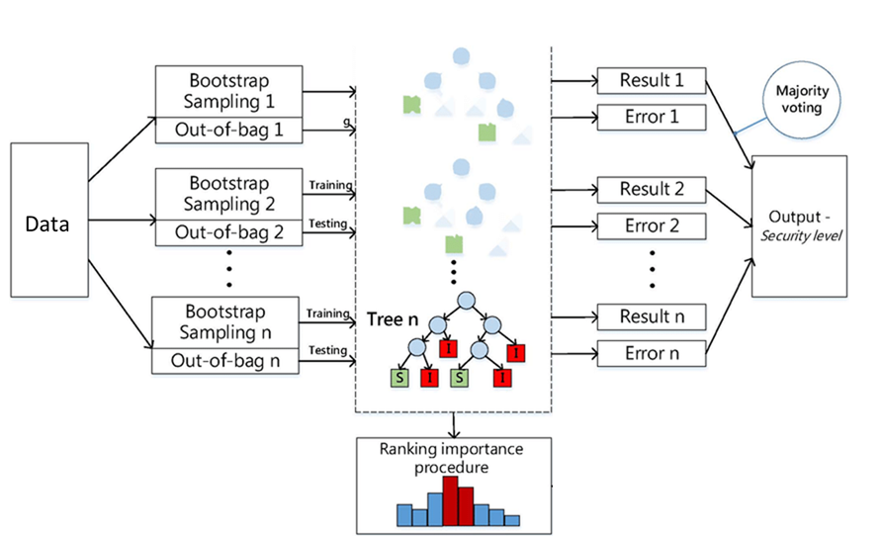
Random Forest

Slide 12
Random Forest vs Decision Tree
Random Forest | Decision Tree
- Classification + Regression | - Classification + Regression
- Require much of data for Bagging step | - Does not require much of data
 | - Easy to interpret and make for straightforward visualizations
- Can provide the Feature Importance scores
 | - This is a greedy model, meaning it makes the most optimal decision at each step, but does not consider the global optimum.
- Can avoid the overfitting | - Decision trees are prone to overfitting, especially when a tree is particularly deep
- Many trees can make the algorithm to slow and ineffective for real-time predictions

Slide 13
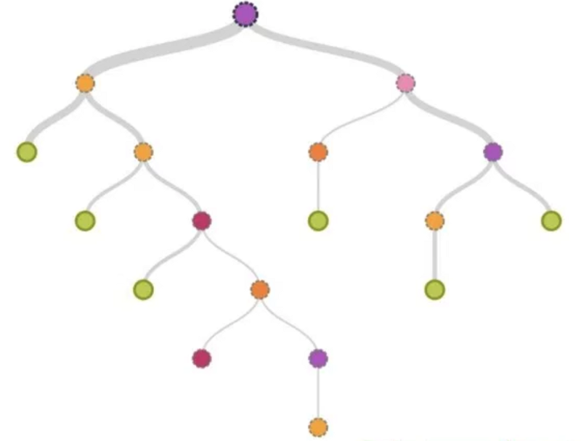
Why vote?
Decision Trees have usually low bias because they maximally overfit to the training data.
➔ Low Bias
High Variance
Want to reduce Variance?
Data
➔ Low Bias
VOTING
➔ Low Bias

Slide 14
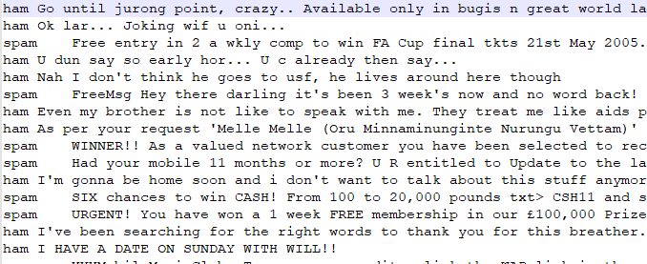

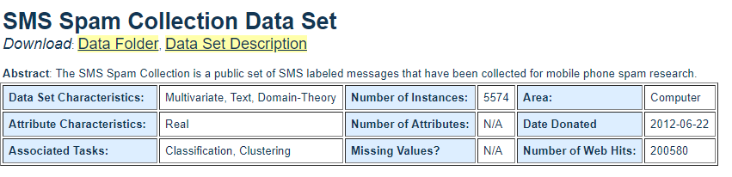
Example for Text Analytics – Ham/Spam SMS
Download at:
https://archive.ics.uci.edu/ml/datasets/SMS+Spam+Collection

Slide 15
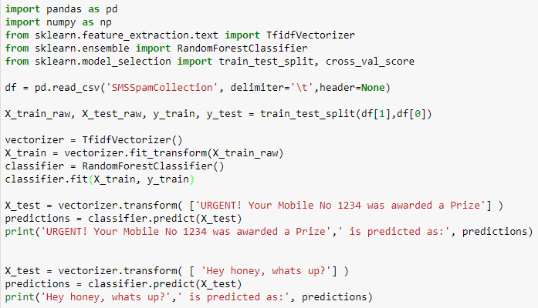
Example in Text Analysis

Slide 16
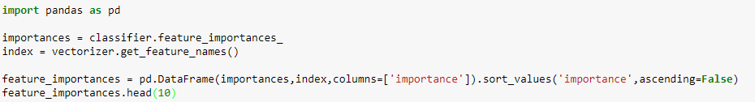
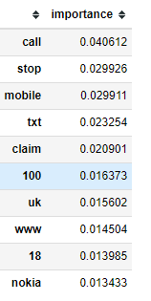
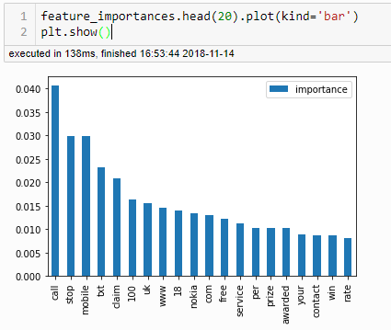
Feature Importance
It is nice if we can see “How are important of token words?”
Make an extra analysis on this - Dictionary for corpus?
- Feature extraction/selection?

