Slide 1
COMP30810 Intro to Text Analytics
Dr. Binh Thanh Le
thanhbinh.le@ucd.ie
Insight Centre for Data Analytics
School of Computer Science
University College Dublin

Slide 2
Today Goals:
Reviewing what we got so far
Future plans?

Slide 3

Learning Objectives
1. Have a clear understanding of the core concepts in text analytics and be familiar with a range of common analytics techniques in this area.
2. Be familiar with common representations used to represent textual data.
3. Have developed a knowledge of the main application areas in which these techniques prove useful.
4. Be able to collect, pre-process and analyze textual datasets using Python.

Slide 4
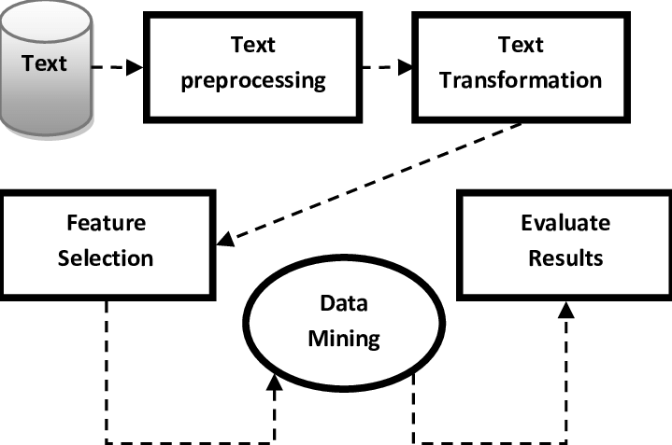
Text Mining | Analytics Process

Slide 5
Future plans in Text Analytics
Search and information retrieval (IR): Storage and retrieval of text documents, including search engines and keyword search.
Document clustering: Grouping and categorizing terms, snippets, paragraphs, or documents, using data mining clustering methods.
Document classification: Grouping and categorizing snippets, paragraphs, or documents, using data mining classification methods, based on models trained on labeled examples.
Web mining: Data and text mining on the Internet, with a specific focus on the scale and interconnectedness of the web.
Information extraction (IE): Identification and extraction of relevant facts and relationships from unstructured text; the process of making structured data from unstructured and semi-structured text.
Natural language processing (NLP): Low-level language processing and understanding tasks (e.g., tagging part of speech); often used synonymously with computational linguistics.
Concept extraction: Grouping of words and phrases into semantically similar groups.
http://www.textanalyticsworld.com/wp-content/uploads/2012/03/PracticalTextMining_Excerpt.pdf

Slide 6
THANK YOU
&
BEST WISHES FOR YOUR FUTURE

