Slide 1
BORU MEDA GENERAL HOSPITAL
Comprehensive Bahmni EMR User Guide
End-to-End Operational Manual for Clinical, Administrative & Technical Staff
Server Endpoint: https://196.189.94.149 | Version: Bahmni Standard 1.1.0 | Published: October 2026

Slide 2
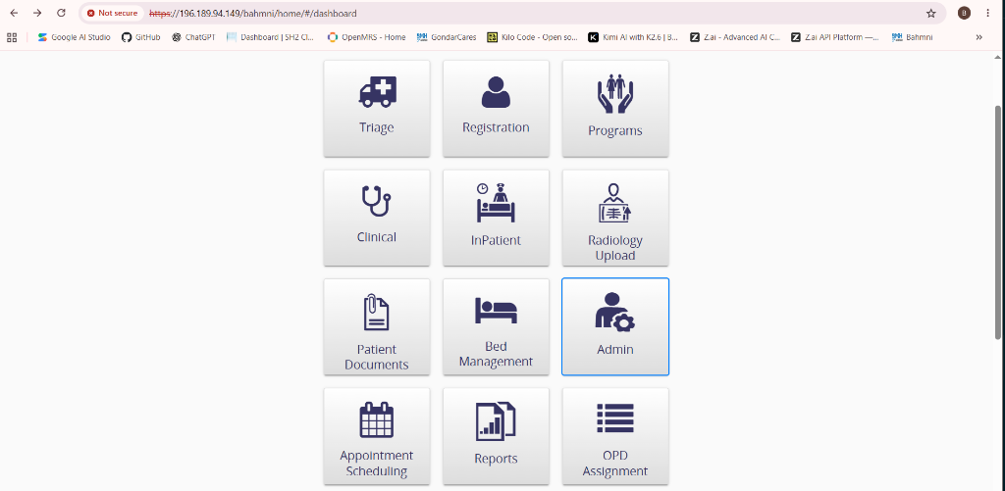
SYSTEM ARCHITECTURE
System Access & Architecture Overview
Server Address: Access the hospital EMR securely via https://196.189.94.149 over encrypted HTTPS.
Security Notice: Self-signed SSL certificate: Click 'Advanced' and proceed to site during first connection.
Supported Browsers: Optimized for Google Chrome and Microsoft Edge (desktop viewports 1280x720 or higher).
Single Sign-On (SSO): One unified credential grants access across Clinical, OpenELIS Laboratory, Odoo Billing, and PACS.
High Availability: Powered by containerized Docker services running PostgreSQL, MySQL 8.0, and Apache 2.4.
TIP / NOTE: Ensure workstations are connected to the internal hospital LAN or authorized health network.
Boru Meda General Hospital EMR (Server: 196.189.94.149) | Standard Operating Procedure & User Manual

Slide 3
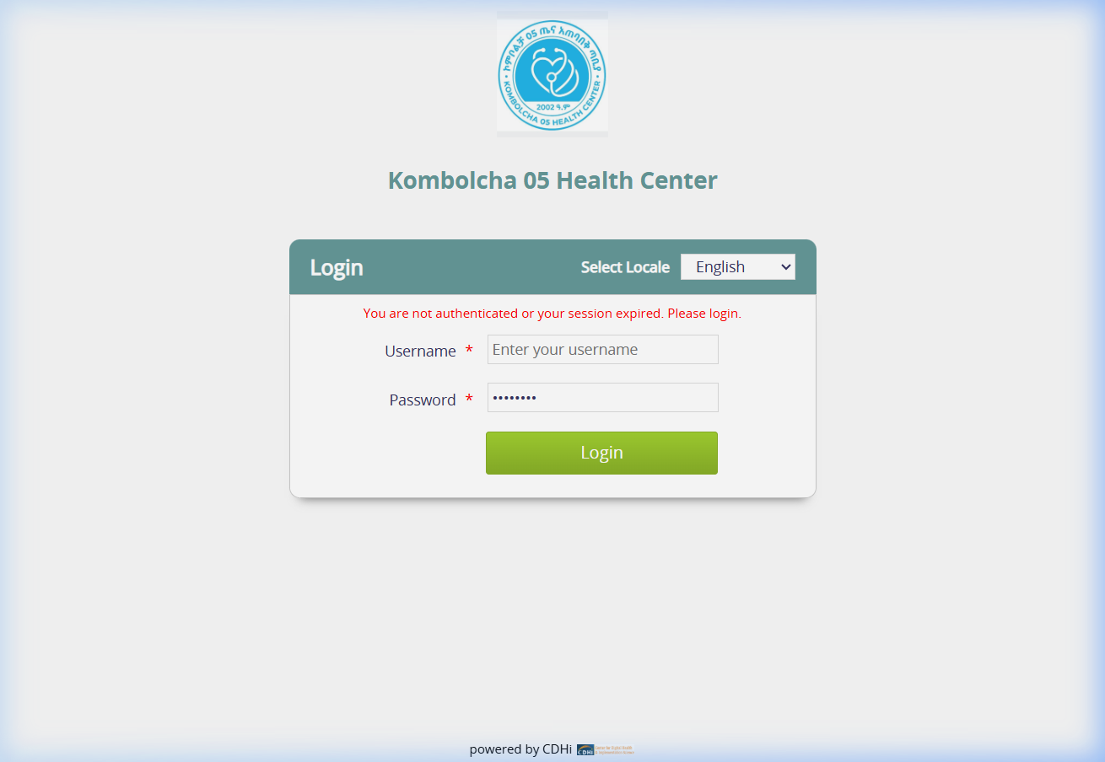
AUTHENTICATION & SECURITY
User Login & Location Session Assignment
Authentication Credentials: Enter assigned username (e.g., Admin, Dr. Name, Nurse) and secure password.
Department Location Picker: Select your active duty station (e.g., OPD 1, Emergency, General Ward, Lab, Pharmacy).
Audit Compliance: Every login, transaction, and patient record access is permanently stamped with your user ID and location.
Password Security: Do not share passwords. Session locks automatically after inactivity to maintain HIPAA/patient privacy.
Multi-Role Privileges: System features adapt automatically according to clinical credentials and department roles.
TIP / NOTE: If your location changes mid-shift, logout and re-select your new ward or clinic room.
Boru Meda General Hospital EMR (Server: 196.189.94.149) | Standard Operating Procedure & User Manual

Slide 4
NAVIGATION & WORKFLOWS
Home Dashboard & Unified App Launcher
Central App Grid: Clean tile-based dashboard providing one-click access to all hospital modules.
Core Clinical Modules: Triage, Registration, Programs, Clinical Consultation, InPatient, and OPD Assignment.
Diagnostic & Ancillary: Radiology Upload, Patient Documents, Appointment Scheduling, and Reports.
System Administration: Admin portal for bulk CSV masterdata, audit trail analysis, bed configs, and backup.
Consistent Navigation: Click the 'Home' icon in the top header at any time to return to this dashboard.
TIP / NOTE: Apps displayed on your dashboard reflect your role privileges (e.g., Doctors see Clinical; Cashiers see Billing).
Boru Meda General Hospital EMR (Server: 196.189.94.149) | Standard Operating Procedure & User Manual

Slide 5
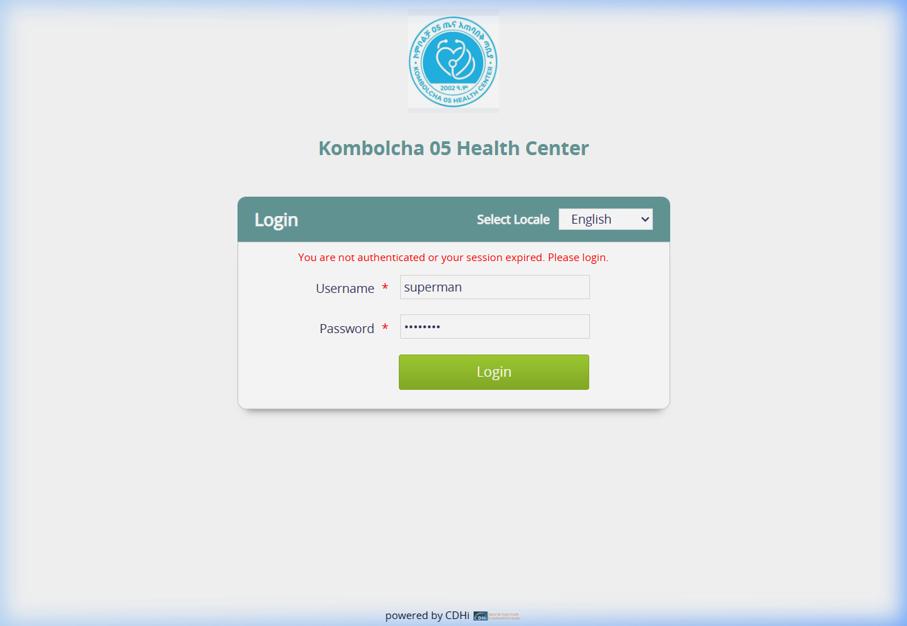
PATIENT ADMINISTRATION
Patient Registration & Identity Management
Unique Patient Identifier (MRN): System automatically generates unique Medical Record Numbers for every patient.
Duplicate Prevention: Search existing patients by Name, Phone Number, or National ID before creating new records.
Ethiopian Calendar Support: Built-in dual Ethiopian & Gregorian calendar converter for birthdates and visit dates.
Demographic Capturing: Record Woreda, Kebele, House No, Contact Info, Emergency Contact, and Sponsoring Entity.
Direct Action Routing: Quickly start an OPD Visit, Emergency Triage Visit, or direct Consultation from registration.
TIP / NOTE: Always verify Phone Number and Kebele to facilitate emergency contact and follow-up tracing.
Boru Meda General Hospital EMR (Server: 196.189.94.149) | Standard Operating Procedure & User Manual

Slide 6
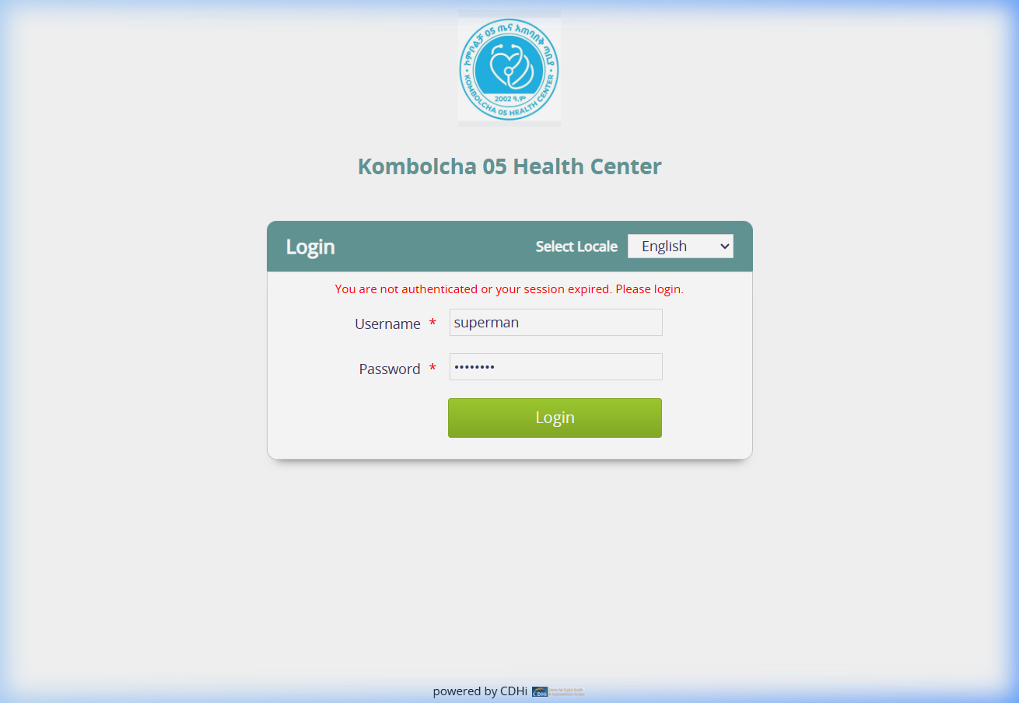
EMERGENCY & TRIAGE
Triage & Vital Signs Recording
Vital Signs Entry: Record Blood Pressure (Systolic/Diastolic), Pulse, Respiratory Rate, Temp, and SpO2.
Emergency Oxygen Tracking: Indicate oxygen therapy requirements and flow rates for critical patient monitoring.
Acuity Classification: Tag patient condition: Red (Emergency), Yellow (Urgent), or Green (Stable non-urgent).
Automated Flowsheet: Vitals entered at triage instantly appear on the doctor's consultation dashboard in real time.
Fast-Track Routing: Immediately transfers patient queue to OPD doctor or emergency physician without delay.
TIP / NOTE: Critical triage alerts flash on clinical workstations to ensure immediate emergency response.
Boru Meda General Hospital EMR (Server: 196.189.94.149) | Standard Operating Procedure & User Manual

Slide 7
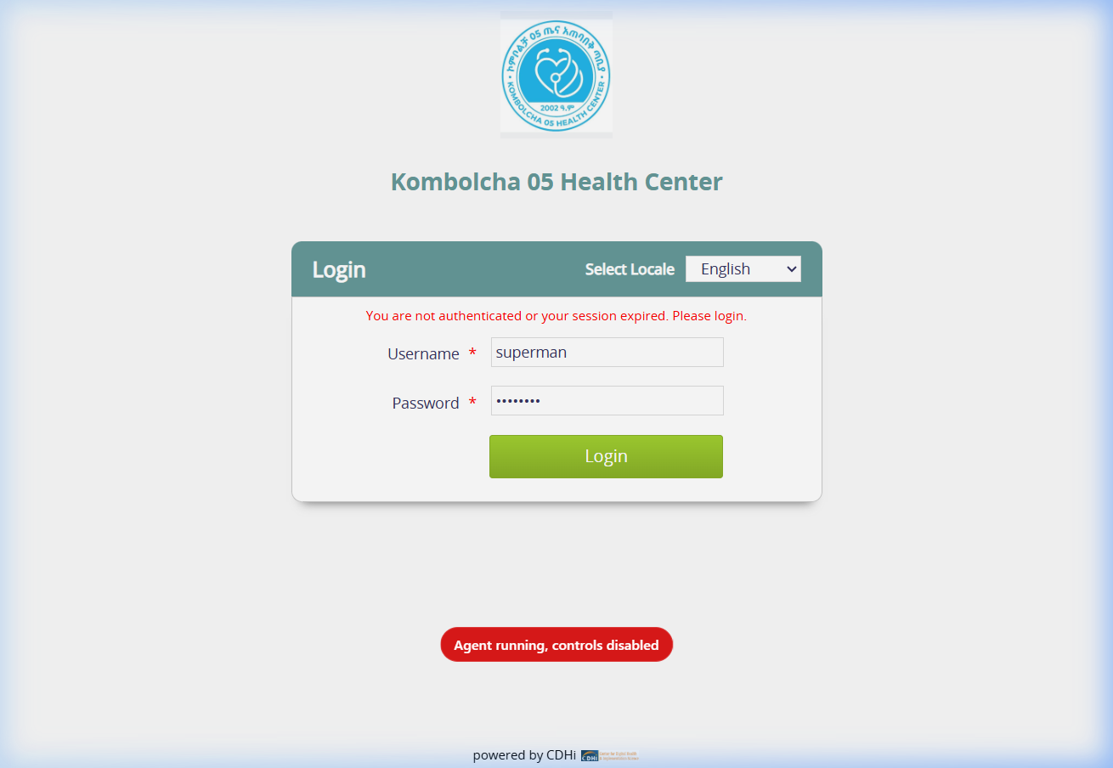
CLINICAL EHR
Outpatient Clinical Consultation & EHR
Holistic Patient Summary: View complete medical history, previous visits, allergies, chronic conditions, and past vitals.
Chief Complaint & HPI: Document narrative clinical findings, history of present illness, and physical exam findings.
ICD-10 / CIEL Diagnosis: Search standardized diagnoses with coded ICD-10 mapping (Primary & Secondary diagnoses).
Clinical Dispositions: Admit to Ward, Discharge, Transfer, Follow-up Appointment, or Inter-Facility Referral.
Digital Signature: Consultation note automatically captures attending doctor name and timestamp.
TIP / NOTE: Use the 'Save' button regularly during long examinations to persist clinical notes safely.
Boru Meda General Hospital EMR (Server: 196.189.94.149) | Standard Operating Procedure & User Manual

Slide 8
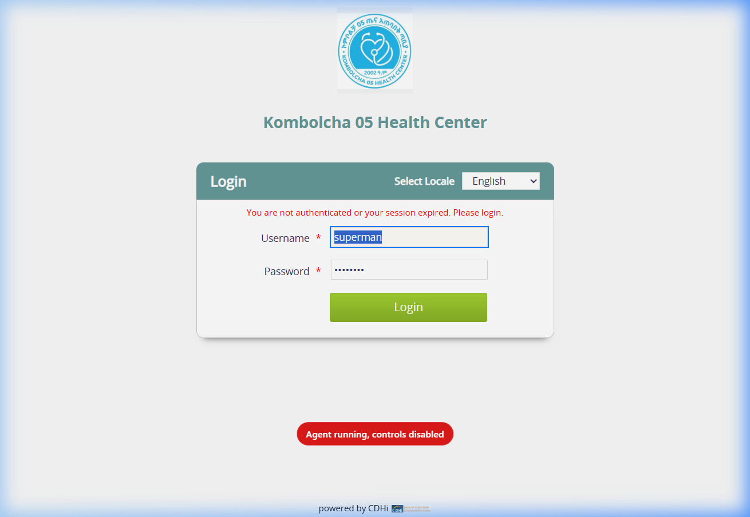
INVESTIGATIONS & LAB
Investigations, Orders & Lab Sync
Order Selector: Search lab tests (CBC, Urinalysis, Blood Chemistry) and radiology exams (X-Ray, Ultrasound, CT).
Order Templates: Pre-configured bundles for Antenatal, Trauma, Diabetic, and Fever workups save ordering time.
OpenELIS Bidirectional Sync: Orders transfer electronically to OpenELIS Laboratory; results stream back automatically.
Urgency Levels: Flag urgent tests as STAT / Emergency for prioritized laboratory processing.
Cumulative Flowsheets: Track lab parameter trends over time across consecutive patient visits.
TIP / NOTE: Doctors can review lab results directly on the patient dashboard without waiting for paper slips.
Boru Meda General Hospital EMR (Server: 196.189.94.149) | Standard Operating Procedure & User Manual

Slide 9
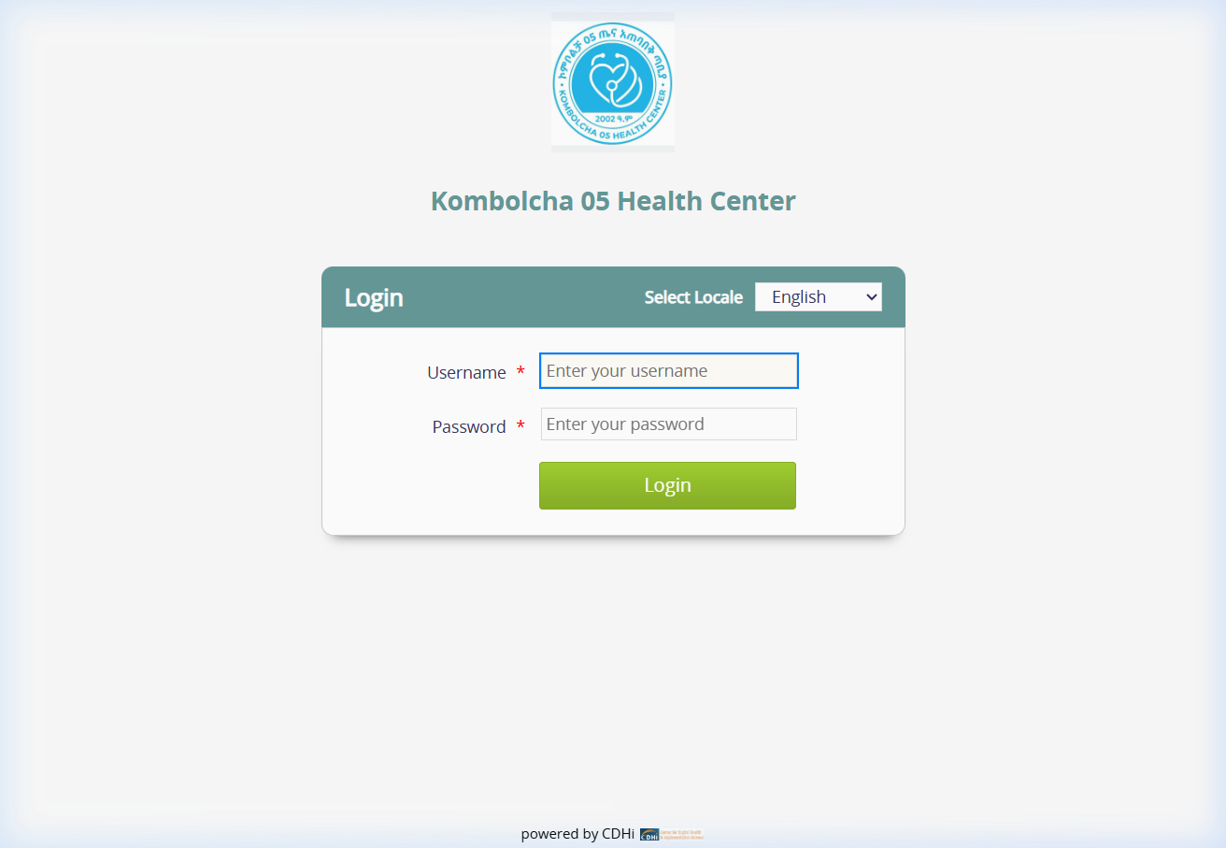
INPATIENT ADMISSIONS
Inpatient Admission & Bed Management
Visual Ward Map: Interactive graphical layout of all hospital wards (Medical, Surgical, Pediatric, Maternity, ICU).
Real-Time Bed Status: Color-coded beds show Available (Green), Occupied (Blue), and Maintenance (Gray).
Seamless Bed Allocation: Drag-and-drop or single-click admission directly assigns admitted patient to vacant bed.
Inter-Ward Transfer: Move patients between beds or wards with automatic audit history and nurse handoff.
Discharge Processing: Frees the bed instantly upon clinical discharge and finalizes inpatient stay billing.
TIP / NOTE: Bed occupancy rates update dynamically, helping nursing supervisors manage ward capacity.
Boru Meda General Hospital EMR (Server: 196.189.94.149) | Standard Operating Procedure & User Manual

Slide 10
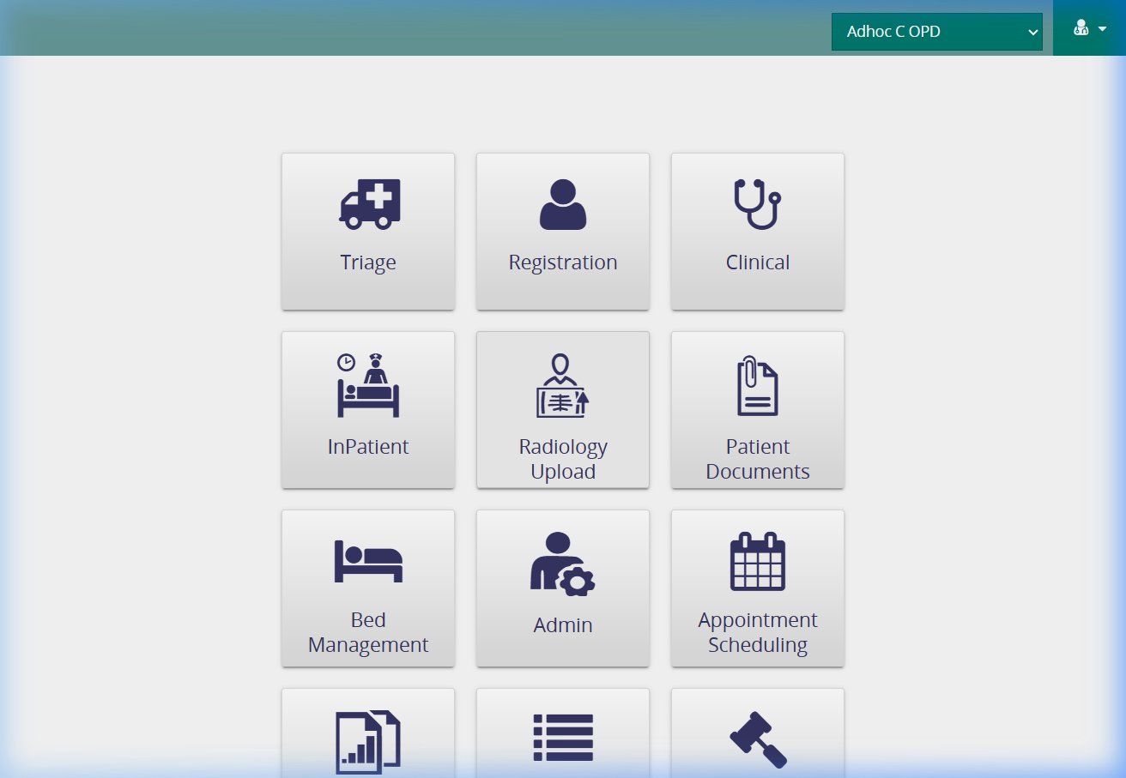
PATIENT REFERRAL WORKFLOW
Inter-Facility Referral & Printable Referral Slip
Referral Disposition: Select 'Refer Patient' disposition in consultation to initiate transfer workflow.
Comprehensive Transfer Record: Captures Receiving Hospital, Specialty Dept, Reason, Clinical History, and Treatments.
Synced Facility Branding: Referral Slip dynamically prints 'BORU MEDA GENERAL HOSPITAL' and official logo.
Ambulance & Escort Logistics: Flags requirements for medical escorts, oxygen support, and ambulance dispatch.
Standardized Print Layout: Generates clean, standardized A4 referral slip ready for receiving facility handoff.
TIP / NOTE: Click 'Print Referral Form' to generate an official hard copy for ambulance transport.
Boru Meda General Hospital EMR (Server: 196.189.94.149) | Standard Operating Procedure & User Manual

Slide 11
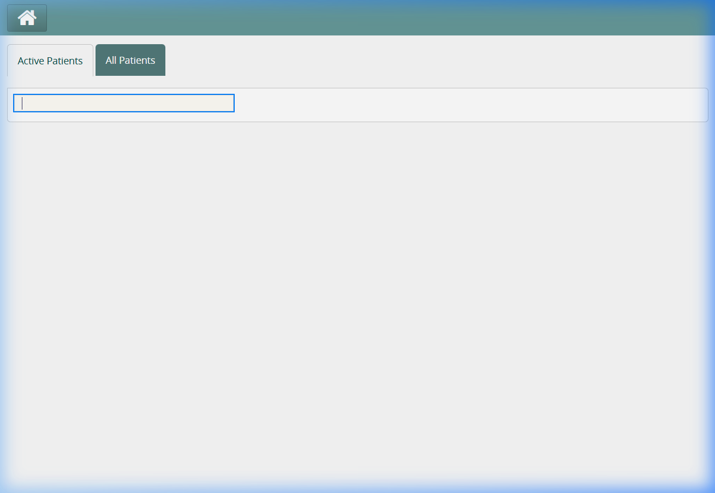
DOCUMENT ARCHIVING
Digital Document & Radiology Scan Uploads
Paperless Record Keeping: Upload external referral letters, scanned lab sheets, identity cards, and discharge notes.
Radiology Upload Module: Attach X-Ray, CT Scan, MRI, and Ultrasound digital images directly to patient file.
Multi-Format Compatibility: Accepts JPEG, PNG, PDF, and DICOM imaging formats up to 50MB per upload.
Encounter Integration: Uploaded files become permanent clinical attachments visible on the patient dashboard.
Secure Docker Volume Storage: All files reside on dedicated encrypted storage volumes backed up automatically.
TIP / NOTE: Clearly label uploaded document titles (e.g., 'Chest X-Ray 21-Oct-2026') for rapid clinical retrieval.
Boru Meda General Hospital EMR (Server: 196.189.94.149) | Standard Operating Procedure & User Manual

Slide 12
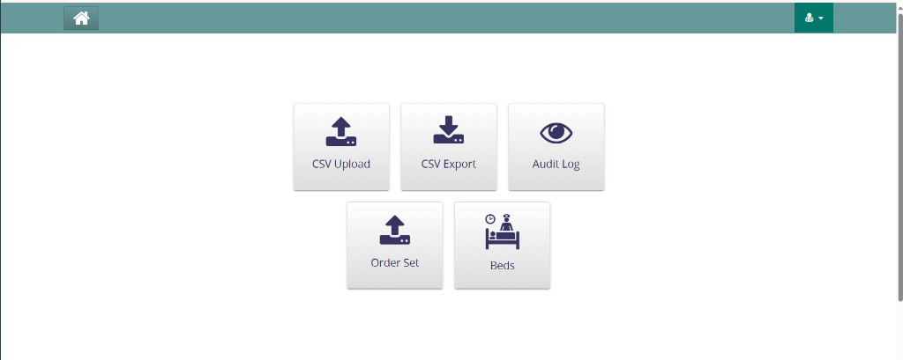
ADMINISTRATION
Hospital Administration & Master Data Control
CSV Bulk Upload: Batch import patient registries, ICD-10 concepts, and pharmaceutical inventory via CSV.
CSV Export Tools: Export demographic cohorts, disease reports, and operational metrics for health bureau analysis.
Audit Log Examiner: Inspect detailed system event logs, user activities, timestamped edits, and logins.
Order Set Dashboard: Create and maintain clinical order sets, custom drug protocols, and test bundles.
Bed Configuration: Add, rename, or reconfigure hospital wards, rooms, and bed numbers as facility expands.
TIP / NOTE: Administrative functions are restricted to authorized IT officers and Medical Directors.
Boru Meda General Hospital EMR (Server: 196.189.94.149) | Standard Operating Procedure & User Manual

Slide 13
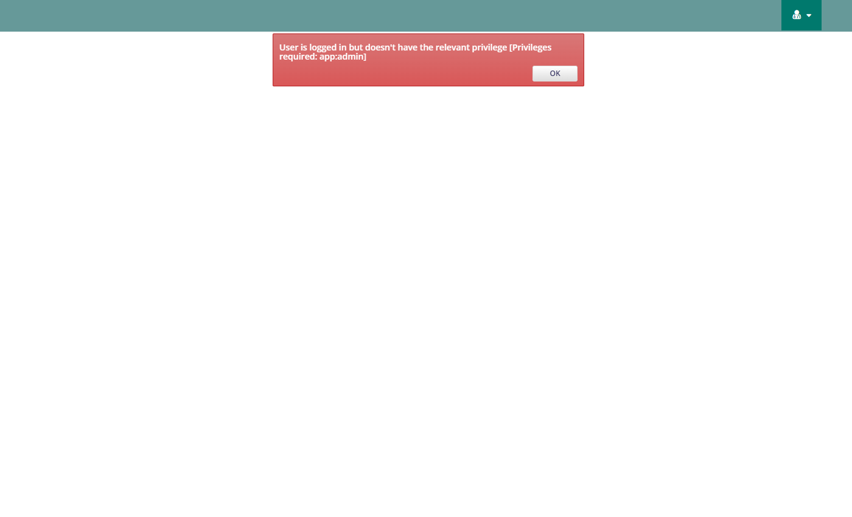
DISASTER RECOVERY
Disaster Recovery: System Backup & Restore
Integrated Admin Tile: Accessible directly inside the Admin portal under 'Backup & Restore'.
Full System Backup: Archives all databases (OpenMRS, OpenELIS, Odoo, Reports, PACS), 11 Docker volumes, and configs.
Database-Only Backup: Lightweight, high-speed SQL dump of all relational databases for daily automated archiving.
Live Progress & Logs Console: Visual progress bar and live terminal stream operations in real time without page refresh.
One-Click Disaster Restore: Restores system from selected archive with automated UI patch protection and safe restart.
TIP / NOTE: Backups are stored locally in /opt/emr/backups/ and automatically pruned with a 10-archive retention limit.
Boru Meda General Hospital EMR (Server: 196.189.94.149) | Standard Operating Procedure & User Manual

Slide 14
SUPPORT & SOP
Routine Maintenance & Helpdesk Procedures
Daily Automated Backups: Scheduled nightly backups safeguard patient data without interrupting shift operations.
Zero-Downtime Patching: UI updates and configurations deploy dynamically without restarting clinical containers.
Troubleshooting Connectivity: Verify LAN network cable, ensure IP is 196.189.94.149, and clear browser cache if needed.
Password Resets: Hospital IT administrator can reset credentials instantly via the OpenMRS administration console.
Technical Escalation: Contact Boru Meda Hospital IT Support Desk for urgent assistance or hardware support.
TIP / NOTE: Hospital IT Helpdesk: Contact Hospital Liaison Office / IT Department on Ext. 101.
Boru Meda General Hospital EMR (Server: 196.189.94.149) | Standard Operating Procedure & User Manual

