Slide 1
TV Script Generation using Recurrent Neural Network
Meghaksh Brahmbhatt /401
Binit Kumar /40172005

Slide 2
Contents
What is Tv Script generation project
How Input and Output looks like.
Why Recurrent Neural Network ?
Framework/Libraries Used
Pre-processing of Input data
Creating batches of data
Neural Network Architecture
Backpropagation
Hyperparameters
Script Generation
Saving model as a checkpoint file

Slide 3

Tv Script Generation Project
Using Tv sitcom Seinfeld script to generate a new script
Dataset source: https://www.kaggle.com/thec03u5/seinfeld-chronicles#scripts.csv
The neural network will generate fake/new script by learning the patterns from training data.
Using Tv sitcom Seinfeld script to generate a new script
Dataset source: https://www.kaggle.com/thec03u5/seinfeld-chronicles#scripts.csv
The neural network will generate fake/new script by learning the patterns from training data.

Slide 4
Input Script and Output Script
Input
george: so, i was in the contrary.
george: so, i guess i was a woman, and the defendants was a good boy.
elaine: i don't know where it is.
jerry: so i was thinking about this one?
hoyt: i thought i was a little adjustment.
jerry: what is that?
hoyt: yes, yes. yes. i got a pee on this. you were in the middle of a plane, and i have a little adjustment.
george: what happened to him?
Output
george: so you want to see how you could do that?
hoyt: i don't want to see you in a hotel.
elaine: you want to get the car on the street and a wheelchair?
hoyt: what do you think?
george: yeah, i guess i was wondering about it.
jerry: what are you doing with this girl?
elaine: no, i got to tell him.
george: i can't believe this is the most exciting thing.

Slide 5
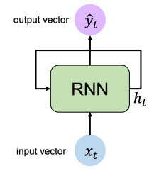
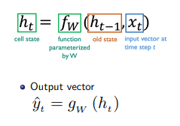
Why Recurrent Neural Network ?
Our script generations takes a word and determine the next word in a sentence. This requires keeping a sequence or order of words.
In Feed-Forward Network, there is no sense of order in the input. How to build order into our network ?
Recurrence relations need to applied at each time step t, such that model learns the concepts of memory by updating the hidden state.

Slide 6
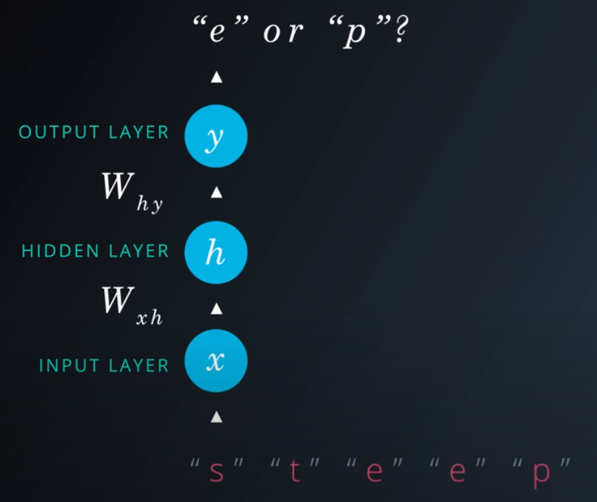
Example
Our goal here is to predict the next character in word “steep”
When we pass “s”, desired output is “t”.
When we pass “t”, desired output is “e”.
When we pass “e”, desired output could be “e” or “p”. The network doesn’t have enough information to determine which character to predict !
To solve this problem we need to include information about the sequence of characters.

Slide 7
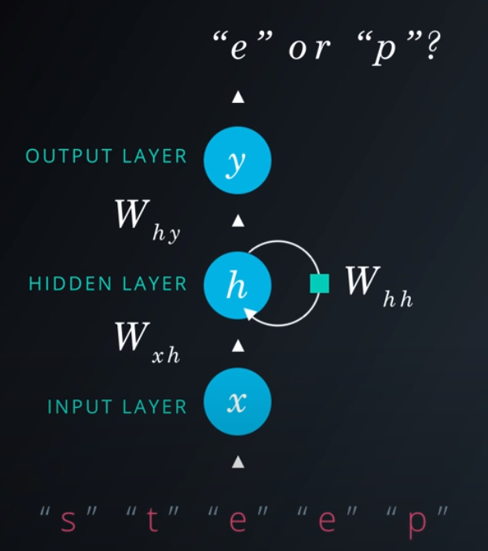
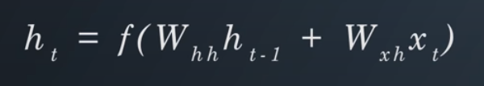
Example
We can solve this problem we routing the hidden layer output from the previous step back into the hidden layer.
The box in the diagram means the value from the previous sequence, or time step.
Now the network sees an “e”, it knows it saw an “s” and a “t” before, so the next character should be another “e”
This architecture is known as Recurrent Neural Network or RNN
Now the total input in the hidden layer is the sum of the layered combinations from the input layer and previous hidden layer

Slide 8
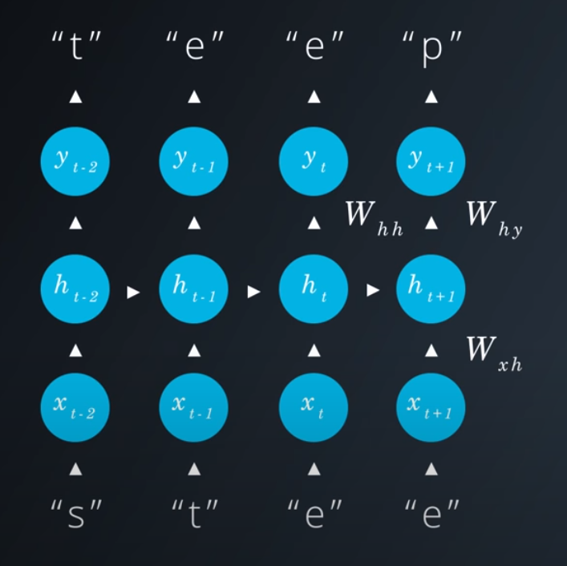
Example
We can view our recurrent network as one big graph by unrolling it.
Now, we have a feed-forward network for each character but connected through the hidden layers.
Each hidden nodes receives inputs from input node and hidden node from the previous step

Slide 9
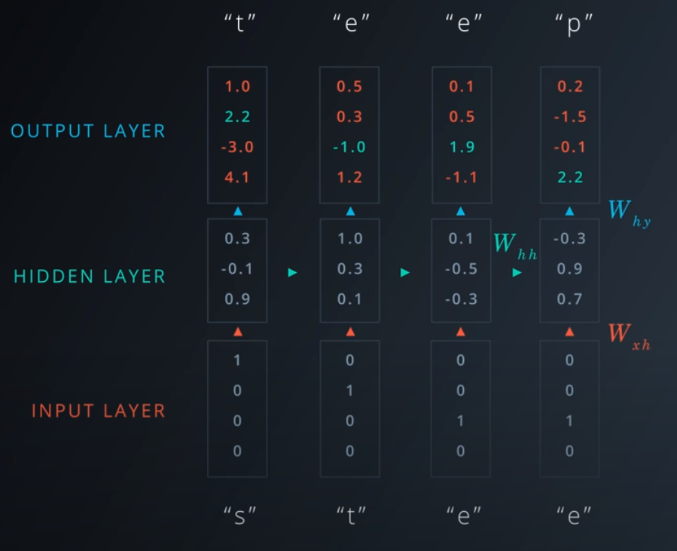
Example
Let’s visualize by adding some numbers here
Here, we’re one hot encoding the input characters.
1000 = “s”, 0100 = “t”, “0010” = “e”, 0010 = “e”
There are three units in the hidden layer and the output layer is showing the logits
We pass the logits into Softmax function to get prediction and to train with a cross entropy loss.
This is basic architecture for Character-Wise RNN.
Notes:
Softmax function: https://deepai.org/machine-learning-glossary-and-terms/softmax-layer

Slide 10
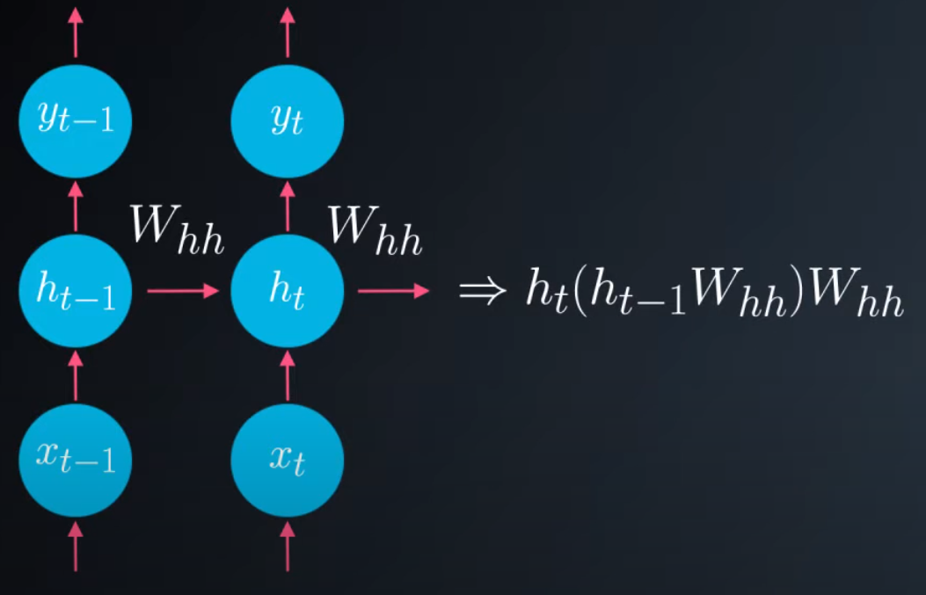
Problem with RNN architecture
We can include information from a sequence of data using a recurrent connection on the hidden layer. This connections goes through these weights, Whh
After enrolling the network, we say the hidden layer at step t is a function of the previous hidden state multiplied by those weights .
The output of that layer is again multiplied by Whh. For every step we have in the the network, we are multiplying by the weights again and again.
And when we do backpropagation, that’s even more multiplication. These leads to problem where gradients going through network either get really small and vanish or get really large and explode.

Slide 11
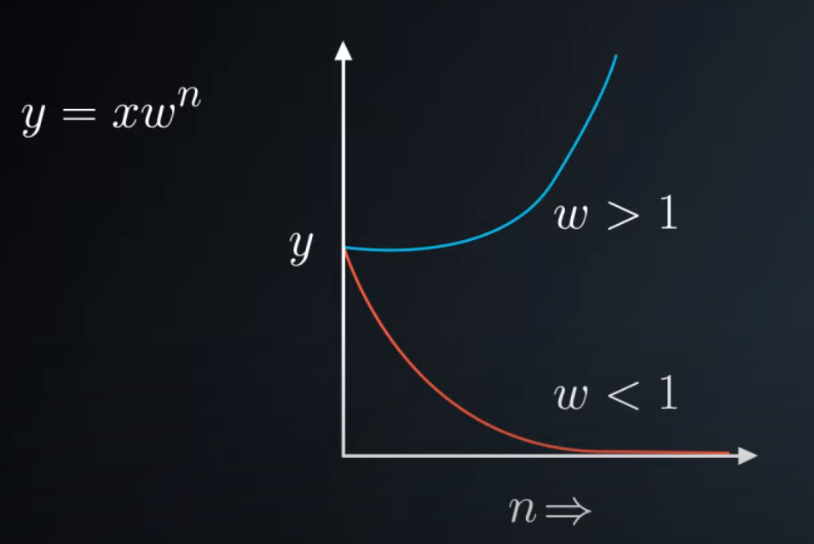
Vanishing or Exploding Gradients
If we multiplying by some number a bunch of times, we will get two results except a couple of special cases.
If that number is less than 1, we will end up at 0
If it greater than 1, we will head towards infinity.
This happens to gradient in normal RNN, where they either vanish or explode.
Resulting in making it difficult for RNNs to learn long range interactions.

Slide 12
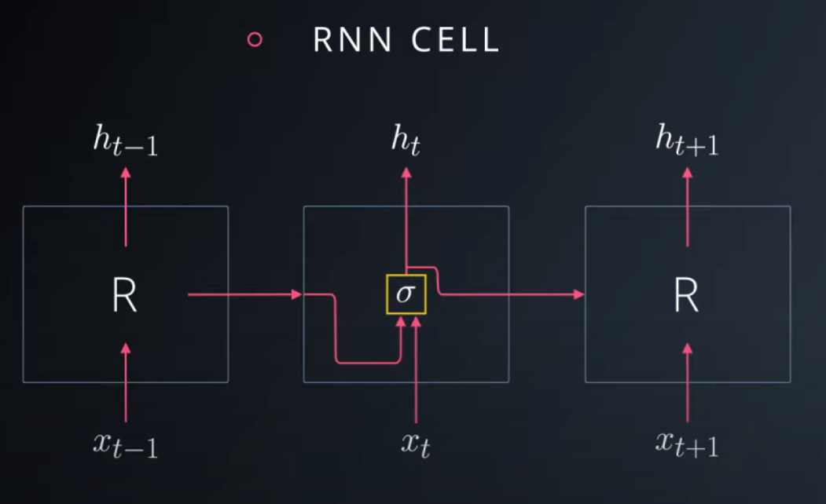
RNN Cell
We can think of RNNs as a bunch of cells with inputs and outputs.
Inside the cell, we have network layers, such as the sigmoid layer labelled with a sigma here.
To solve the problem of the vanishing gradients, we can use more complicated cells called long short-term memory or LSTM

Slide 13
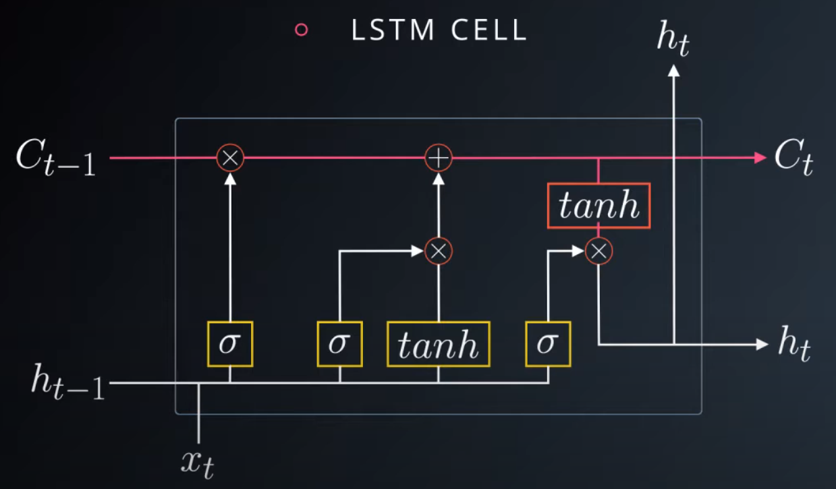
LSTM Cell
Let’s break down LSTM to understand:
The key addition here is the cell state labelled C
In this cell, there are four network layers shown as yellow boxes. Each of them with their own weights. The layers labelled with sigma are sigmoid and tanh is the hyperbolic tangent function. Tanh is similar to a sigmoid in that it squashes input, but the output is between -1 to 1 instead of 0 and 1
The red circles are point-wise or element-wise operations i.e. they operate on matrices element by element
The main improvement here is through the cell state. The cell state goes through LSTM cell with little interaction allowing information to flow easily through the cells. The cell state is modified only through element-wise operation which functions as gates.
And the hidden state is now calculated through cell state, then passed on

Slide 14
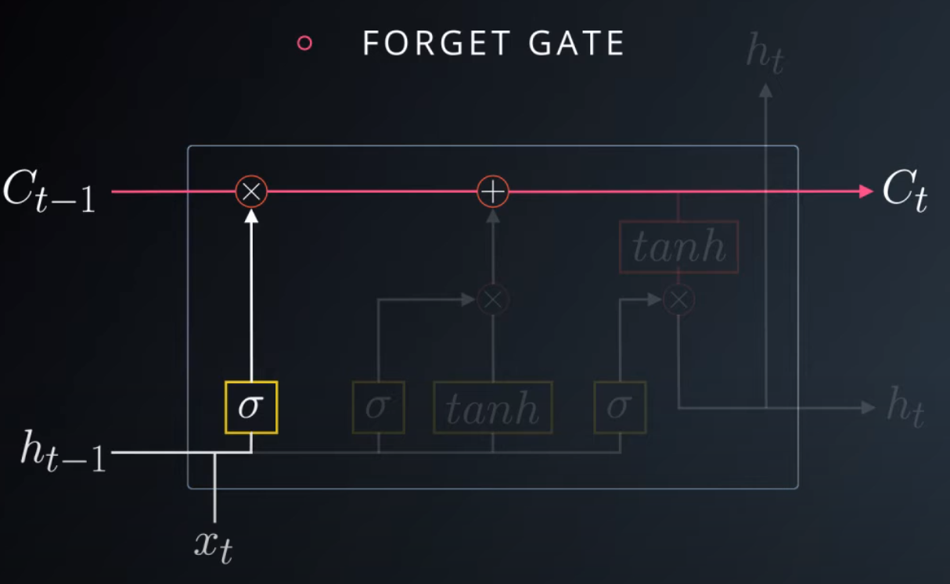
FORGET Gate
The first gate is the forget gate. The values coming out of sigmoid layer are between 0 and 1. Then they are multiplied element-wise with the cell state.
So the values from this layer close to 0 will shut off certain elements in the cell state. Effectively, forgetting that information going forward. Conversely, values close to 1 will allow information to pass through unchanged.
This is helpful, because the network can learn to forget information that causes incorrect predictions. On the other hand, long range information that are helpful is allowed to flow through freely

Slide 15
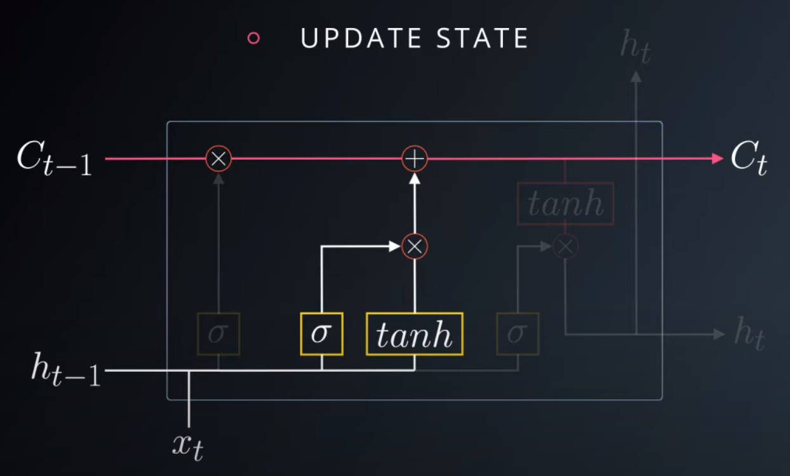
Update Gate
The next gate updates the cell state from the input and previous hidden state.
The tanh layer output is added to the cell state and again gated by a sigmoid layer.
In this way, the cell state can be updated in the step and passed along to the next cell

Slide 16
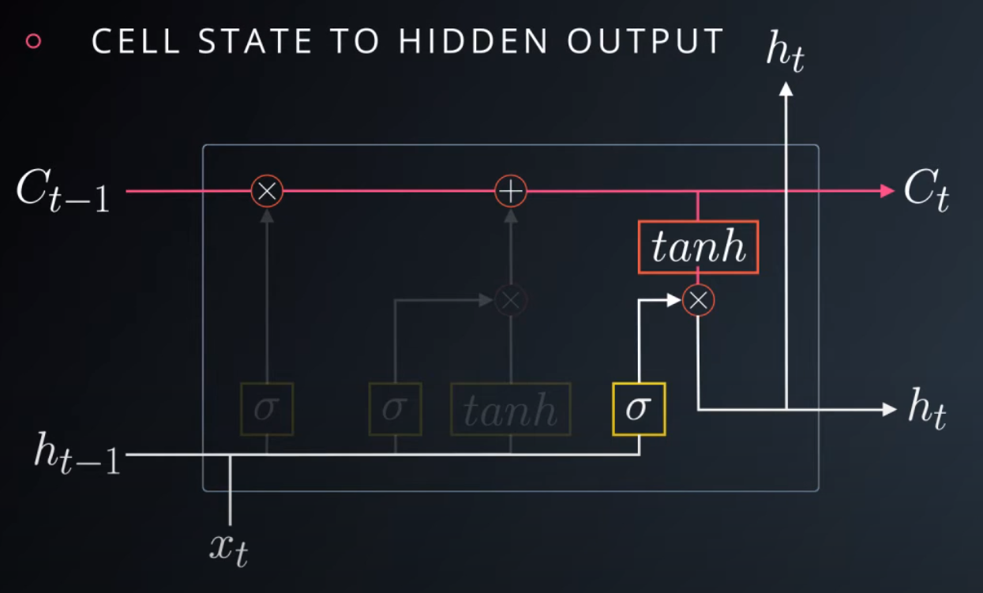
Cell State to Hidden Output
Here, the cell state is used to produce the hidden state which is sent to the next hidden cell as well as to higher layers. It’s the arrow pointing up here
The cell state is passed through another tanh then gated again with another sigmoid layer. All these sigmoid gates let the network learn which information to keep and which information to get rid of.

Slide 17
LSTM Cell
Putting all this together, the LSTM cell consists of a cell state with a bunch of gates used to update it, and leak it out to the hidden state.
This is just the basic LSTM. There are multiple variations and lot of ongoing experimentation into improving these.
They are also stacked into deeper layer. We just send the output from one cell to the input of another

Slide 18
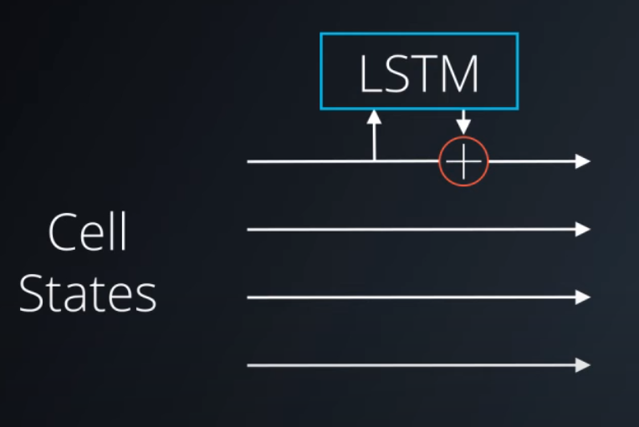
How fix the gradient problem ?
Since the cell state is allowed to flow through the hidden layers with only this linear sum operation. Gradient can easily move through the network without being diminished.
We can also get gradients added into the network through the LSTM cells but they are just added to the gradients flowing through
Math behind LSTMs https://www.youtube.com/watch?v=iX5V1WpxxkY
Understanding LSTM Networks http://colah.github.io/posts/2015-08-Understanding-LSTMs/
LSTMs are basic unit of RNNs in many applications

Slide 19
Framework/Libraries Used
Pytorch
numpy
pickle

Slide 20
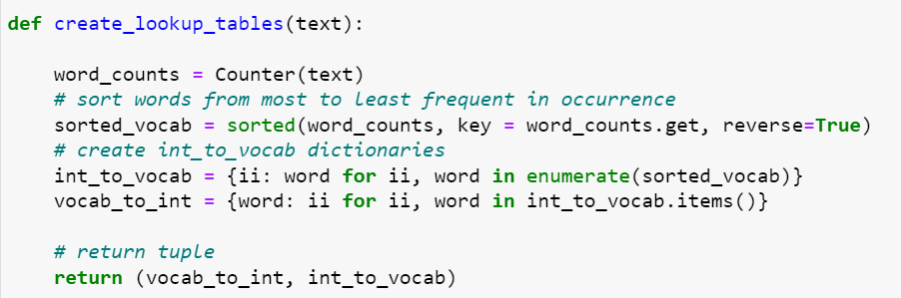
Pre-processing of Input data
Changing the entire data set into lowercase
Splitting the sentences to get all the words
Creating lookup table to generate word embeddings i.e. transforms the word to integer ids
vocab_to_int : dictionary to go from a word to id
int_to_vocab : dictionary to go from the id to word

Slide 21
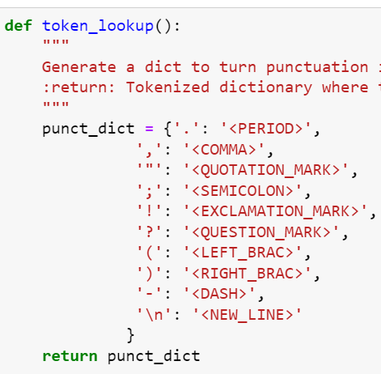
Pre-processing of Input data
Tokenize Punctuation
Punctuations like periods and exclamation marks can create multiple ids for the same word. For e.g. bye, bye!
This dictionary will be used to tokenize the symbols and add the delimiter (space) around it. This separates each symbols as its own word, making it easier for the neural network to predict the next word.

Slide 22
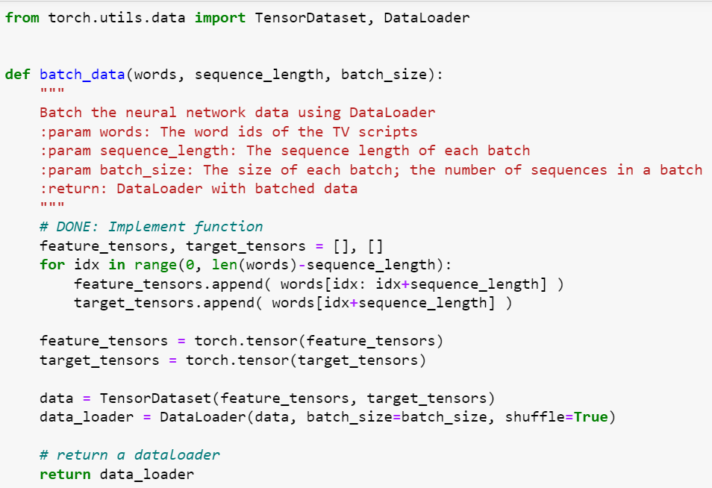
Creating batches of data
batch_data function to batch words data into chunks of size batch_size using pytorch’s DataLoader classes.
DataLoader class will help to create feature_tensors and target_tensors of correct size and content of given sequence_length
E.g. words = [1, 2, 3, 4, 5, 6, 7]
sequence_length = 4
First feature_tensor would be : [1, 2, 3, 4]
The corresponding target_tensor would be: 5
Second feature_tensor would be : [2, 3, 4, 5]
And the second target_tensor would be : 6

Slide 23
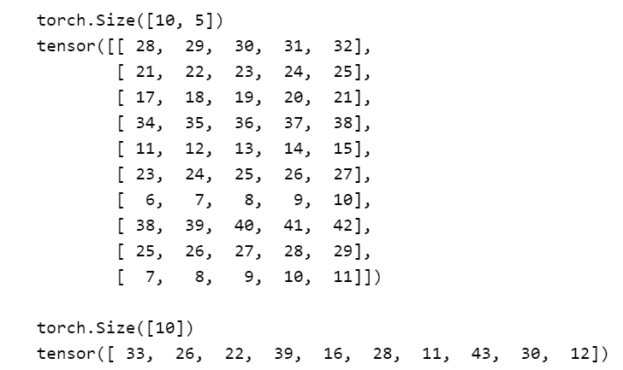
How dataloader looks like
Sample batch of inputs sample_x and targets sample_y from the dataloader
We are shuffling the data in the dataloader to get random batches.

Slide 24
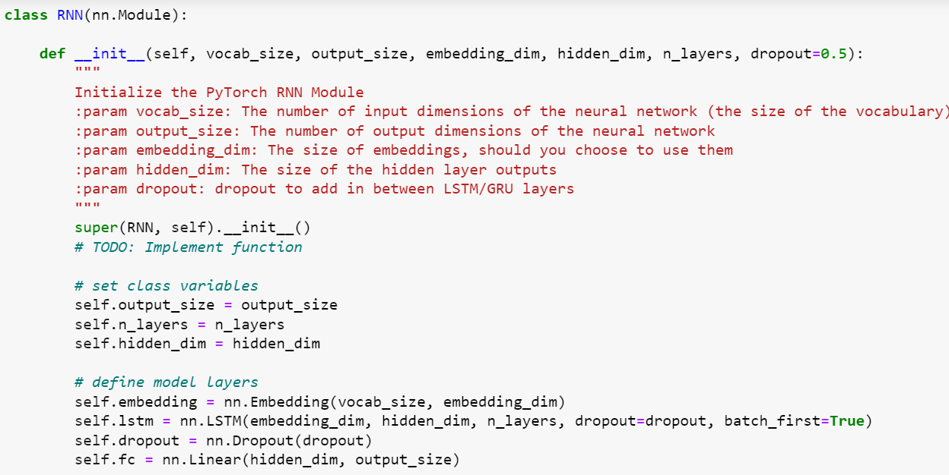
Neural Network Architecture
RNN Class
constructor

Slide 25
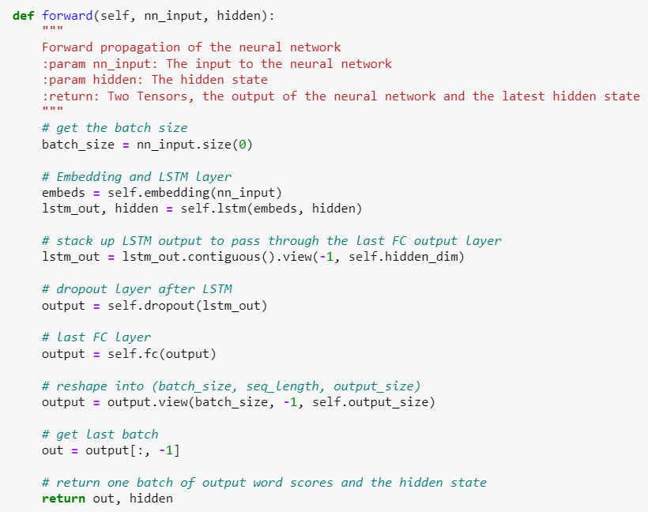
Neural Network Architecture
Forward function

Slide 26
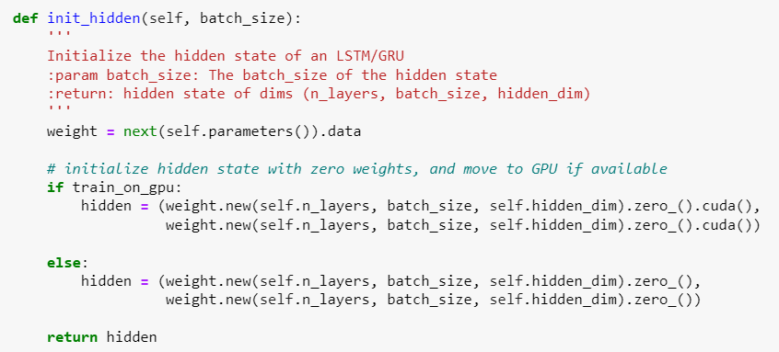
Neural Network Architecture
Initializing the hidden state of LSTM

Slide 27
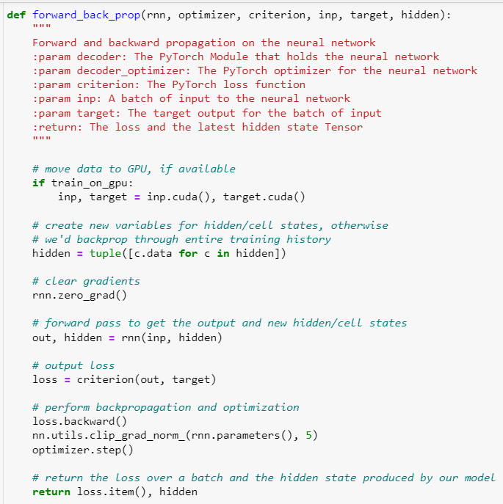
Backpropagation
Use the above RNN class to apply forward and back propagation
This function will be called iteratively, in the training loop

Slide 28
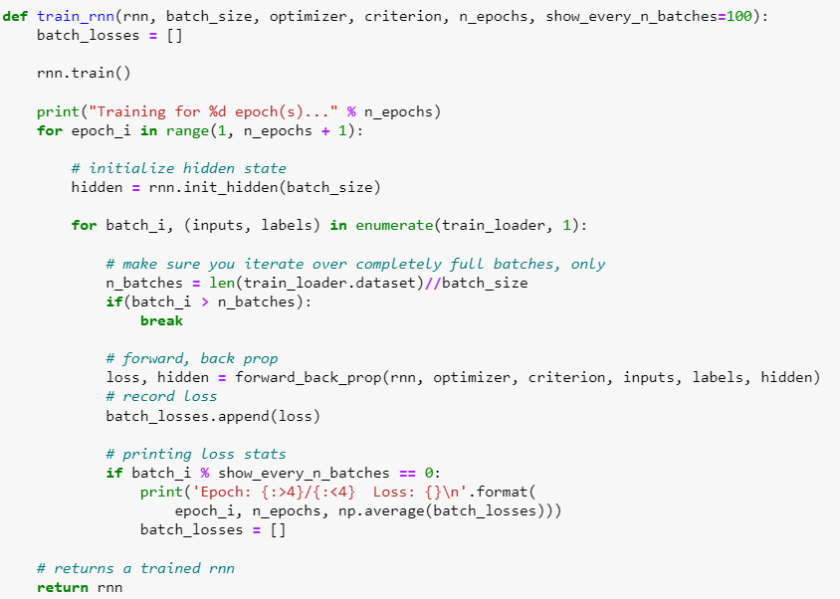
Training Loop
This function train the network over all the batches for the number of epochs given.
The model progress is printed every number of batches

Slide 29
Hyperparameters
Sequence Length: to set the length of the sequence
Batch Size : to set the size of batches
Number of epochs : to set the number of epochs to train for
Learning Rate: to set the learning rate of Adam Optimizer
Vocab Size : to set the number of unique tokens in vocabulary
Output Size : to set the desired size of output
Embedding Dim : to set the embedding dimension, smaller than vocab_size
Hidden Dim : to set the hidden dimension of RNN
N Layer: to set the number of layers in the RNN
Show N Batches: to set the number of batches at which neural network should print progress

Slide 30
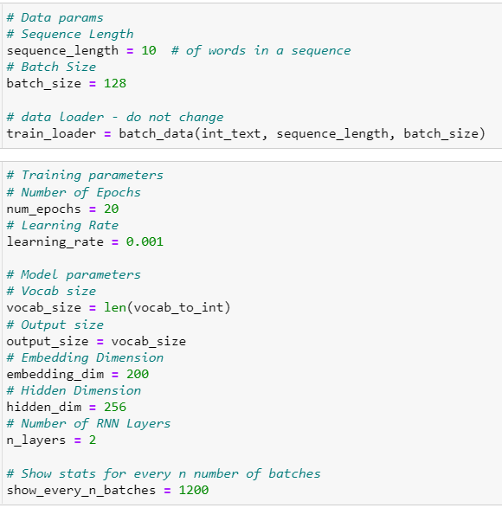
Hyperparameters

Slide 31
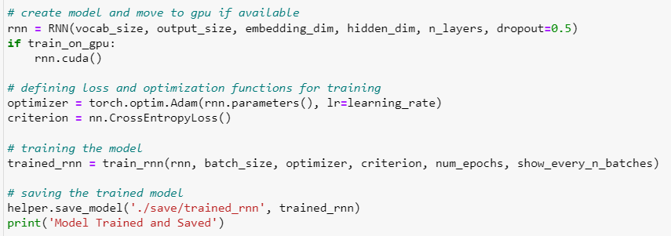
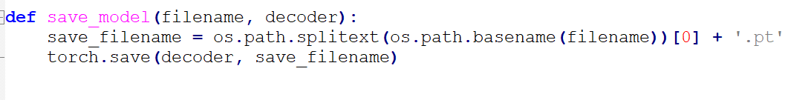
Training
Using Adam Optimizer as optimizer function
Using Cross entropy loss as a loss function
Training the model
Saving the model as a physical checkpoint file after training is complete.

Slide 32
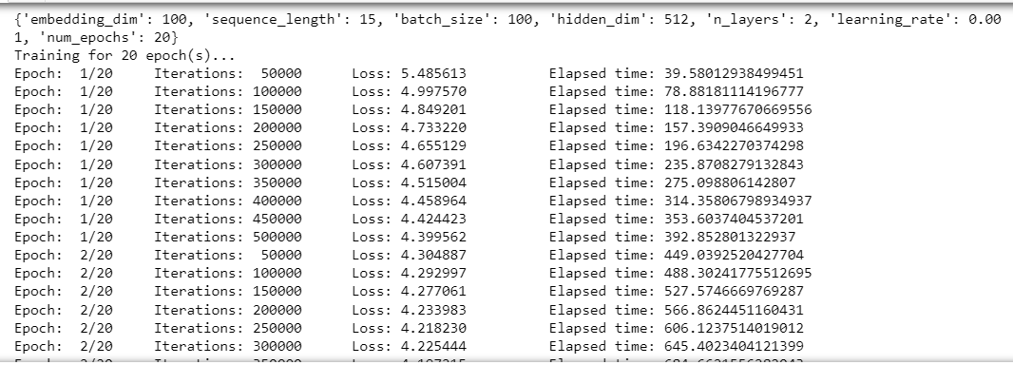
Training Progress

Slide 33

Script Generation

Slide 34
Thank You

