Slide 1
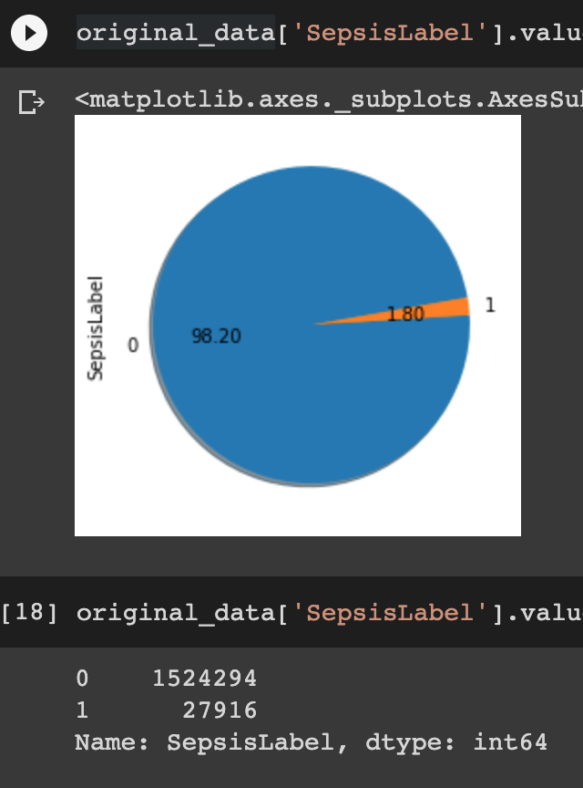
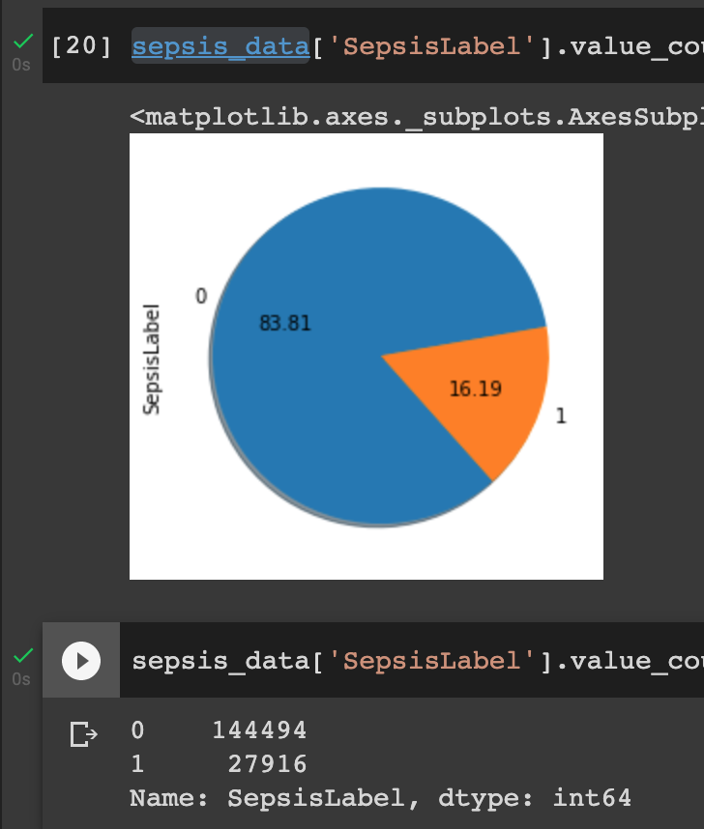
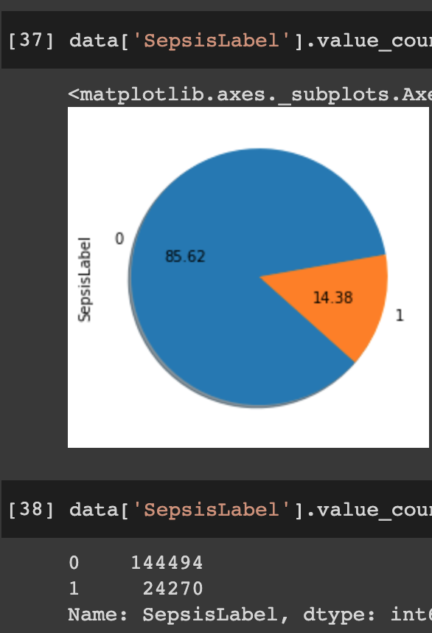
Original Dataset
Sepsis aftAdm+befAdm Dataset
Sepsis aftAdm Dataset
Notes:
Use resampling techniques to handle imbalanced data

Slide 2
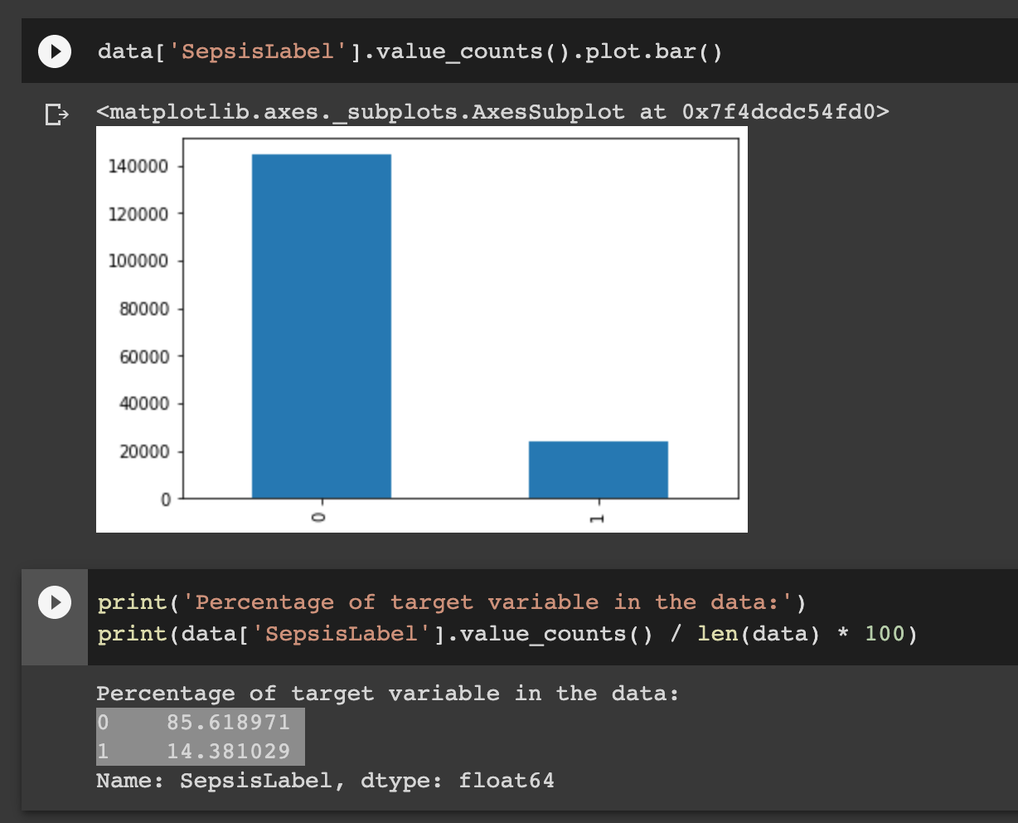
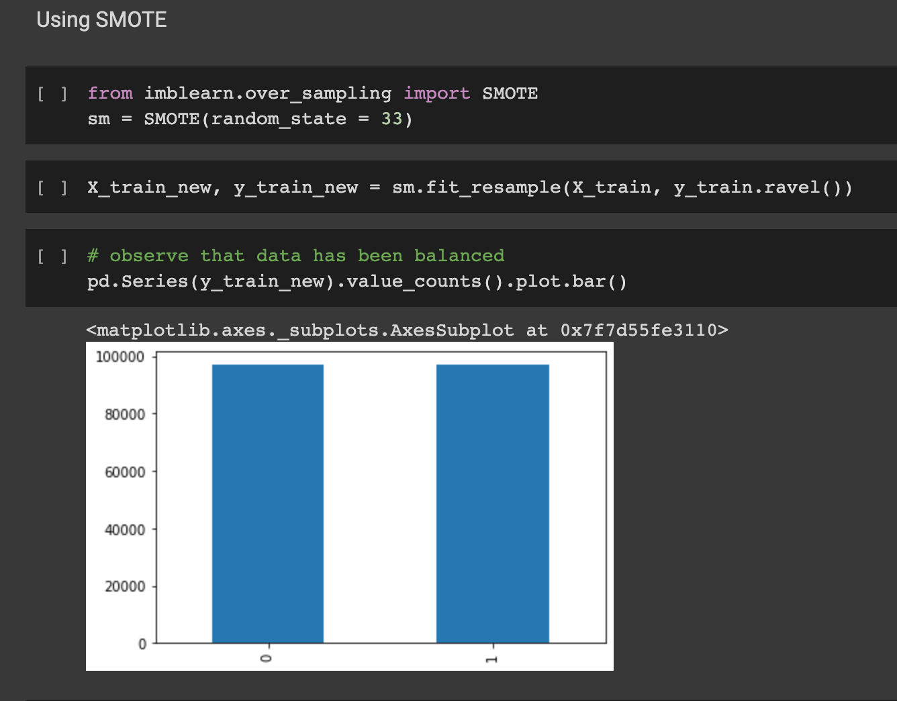
SepsisAfterAdmData before and after Upsampling using SMOTE(Synthetic Minority Oversampling Technique ]
Notes:
Today any machine learning practitioner working with binary classification problems must have come across this typical situation of an imbalanced dataset. This is a typical scenario seen across many valid business problems like fraud detection, spam filtering, rare disease discovery, hardware fault detection, etc. Class imbalance is a scenario that arises when we have unequal distribution of class in a dataset i.e. the no. of data points in the negative class (majority class) very large compared to that of the positive class (minority class).Most of the predictions will correspond to the majority class and treat the minority class features as noise in the data and ignore them. This will result in a high bias in the model.
Dealing with Imbalanced Data
Resampling data is one of the most commonly preferred approaches to deal with an imbalanced dataset. There are broadly two types of methods for this i) Undersampling ii) Oversampling. In most cases, oversampling is preferred over undersampling techniques. The reason being, in undersampling we tend to remove instances from data that may be carrying some important information
Synthetic Minority Oversampling Technique (SMOTE) is a statistical technique for increasing the number of cases in your dataset in a balanced way.

Slide 3
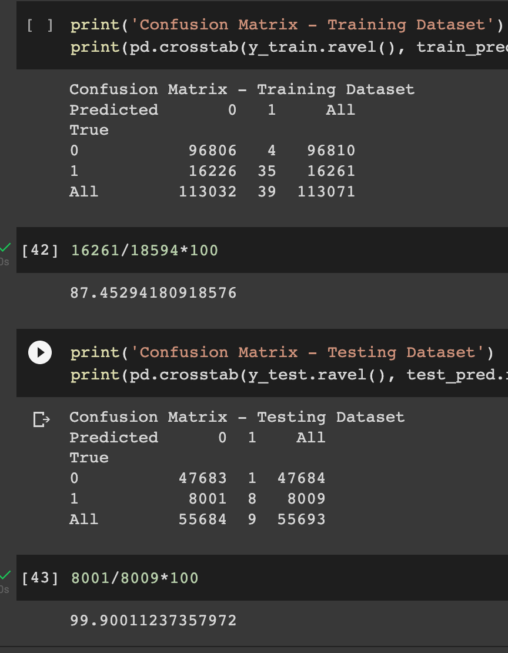
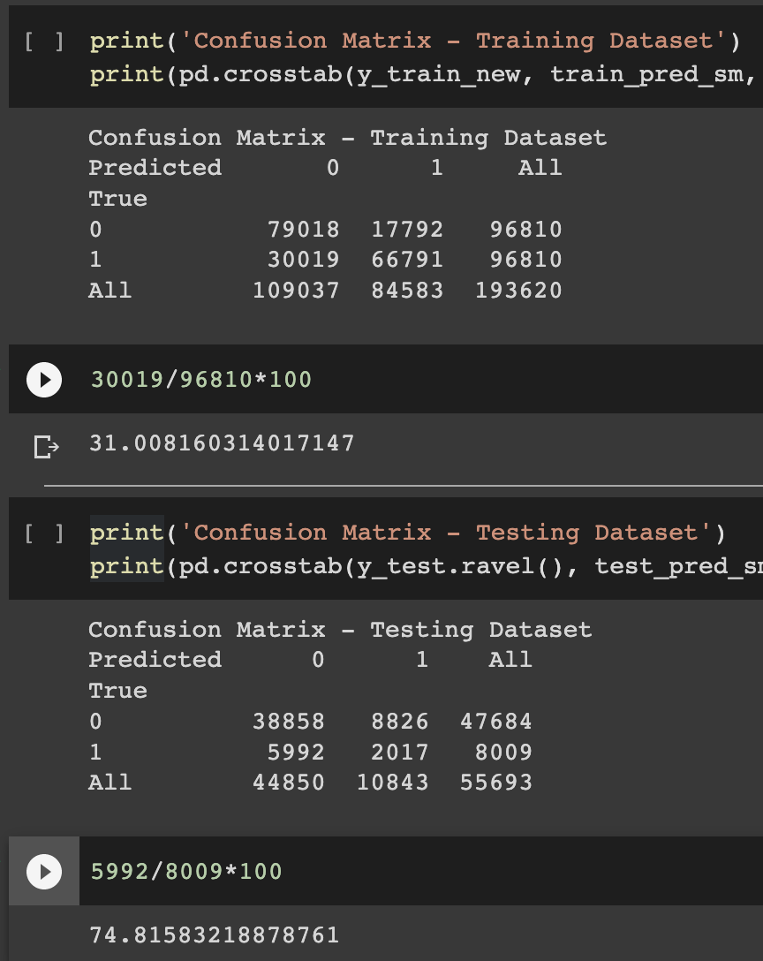
XGB Classifier Without SMOTE
XGB Classifier With SMOTE

