Slide 1
HOPHACKS 2026 · CONGRESS ON TWITTER, 2011 TO 2026
What's making
US angry?
4.8 million tweets, one finding: anger in Congress isn't an opinion. It's a jersey you put on when your side loses the White House.
Mean anger score by party, 2011 to 2026. The lines cross at every inauguration.
github.com/biniyam112/hophacks-congress-anger

Slide 2
THE QUESTION
Where does political anger actually live?
Political anger online is usually described with an anecdote or a single trend line. Neither tells you the mechanism. Is anger a property of people (temperament, age), of time (hours, seasons, elections), of position (in power or out of it), or of the medium (a retweet or a call-out)?
When
hour, month, election cycle
Who
party, person, age, volume
What for
shutdowns, presidents, tragedies
We treat anger as a memetic phenomenon, something that spreads and clusters, and try to locate it.
To whom
retweets vs call-outs
Given a tweet from a member of Congress, what predicts that it is angry, and how well?
Together or apart
uniting vs dividing tweets
What's making US angry? · HopHacks 2026 · 2

Slide 3
THE DATA
5.1 million tweets, filtered to sitting members
5.1M
4.83M
902
14
raw tweets in the HopHacks congress-tweets-unified dataset (two merged corpora, 1999 to 2026)
tweets kept: members of the House and Senate, sent while in office, 2011 onward
members of Congress, 100% matched to birthdays, terms and handles
scores per tweet: 11 emotions and 3 sentiment classes
Source 1: the HopHacks parquet (tweet text, author, party, state, timestamp, topic).
Source 2: the open unitedstates/congress-legislators dataset for birthdays, terms and Twitter handles. Handles were matched first (including 14 yearly snapshots of the social-media file, so former members are covered), then names plus state as a fallback.
Dropped: executive-branch accounts (cabinet secretaries, the President), tweets members posted before they were elected, and a few corrupt pre-2011 rows.
Added per tweet: age of the member that day, hour of day in the member's home-state time zone, month, and position in the two-year election cycle.
What's making US angry? · HopHacks 2026 · 3

Slide 4
HOW WE PROCESSED IT
From raw tweets to an anger score for each one
1
Match
2
Enrich
3
Score
1,156 handles to bioguide IDs and birthdays; keep only in-office tweets
age at tweet, local hour, month, days to the next election
cardiffnlp twitter-roberta emotion model (11 emotions) and a sentiment model (3 classes)
4
Label
5
Analyze
6
Publish
all 4.97M tweets on a laptop RTX 4050 in under two hours (about 630 tweets per second)
year, party, hour, month, cycle, age, volume, spikes, networks, uniting vs dividing
a web story, an animated interlude or two, and a marimo notebook
Choosing the model: we benchmarked three on a sample. The 4-class TweetEval model rated "when we fight, we win!" as rage, so it was out. The multilabel model's top-scored tweets were genuinely angry, and a separate sentiment model's negative score correlates 0.80 with it. A tweet counts as angry when P(anger) is above 0.5.
What's making US angry? · HopHacks 2026 · 4

Slide 5
RESULT 1
It's not you. It's the White House.
Anger sat below 0.21 through the Obama years, jumped to 0.29 in 2017 and reached 0.44 in 2025, the angriest year on record.
Split by party it is an X. Democrats spike when Trump takes office (2017, 2025). Republicans spike under Biden. The lines cross at every inauguration.
Each hand-over ratchets the floor higher: today's in-party (0.35) is angrier than 2017's out-party (0.34).
What's making US angry? · HopHacks 2026 · 5

Slide 6
RESULT 1, CONTINUED
Same rule, four presidencies
0.18 vs 0.19
Democrats and Republicans under Obama. Equal, and calm.
0.12 to 0.17
how much angrier the out-party has been than the in-party in every presidency since
0.50
Democrats in Trump's second term, the angriest any group has ever been
What's making US angry? · HopHacks 2026 · 6

Slide 7
RESULT 2
Congress's most reliable source of anger is Congress
Week | Event | Excess
2013-09-30 | GOVERNMENT SHUTDOWN begins (Oct 1) | +0.22
2021-01-04 | JANUARY 6 Capitol attack | +0.16
2025-09-29 | GOVERNMENT SHUTDOWN begins (Oct 1), angriest week on record | +0.14
2019-01-07 | 35-day shutdown peak; Trump Oval Office address | +0.14
2018-01-15 | GOVERNMENT SHUTDOWN (Jan 20 to 22) | +0.12
2011-04-04 | Near-shutdown, Apr 8 deadline | +0.11
2016-01-04 | Obama gun executive actions; ACA/PP repeal veto | +0.11
Four of the top five spikes are government shutdowns. January 6 is the only external event in that tier. Of the 40 biggest spikes, 13 are fiscal brinkmanship, about 10 are presidential actions, and 6 are violence or tragedy, the only weeks when the two party lines converge.
Blue and red are braided together until 2017, then split into two bands and swap places at each inauguration.
What's making US angry? · HopHacks 2026 · 7

Slide 8
RESULT 3
Anger keeps office hours
13 of 16
14 of 16
6 of 7
years in which 9 pm to 4 am (home-state time) is angrier than that year's average. Working hours sit exactly on the average.
years in which August, the recess month, is calmer than the year's average
elections where the final four weeks were calmer than the rest of the year. There is no ramp into November in any of eight cycles.
Every curve is measured against its own year, so the steep 2011 to 2026 trend cannot masquerade as a daily or seasonal pattern.
Member | Type | Angry by day | Angry at night
Mike Levin | night owl | 25% | 56%
Mazie K. Hirono | night owl | 37% | 65%
Joe Wilson | night owl | 26% | 48%
Jason Crow | night owl | 27% | 48%
Bill Hagerty | morning person | 53% | 29%
Ronny Jackson | morning person | 66% | 46%
Jim Jordan | morning person | 50% | 33%
Some members run on their own clock. Mike Levin is a mild 25% angry by day and 56% after dark. Bill Hagerty is the opposite. The web story turns these nine into an animated day on the Hill, sunrise to sunset, with faces driven by the hourly numbers.
What's making US angry? · HopHacks 2026 · 8

Slide 9
RESULT 4
The anger forecast
Overall, 29% of tweets are angry. Knowing the party tells you nothing (29%).
Knowing the party and the president moves it to 52%. The hour adds nothing on top.
Knowing the person makes it nearly certain: Chris Van Hollen, 9 to 5, in Trump's second term, is a 90% forecast. If Patty Murray tweets before sunrise in that period, 84% of the time it's angry.
Volume predicts anger too (Spearman 0.31). Everyone who tweets more than seven times a day is angrier than average. Except Cory Booker: 8.5 tweets a day, 18% angry.
What's making US angry? · HopHacks 2026 · 9

Slide 10
RESULT 5
Nobody unites from opposition
Polarizing tweets belong to the out-party: Democrats 17% in 2017, Republicans 25% in 2022, Democrats 35% in 2025, the record.
Civic unity belongs to the in-party. Republicans' peak is 2018, Democrats' is 2024. In 2025 both fall to 2.6%.
The parties felt roughly the same things until 2016, split in 2017 (anger), came back together in 2020 (the pandemic year), and have been apart since 2021, where the gap is optimism, and in 2025, disgust.
What's making US angry? · HopHacks 2026 · 10

Slide 11
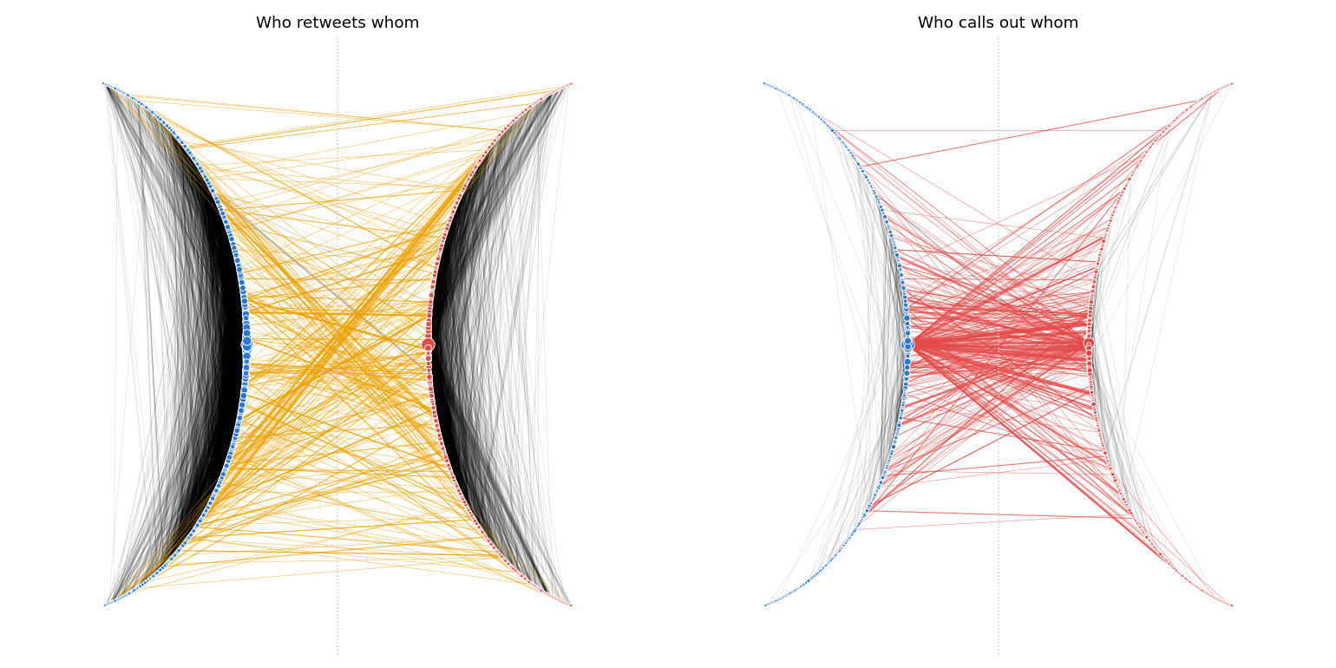
RESULT 6
Two networks, one Congress
2% cross the aisle
of 64,456 retweets of fellow members. Their anger: 0.16, the calmest tweets in Congress (0.40 within a party).
37% cross the aisle
of 4,706 public call-outs. Their anger: 0.61, the angriest (0.30 within a party).
Lightning rods: Pelosi (514 call-outs, anger 0.76), McConnell (338, 0.63), Schumer (136, 0.82). Bridges: Massie, DeGette, McCain. Massie and McCain are on both lists, the only people both sides retweet and yell at.
Left: who retweets whom. Right: who addresses whom in public with .@ (a call-out when it crosses the aisle). Democrats on the left arc, Republicans on the right, hubs nearest the centre, line width by tweet count.
What's making US angry? · HopHacks 2026 · 11

Slide 12
THE PATTERNS
Five things the data keeps saying
1
Anger is positional, not personal
The same people are calm in power and furious out of it. Age adds nothing once you know the party: the within-person slope is a tight zero.
2
Events beat the calendar
No ramp into elections in eight cycles. Shutdowns, Jan 6 and presidential actions make the spikes. The month before an election is the calm one.
3
Volume predicts anger
The prolific are angry, because anger is the high-volume genre. The one exception, Cory Booker, is the kind of thing a reader remembers.
4
The medium is the mood
Retweets across the aisle are the calmest tweets we have. Call-outs across the aisle are the angriest, and they go straight to party leaders.
5
The floor ratchets
Every hand-over of the White House leaves the baseline higher than it found it. The in-party of 2025 is angrier than the out-party of 2017.
What's making US angry? · HopHacks 2026 · 12

Slide 13
CONCLUSION
Anger in Congress is a jersey.
You put it on when your side loses the White House and take it off when you win. It does not spread evenly. It jumps to the losing party, concentrates on a handful of lightning rods, ratchets the baseline up each cycle, and it is loudest at 2 am, in October, during a shutdown.
Web story
marimo notebook
Pipeline
six chapters, two animated interludes: a day on the Hill, and the parties' emotional distance as Gone with the Wind
every chart interactive, the forecast as a function, a custom anywidget, on molab
reproducible from the raw parquet: match, enrich, label on GPU, analyze, export
github.com/biniyam112/hophacks-congress-anger

