Slide 1
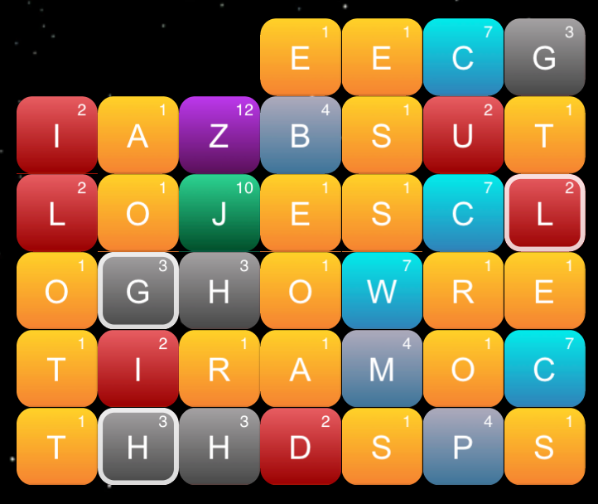
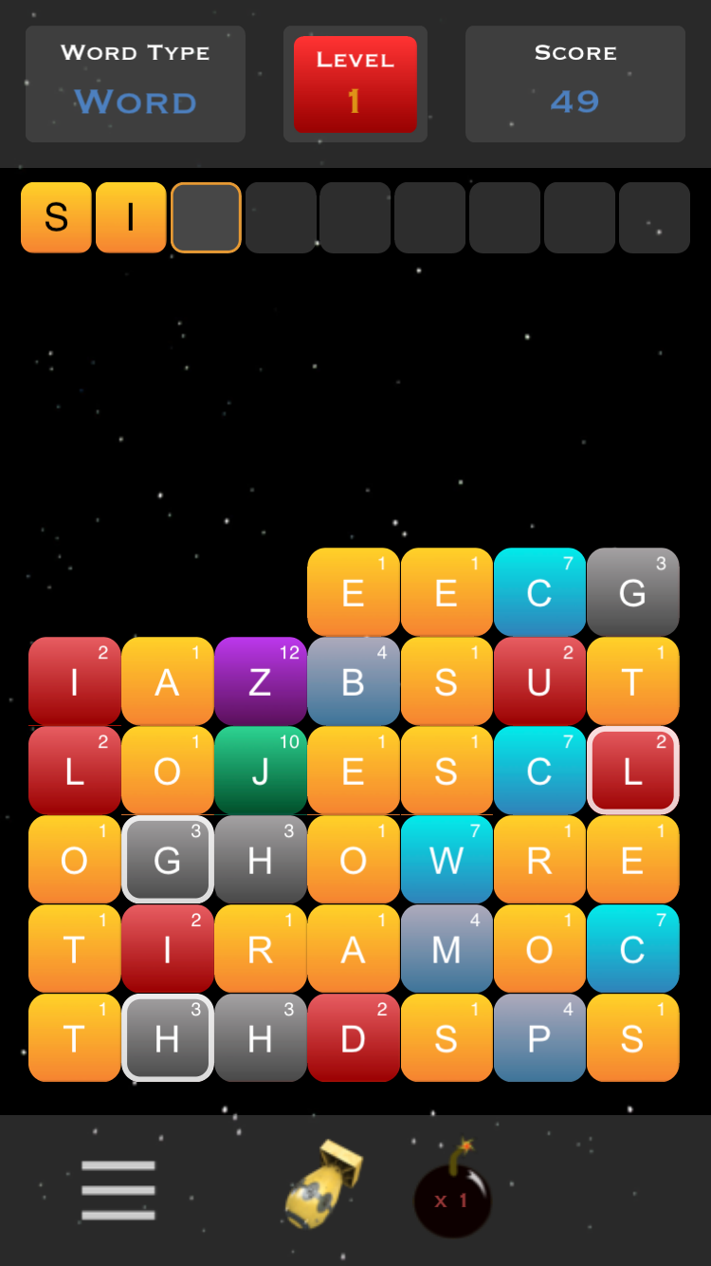
How to Play
Keep the letters form reaching the top of the screen by forming words, which will eliminate the pieces.
Swipe the letters in any direction to form words:
Swap any two letters by first tapping one letter followed by tapping another:
1
2
Advance to new levels by forming words in the top boxes from letters in the white squares. The formed word must be of the word type (word, noun, verb, etc.).
Use the Nuke Piece to eliminate all the letters and the Bomb piece to eliminate a single row.
Don’t Show this Again

