Slide 1
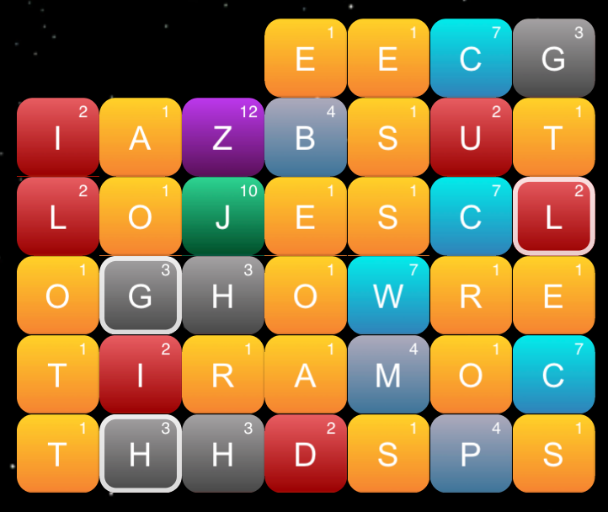
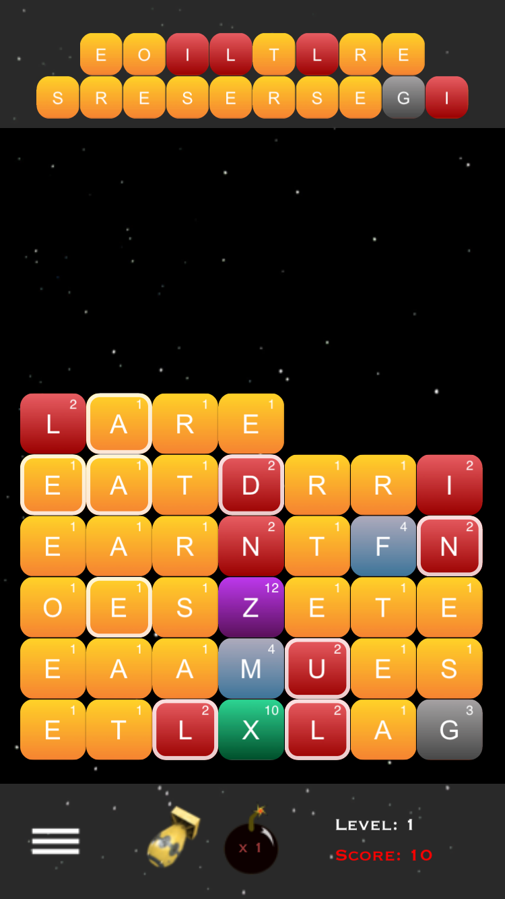
How to Play
Keep the letters form reaching the top of the screen by forming words, which will eliminate the pieces.
Swipe the letters in any direction to form words:
Swap any two letters by first tapping one letter followed by tapping another:
1
2
Advance to new levels by eliminating all letters in the top bar. This is done by forming words with the white boxes – when a word is formed, any letters in the white boxes will knock out one or more matching letters on Top.
Use the Nuke Piece to eliminate all the letters and the Bomb piece to eliminate a single row.
Don’t Show this Again

