Slide 1
NetworkManager Inside
Novell
Bin Li
binli@opensuse.org

Slide 2
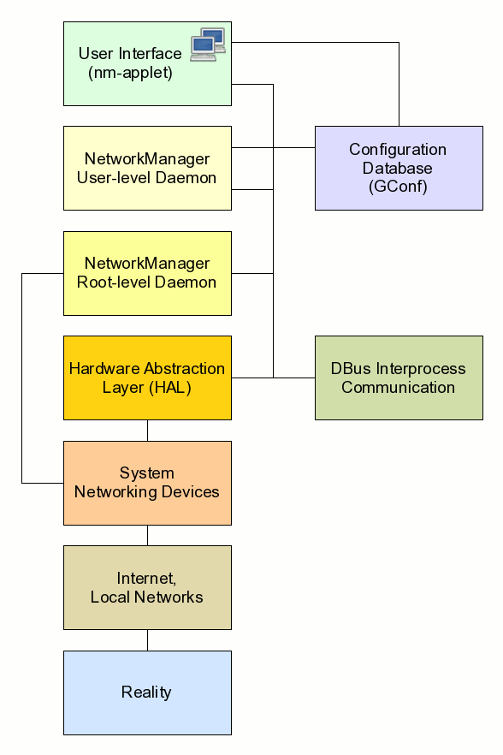
Framework
C/S
Preliminaries
  GTK
  DBus
  Gconf
  HAL
  udev

Slide 3
Connections
Scope
  User Level
  System Level
Gconf
gconftool-2 -R /system/networking/connections
/etc/NetworkManager/system-connections/

Slide 4
Configuration
/etc/NetworkManager/nm-system-settings.conf
/etc/sysconfig/network/ifcfg-*
/etc/NetworkManager/system-connections/
[main]
plugins=ifcfg-suse,keyfile
[keyfile]
Unmanaged-devices =
mac:00:22:68:1c:59:b1;mac:00:1E:65:30:D1:C4

Slide 5
Depends
dhcp-client / dhcpcd
sysconfig
wpa_supplicant
modemmanager
usb_modeswitch

Slide 6
Code Tree
./libnm-glib/
./libnm-util/
./src/
./src/dhcp-manager/
./src/modem-manager/
./src/supplicant-manager/
./src/ppp-manager/
./src/named-manager/
./src/vpn-manager/
./introspection/*.xml
./system-settings/plugins/
Notes:
libnm-glib is only used by _client_ of NetworkManager, and wraps the
D-Bus objects that NetworkManager exports in a glib friendly API.
libnm-util is common code and structures used both by clients of NetworkManager and NetworkManager itself.

Slide 7
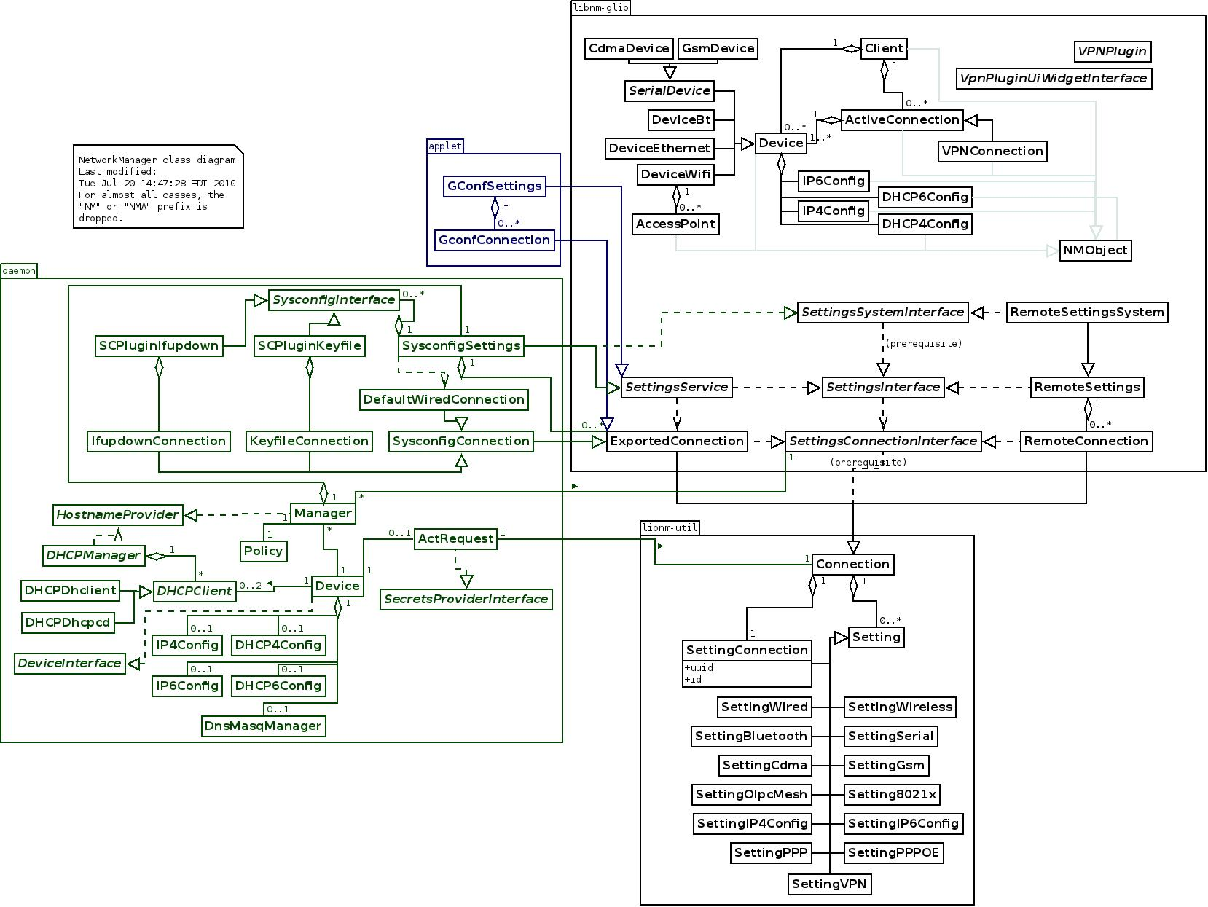
Class Diagram
Notes:
NMConnection — Describes a connection to specific network or provider
NMSetting — Describes related configuration information
NMSettingConnection — Describes general connection properties
NMSettingCdma — Describes CDMA-based mobile broadband properties
NMSetting8021x — Describes 802.1x-authenticated connection properties

Slide 8
How to read
Gobject
  G_DEFINE_TYPE
  mm_manager_new
  mm_manager_init
  mm_manager_class_init
Makefile.am
typedef struct {
Gobject parent;
…..
} MMManager;

Slide 9
Trouble shooting
Driver info
'hwinfo –-netcard', '
/var/log/NetworkManager
NetworkManager --no-daemon

Slide 10
Debug WiFi
wpa_supplicant
/usr/share/dbus-1/system-services/fi.epitest.hostap.WPASupplicant.service
[D-BUS Service]
Name=fi.epitest.hostap.WPASupplicant
Exec=/usr/sbin/wpa_supplicant -c /etc/wpa_supplicant/
wpa_supplicant.conf -u -f /var/log/wpa_supplicant.log -dddt
User=root

Slide 11
Debug WiFi (Con.)
Stop NetworkManager
killall -TERM wpa_supplicant
rm -f /var/log/wpa_supplicant.log
Start NetworkManager
reproduce your problem

Slide 12
Debug 3G/Modem
Stop NetworkManager
killall -TERM modem-manager
modem-manager --debug
Start NetworkManager
NM_PPP_DEBUG=1 /usr/sbin/NetworkManager --no-daemon
reproduce your problem

Slide 13
Debug VPN
Stop NetworkManager
killall -TERM nm-openvpn-service
In a root terminal, run
OPENVPN_DEBUG=1 /usr/lib/nm-openvpn-service
Start NetworkManager
/usr/sbin/NetworkManager --no-daemon
Start your VPN connection
reproduce your problem

Slide 14
NovellVPN
turnpike
novell-ipsec-tools
novell-nortelplugins
Networkmanager-novellvpn

Slide 15
OSC
OpenSUSE Buildservice
Usage
  osc branch
  osc checkout
  quilt setup, quilt push, quilt new, quilt add, quilt refresh
  osc ci -m “check in”
  osc r
  osc sr -m “submit request”

Slide 16
Links
http://live.gnome.org/NetworkManager
http://live.gnome.org/NetworkManagerConfiguration
http://live.gnome.org/NetworkManager/SystemSettings

Slide 17
Question
?

