Slide 1
GNOME Shell
Nexus 7
Bin Li
2015.05

Slide 2
Me?
Canonical, SUSE
Beijing GNOME User Group
GNOME member, openSUSE member
Notes:
Gtk是用C语言编写的,如果你不会C也没关系针对各个语言我们都做了封装,

Slide 3
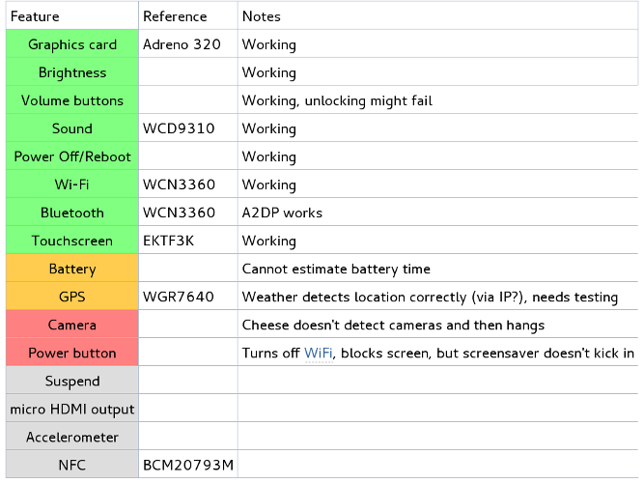
Why try GNOME in Nexus?
A video
VadimRutkovsky wiki
  Good time to learn new thing
Pad > PC
  https://wiki.gnome.org/VadimRutkovsky/Nexus7

Slide 4
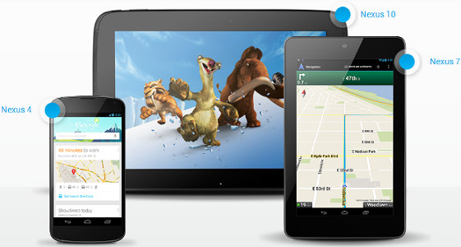
Device Code
Nexus 4 ("mako")
Nexus 7 [2013] (Wi-Fi) ("flo")
Nexus 7 [2013] (Mobile) ("deb")
Nexus 7 (Wi-Fi) ("grouper")
Nexus 7 (Mobile) ("tilapia")
Nexus 10 ("manta")
...

Slide 5
Image Name
Nexus 7 [2013] (Wi-Fi) ("flo")
  Android 4.3 (JSS15Q)
  Android 4.4 (KRT16S)
  Android 4.4.4 (KTU84P)
  Android 5.0 (LRX21P)
  Android 5.1.0 (LMY47O)
  Android 5.1.1 (LMY47V)
  https://developers.google.com/android/nexus/images

Slide 6
Preparation
In Nexus device
  Install MultiRom app
  Enable debug mode
In Computer
  Install Android-tools-adb & android-tools-fastboot
  fastboot oem unlock
  fastboot flash recovery openrecovery-twrp-2.8.5.0-flo.img
  http://techerrata.com/browse/twrp2/flo
  http://forum.xda-developers.com/showthread.php?t=2011403

Slide 7
Build Kernel
arm-eabi-4.7
In kernel_msm
  ARCH=arm make flo_defconfig
  ARCH=arm CROSS_COMPILE=../arm-eabi-4.7/bin/arm-eabi- make
  adb push arch/arm/boot/zImage /sdcard/
  https://android.googlesource.com/platform/prebuilts/gcc/linux-x86/arm/arm-eabi-4.7
  git clone git@github.com:crondog/kernel_msm.git

Slide 8
Error!!
arch/arm/mach-msm/wcnss-ssr-8960.o: In function `do_ramdump':
/source/gits/kernel_msm/arch/arm/mach-msm/ramdump.c:264: multiple definition of `do_ramdump'
arch/arm/mach-msm/ramdump.o:/source/gits/kernel_msm/arch/arm/mach-msm/ramdump.c:264: first defined here
arch/arm/mach-msm/wcnss-ssr-8960.o: In function `destroy_ramdump_device':
/source/gits/kernel_msm/arch/arm/mach-msm/ramdump.c:252: multiple definition of `destroy_ramdump_device'
arch/arm/mach-msm/ramdump.o:/source/gits/kernel_msm/arch/arm/mach-msm/ramdump.c:252: first defined here
In .config,
  CONFIG_MSM_WCNSS_SSR_8960=n

Slide 9
Building the initramfs
Edit systemd-initramfs/init
cd systemd-initramfs; find . | cpio -o -H newc | gzip > ../minimal.initramfs
Rename it to initrd.img
  https://github.com/willcast/arch-flo

Slide 10
Build Image
adb push install-arch.sh /sdcard/
adb shell
sh install-arch.sh
  Make image with dd
  Mount & chroot
  Install packages
  https://github.com/borh/nexus-7-2013-arch-scripts

Slide 11
Error!!
busybox mount -t ext4 -o rw,noatime /dev/block/loop256 /data/arch
No such file
busybox mount -t ext4 -o rw,noatime /dev/loop256 /data/arch
Can't download packages, no dns server.
busybox rm ${CHROOT}/etc/resolv.conf
echo "nameserver 8.8.8.8" > ${CHROOT}/etc/resolv.conf

Slide 12
Install GNOME
sh chroot.sh root
pacman -S gnome-shell
gnome-shell-3.16.1-2
  https://github.com/borh/nexus-7-2013-arch-scripts.git

Slide 13
Add rom into MultiRom
adb shell ; su
mkdir /data/media/0/multirom/roms/arch/
Move arch.img to /data/media/0/multirom/roms/arch/root.img
Move zImage to
/data/media/0/multirom/roms/arch/boot/vmlinuz
Move initrd.img in /data/media/0/multirom/roms/arch/boot/initrd.img
Push rom_info.txt in /data/media/0/multirom/roms/arch/
  https://github.com/willcast/arch-flo

Slide 14

Error!!!
1) kernel_flo
mdp4_overlay_mdp_perf_upd mdp clk is changed [1] from 0 to 200000000
2) kernel_msm
[ 8.569091] WARNING: at arch/arm/mach-msm/clock-local.c:313 rcg_clk_enable+0x20/0x40()
[ 8.569213] dsi1_byte_clk status stuck at 'off'[<c010b408>] (unwind_backtrace+0x0/0xe0) from [<c016b6b0>] (warn_slowpath_common+0x48/0x60)
reboot into recovery
  adb shell
  cat /proc/last_kmsg
Reboot into android
  adb shell
  cat /sdcard/multirom_log.txt

Slide 15
Vision
Images server
Tools in gnome
  Like 'ubuntu-device-flash'
  Download the image
  Flash the image
….

Slide 16

Thank you!
Bin Li
binli@gnome.org

Slide 17
Links
  http://source.android.com/source/building-kernels.html

