Slide 1

GNOME in Asia
BinLi
GNOME.Asia Committee

Slide 2
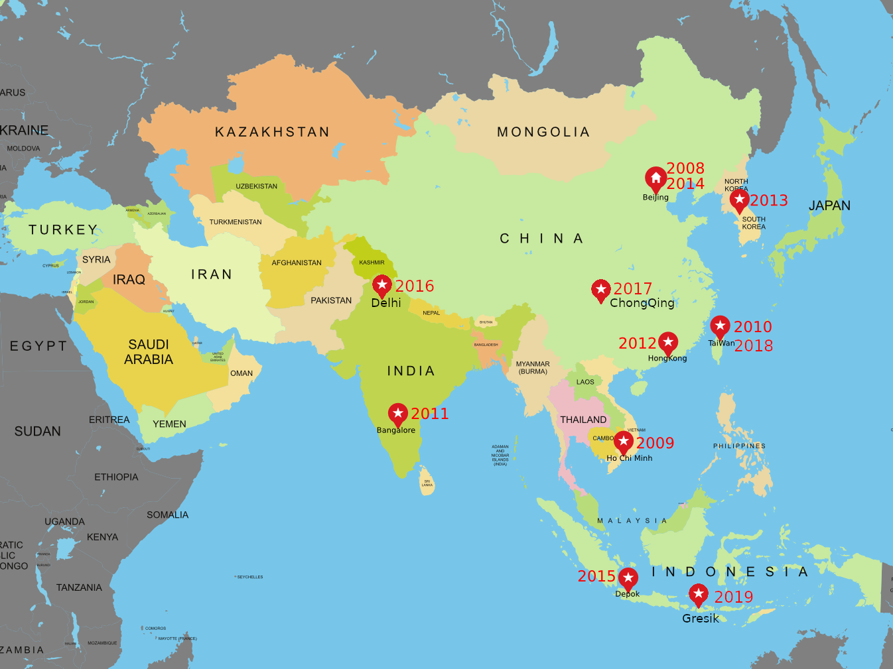

Slide 3

GNOME.Asia 2018
Statics
  Register: 1400 people
  Day 1: 1364
  Day 2: 784
  2 tracks, 18 speakers.

Slide 4

GNOME.Asia 2019 Status
March 2019, Call For Host
April 2019, 2 proposals, Melbourne and Gresik
May 2019, Logo Competition
July 2019, Call For Paper
Aug 2019, two roadshow events
Now, Call For Sponsor
Registration will open.

