Slide 1

Spreading GNOME With Local User Group
Bin Li (binli@gnome.org)
GNOME.Asia committee member

Slide 2

When And Where is the first GNOME.Asia Summit?

Slide 3

18th Oct 2008
Beijing
Delhi is the 9th
GNOME.Asia Summit

Slide 4
How many countries we had?

Slide 5
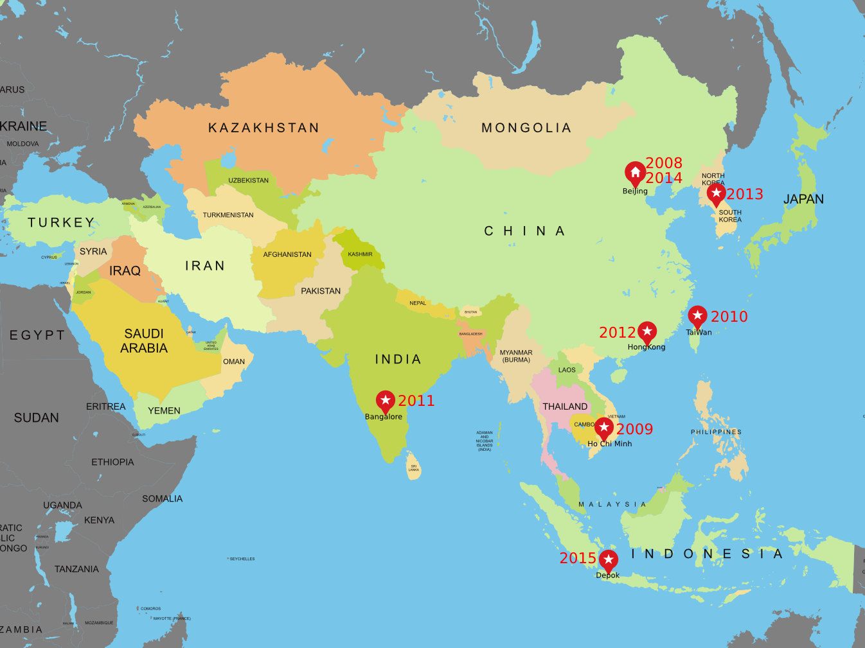

Delhi

Slide 6
Why local user group?
Local Language
Local Area

Slide 7
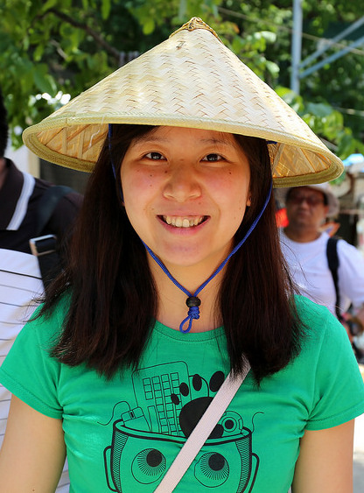

Beijing GNOME User Group
2008.11.26
bjgug, BeijingGUG
Website
  http://www.bjgug.org
Logo
Emily Chen

Slide 8
How to spread GNOME?

Slide 9

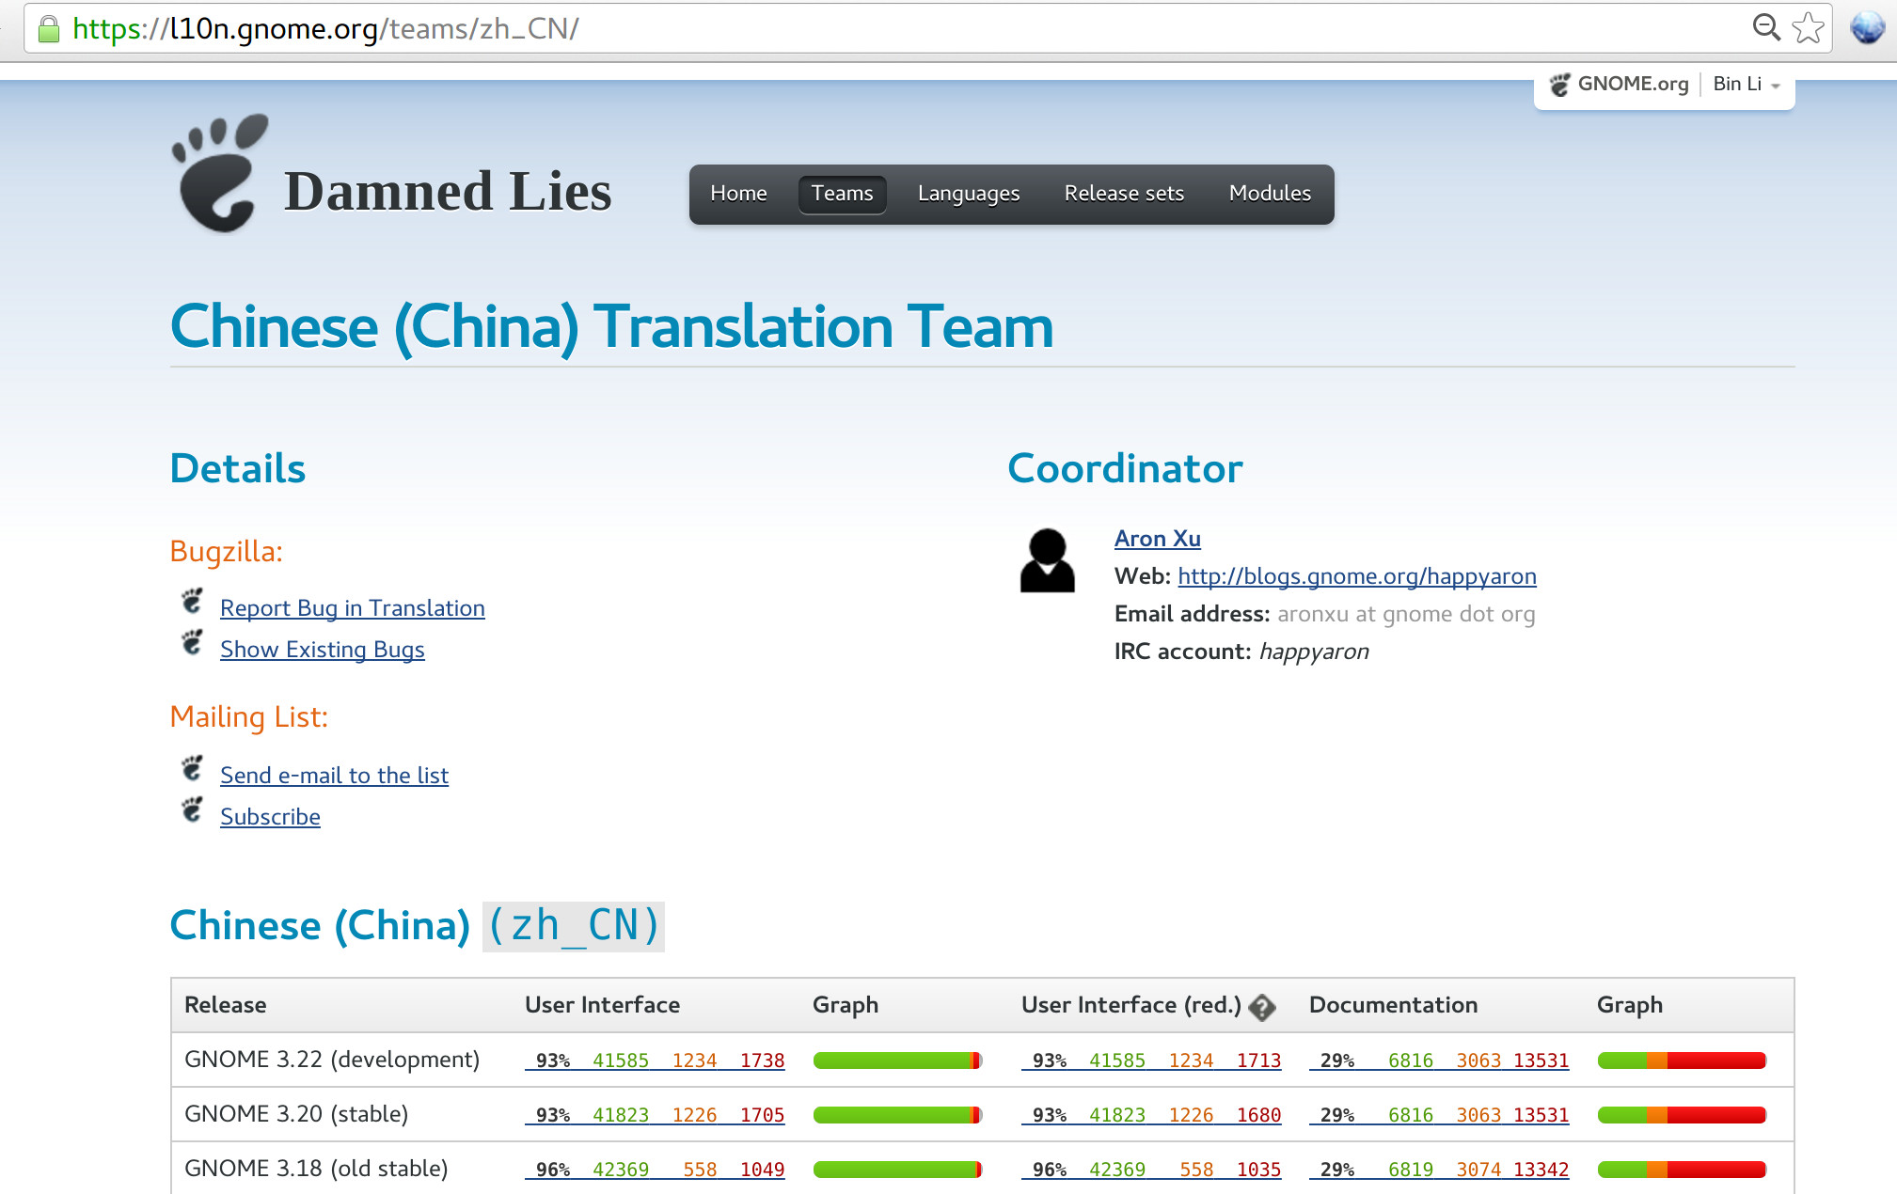
Translation

Slide 10
Events
Release Party
Festival
  SFD (Software Freedom Day
Meeting with other local community / group
  Beijing Linux User Group

Slide 11
Classic Social Media
Website
  http://ww.bjgug.org
Mailing List
  gnome-cn-list@gnome.org
Google group
  bjgug@googlegroups.com

Slide 12
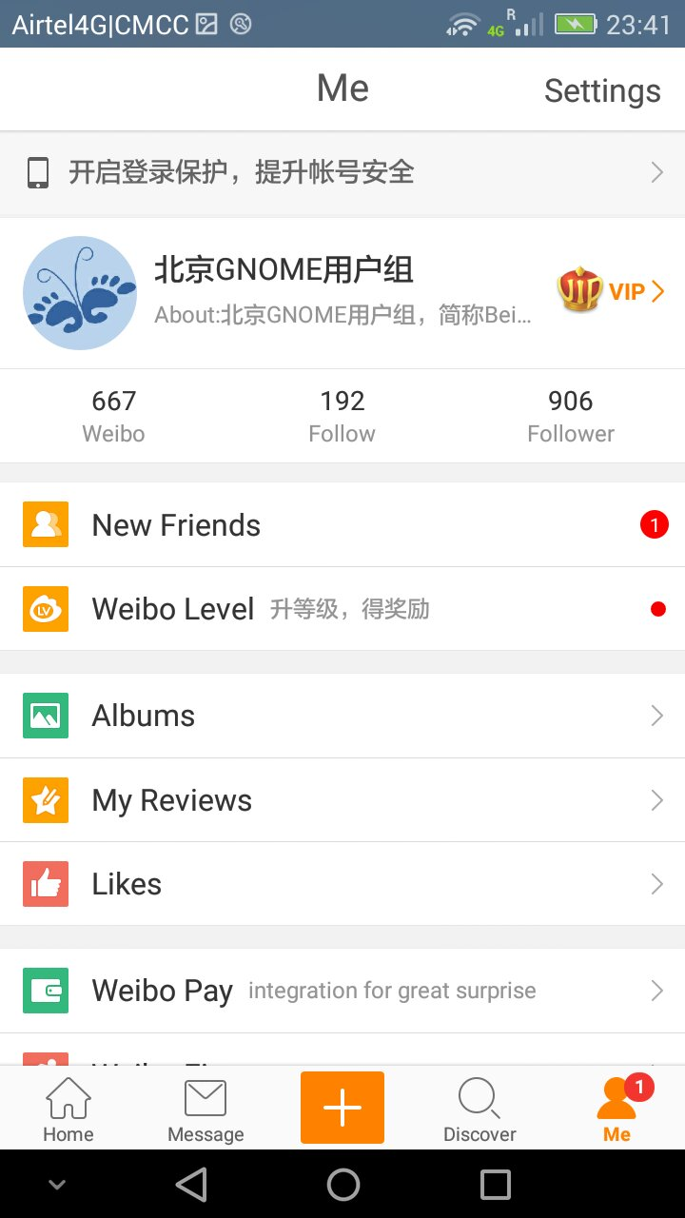
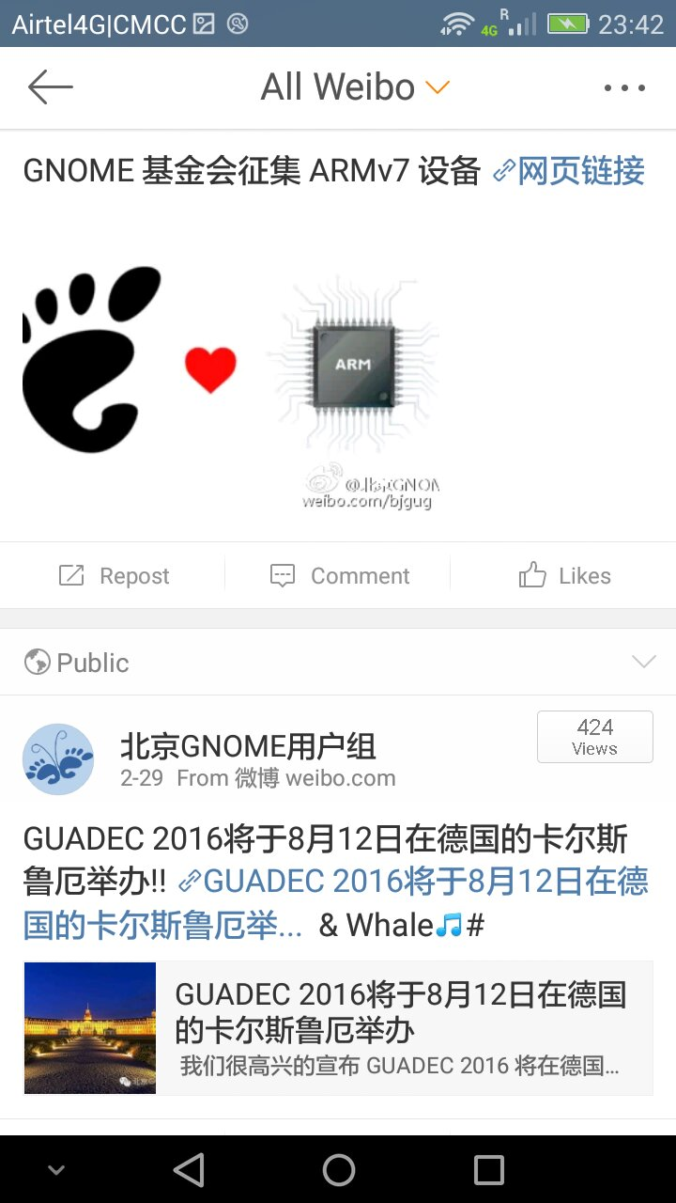
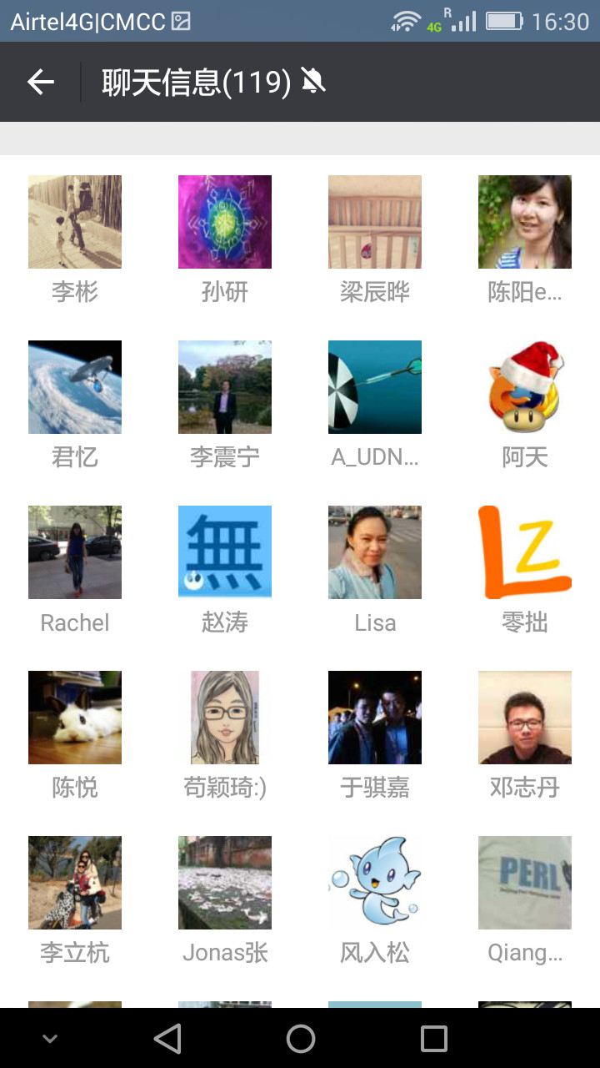
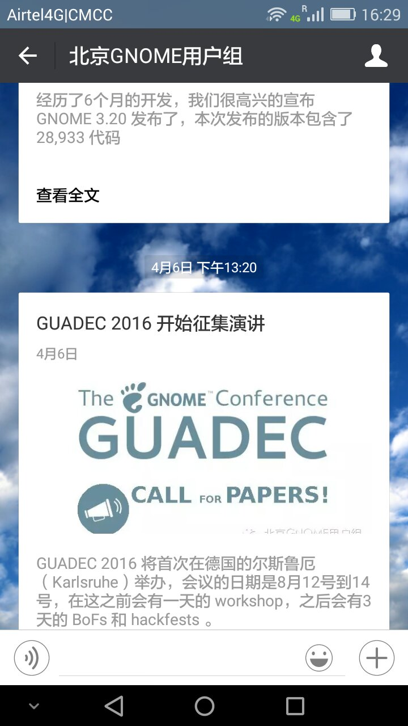
Modern Social Media
Weibo (twitter)
WeChat (Telegram)

Slide 13
Where to get GNOME news?

Slide 14
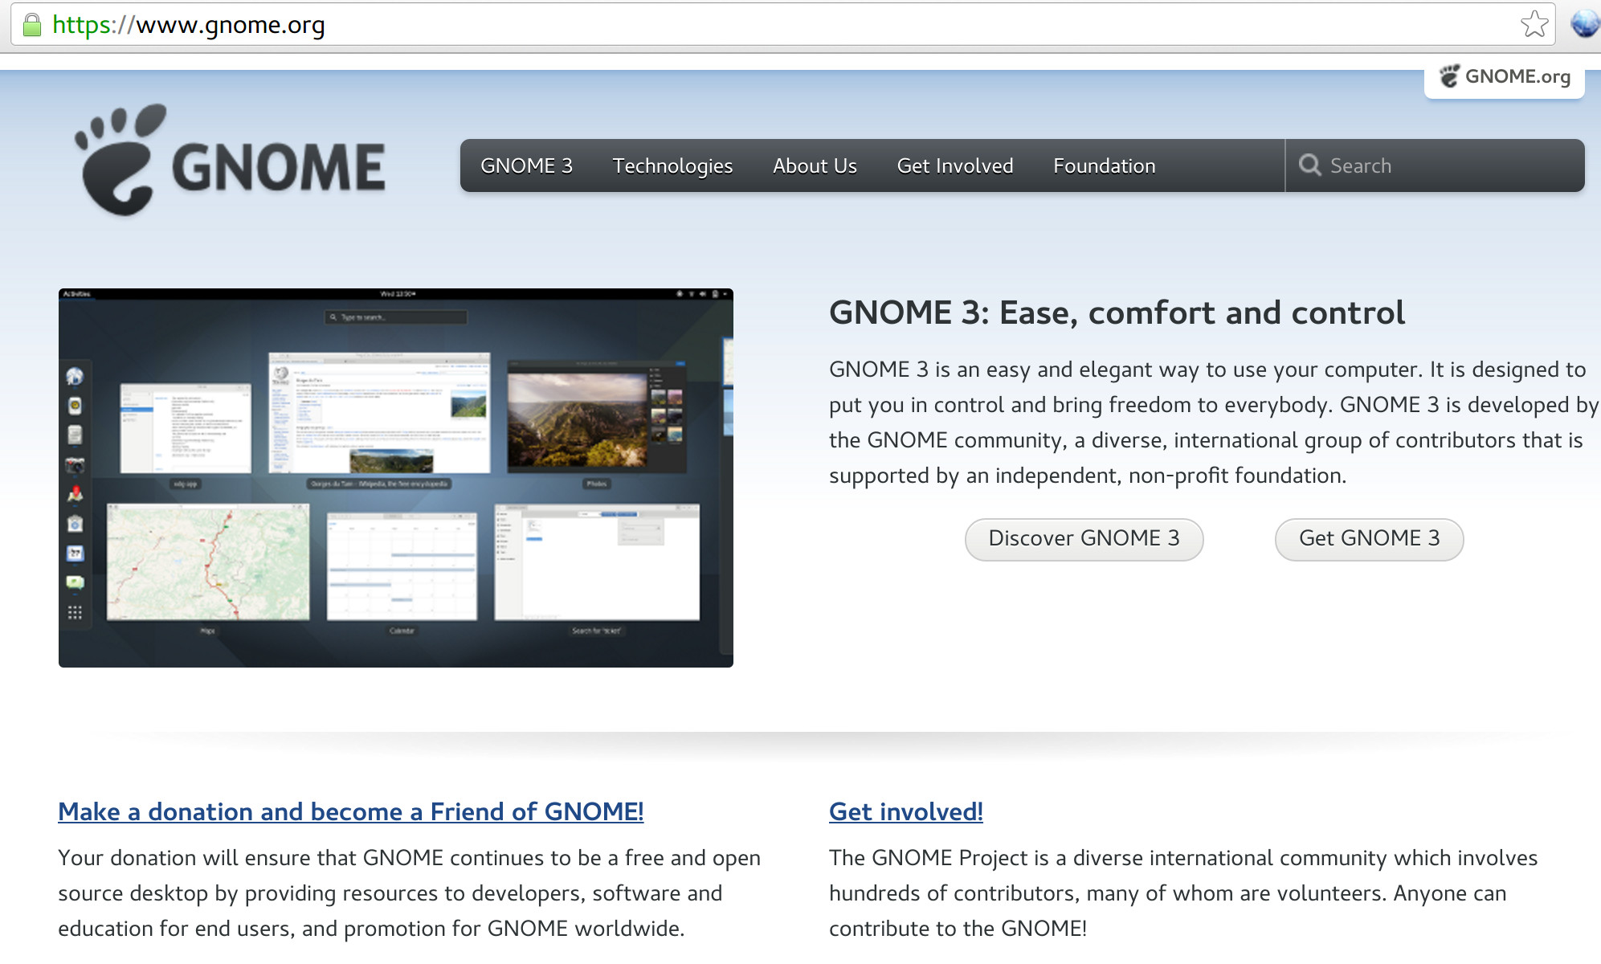
http://www.gnome.org

Slide 15

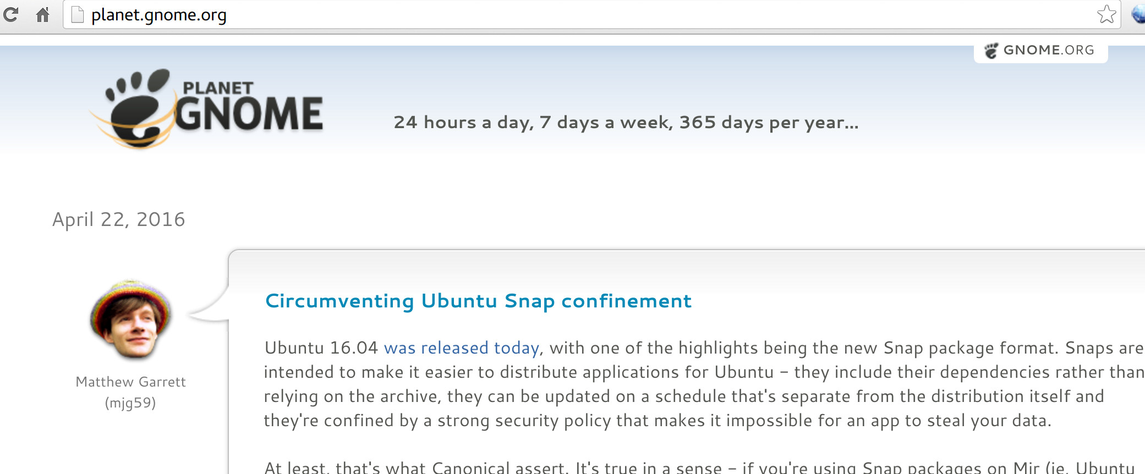
http://planet.gnome.org

Slide 16

Help us make GNOME better by getting involved today! https://www.gnome.org/get-involved/

Slide 17
Thank You!

