Slide 1

GNOME Shell Introduction
Bin Li

Slide 2
Flatpak vs. Snap
李彬(Bin Li)
GNOME.Asia Summit 2018

Slide 3
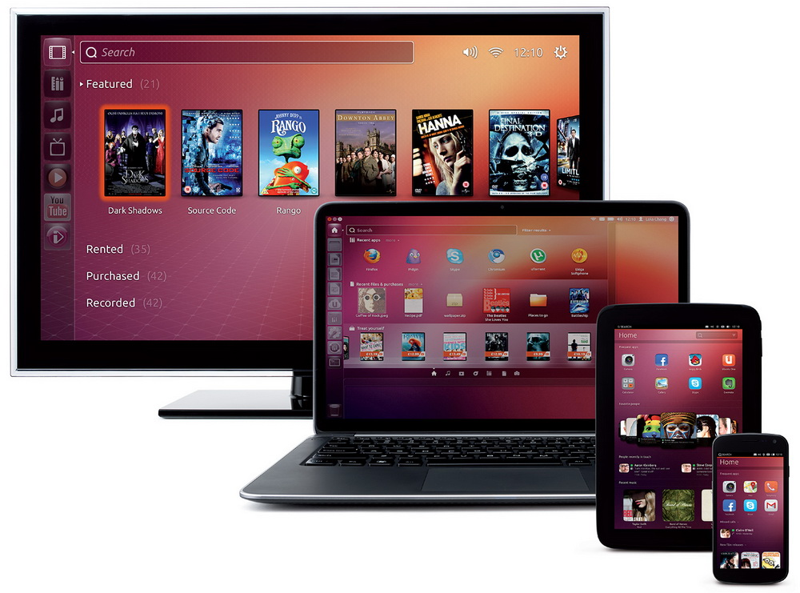
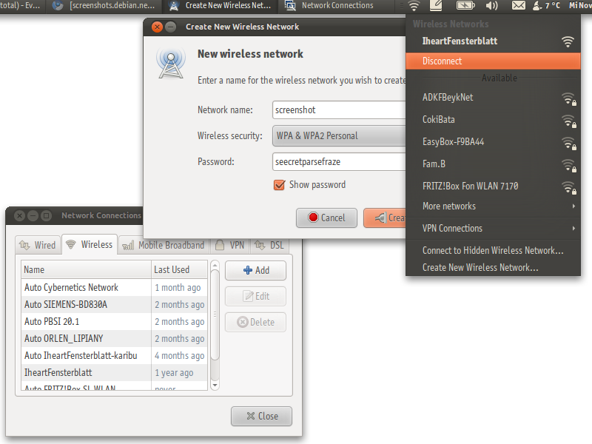
Me
Canonical
  PC,Laptop,Phone
SUSE
  NetworkManager
北京GNOME 用户组
  http://www.bjgug.org/
GNOME.Asia 组委会成员

Slide 4
Me
Canonical (2012-Now)
  PC,Laptop,Phone
SUSE (2007-2012)
  NetworkManager
Beijing GNOME User Group
  http://www.bjgug.org/
GNOME.Asia committee
Notes:
Since 2007, I’ve used GNOME Desktop.
I learnt a lot opensouce software from GNOME, it’s a gate of opensource world. I use GNOME in my daily life, I love it. I could almost find anything which I want.
In my spare time, I’m a volunteer in BJGUG and GNOME.Asia committee.

Slide 5
弹幕
http://dm.tuna.moe/channel/GNOME
git clone git@github.com:tuna/gdanmaku.git

Slide 6
Why we need them?
Package for different distributions
Dependency
Security (sandbox)

Slide 7
snap vs. flatpak
Canonical
Snappy
Unity
Ubuntu Phone
Alexander Larsson (RedHat)
xdg-app
GNOME

Slide 8
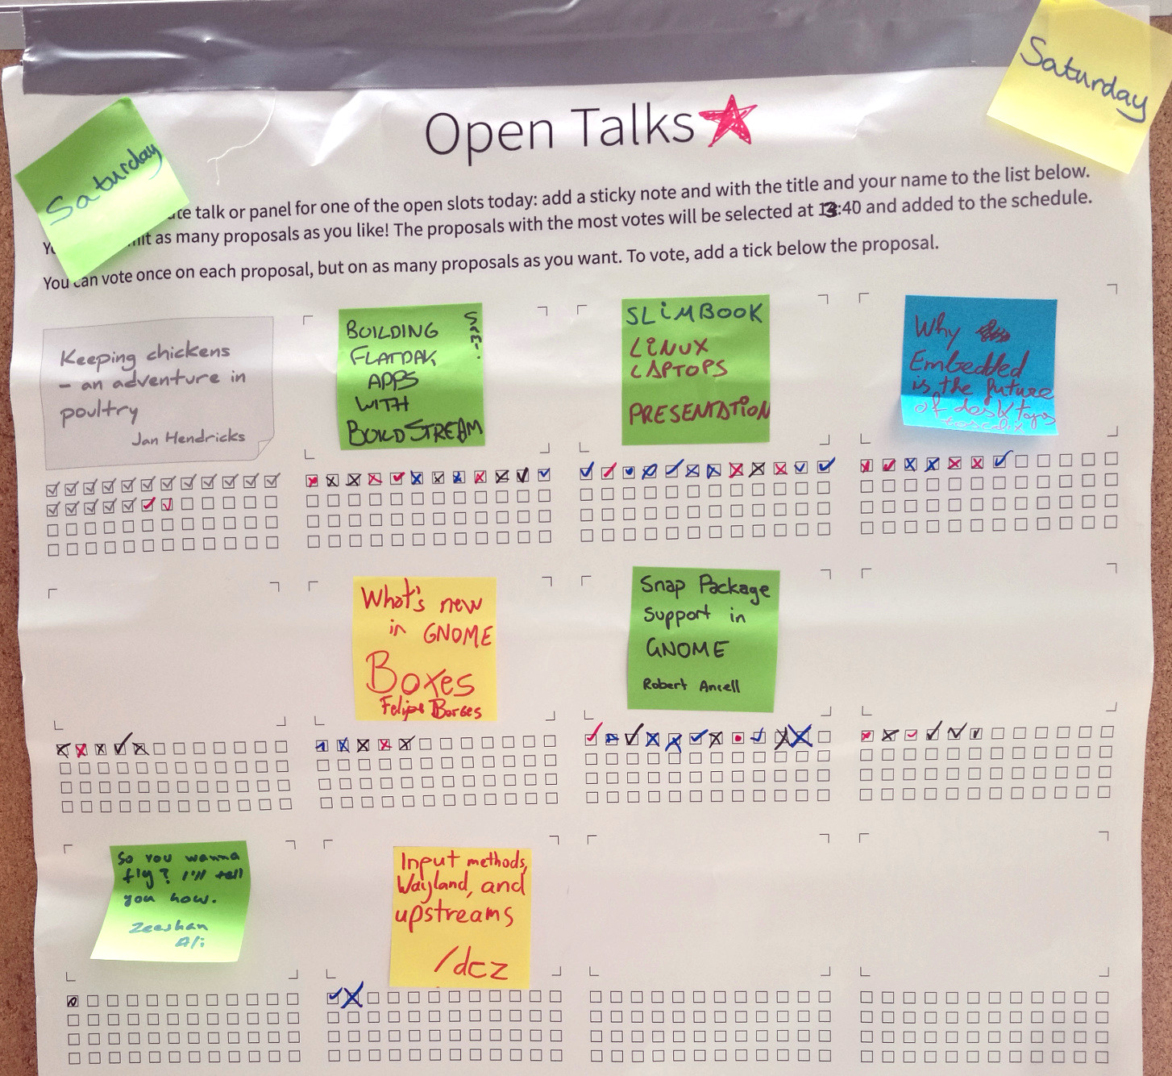
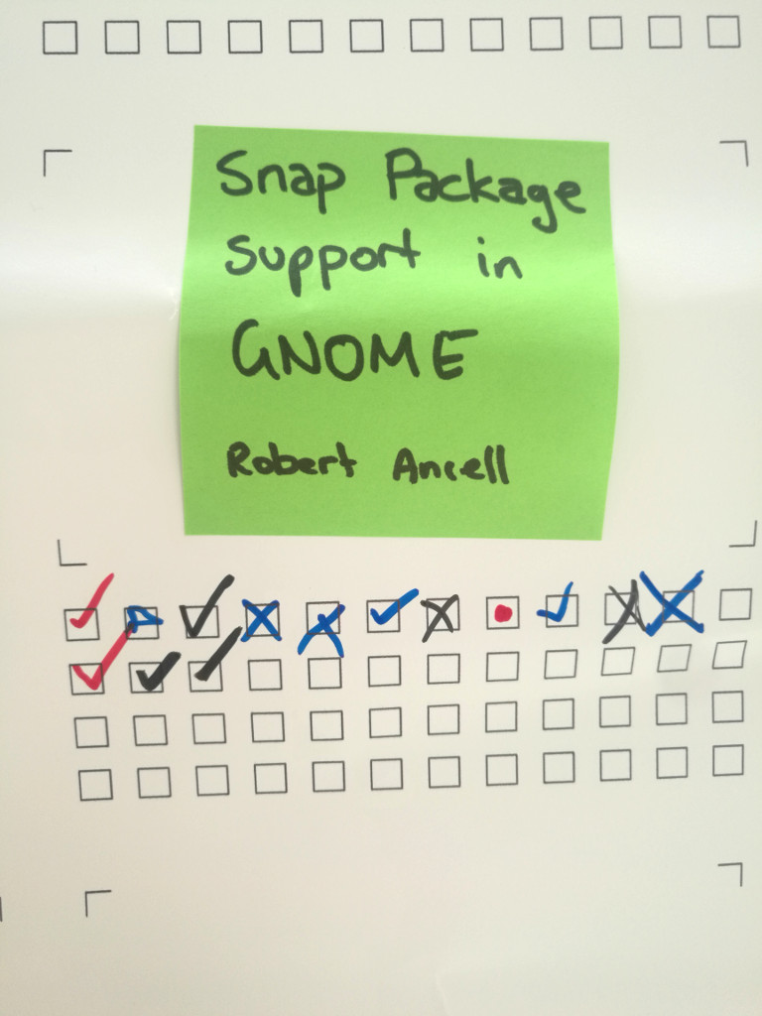
Snap with GNOME

Slide 9
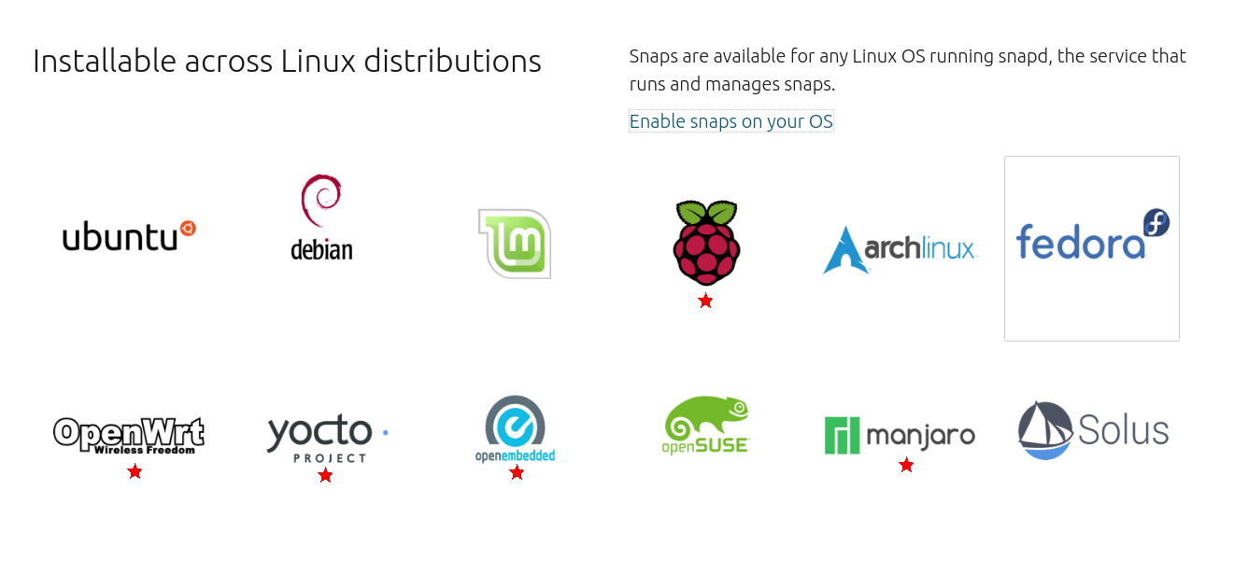
Support distro(Snap)
https://snapcraft.io/

Slide 10

Support distro(Flatpak)
https://flatpak.org/setup/

Slide 11
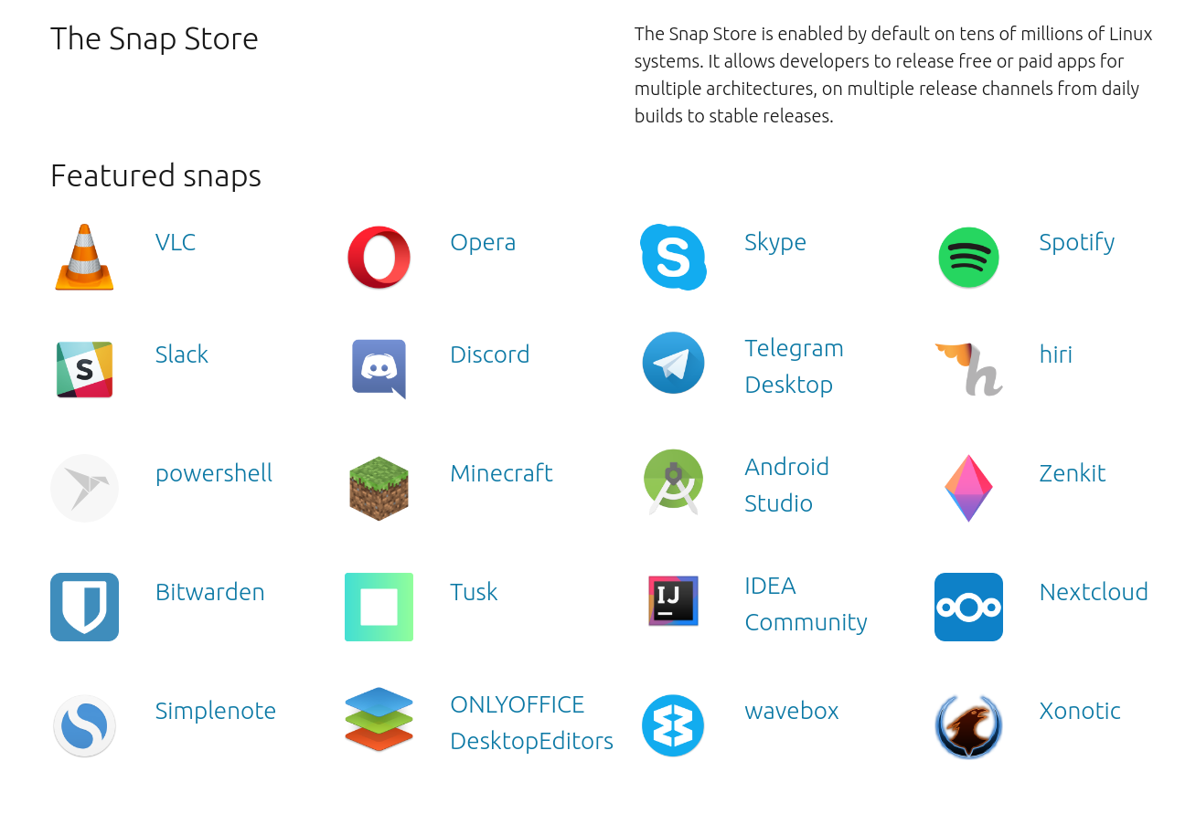
Store (Snap)
2434
results
https://snapcraft.io/store

Slide 12
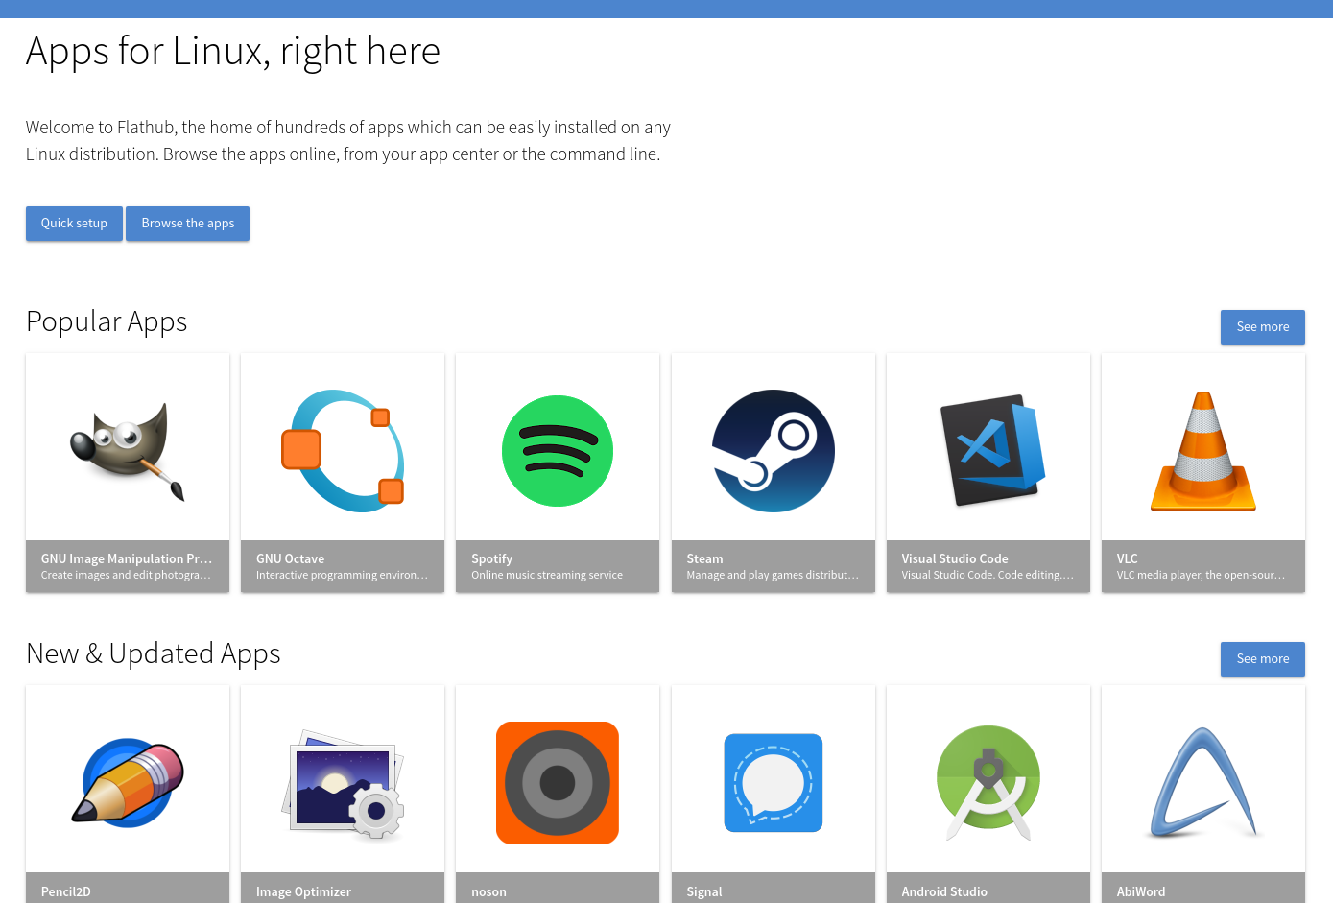
Store (Flatpak)
348
results
https://flathub.org/apps

Slide 13
Commands (S vs. F)
snap list
snap find calculator
snap install gnome-calculator
snap refresh gnome-calculator
Snap remove gnome-calculator
flatpak list
flatpak search calculator
flatpak remote-add flathub https://flathub.org/repo/flathub.flatpakrepo
flatpak install flathub org.gnome.Calculator
flatpak update org.gnome.Calculator
flatpak remove org.gnome.Calculator

Slide 14
Snap
App snap
App snap
App snap
Content interface snap
Ubuntu Core snap
Operating System

Slide 15
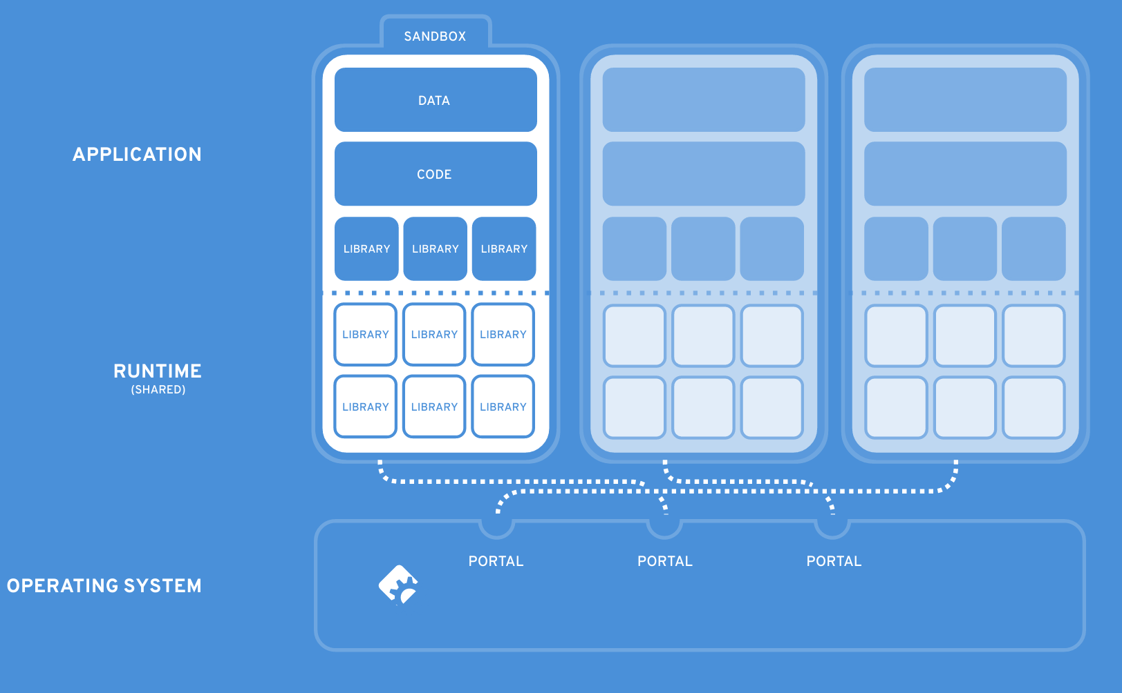
Flatpak

Slide 16


Build a package

Slide 17
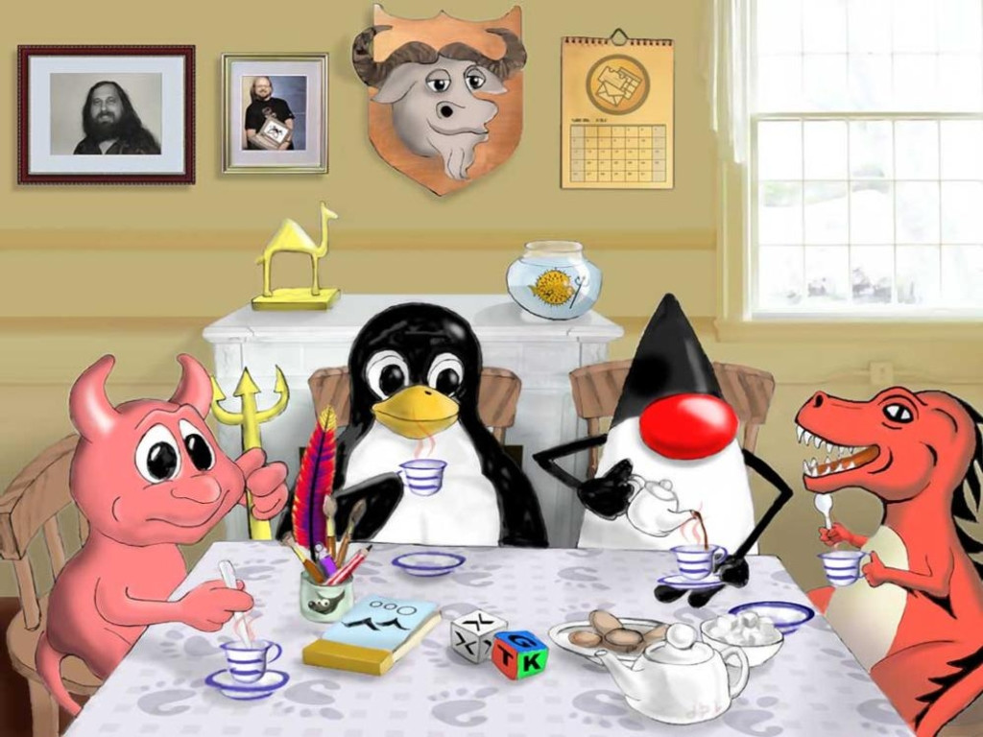
Notes:
Java(那个尖尖的头和咖啡)
Linux(企鹅)
FreeBSD(小魔牛)
GNU(牛头)
evolution(挂历)
Perl（骆驼）
Apache(羽毛)
GNOME(桌布上的小脚丫)
OpenOffice(本子)
GTK（彩色的立方体）
X.org（白色的立方体）
Richard Stallman(左边的相框)
James Gosling（右边的相框）
OpenBSD（鱼缸里的鱼）
GIMP(笔筒)
Mozilla基金会

Slide 18
标准发音
GNOME（/ɡˈnoʊm/）
https://en.wikipedia.org/wiki/GNOME

Slide 19
Pronunciation
GNOME（/ɡˈnoʊm/）
https://en.wikipedia.org/wiki/GNOME

Slide 20
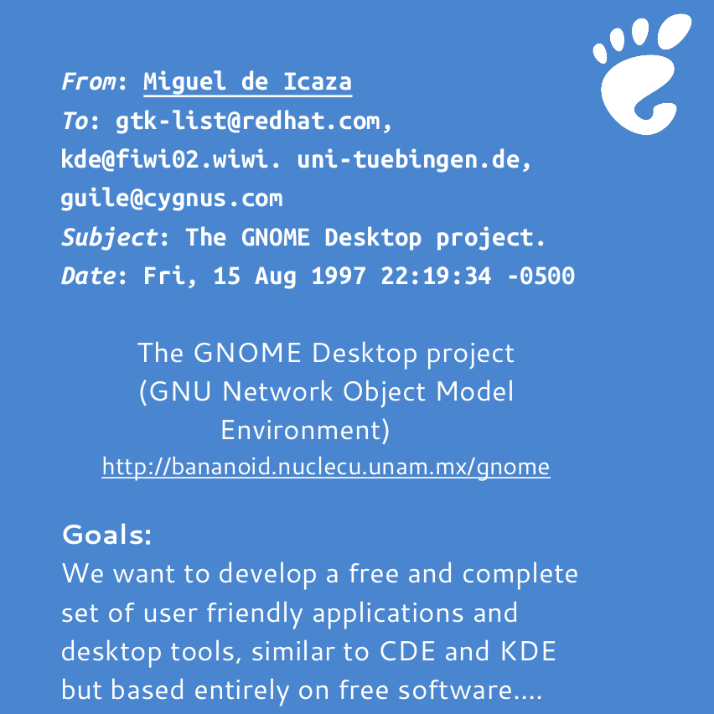






Desktop History
1984
1991
1995
1996
Notes:
当前Linux的桌面可以说百花齐放,但在10几年前你只能通过命令行来使用Linux.
我在这里列出了目前比较常用的桌面环境地,GNOME在Linux桌面环境中

Slide 21
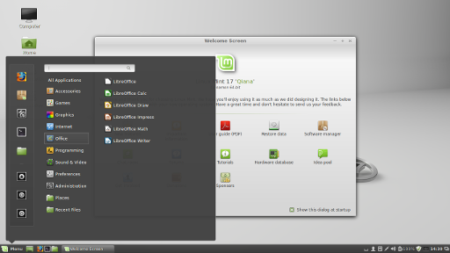
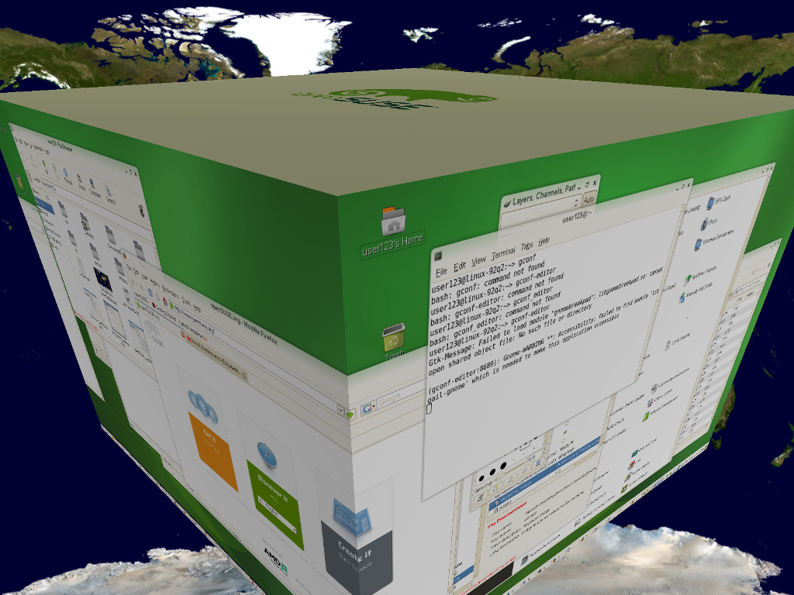
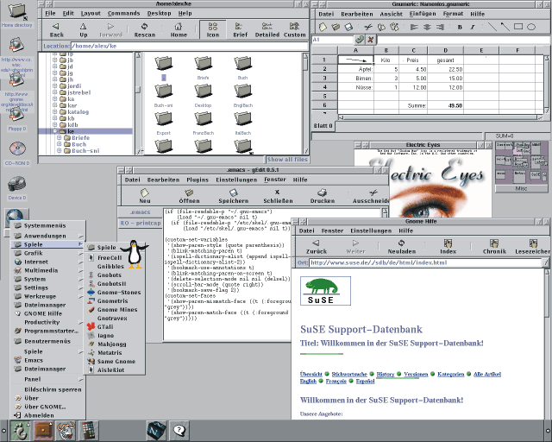
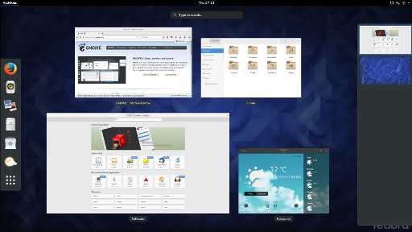
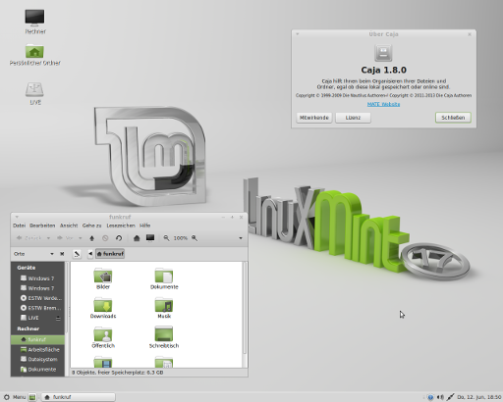
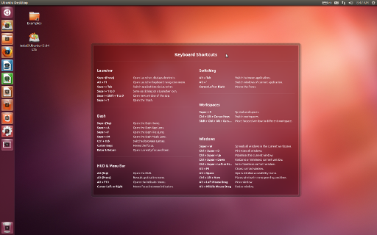
Desktop History
Cinnamon
GNOME
GTK+
GNOME
2.32
GNOME Shell (3.0)
2012.1
GNOME 3.34
2006
1997
1999.3
2010.9
2011.4
2010.10
2011.8
MATE
LXDE
XFCE (GTK+ 2.x)
Unity
Notes:
当前Linux的桌面可以说百花齐放,但在10几年前你只能通过命令行来使用Linux.
我在这里列出了目前比较常用的桌面环境地,GNOME在Linux桌面环境中
The MATE Desktop Environment is the continuation of GNOME 2.
The Cinnamon desktop layout is similar to GNOME 2.
The underlying technology is forked from gnome-shell. They want to make users feel at home and provide them with an easy to use and comfortable desktop experience.
In the opensource world, you could feel the freedom. If you don’t like it, start a new one, if you like it, make it better.

Slide 22

桌面的历史
2017
Ubuntu 18.04 To Ship with GNOME Desktop
Notes:
当前Linux的桌面可以说百花齐放,但在10几年前你只能通过命令行来使用Linux.
我在这里列出了目前比较常用的桌面环境地,GNOME在Linux桌面环境中

Slide 23
GNOME是什么?
桌面环境
开发平台(GTK+, Qt)
  C/C++
  Python
  JavaScript
  Vala
Notes:
Gtk是用C语言编写的,如果你不会C也没关系针对各个语言我们都做了封装,

Slide 24
GNOME?
Desktop Environment
Development Platform(GTK+, Qt)
  C/C++
  Python
  JavaScript
  Vala
Notes:
Gtk是用C语言编写的,如果你不会C也没关系针对各个语言我们都做了封装,
If you want to be a developer, GNOME is definely a good platform to learn programming.

Slide 25
GNOME Shell 扩展机制
定制GNOME Shell
优势
  不用更改源代码
  不用重新编译
  容易使用,语法简单
  自我保护,调试方便

Slide 26
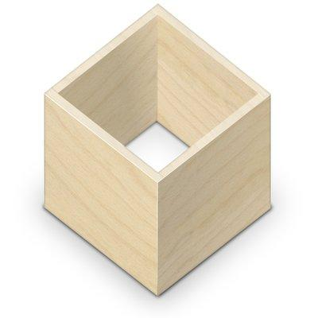
GNOME的未来 Flatpak
build once, run everywhere
application developers are in control of the release cycle
"Docker for desktop apps"

Slide 27
如何安装flatpak包
添加源
  flatpak remote-add --if-not-exists flathub https://flathub.org/repo/flathub.flatpakrepo
安装包
  https://www.flathub.org/apps.html
  flatpak install --from https://flathub.org/repo/appstream/io.mgba.mGBA.flatpakref

Slide 28
如何制作一个flatpak包
$ mkdir -p hello/files/bin
$ mkdir hello/export
hello.sh
#!/bin/sh
echo "Hello world, from a sandbox"
metadata
[Application]
name=org.test.Hello
runtime=org.gnome.Platform/x86_64/3.24
sdk=org.gnome.Sdk/x86_64/3.24
command=hello.sh

Slide 29
如何制作一个flatpak包
flatpak build-export repo hello
flatpak --user remote-add --no-gpg-verify tutorial-repo repo
flatpak --user install tutorial-repo org.test.Hello
flatpak run org.test.Hello

Slide 30
Ubuntu 与 GNOME 的关系
Redhat
  RHEL
SUSE
  SLES
Canonical
  Ubuntu
Fedora
openSUSE
Ubuntu GNOME
Kubuntu
Lubuntu
UbuntuKylin

Slide 31






桌面和发行版的选择
先入为主
个人喜好
不要纠结

Slide 32
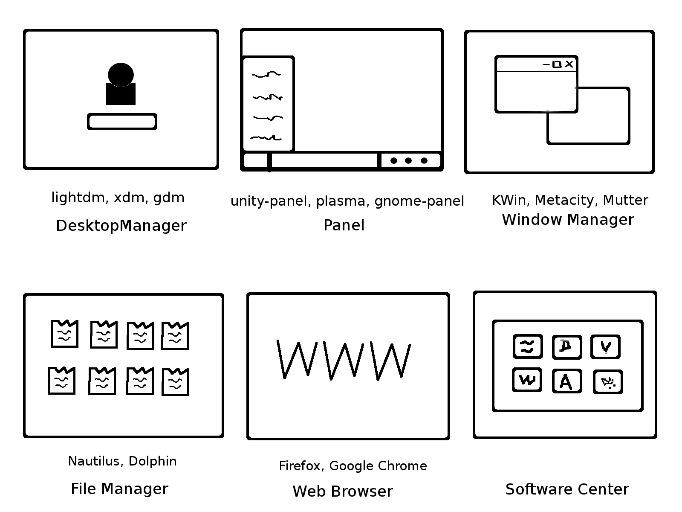

Slide 33
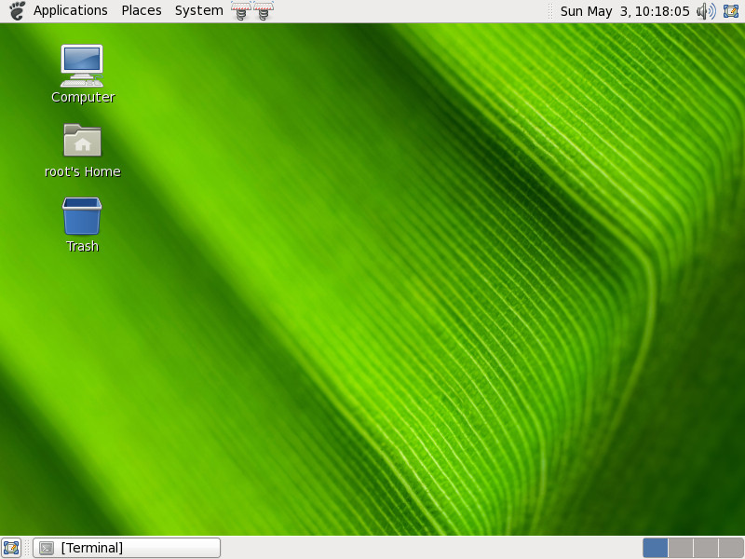

Slide 34
GNOME
Window Manager (Mutter, Shell)
File Manager (Nautilus, Sushi)
Hardware (Bluetooth, Network, Disk, Power)
Graphics (Gtk+, Clutter, St)
Multimedia (Gstreamer, pulseaudio)
IPC (D-Bus, Gsettings)
Notes:
GNOME project is a huge project, it involves too many opensource projects.
Each application shows in a window.

Slide 35
GNOME
Translation (damned lies, gtranslator)
Tasks (Calendar, Notes, Tasks, Todo)
Browser (Epiphany)
Security (PolicyKit, seahorse, sandboxing)
Messenger (empathy)
System Setting (Control Center)
Guide (Hig, wmspec, icons, thumnails)

Slide 36
Developer Tools
terminal
gedit
anjuta
Builder
meld
ghex
gitg
devhelp
yelp
gtk-doc
nemiver
gnome-boxes
d-feet
looking glass

Slide 37
Extensions
Customize GNOME Shell
Advantages
  Self-protection
  Easy to debug and create new extension
  Don't recompile the whole gnome shell

Slide 38
hello-world extension
gnome-shell-extension-tool –create-extension
Alt + F2 → r
~/.local/share/gnome-shell/extensions/

Slide 39
GNOME
翻译 (damned lies, gtranslator)
效率管理(Calendar, Notes, Tasks, Todo)
浏览器 (Epiphany)
安全 (PolicyKit, seahorse, sandboxing)
通信 (empathy)
系统设置 (Control Center)
设计准则和标准(Hig, wmspec,icons,thumnails)

Slide 40
开发工具
terminal
gedit
anjuta
Builder
meld
ghex
gitg
devhelp
yelp
gtk-doc
nemiver
gnome-boxes
d-feet
looking glass

Slide 41
常用扩展
https://extensions.gnome.org
Windows Alt Tab
Applications Menu
Frippery Move Clock
Dash to Dock

Slide 42
如何创建一个扩展?
一分钟搞定!!

Slide 43
GNOME 3.18
Google Drive 集成
文件管理器的改进
固件更新
自动屏幕亮度
新的日历（Calendar）

Slide 44
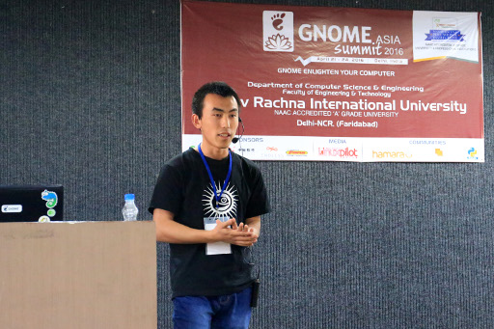
GNOME 福利
GNOME.Asia 亚洲峰会
GUADEC 欧洲峰会
Google Summer of Code 谷歌代码之夏

Slide 45
小结
GNOME
扩展机制

Slide 46

Notes:
The GNOME Project is a diverse international community which involves hundreds of contributors, many of whom are volunteers. Anyone can contribute to the GNOME!

Slide 47
Become a friend of GNOME!
https://www.gnome.org/getting-gnome/https://wiki.gnome.org/Newcomers/https://www.gnome.org/get-involved/

Slide 48
Become a friend of GNOME!
它会为你开启体验开源世界的大门

Slide 49
Thank you!
Bin Li
binli@gnome.org
www.bjgug.org

Slide 50
参考链接与图片链接
  https://live.gnome.org/GnomeShell/Extensions
  https://blogs.gnome.org/jrb/2017/07/29/gnome-populum-est/
  http://flatpak.org/hello-world.html
  https://extensions.gnome.org

