Slide 1
FilynAI
AI-powered IND & Regulatory Intelligence Platform

Slide 2
Agender
Technology Stack
Architecture overview
Engineering walk through
Works walk through
Q/A

Slide 3
Technology Stack -UI
React/Next.js, Vercel, Redux
Supabase PostgresSQL
node v25.1.0
pnpm, npm
Storybook, Jest
V0.dev + figama
Tiptap commercial editor license
Repo: Ind-manager.v2
Branch dev is default branch, branch main is the build branch
New PR merge or manual merge to main branch will trigger vercel deploy
Dev deploy: https://ind-manager-v2.vercel.app
npm install; pnpm install
npm run dev; pnpm run dev

Slide 4
Feature development Process
Create a jira ticket in IND_Manager board Jira IND
Create a feature branch off the dev. Branch name is Jira number
Develop your code in the feature branch, commit/push your changes
Create a pull request, dev ← feature branch.
Copy the screenshots to PR if your changes are related to UI.
PR title start with Jira-numbers.
PR has to be at least reviewers, and correspond with comments.
We can push dev → main under a schedule.

Slide 5
Feature development Process
Create a jira ticket in IND_Manager board Jira IND
Create a feature branch off the dev. Branch name is Jira number
Develop your code in the feature branch, commit/push your changes
Create a pull request, dev ← feature branch.
Copy the screenshots to PR if your changes are related to UI.
PR title start with Jira-numbers such as ”IM-27 xxx”.
PR has to be at least reviewers, and correspond with comments.
We can schedule to push dev → main.

Slide 6
Feature pull requests Process
Go to github, find the PR
Go to changes, find differences.
Something we cannot approve PR,
Username/password in the code
API_key, and cloud confidential data
All comments code need to be removed.
Checkout the branch, run locally, reference to jira stories, make sure the PR do what need to be done

Slide 7
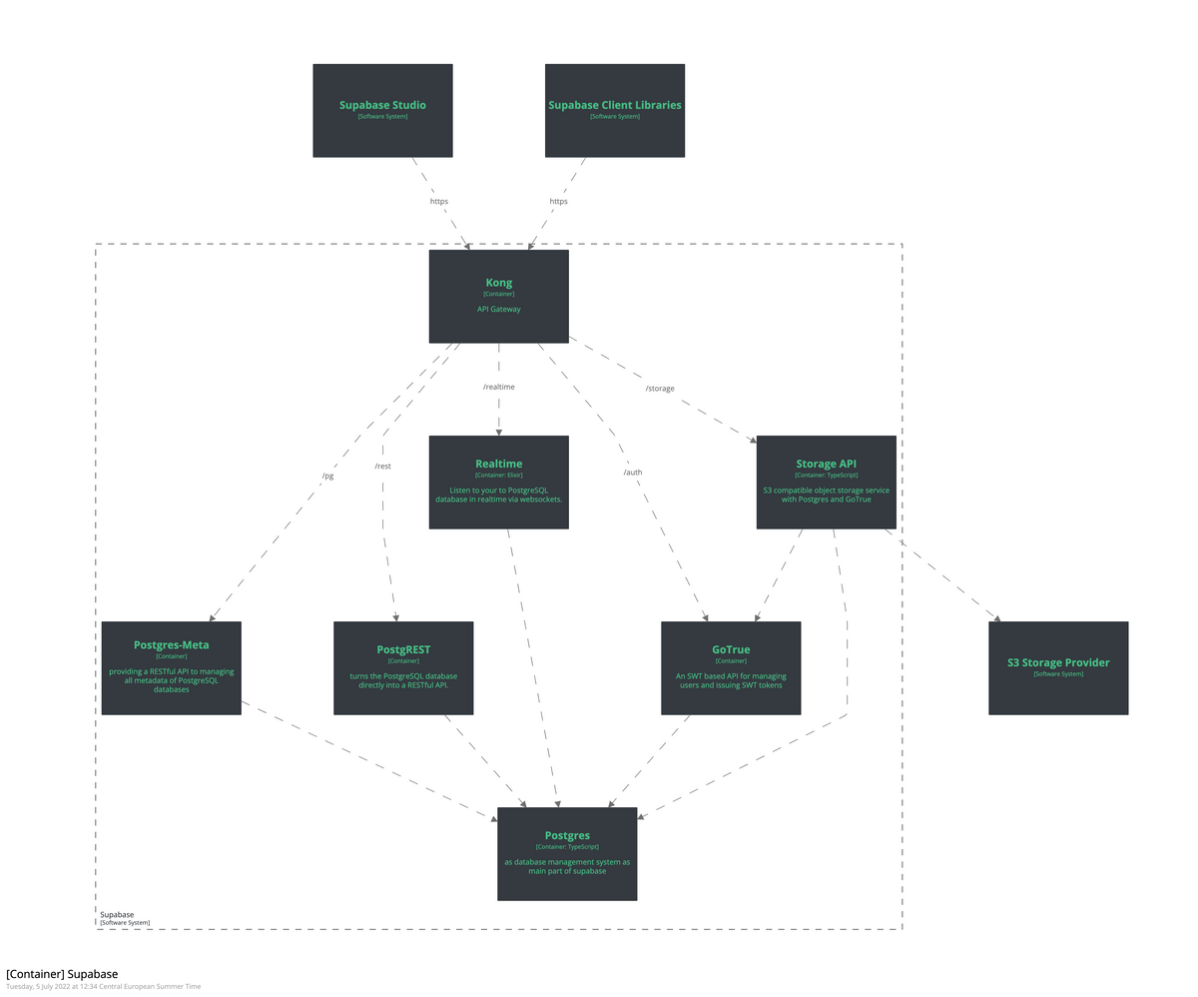
Supabase

Slide 8
Supabase - continue
Supabase is an open-source Backend-as-a-Service (BaaS) built on top of PostgreSQL.
At its core:
Supabase is PostgreSQL
With opinionated, production-ready services layered on top
Supabase gives you:
🗄️ Managed PostgreSQL (you own the schema, SQL, extensions)
🔐 Authentication & Authorization (JWT-based, row-level security aware)
🌐 Auto-generated REST & GraphQL APIs
🪣 File storage (backed by object storage)
⚡ Realtime subscriptions (via Postgres WAL)
🧩 Edge Functions (serverless logic close to users)
📊 Observability & migrations

Slide 9
Supabase – Walk through
Vercel – Walk through
Application – Walk through
Jira stories – Walk through

