Slide 1
Cluster
Cluster
1
2
1
2
1
2
Bridges
3
3
3
Mosquitto
EMQX
RabbitMQ

Slide 2
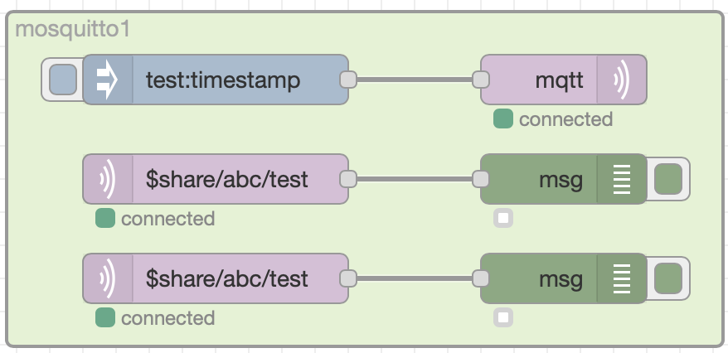
Connection A
Publish
Subscribe
Connection B

Slide 3
Client
Client
MQTT Broker
Client
…
Client
Client
Publish
Subscribe

Slide 4
Client
Client
MQTT Broker
Client
…
Client
Client
Publish
Subscribe

