Slide 1
AMAZON
-Sales Data Analysis-

Slide 2
INTRODUCTION
Amazon is a popular e-commerce platform, where numerous products are being handled, on a worldwide basis.
The Dataset considers ’76 Countries’ and their respective ‘Sub-regions’, highlighting the receipt of order and further shipment process for about ’12’ different products.
The Sales pertaining to the time period of ‘2010 - 2017’ are being considered.
The Analysis mainly highlights the ‘General Overview’ and the ‘Periodic Overview’, upon the Sales transactions handled by the Amazon globally.

Slide 3
ASSUMPTIONS
The monetary aspects within the Dataset (Total Cost, Total Revenue, etc.) are all represented based on the ‘Dollar ($)’ format.
The ‘Order Process Gap (Days)’, i.e., the difference between the ‘Order Date’ & the ‘Shipment Date’, has an impact on the ‘Customer Purchase Behavior’, which would influence the ‘Number of Units Sold’.

Slide 4
METRICS
Total Revenue : Revenue earned over a specific product
Total Cost : Cost incurred for a specific product
Total Profit : Net Profit earned over a specific product
Units Sold : Number of units sold (Product Basis)
Order Process Gap : Number of Days between ‘Order Date’ and ‘Shipment Date’

Slide 5
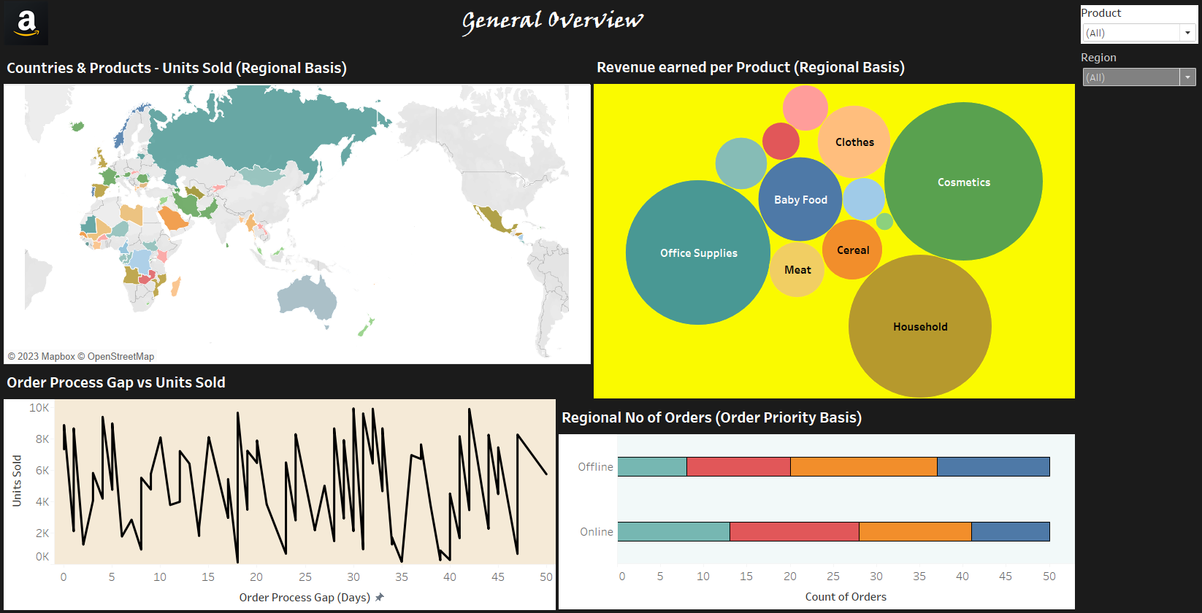
DASHBOARD – GENERAL OVERVIEW

Slide 6
DATA FINDINGS
Amongst variety of Sales having handled across ‘76 countries’ and the respective regions, it is observed that about 15739 units of Fruits in Sao Tome and Principe have marked the highest sales, in terms of ‘Units Sold’, and about 124 units of Vegetables in Kyrgyzstan being the lowest in such aspect. When Online and Offline orders were handled in an equal proportion (50 orders each), the ‘Offline’ orders reflected a maximum number of ‘H’ priority orders (17 orders) and in case of ‘Online’ orders, it is observed that, a maximum number of ‘L’ priority orders (15 orders) have been reflected. On an overall basis, Cosmetics have marked the major contribution with about $ 36,601,510, followed by Office Supplies ($ 30,585,380), Household ($ 29,889,712), and so on., from the ‘Revenue’ point of view. By analyzing the impact of ‘Units Sold’ through the factor ‘Order Process Gap’ (in Days), it is observed that, there is an instability within the ‘Sales’ pattern. The reason would be of the difference in the ‘Purchasing Behavior’ pattern or the ‘Product Preference’. In this aspect, it is evident that, up to 30 Days of Order Process Gap would be an acceptable one, which specifically denotes that, about 9925 units were sold in such a number of days gap, which stands at the highest amongst other cases.

Slide 7
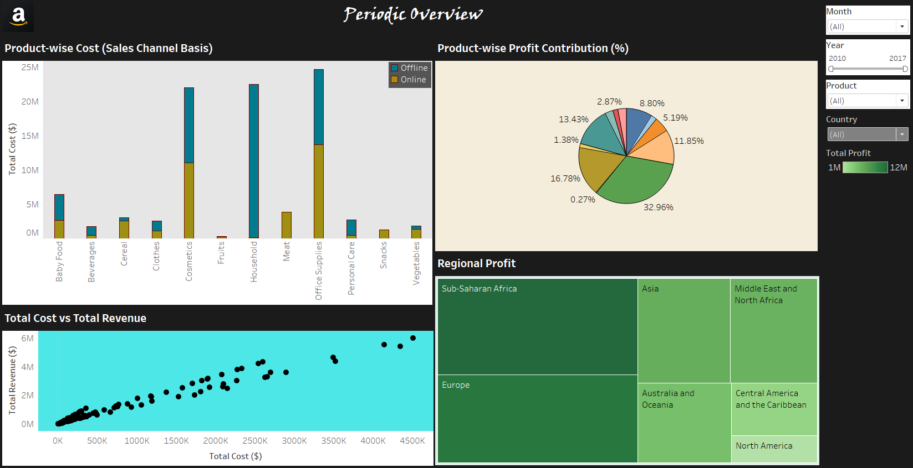
DASHBOARD – PERIODIC OVERVIEW

Slide 8
DATA FINDINGS
Over the time period of overall sales across ‘7 years’ (2010 – 2017), the ‘Key Performing’ monetary aspects showcases a specific pattern of change. On a ‘Product-wise’ point of view, it is evident that, ‘Higher the Cost incurred, Higher the Profit earned.’ For instance, as a whole, the product ‘Office Supplies’ marks the highest Cost incurred ($ 10,918,643 (Offline) and $ 13,737,153 (Online)). The profit earned by the same product stands as one of the top contributions amongst others (13.43%). Similar pattern is being reflected by the products - ‘Cosmetics’ (Cost : $ 10,993,764 (Offline) and $ 11,051,697 (Online); Profit : 32.96%) and ‘Household’ (Cost : $ 22,335,390 (Offline); Profit : 16.78%), which stands as the top-most contributors towards the ‘Profit’ aspect. On the ‘Region-wise’ point of view, Sub-Saharan Africa marks the highest Profit with $ 12,183,211, while, North America marks the lowest Profit with $ 1,457,943. The testimony behind the ‘Success’ factor of the Sales lies within the ‘Positive’ correlation between the Total Cost incurred and the Total Revenue earned. Here, ‘Break-even point’ is not being observed in any of the cases, and that the Total Revenue exceeds the Total Cost, which marks ‘Profit’ in all of the cases.

Slide 9
LINKS
Dashboard : General Overview
https://public.tableau.com/app/profile/binni.thomas/viz/AmazonSalesAnalysis-1_16873610509620/GeneralOverview?publish=yes
Dashboard : Periodic Overview
https://public.tableau.com/app/profile/binni.thomas/viz/AmazonSalesAnalysis-2_16873756875790/PeriodicOverview?publish=yes

Slide 10
THANK YOU
----------------------

