Slide 1

ENTERTAINMENT
-Data Analysis-

Slide 2
INTRODUCTION
Entertainment industry is a stress buster sector, that influences human behavior and also, an unavoidable part of human life.
The Dataset being analyzed considers 70 Entertainers from 4 different Areas of Entertainment.
Major highlights within the Dataset : Name, Gender, Area of Entertainment, Year of Birth, Breakthrough Year, Breakthrough Name, Genre, Rating, Year of First Award, Last Work Year, Year of Death, Lifetime and Success Gap.
The Data information majorly reflects the entertainers from the US region.
The time period being highlighted is the 20th century.

Slide 3
ASSUMPTIONS
The Golden Era of holistic Entertainment sector (Considering all the Areas of Entertainment) is the 20th Century (1900-2000).
The Success factor with respect to the listed Entertainers within the dataset would be the difference between Breakthrough Year and Year of First Award, which is represented as the ‘Success Gap’.
Breakthrough work ratings (from sources including IMDB) are best reliable.

Slide 4
METRICS
Area of Entertainment – The Entertainment Area with respect to the ‘Breakthrough’ of an Entertainer.
Breakthrough Name – Breakthrough work by an Entertainer.
Genre – Sub-categories under a specific ‘Area of Entertainment’.
Rating – Rating of a Breakthrough work.
Success Gap (in Years) – The difference between the ‘Breakthrough Year’ and the ‘Year of First Award’.
Lifetime (in Years) – The Age of an Entertainer.

Slide 5
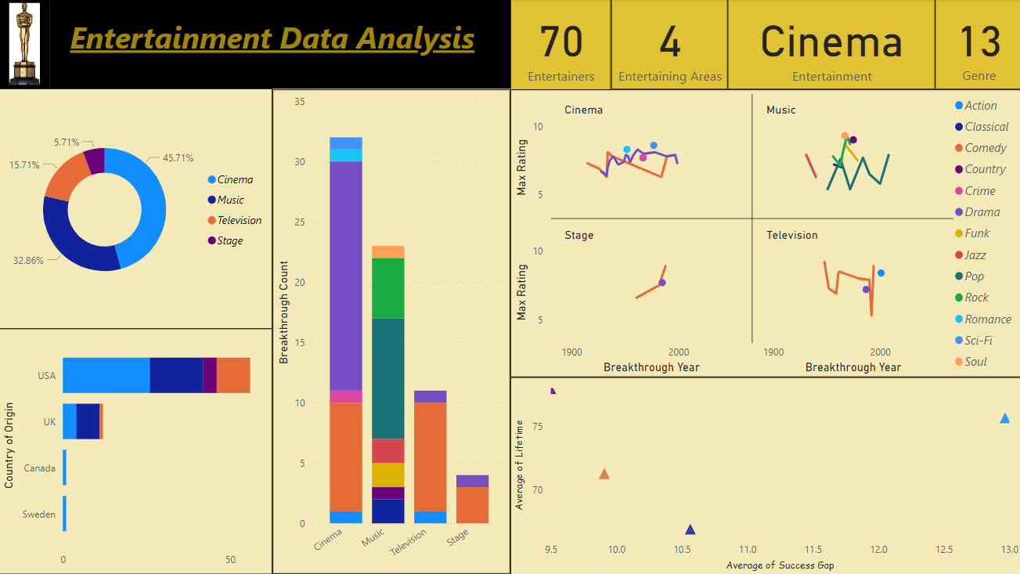
DASHBOARD

Slide 6
DATA FINDINGS
The golden era of world entertainment, i.e., the 20th Century had witnessed an immense rise in the forms of entertainment, and correspondingly, the support of the audience as well. The entertainers who originated from the ‘US’ region were more widespread to excel in various entertainment areas including Cinema, Music, Television and Stage, amongst other entertainers from UK, Canada and Sweden regions respectively. Major breakthroughs are noticed in the field of ‘Cinema’, amongst other prominent entertainment areas. The usual taste of audience relied upon ‘Dramatic’ and ‘Comedy’ movies, which gave rise to consistent breakthroughs. ‘Sci-Fi’, ‘Action’ and ‘Romantic’ movies were popular with high ratings. It was also a time, when ‘Music’ lovers had consistently preferred ‘Pop’ music into their choice of taste. The initial preference towards ‘Jazz’ form of music (prior 1950) had been shifted to the ‘Pop’ music, even after the commencement of the 21st Century. Amongst various genres in this field, ‘Soul’ and ‘Country’ genres were most popular with high ratings. However, ‘Drama’ and ‘Comedy’ genres had shown up an active presence in ‘Stage’ as well as ‘Television’ fields respectively. All throughout the period, audience’ taste relied on ‘Comedy’ consistently. ‘Action’ genre gained popularity amongst the ‘Home Entertainment’ audiences by the commencement of the 21st Century. It is also observed that, ‘Stage’ entertainers stands at the ‘lower’ position in case of ‘Success Gap’ (9.5 Years) and at the ‘higher’ position in case of ‘Lifetime’ (78 Years).

Slide 7
Thank You

