Slide 1
FINANCE
-Data Analysis-

Slide 2

Introduction
For every business, ‘Finance’ is a crucial aspect in determining the ‘Growth Opportunities’.
The Dataset being analyzed considers ‘Top 488’ companies from various Sectors/Industries.
Major highlighting aspects within the Dataset within includes Name, Sector/Industry, Capital Size, Market Capital (in Crores), Quarterly Sales (in Crores), and Price-To-Sales Ratio., with respect to the specific company.
The Analysis pertains to the determination of ‘Good-To-Invest firms’ (Using Price-To-Sales Ratio) and ‘Sector/Industry wise Performance’ (Using Market Capital and Quarterly Sales).

Slide 3
Assumptions
Various aspects being considered within the dataset pertains to the ‘Current Time period’.
Since, the ‘Sales’ of the respective companies are considered on ‘Quarterly basis’, the ‘Price-to-Sales Ratio’ lying nearer to the ideal position (i.e., 2), reflects a scope of growth in the near future.
The ‘Price-To-Sales Ratio’ depends on the respective Industries.

Slide 4
Metrics
Price-To-Sales Ratio : Ratio which indicates the ‘favorability for Investment’
Market Cap - Crore : Measure that indicates the ‘Size’ of a company
Sales Qtr - Crore : Measure that indicates the ‘Quarterly Sales’ of a company

Slide 5
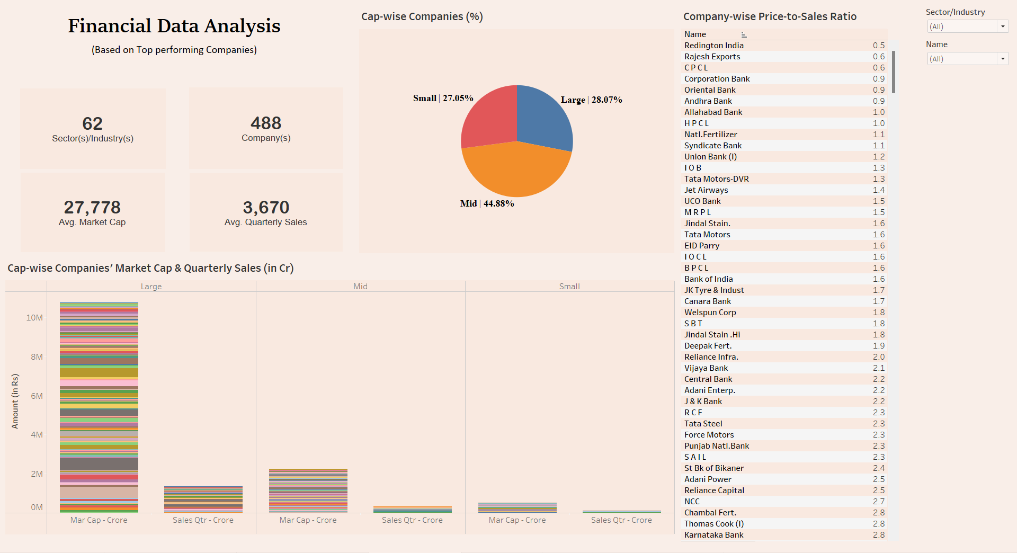
Dashboard

Slide 6
Data Findings
Amongst the listed, top performing ‘488’ companies from various Sectors/Industries being considered, most of the companies reflects the ‘Mid Cap’ category (44.88%), followed by ‘Large Cap’ category (28.07%), and ‘Small Cap’ category (27.05%). While analyzing the ‘Performance’, from the ‘Market Capital’ point of view, ‘Reliance Industries’ (Private Sector) stands at the top, in the ‘Large Cap’ aspect (5,83,436.72 Cr), followed by ‘RBL Bank’ (Banking Sector) in the ‘Mid Cap’ aspect (19,748.79 Cr), and ‘Jagran Prakashan’ (Media & Entertainment Sector) in the ‘Small Cap’ aspect (4,995.05 Cr). From the ‘Quarterly Sales’ point of view, it is observed that, ‘IOCL’ (Large Cap/Public Sector) stands at the top (reflecting a sales of 1,10,666.93 Cr), while ‘SPARC’ (Mid Cap/Pharmaceuticals Sector) stands at the bottom (reflecting a sales of 19.42 Cr).

Slide 7
Data Findings (Continued)
While analyzing the ‘Scope of Investment’, it is observed that, majority of the companies from the ‘Banking Sector’ (15 companies), followed by the companies from the ‘Public Sector’ (8 companies), the companies from the ‘Metals Sector’ (3 companies), and so on., shows a favorable sign in attracting the ‘Investors’ (Price-To-Sales Ratio lying at an ideal position (between 0 & 2)). On such a basis, at a point when ‘Yearly Sales’ is considered, companies mainly from the Private, Travel, Banking, Financial Services, Logistics, Construction, Plastics, and so on., within all of the ‘Capital Size’ aspects, but majorly from the ‘Mid Cap’ and ‘Small Cap’ categories, reflects a ‘Scope of Growth’ through ‘Investment Opportunities’ in the near future (Price-To-Sales Ratio lying at a position (between 2 & 3)).

Slide 8
Links
Dashboard Link
https://public.tableau.com/app/profile/binni.thomas/viz/FinancialAnalysis_16893620038920/AnalysisDashboard?publish=yes
Python Notebook Link
https://colab.research.google.com/drive/1ea9rizoKdxOz6IXmLvvPtHV_j7T7cQzh

Slide 9
THANK YOU

