Slide 1
Popular Gaming Consoles
-Data Analysis-

Slide 2
Introduction
Gaming is a popular form of entertainment prevailing in this busy world.
The Dataset being analyzed mainly highlights the ‘Sales’ (Considered on ‘Million’ basis) been generated by various gaming consoles produced by different popular companies. (Source : Kaggle)
The Dataset also highlights the ‘Released Year’ and the ‘Discontinued Year’ for each consoles, which states whether the specific gaming console is ‘active or not’.
Through such an analysis, the popularity of the gaming consoles being reflected through the ‘sales’ made upon the ‘no. of years active’ is aimed to be showcased.

Slide 3
Metrics
Units Sold (in Millions) - Overall sales generated by a specific gaming console
No. of Years Active – No. of years at which a specific gaming console is/was active in the market (Difference between ‘Discontinued Year’ and ‘Released Year’)

Slide 4
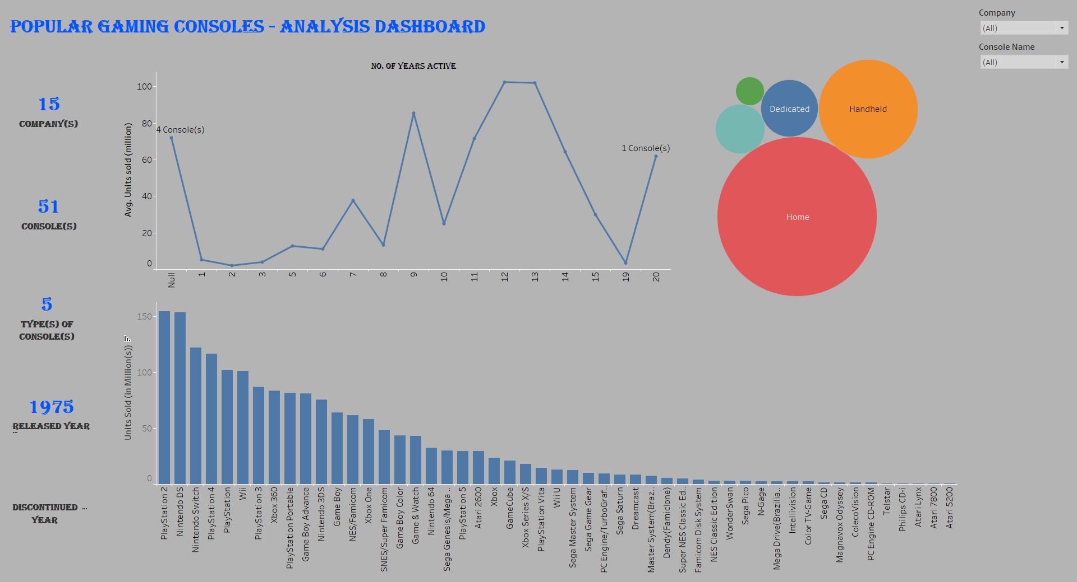
Dashboard

Slide 5
Data Findings
Through an analysis based on 15 popular companies, 51 consoles, and 5 types of consoles, it is observed that, most of the consoles from the company ‘Nintendo’ (17 consoles), followed by the companies including ‘Sega’, ‘Sony’ (7 consoles each), ‘Microsoft’, ‘Atari’ (4 consoles each), and on., have been considered. Amongst the types of consoles, ‘Home’ (31 consoles), followed by ‘Handheld’ (12 consoles), ‘Dedicated’ (4 consoles), ‘Home console add-on’ (3 consoles), and ‘Hybrid (1 console) are considered. From the ‘Sales’ point of view, ‘PlayStation 2’ (‘Home’ console from ‘Sony’; active for 13 years), stands at the top, generating a sales of around 155.0 million, followed by ‘Nintendo DS’ (‘Handheld’ console from ‘Nintendo’; active for 9 years), generating a sales of around 154.0 million, ‘Nintendo Switch’ (‘Hybrid’ console from ‘Nintendo’; still active), generating a sales of around 122.6 million, and so on. While 4 consoles are still active in the market, on an average, around 72.1 million worth sales have been generated by such consoles, whereas, on an overall point of view, 1 console (active for 12 Years) stands at the top, having generated a sales of around 102.5 million, followed by 2 consoles (active for 13 Years), having generated a sales of around 102.1 million, all being considered on an average basis.

Slide 6
Links
Dashboard Link:
https://public.tableau.com/app/profile/binni.thomas/viz/PopularGamingConsoles-Analysis/DashboardAnalysis?publish=yes+
Python Notebook Link:
https://colab.research.google.com/drive/1qD52xbsIfVvSwxTlaUGb7yjToOZ9f4XL

Slide 7
THANK YOU

