Slide 1

Google Play Store
-Data Analysis-

Slide 2

Introduction
Google Play Store is a renowned platform, where, most of the popular apps are made available to the users, either for free or for payment.
The dataset being analyzed considers an overall view with respective to about 8276 apps, representing 48 unique genres and 33 different categories.
The major highlights within the dataset, with respect to a specific app, includes the name, category, genre, type, price, content rating, rating, reviews, installs, size, minimum android version, current version, and last updated (date).
The analysis mainly depicts an overall performance of the apps, majorly on ‘category’ and ‘genre’ basis, by considering the important metrics including the rating, no. of installs, etc.

Slide 3
Metrics
Price : Price charged in order to download a specific app (Subject to the type – Free/Paid)
Installs : No. of install with respect to a specific app
Rating : Rating given to a specific app (Considered on an average basis, out of 5)
Size : A specific app size (Considered on an average basis, in ‘MB’)

Slide 4
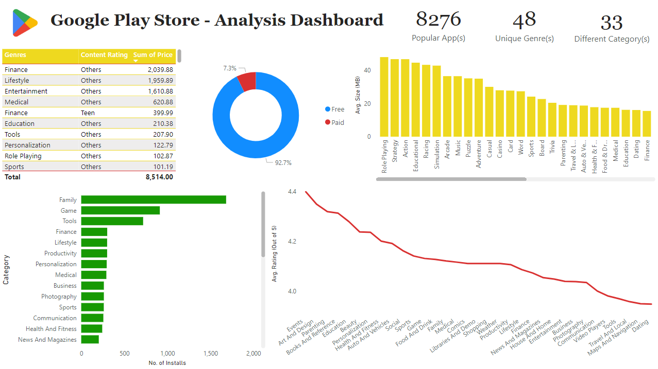
Dashboard

Slide 5
Data Findings
The analysis mainly pertains to the ‘Category’ and ‘Genre’ for about 8276 popular apps. In such an aspect, the performance of the apps are being highlighted based on the important metrics in a generalized way. From the ‘price’ point of view, which is subject to whether the app is charged or not charged for downloading, about 92.7% of apps are ‘free of charge’, while the rest 7.3% of apps are ‘charged’. On an aggregate basis, ‘Finance’ genre apps do stand at the top, reflecting a price charge of about 2,039.88/-. From the ‘installs’ point of view, ‘Family’ category stands at the top, reflecting about 1683 installs, followed by ‘Game’ category, reflecting about 913 installs, extending until ‘Beauty’ category, reflecting about 42 installs. From the ‘rating’ point of view, with respect to the ‘genres’, ‘Events’ apps are observed to showcase the highest popularity amongst the users with an average rating of 4.40/5, while, ‘Dating’ apps are observed to be at a contrary stage, with an average rating of 3.95/5. From the ‘size’ point of view, on an average basis, the ‘Role playing’ category apps are observed to consume maximum amount of data of about 47.90 MB at the course of installation, while, the ‘Tools’ category apps are observed to consume a minimum amount of data of about 7.36 MB at the course of installation.

Slide 6
Link
Python Notebook (EDA) :
https://colab.research.google.com/drive/1td-x_Qr85xWfNvMnNknCx25SXld2_BbQ

Slide 7
Thank You

