Slide 1
HR Absenteeism
-Data Analysis-

Slide 2
Introduction
‘Absence’ is an important aspect to be observed in the field of Human Resources (HR), that helps in an effective planning process in arranging the employees, in order to ensure a timely task accomplishment.
The dataset being analyzed considers 8336 employees from various departments, handling different job positions.
The analysis mainly highlights the range of ‘absence’ being observed amongst the employees from various departments, considering the important metrics and perspectives.

Slide 3
Assumptions
Various aspects being depicted within the dataset relates to the ‘Current time period’.
The employees being considered within the dataset may or may not be subject to ‘attrition’ or ‘retirement’.
The reason for ‘absence’ is not a considerable factor in this aspect.

Slide 4
Metrics
Count of Employee Number : The no. of employees being considered
Age : The age of a specific employee
Length Service : Total no. of years served by a specific employee
Active Hour : No. of active hours observed for a specific employee at the course of worktime
Absent Hour : No. of absent hours observed for a specific employee at the course of worktime

Slide 5
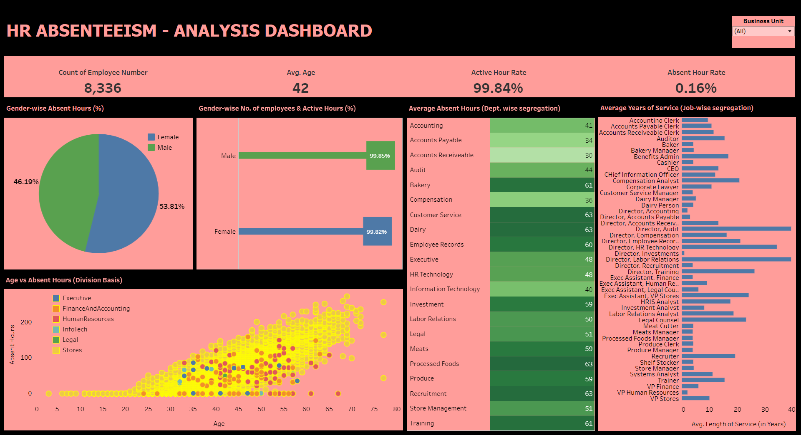
Dashboard

Slide 6
Data Findings
The analysis which pertains to the range of ‘absence’ based on 8336 employees is being conducted based on the major ‘Business Units’ – Head Office & Stores. In this aspect, most of the employees are from ‘Stores’ (8163 employees) than ‘Head Office’ (173 employees). Generally, ‘Female’ employees are observed to show more absence (53.81%) than ‘Male’ employees (46.19%). From the ‘Activeness’ point of view, ‘Male’ employees shows 99.85% rate, while the ‘Female’ employees shows 99.82% rate, which is of not much difference. When observing from the ‘Head Office’ point of view, ‘absence’ rate is seen to be higher amongst the ‘female’ employees (58.74%), than the ‘male’ employees (41.26%). ‘Activeness’ is observed at a consistent rate amongst the employees (‘female’ employees - 99.96% & ‘male’ employees – 99.97%). From the ‘Dept. wise’ point of view, on an average, ‘absent hours’ is observed to be more in the ‘Recruitment’ dept. (63 Hours), followed by ‘Training’ dept. (61 Hours), ‘Employee Records’ dept. (60 Hours), and so on. In such an aspect, ‘Directors from Audit & Labor Relations’ are observed to have more ‘years of service’ in the respective fields (39 years each) amongst others, on an average.

Slide 7
Data Findings (Continued)
When observing from the ‘Stores’ point of view, ‘absence’ rate is seen to be higher amongst the ‘female’ employees (53.73%), than the ‘male’ employees (46.27%). ‘Activeness’ is observed at a consistent rate amongst the employees (‘female’ employees - 99.81% & ‘male’ employees – 99.84%). From the ‘Dept. wise’ point of view, on an average, ‘absent hours’ is observed to be more in the ‘Customer Service’ dept., ‘Dairy’ dept., and ‘Processed Foods’ dept. (63 Hours each). In such an aspect, ‘Dairy Managers’ are observed to have more ‘years of service’ in the respective field (5 years) amongst others, on an average. When analyzing the impact on ‘Age’ over the ‘Absent Hours’, from the ‘Head Office’ point of view, as the employees’ ‘age’ increases, the ‘absent hours’ shows an inconsistent pattern, i.e., increase/decrease is shown at a nearer stage. ‘Instability within the work load or work pressure’ must be the prevailing cause in this aspect. From the ‘Stores’ point of view, as the employees’ ‘age’ increases, the ‘absent hours’ shows a consistent pattern, i.e., ‘absent hours’ also increases. ‘Comparatively ‘lesser’ work load or work pressure’ must be the prevailing cause in this aspect.

Slide 8
Links
Dashboard Link:
https://public.tableau.com/app/profile/binni.thomas/viz/HRAbsenteeismAnalysis/HRAbsenteeism-AnalysisDashboard?publish=yes
Python Notebook (EDA) Link:
https://colab.research.google.com/drive/1FrngNnB5nXToiguYuoUTXtlm-TlCdUtX

Slide 9
Thank You

