Slide 1
HR Attrition
-Data Analysis-

Slide 2
Introduction
‘Attrition’ is an important term being considered in the field of ‘Human Resources’.
The dataset being analyzed considers about 1,470 employees from 3 different departments, representing from about 9 different job roles.
The analysis mainly highlights the range of ‘Job Satisfaction’ and ‘Attrition’, based on the important metrics.

Slide 3
Metrics
Employee Count : Total No. of employees being considered
Active Employees : No. of employees who still handle the respective job role
Attrition Count : No. of employees who had left the respective job role
Attrition Rate : Percentage of employees who had left the respective job role
Average Age : The average age amongst all of the employees’ ages
Job Satisfaction Rating : The rating given by a respective employee for the respective job role

Slide 4
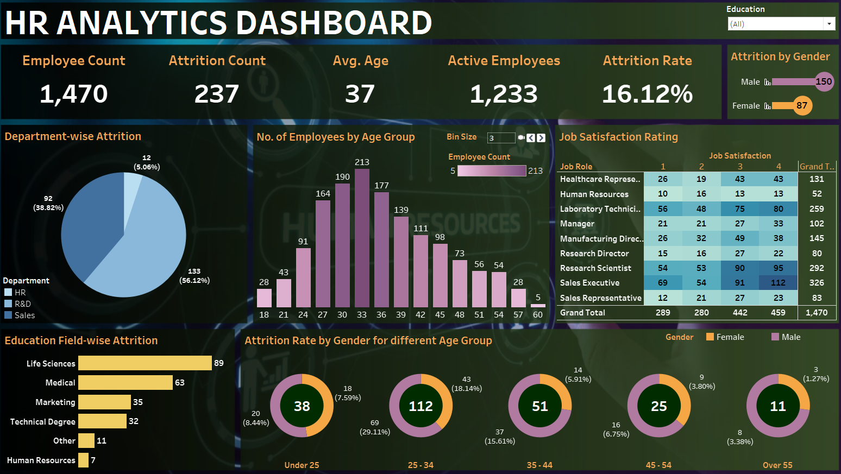
Dashboard

Slide 5
Data Findings
Through an analysis based on 1,470 employees, it is observed that, about 16.12% of employees (237 in number) have left the respective job roles. About 1,233 employees are seen to be active in this aspect. Amongst those employees who are subject to attrition, ‘Male’ employees are observed to be at the higher position (150 employees) than the ‘Female’ employees (87 employees). In this aspect, it is observed that, more of the ‘Male’ employees between the age gap of 25-34 years (69 employees), than the ‘Female’ employees of the similar age category (43 employees), are subject to attrition. From the ‘education’ point-of-view, ‘Life Sciences’ category have witnessed more attrition (89 employees), followed by ‘Medical’ (63 employees), ‘Marketing’ (35 employees), and so on. Based on the respective ‘departments’, attrition is seen to be higher amongst the ‘R&D’ employees (133 employees), than the ‘Sales’ employees (92 employees) and the ‘HR’ employees (12 employees). From the ‘Job Satisfaction’ point-of-view, on a major range, it is observed that, the ‘Sales Executives’ are more satisfied (Rating at 4, given by 112 employees), as well as, least satisfied (Rating at 1, given by 69 employees), amongst other employees handling other job roles.

Slide 6
Link
Dashboard Link:
https://public.tableau.com/app/profile/binni.thomas/viz/HR_Analysis_16922695041260/HRAnalyticsDashboard?publish=yes

Slide 7
Thank You

