Slide 1
HONDA
- Data Analysis -

Slide 2

INTRODUCTION
HONDA is a popular automobile brand, prevailing on a global basis.
The dataset being analyzed considers 27 unique models, based on various kinds of Engines, Drivetrains & Transmission types, reflecting different levels of Mileage performances. (Source - Kaggle)
The model of cars being considered in this aspect are sold via the ‘Dealers’.
The timeline being considered are for the years 2022 & 2023.
The analysis mainly highlights the overall performance of each car models being considered, reflected based on the important metrics including Price, Mileage, Consumer Rating, and so on.

Slide 3
METRICS
Price : The price of a specific car model (Considered in ‘$’ format)
Mileage : The range of Mileage reflected by a specific car model
No. of Consumer Reviews : Total No. of consumer reviews received for a specific car model
Consumer Rating : Overall consumer rating achieved by a specific car model (Considered Out of 5)
Comfort Rating : Ratings achieved based on the comfort by a specific car model (Considered Out of 5)
Performance Rating : Ratings achieved based on the performance by a specific car model (Considered Out of 5)

Slide 4
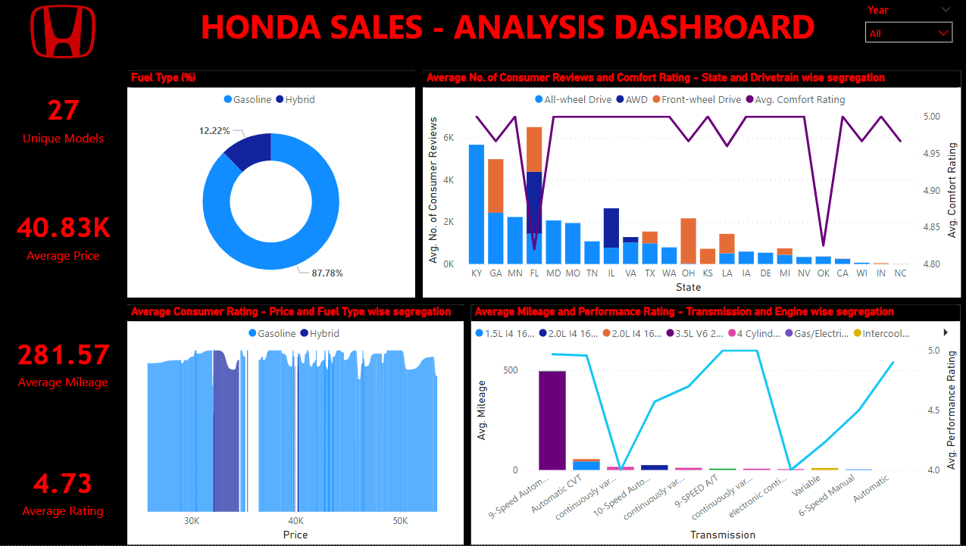
DASHBOARD

Slide 5
DATA FINDINGS
The analysis depicts on the ‘sales’ and ‘performance’ with respect to 27 unique car models. When observing the important metrics and their reflections based on the year 2022, it is observed that, majority of the cars are powered based on the ‘Gasoline’ fuel (91.14%) than the ‘Hybrid’ fuel (8.86%). The ‘Gasoline’ fuel based cars are highly rated, where the ‘Price’ ranges between 25k – 31k, 36k – 44k and 46k – 53k (Rating at 5), while the ratings faces a downward flow, at the ‘Price’ range of 31k and 45k (Rating below 5, but greater than 4). From the view point of ‘Hybrid’ fuel based cars, high ratings are seen at the ‘Price’ range of 32k (Rating at 5), while ratings face a downward flow, at the ‘Price’ range of 34k (Rating between 4 & 5). Maximum ‘Consumer reviews’ have been received from the consumers from the state ‘KY’, based on the Drivetrain ‘All wheel Drive’. Majority of the ‘Drivetrain’ based cars are seen to be used amongst the consumers from the state ‘FL’, where maximum reviews are based on the Drivetrain ‘AWD’ amongst others. While majority of the ‘Comfort Rating’ lies at the range of 5, the least ratings have been observed amongst the states ‘FL’ and ‘OK’ (4.8 and 4.9 respectively). Mileage wise performance (on an average basis) is seen to be high for those cars based on the ‘9-speed auto’ Transmission model (495.16), where the ‘Engine’ model is ‘3.5L V6 24V GDI SOHC’, followed by ‘Automatic CVT’ Transmission model based cars (43.14), where the ‘Engine’ model is ‘1.5L 1416V GDI DOHC Turbo’. The least ‘performance rating’ have been seen with the ‘Transmission’ models ‘Variable’ (4.7), ‘Continuously variable’ (4.7), and ‘6-Speed Manual’ (4.5). Here, the ‘Automatic’ Transmission based model cars have least mileage, while the ‘Performance’ rating is at 5. The quality or comfort in using such cars, i.e., factors other than ‘Mileage’, must be the reason for such an observation.

Slide 6
DATA FINDINGS - Continued
When observing the important metrics and their reflections based on the year 2023, it is observed that, majority of the cars are powered based on the ‘Gasoline’ fuel (63.64%) than the ‘Hybrid’ fuel (36.36%). The ‘Gasoline’ fuel based cars are highly rated, where the ‘Price’ ranges is across and beyond 36k (Rating at 5), while the ratings faces a downward flow, at the ‘Price’ range of 43k, 46k and 50k (Rating below 5, but greater than 4). From the view point of ‘Hybrid’ fuel based cars, high ratings are seen at the ‘Price’ range of 39k (Rating at 5), while ratings face a downward flow, at the ‘Price’ range of 40k (Rating between 4 & 5). Maximum ‘Consumer reviews’ have been received from the consumers from the states ‘GA’ and ‘DE’, based on the Drivetrain ‘All wheel Drive’. While majority of the ‘Comfort Rating’ lies at the range of 5, the least rating has been observed based on the state ‘OK’ (4.75). Mileage wise performance (on an average basis) is seen to be high for those cars based on the ‘Continuously Variable (m cvt)’ Transmission model (16.00), where the ‘Engine’ model is ‘4 Cylinder engine’, followed by ‘Continuously Variable Automatic’ Transmission model based cars (7.00), where the ‘Engine’ model is again ‘4 Cylinder engine’. The least ‘performance rating’ have been seen with the ‘Transmission’ models ‘Continuously Variable (m cvt)’, ‘Electronic Continuously Variable’, ‘10-Speed Automatic’ and ‘Variable’ (All at the Rating of 4). Here, the ‘Automatic’ and ‘Variable’ Transmission based model cars have least mileage, while the ‘Performance’ rating based on the ‘Automatic’ Transmission model is at 4.8. The quality or comfort in using such cars, i.e., factors other than ‘Mileage’, must be the reason for such an observation.

Slide 7
LINK
Python Notebook (EDA):
https://colab.research.google.com/drive/1ozRWEADeGLdr8BbXTSs50jOugxBbB51z

Slide 8
THANK YOU

