Slide 1
Instagram
-Popularity Data Analysis-

Slide 2
Introduction
Instagram is a popular social media platform, which has shown presence on a global basis.
The Dataset being analyzed here considered ‘198’ popular accounts handled on the basis of various categories. (Source : Kaggle)
The major highlights within the Dataset includes – Rank; Name; Channel Info; Category; Posts; Followers; Avg. Likes; Eng. Rate.
The Analysis being conducted reflects the ‘Popularity’ with respect to the listed ‘Accounts’, from various perspectives. (As on the year 2022)

Slide 3
Metrics
Followers – No. of Followers for a specific account
Posts – No of ‘Posts’ having posted by a specific account
Avg. Likes – Average No. of ‘Likes’ gained through the ‘posts’ by a specific account
Eng. Rate (%) – Rate of ‘Preference’ of users over the specific account ‘content’

Slide 4
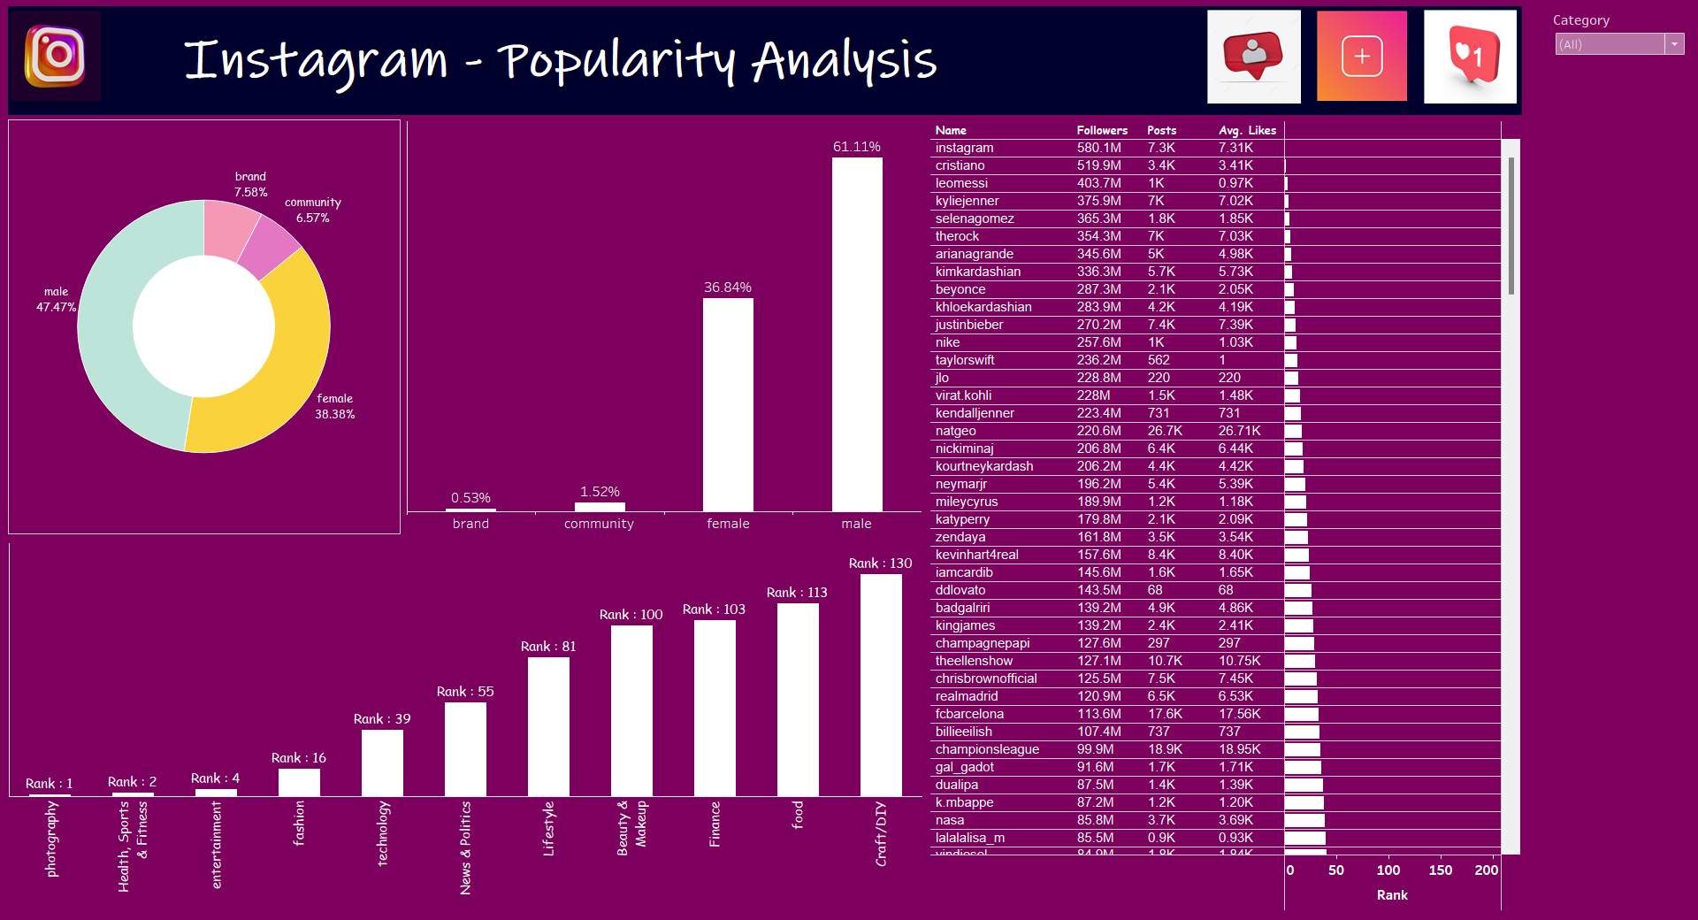
Dashboard

Slide 5
Data Findings
The analysis mainly emphasizes the ‘Popularity’ based on the ‘Categorical’ point-of-view. Based on the ‘No. of followers’, ‘Photography’ stands at the top ranking position, followed by ‘Health, sports & fitness’, ‘Entertainment’, and so on. When emphasizing on to the ‘Channel Info’, it is observed that, most of the accounts been listed are handled by individual ‘Male’ celebrities (47.47% - 94 accounts), followed by individual ‘Female’ celebrities (38.38% - 76 accounts), ‘Brands’ (7.58% - 15 accounts), and ‘Communities’ (6.57% - 13 accounts). From the specific ‘account’ point-of-view, it is observed that, ‘Instagram’ (Photography) stands at the top position, while ‘5.min.crafts’ (Craft/DIY) on an opposite note, based on ‘No. of followers’. The major related metrics (Posts & Avg. Likes) showcases a ‘Positive’ mode of correlation. When emphasizing on to the ‘Engagement Rate’, based on the unique and interesting ‘content’ introduced by the respective ‘accounts’, it is observed that, individual ‘Male’ celebrities’ based accounts are at the top position (61.11%), followed by individual ‘female’ celebrities’ based accounts (36.84%), ‘Community’ based accounts (1.52%), and ‘Brand’ based accounts (0.53%), on a general perspective.

Slide 6
Link
Dashboard link
https://public.tableau.com/app/profile/binni.thomas/viz/Instagram-PopularityAnalysis/Instagram-PopularityAnalysis?publish=yes

Slide 7
Thank You

