Slide 1

Machine Learning Hands-on
KhanhPhamDinh, Neurond, Ha Noi
my book: Machine Learning Algorithms to Practices
https://phamdinhkhanh.github.io/deepai-book/intro.html

Slide 2
Principal Component Analysis

Slide 3
Content
PCA application
SVD algorithm
PCA steps

Slide 4
PCA application

Slide 5
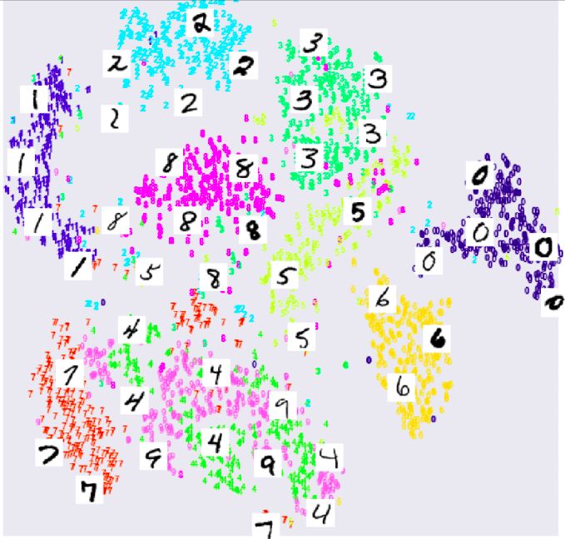
PCA applications
Data Visualization: Input data is n-dimension can be reduced into 2D or 3D to be visualized.
Save time computational cost
Statistical: fewer dimensions → better generalization
Noise removal (improving data quality)
Further processing by machine learning algorithms.

Slide 6
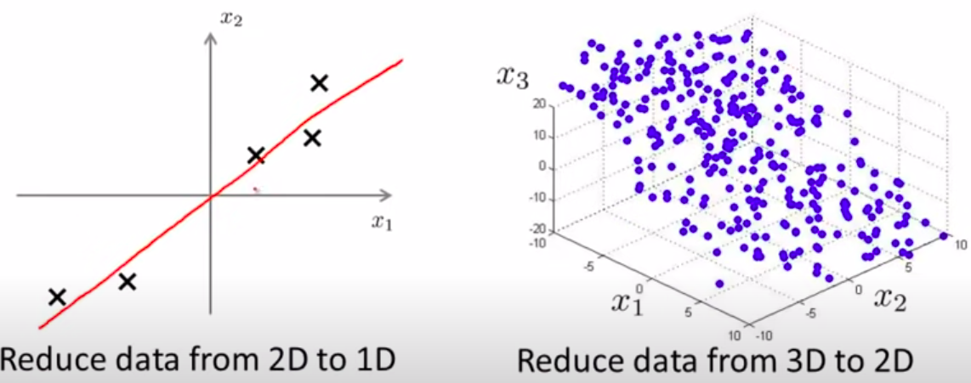
PCA target
Reduce data from high dimensionality to low dimensionality but keep the variance structure

Slide 7
2. SVD algorithm

Slide 8


SVD - orthogonal and orthonormal
is orthogonal if:
is orthonormal matrix:
⇒
Rotation in orthonormal matrix is reserve inner product:

Slide 9
SVD - eigenvalue and eigenvector
,
x is eigenvector and is eigenvalue
Some characteristic:
x is eigenvector corresponds with then kx also eigenvector of
If A is positive semi definite if uAu >= 0. So eigenvalue is a non-negative value.

Slide 10
SVD - Eigen Decomposition
Eigen decomposition is a matrix factorization of a square matrix
P is square matrix and D is a diagonal matrix
Each column of matrix P is an eigenvector which has eigenvalues is element in diagonal matrix:

Slide 11
SVD - Singular Value Decomposition
Singular value Decomposition of matrix A is:
A is input matrix:
mxn matrix (m documents, n terms)
U is left singular matrix
mxr matrix (m documents, r topics)
Sigma is singular value matrix
rxr diagonal matrix (strength of each topic)
r is rank of matrix A
V is right singular vector
nxr matrix (n terms, r topics)

Slide 12
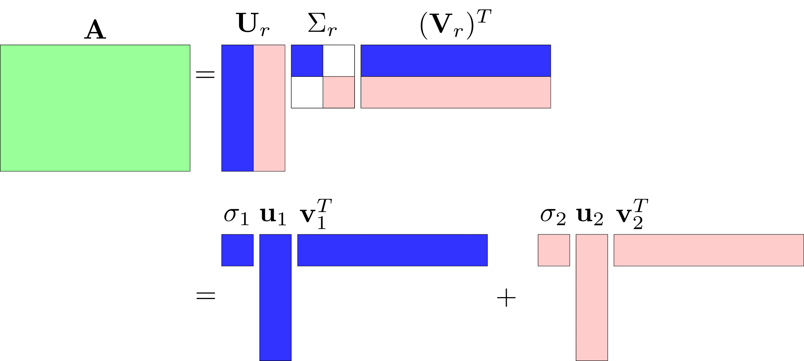
SVD - Singular Value Decomposition
Singular value Decomposition of matrix A is:

Slide 13
SVD - Singular Value Decomposition
Matrix A can write as:
So if we select k highest value of diagonal matrix we get a approximation of matrix A
m
n

Slide 14
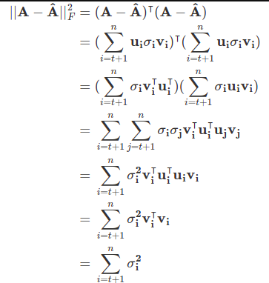
SVD - Singular Value Decomposition
The difference of matrix A and its approximation :

Slide 15


SVD - Singular Value Decomposition
Frobenious norm of matrix A
The percentage of information loss:

Slide 16
3. PCA steps

Slide 17
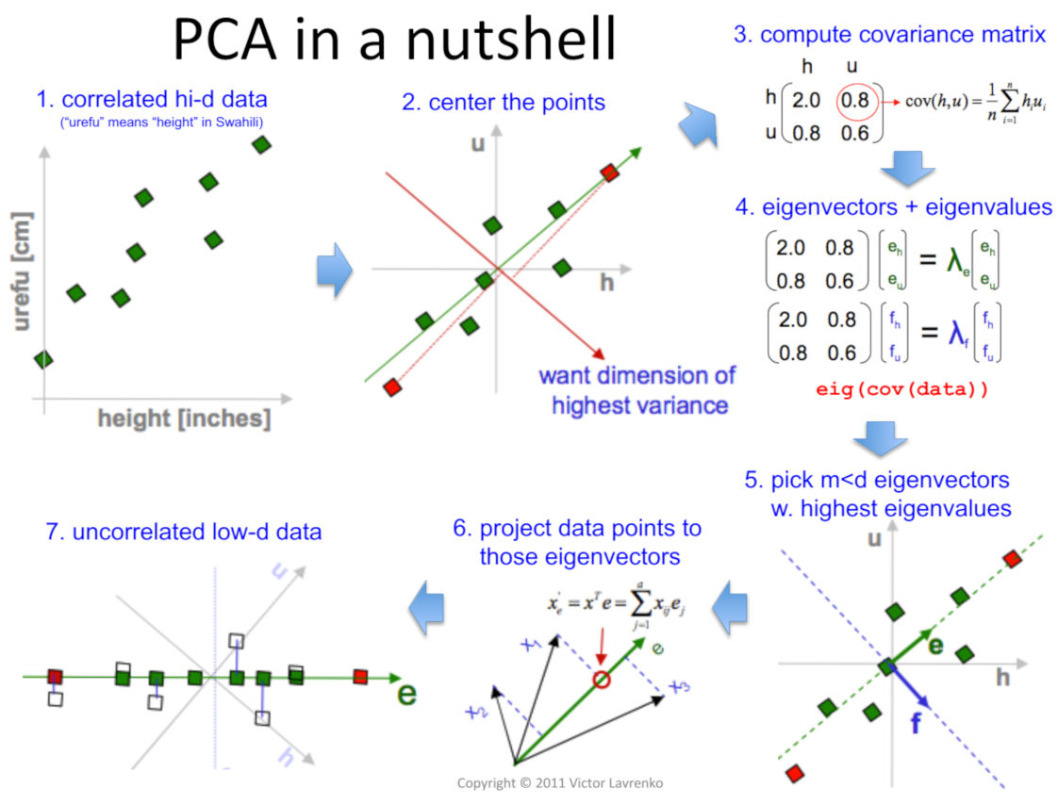
PCA algorithm

Slide 18



PCA - Data Processing
Step 1: Data preprocessing
Training dataset:
Preprocessing (feature scaling/mean normalization):
If features are different in the scale (for example the x1 = the size of house, x2 = number of room), we need to scale data:

Slide 19
PCA - Compute Covariance Matrix
Step 2: Compute Covariance Matrix (shape dxd)

Slide 20
PCA - Compute Eigenvector
Step 3: Compute eigenvector of the covariance matrix by SVD algorithm
Set A is the Covariance Matrix
Singular Decomposition Value
Python code
import scipy.linalg as ln
U, S_diag, V = ln.svd(Sigma)

Slide 21
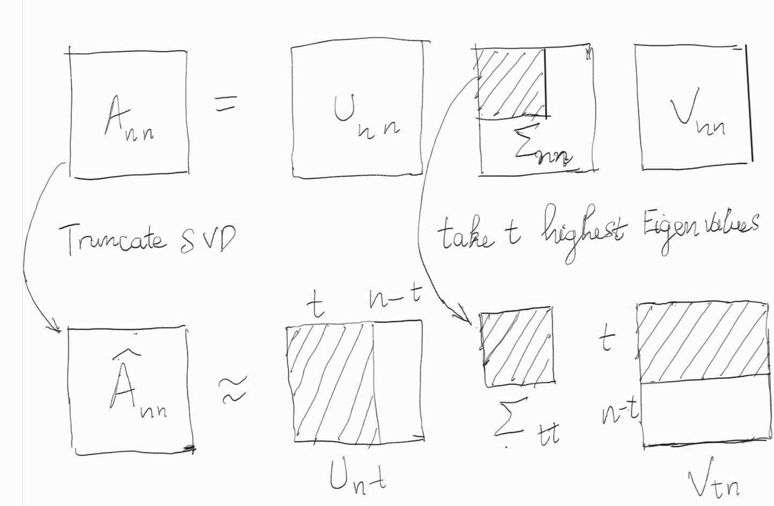
PCA - Compute Eigenvector
Step 4: Select t highest eigenvalues

Slide 22
PCA - Compute Eigenvector
Step 5: Project into these eigenvector
The value of a new point is calculated by

Slide 23
References
https://stanford.edu/~shervine/teaching/cs-229/cheatsheet-unsupervised-learning
https://cs229.stanford.edu/notes2021fall/cs229-notes10.pdf
https://www.cs.cmu.edu/~mgormley/courses/10701-f16/slides/lecture14-pca.pdf
https://youtu.be/FgakZw6K1QQ

