Slide 1

Machine Learning Hands-on
my book: Machine Learning Algorithms to Practices
https://phamdinhkhanh.github.io/deepai-book/intro.html
Ha Noi, 27/03/2022
Kan Pham

Slide 2
Naive Bayes

Slide 3
Content
Maximum Likelihood Estimation
Maximum a Posteriori
Naive Bayes model
Gaussian Naive Bayes
Multinomial Bayes

Slide 4
Maximum Likelihood Estimation

Slide 5
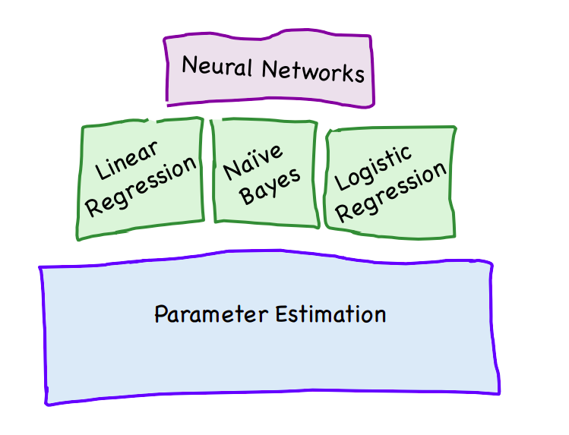
Parameter Estimation
Parameter estimation is the process of computing a model's parameter values from measured data.

Slide 6



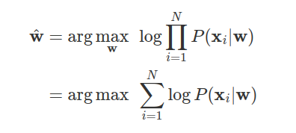
Maximum Likelihood Estimation
It is finding a set of parameters that is the best fit with a dataset. That means returning the highest probability of likelihood function over the dataset.
Dataset: has probability distribution with hyper parameters
Likelihood function:
Estimate Parameters:

Slide 7
2. Maximum a Posteriori

Slide 8
Limitation of MLE
We can not give the prior experience about the parameter distribution (P(w)) into the dataset
⇒ Maximum a Posteriori can solve this issue while take into account P(w)

Slide 9
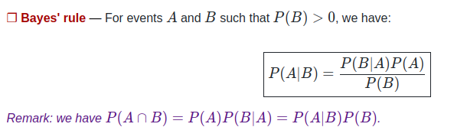
Bayes’ rule

Slide 10
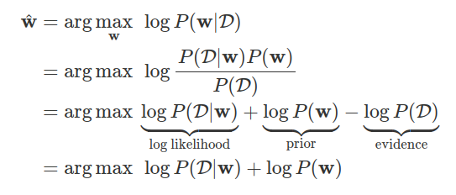
Maximum a Posteriori
The set of parameters also best fit with the model but it is based on maximizing the a posteriori function over the dataset.

Slide 11
3. Naive Bayes Model

Slide 12
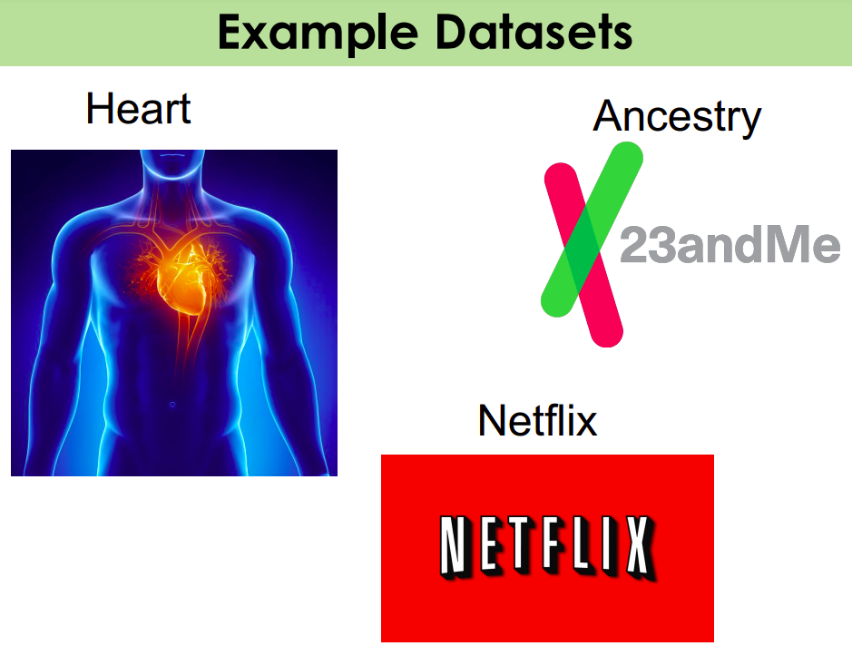
Naive Bayes model applications

Slide 13
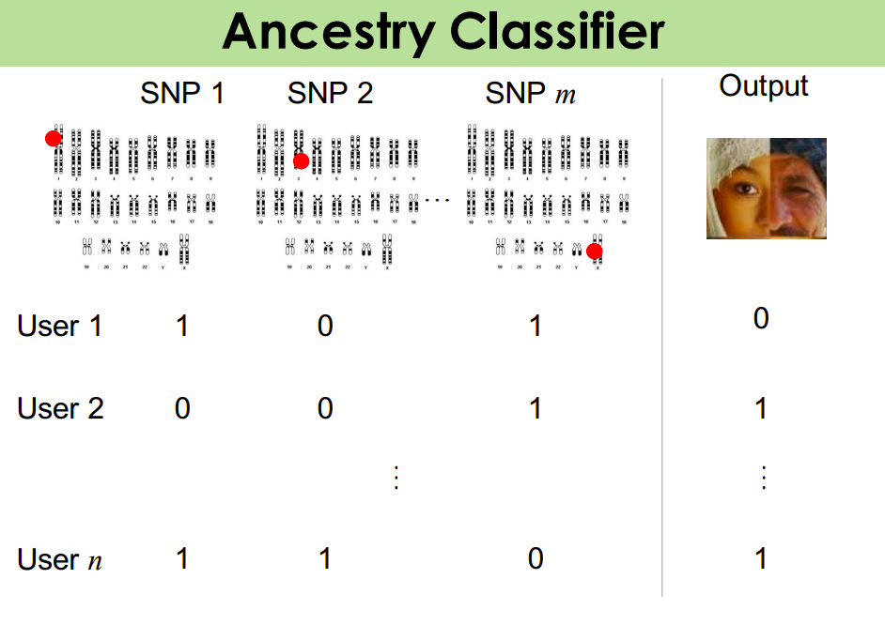
Naive Bayes model applications

Slide 14
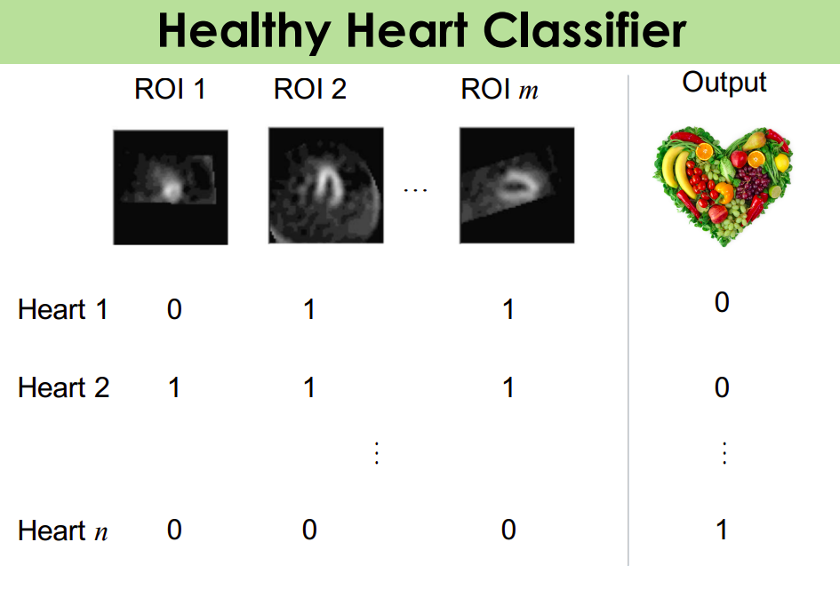
Naive Bayes model applications

Slide 15
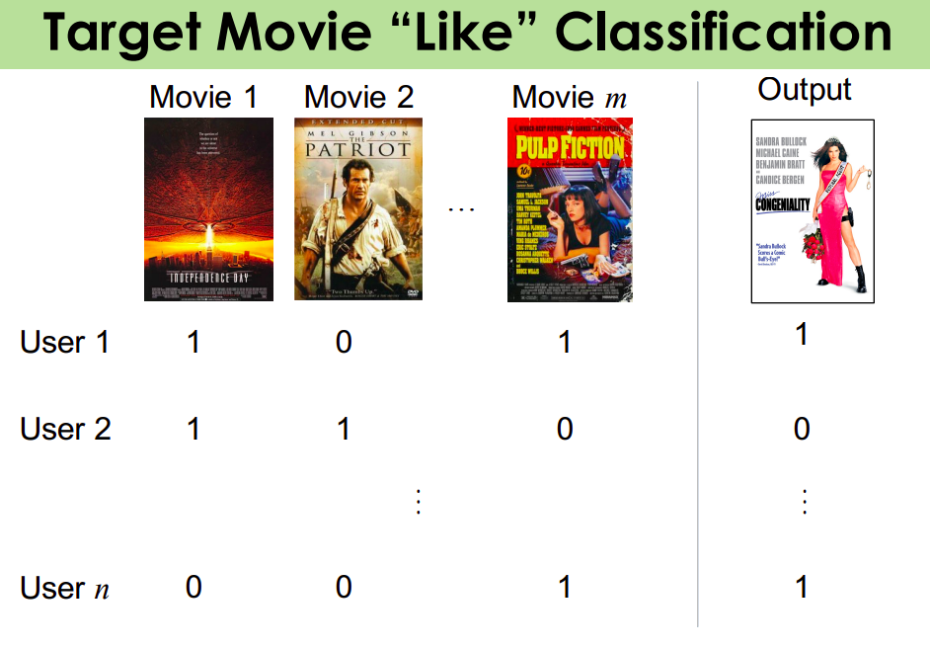
Naive Bayes model applications

Slide 16

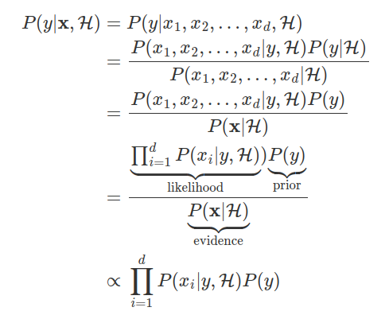

Maximum a Posteriori
Dataset:
Maximizing Posteriori:
d input:
target:
Hypothesis:
Classes:

Slide 17
Maximum a Posteriori
Dataset:
Maximizing Posteriori:
d input:
target:
Hypothesis:
Classes:

Slide 18
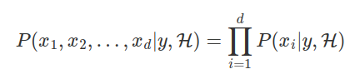
Naive Assumption
We assume that each input sample is iid, thus the likelihood function can be computed by product of the input probability:
Maximizing Posteriori:

Slide 19
Naive Assumption
We assume that each input sample is iid, thus the likelihood function can be computed by product of the input probability:
Maximizing Posteriori:
It is really hard to achieve in reality
⇒ it is a naive assumption for Naive Bayes algorithm.

Slide 20

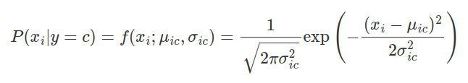
Gaussian Naive Bayes
P(xi|y=c) is computed based on Gaussian Distribution of all sample {xi | yi = c}. Which has hyperparameters:

Slide 21
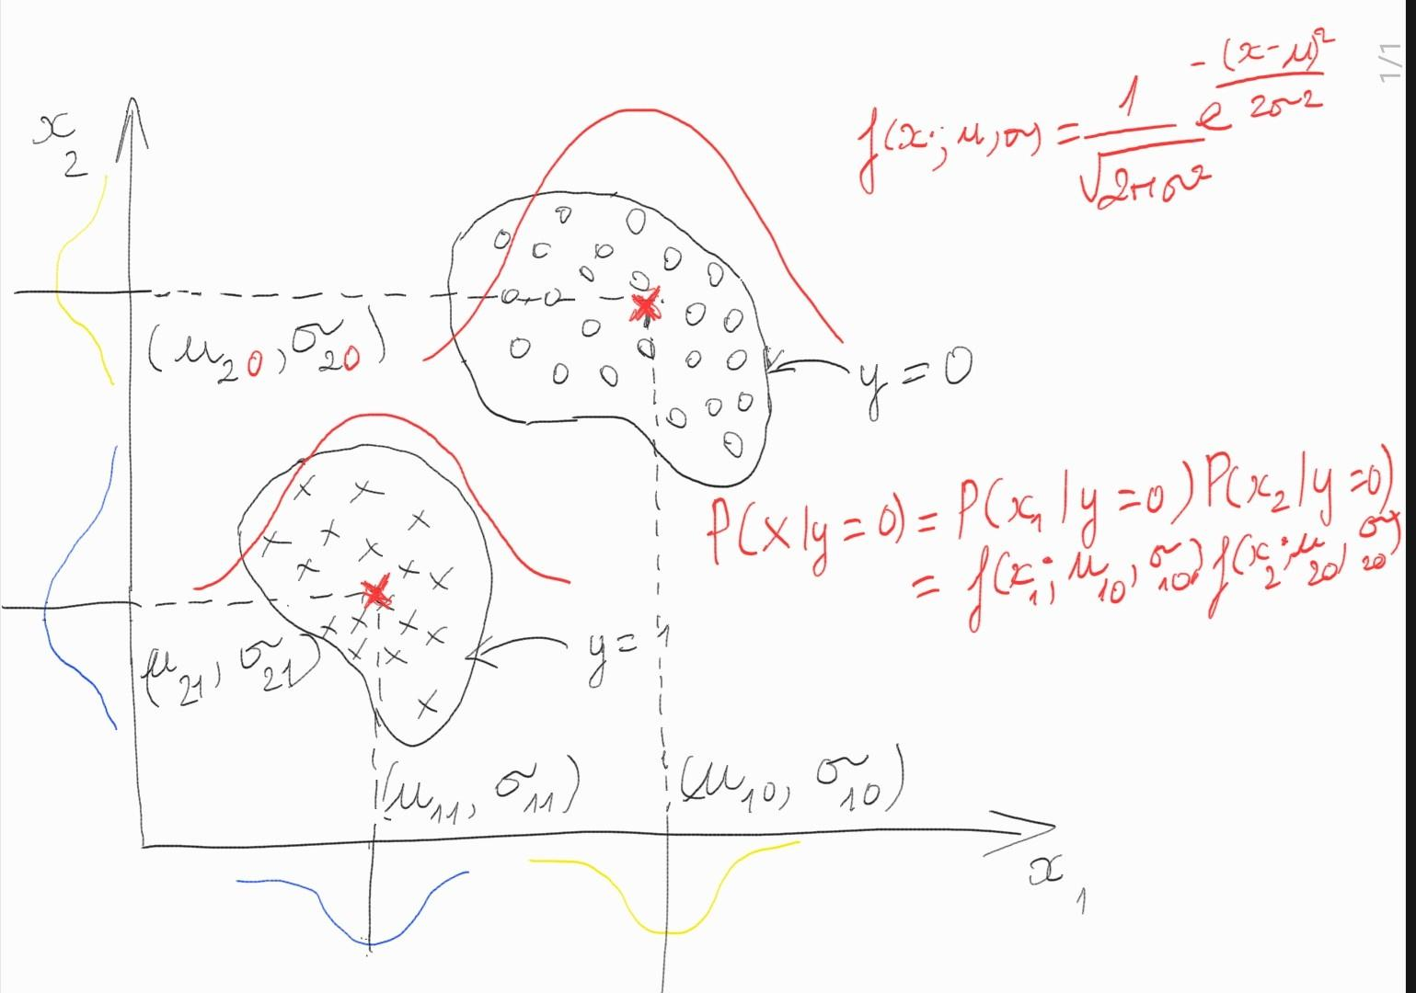
Gaussian Naive Bayes
P(xi|y=c) is computed based on Gaussian Distribution of all sample {xi | yi = c}. Which has hyperparameters:

Slide 22
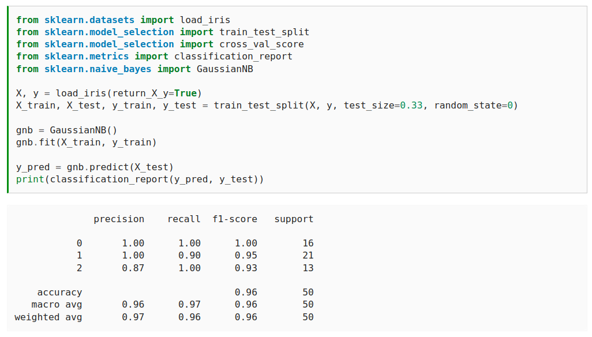
Gaussian Naive Bayes

Slide 23


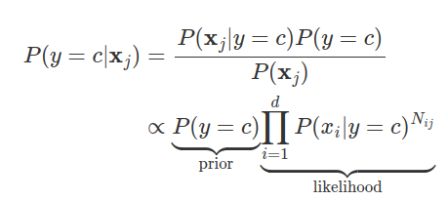
Multinomial Naive Bayes
Vocabulary:
word xi; document xj.
Each document xj is parameterized by frequency vector:
⇒ Estimate posterior probability

Slide 24
Multinomial Naive Bayes
Vocabulary:
word xi; document xj.
Each document xj is parameterized by frequency vector:
⇒ Estimate posterior probability

Slide 25
Multinomial Naive Bayes
Vocabulary:
word xi; document xj.
Each document xj is parameterized by frequency vector:
⇒ Estimate posterior probability
How to estimate ?

Slide 26


Multinomial Naive Bayes
Set:
Estimate:
in which Nij is frequency of word xi in document xj. Nc is total words belong to class y = c

Slide 27

Multinomial Naive Bayes
Set:
Estimate:
in which Nij is frequency of word xi in document xj. Nc is total words belong to class y = c
⇒

Slide 28

Multinomial Naive Bayes
Set:
Estimate:
in which Nij is frequency of word xi in document xj. Nc is total words belong to class y = c
⇒
Posteriori Estimation:

Slide 29
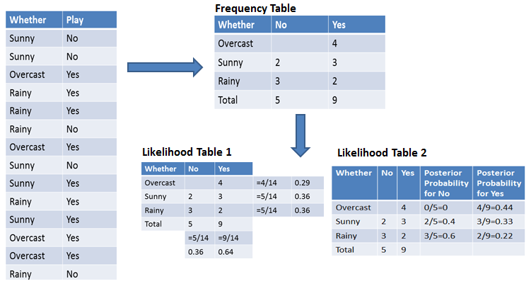
Example of Multinomial Naive Bayes
Classifying whether we should play according to whether
Datacamp Naive Bayes

