Slide 1

Machine Learning Hands-on
KhanhPhamDinh, VinAI Applied, Ha Noi
my book: Machine Learning Algorithms to Practices
https://phamdinhkhanh.github.io/deepai-book/intro.html

Slide 2
MLP model
References:

Slide 3
Content
History of Neural Network
The shortage of traditional learning algorithm
Neural Network
Feed Forward
Loss Function
Gradient
Back Propagation

Slide 4
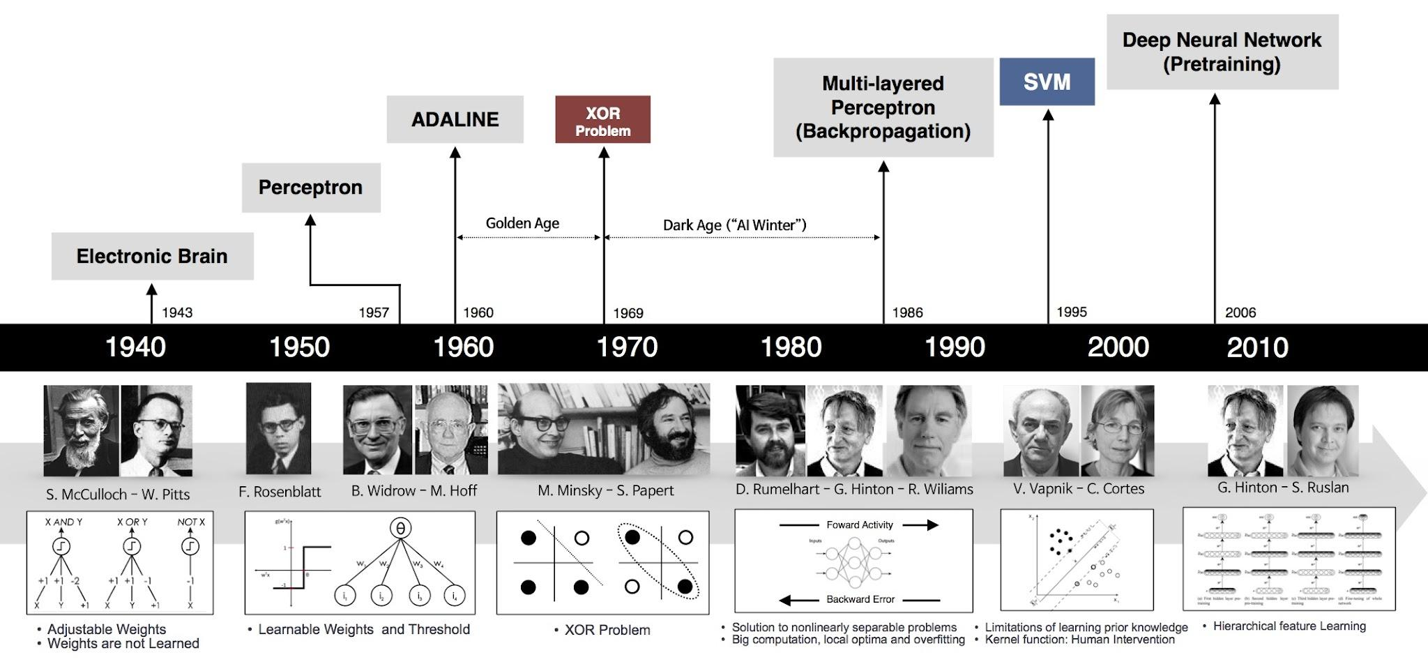
History of Perceptron
In the 1960s, this “perceptron” was argued to be a rough model for how individual neurons in the brain work.
Was very widely used in 80s and early 90; But it did not prove to be efficient and was forgotten in late 90s.
Recently, neural network become state-of-the-art technique compare with the traditional learning algorithms in Computer Vision and NLP.

Slide 5
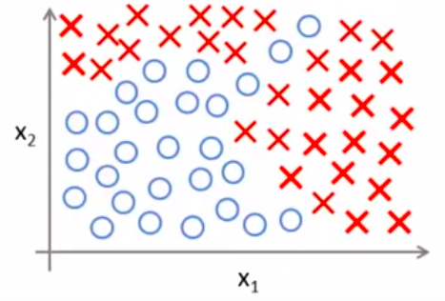
The shortage of traditional learning algorithm
Non-Linear classification:
x1 = area
x2 = distance
x3 = room
…
x100 = floor
Do Feature Engineering to improve model performance.
Such as quadratic feature engineering:
That can lead to overfitting and computational waste.

Slide 6
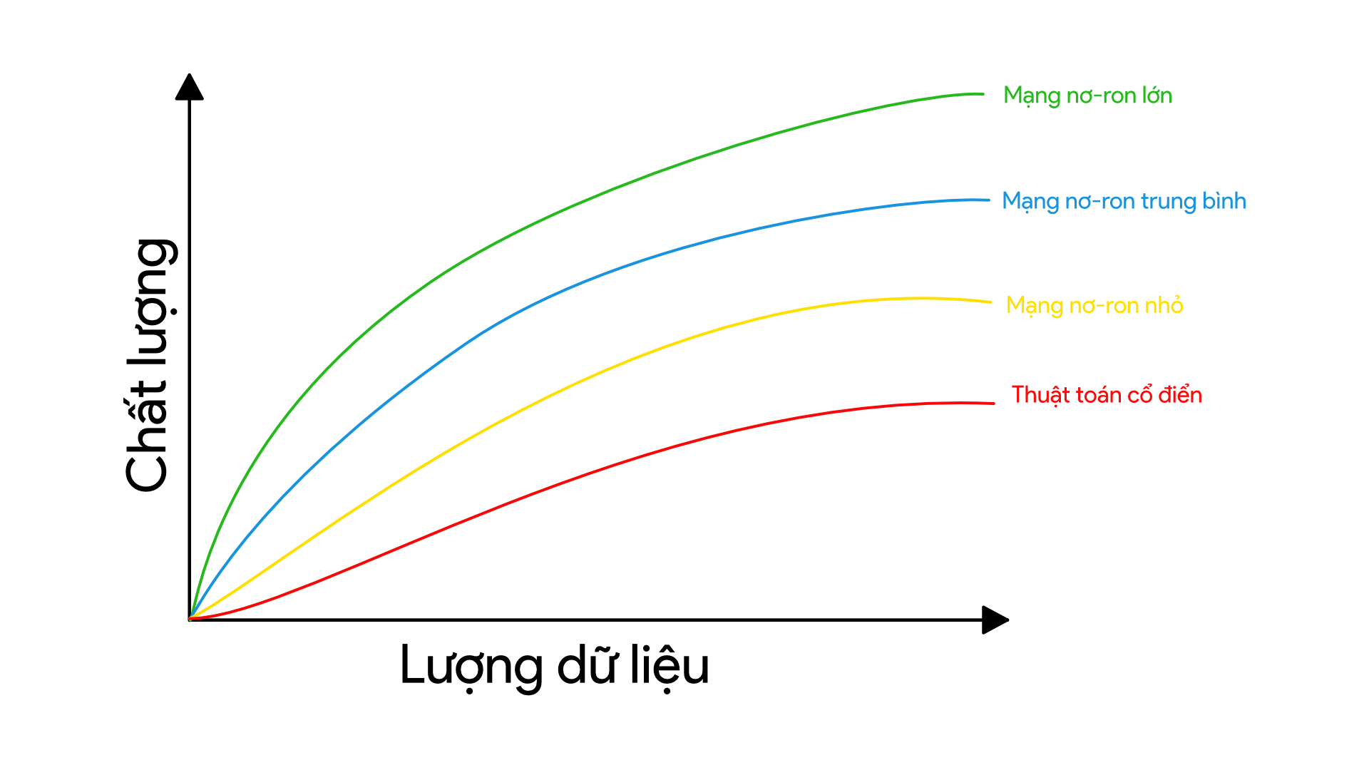
The shortage of traditional learning algorithm
Traditional learning algorithms are quite simple to be good at represent with the big dataset.
Source: Machine Learning Yearning - Andrew Ng

Slide 7
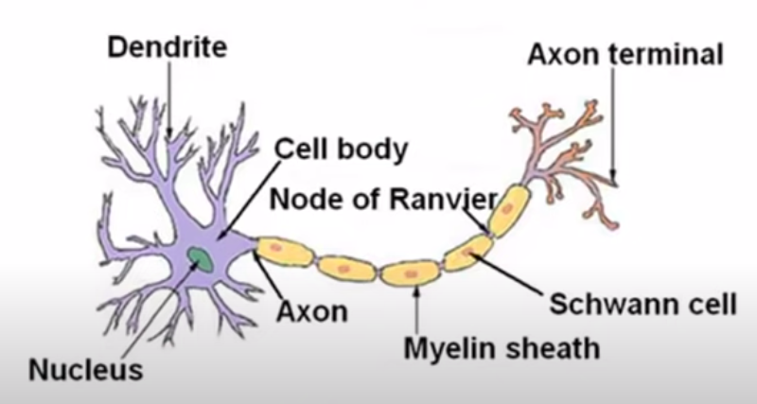
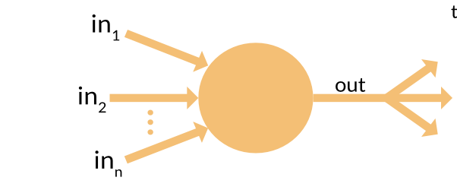
Neural in brain
dendrites like input signal
nucleus is a node which processes information and return axon.
axon continuous forward to the next neural components and we get axon terminals as the final outputs.

Slide 8
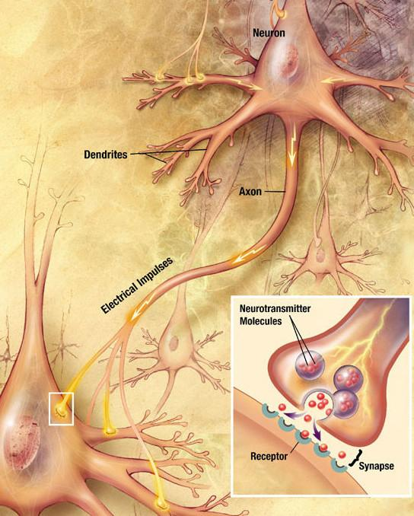
Neural in brain
How information process in our neural brain?
dendrites forward information into neuron.
neuron push the electrical impulses to next neurons and continue to process.
in final, we get the output message that commands human body.
Credit: US national of health, National Institution of Aging

Slide 9
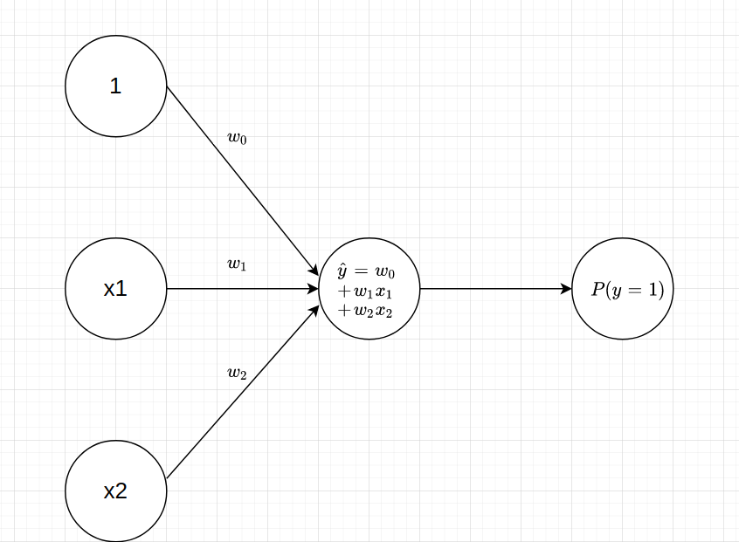



Neural model: Logistic Unit
inputs
weights or parameters
Logistic using a sigmoid activation function.

Slide 10
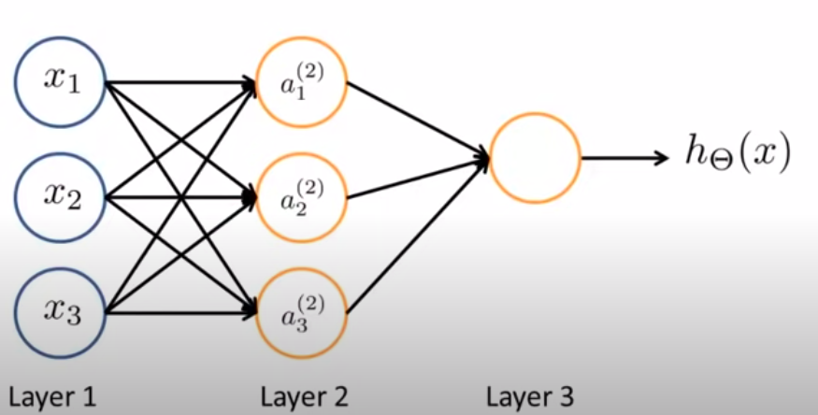
Neural network
Neural network architecture with 1 hidden layers.
Layer 1: Input layer
Layer 2: Hidden layer
Layer 3: Output layer

Slide 11
Neural network
Neural network architecture with 1 hidden layers.
Layer 1: Input layer
Layer 2: Hidden layer
Layer 3: Output layer
How is data computed?

Slide 12

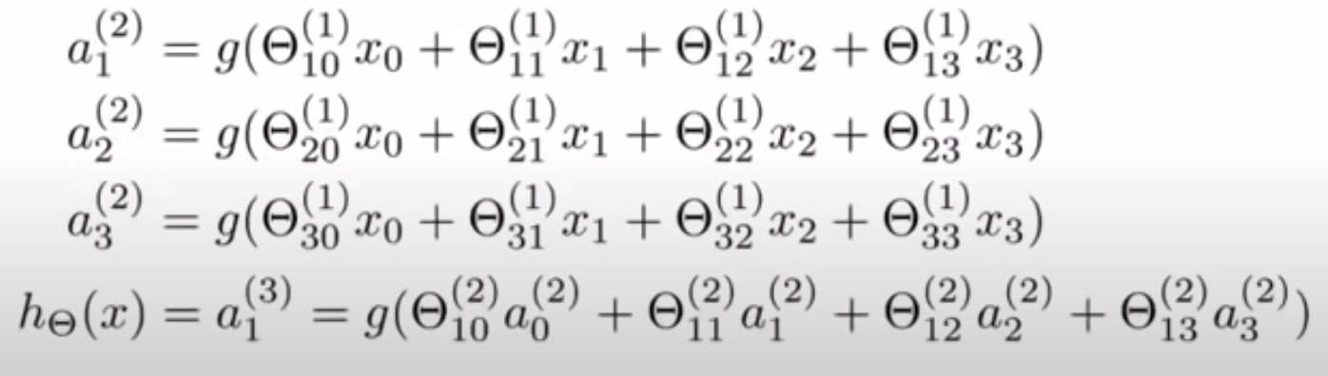

Neural network
Notation:
: Activation unit i in the layer j.
: Matrix of weights control mapping from layer j to layer j+1
If layer j have shape and layer j+1 have shape then matrix
have shape

Slide 13
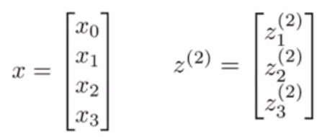



Forward Propagation
Propagation is process of compute output from input.
Define:
Step 1: Calculate output for Layer 1
Add bias unit:
Step 2: Calculate probability distribution at Layer 3

Slide 14
Neural network learning its own features
If we truncate first layer, it turn into a logistic regression.

Slide 15
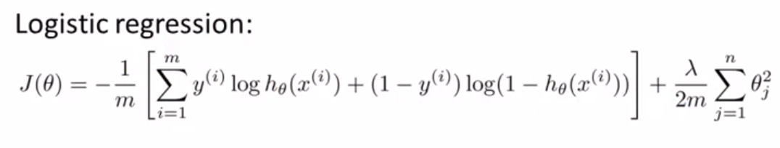
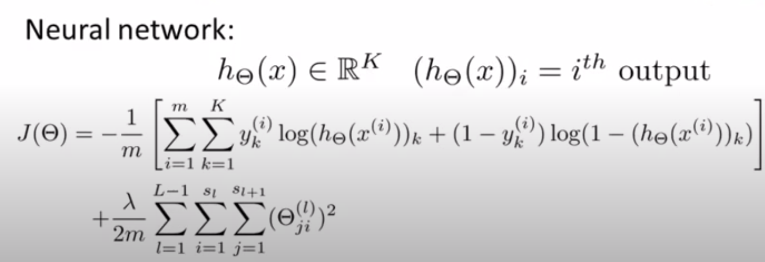
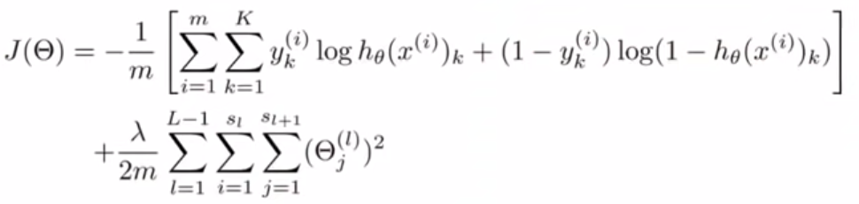
Loss function

Slide 16

Loss function
Compute

Slide 17

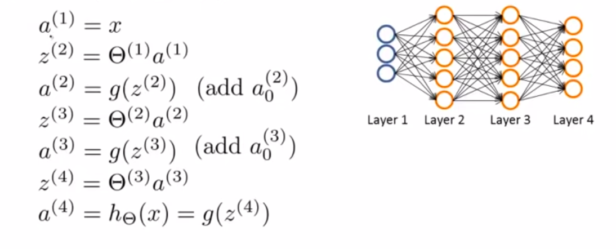
Gradient computation
Given one training example
Feed forward

Slide 18




Gradient computation
is error of unit i in layer j
For each output unit layer l (here is layer 4)

Slide 19






Backpropagation
Training set
Set = 0 for all i,j,l
For i in 1 to n: (looping through all dataset)
Set
Perform feed forward propagation to compute for
Using to compute
Compute
(accumulate delta through whole dataset)

Slide 20


Backpropagation
Training set
Set = 0 for all i,j,l
For i in 1 to n: (looping through all dataset)
Set
Perform feed forward propagation to compute for
Using to compute
Compute
(accumulate delta through whole dataset)

Slide 21
Backpropagation
Training set
Set = 0 for all i,j,l
For i in 1 to n: (looping through all dataset)
Set
Perform feed forward propagation to compute for
Using to compute
Compute
(accumulate delta through whole dataset)

Slide 22

Backpropagation
Update weights:

Slide 23
Practice
MLP practice on keras

Slide 24
Thanks you, Ask me a question

