Slide 1

Machine Learning Hands-on
KhanhPhamDinh, VinAI Applied, Ha Noi
my book: Machine Learning Algorithms to Practices
https://phamdinhkhanh.github.io/deepai-book/intro.html

Slide 2
Support Vector Machine

Slide 3
Content
General idea of SVM
Logistic Regression
Margin in SVM
Optimization margin classifier
Lagrange Duality
Support Vector

Slide 4
General idea of SVM
SVM is supervised learning algorithm.
What is margin that separate the classes of data with the large gap.
Lead to solve a optimal margin classifier by Lagrange duality.
kernel is an efficient way to apply SVM in a high dimensional space.

Slide 5
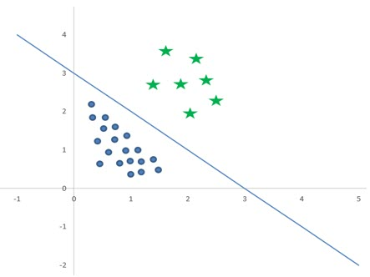



Logistic Regression
Hypothesis function
Example
-

Slide 6
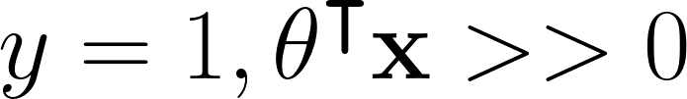
Logistic Regression
Consider 3 cases A, B, C:
A: is far from boundary and positive
A
B
C

Slide 7
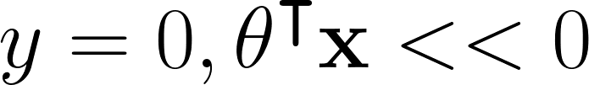
Logistic Regression
Consider 3 cases A, B, C:
A: is far from boundary and positive
C: is far from boundary and negative
A
B
C

Slide 8
Logistic Regression
Consider 3 cases A, B, C:
A: is far from boundary and positive
C: is far from boundary and negative
B is near the boundary and hard to
classify.
A
B
C

Slide 9
Logistic Regression
Consider 3 cases A, B, C:
A: is far from boundary and positive
C: is far from boundary and negative
B is near the boundary and hard to
classify.
⇒ To well classify all points.
A
B
C
Find a boundary that is farest from any points, even these are nearest points.
That means find a largest margin.

Slide 10
Notation - SVM
A
Target label:
Hypothesis Function:
B
C

Slide 11

Function and Geometric margin
Functional margin:
A
Define a label of each point (xi, yi) by functional margin:
Consider the two cases of correct prediction:
yi > 0 → wTx + b > 0
yi < 0 → wTx + b < 0
⇒ Model make a right prediction when
a prediction is more confident if is high
B
C

Slide 12
Functional Margin Characteristic
Functional margin:
A
Margin does not well measure of probability (value return is {-1, 1}).
The hypothesis function does not change if we scale functional margin.
Hypothesis function:
Replacing (w, b) with (2w, 2b) the sign of point does not change.
That means we can normalize:
B
C

Slide 13
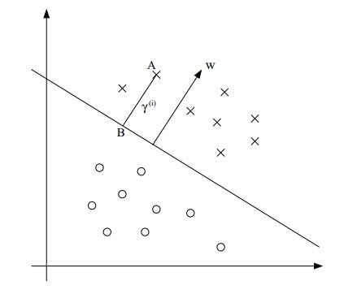
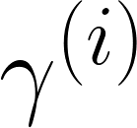


Distance from one point to hyperplane
Geometric margin:
Geometric margin is real distance from A to separation hyperplane space.
from A project to hyperplane by 90 degree to get B. vector w is orthogonal to the hyperplane.
How can we find margin is the length of AB ?
AB is parallel with w
normalize w by w/||w||
position of A is xi ⇒ B is
B lies on hyperplane
2
Solving to get:
1
1

Slide 14

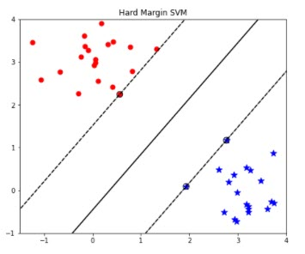


Optimal margin classification
Assume that dataset is separable.
We try to find boundary that have largest margin.
Largest margin means that hyperplane will separate between negative and positive values with a largest gap.
Maximize the geometric margin mean that each functional margin is at least
Transform into convex optimization problem:

Slide 15



Lagrange Duality
Constrained optimization problems in general form which may have inequality as well as equality constraints. We call primal optimization problem as bellow:
We define a generalized Lagrangian:
We consider a maximum problem of generalized Lagrangian according to Lagrangian multipliers

Slide 16
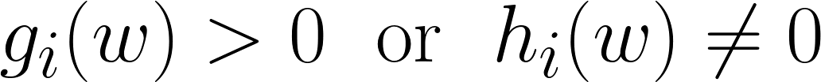
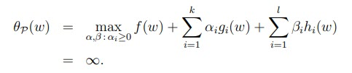


Lagrange Duality
If w is violate the constraints (for example ) then:
Hence:
To find minimum value of just take several values of w satisfying the primal constraints and find infimum of its, after that find minimum of them.

Slide 17

Lagrange Duality
Primal problem: find minimum optimal value w in a set of maximum value of Lagrange function.
Dual problem: find maximum optimal value alpha, beta in a set of minimum value of Lagrange function:
The optimal value of dual is infimum of primal value:
https://see.stanford.edu/materials/aimlcs229/cs229-notes3.pdf

Slide 18
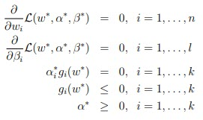
Lagrange Duality
Under certain constraints, optimal value of primal problem and dual problem are equal. Thus, we can find optimal value of dual problem instead of primal problem:
Generalized Lagrange problem:
Suppose that f, gi are convex and hi are affine. The two problems are the same roots under constraints of Karush-Kuhn-Tucker (KKT) conditions,

Slide 19



Optimal Margin Classifier
Optimal margin problem:
Constraints:
Lagrange function:

Slide 20





Optimal Margin Classifier
Take derivative of Lagrange according to w and b equal zero
Derivative of w:
(1)
Derivative of b:
Replace with w into original Lagrange function:
Finally:

Slide 21
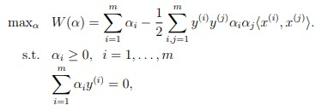
Optimal Margin Classifier
Dual problems with constraints from KKT:
After solve dual problems we can calculate w according to formulation (1)
Almost values of alpha_i is zero and only small points lie on margin line have alpha_i <> 0. We call that points is support vectors.

Slide 22

Optimal Margin Classifier
Procedure of SVM:
Step 1: Solve dual problem to define a set of support vectors corresponds with alpha_i > 0.
Step 2: Replace support vector into w equation.
Step 3: According to KKT:
Find b by equation:

Slide 23
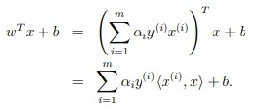
Optimal Margin Classifier
Define a label of a point:
Label of a point can define according to sign of wTx + b:
wTx + b can define through by sum of inner products between support vector with the relative point on train dataset.

Slide 24
SVM - Hard Margin Summary
Data is assumed linear separable.
Find the boundary that well perform on the training dataset.
That means find the largest boundary to separate between two groups.
Solve a convex optimization with the linear constraints.
Using KKT conditions to get optimal values.
The boundary formulation can be found based on support vectors which correspond with alpha_i > 0.

Slide 25
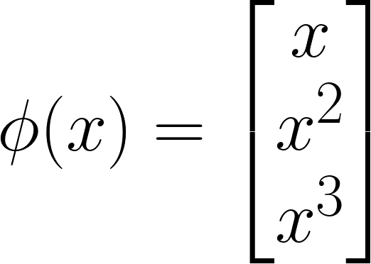

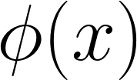

Kernels - SVM
Consider a linear regression with input x:
To decrease the model error between predict and ground truth we can add polynomial features such as: x^2, x^3,....
What is kernel SVM?
Feature mapping function:
Rather learn on we replace input with
Kernel function is a inner product between two inputs:

Slide 26
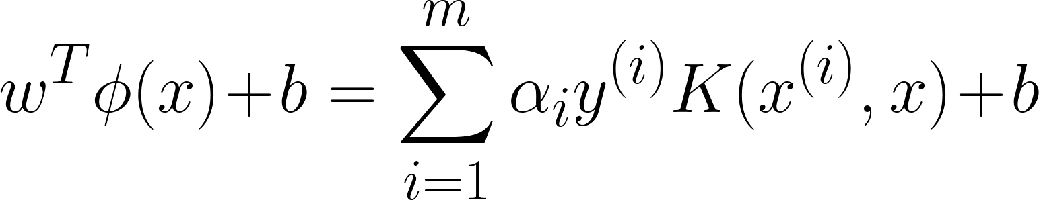
Kernels - SVM
Advantage of kernels:
Project input into higher dimensionality space.
Kernel function can be easier calculated even without explicitly finding representation vector .
Label of a point can define according to sign of wTx + b:
That are sum of m points on support vectors. We save the computational cost of inference by using Kernel function instead of using

Slide 27

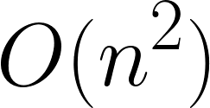
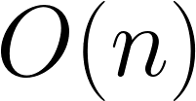
Kernels - SVM
Example of kernels:
Assume that the kernel function is kind of quadratic function:
Correspond with feature map:
To calculate feature map we need to take computational cost whereas kernel function only require . Don’t need to compute the feature map → save computational cost but increase model representation ability.

Slide 28
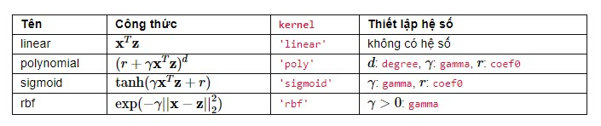
Kernels - SVM
Common kernel functions:

Slide 29

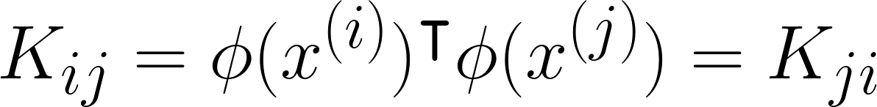

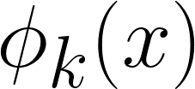
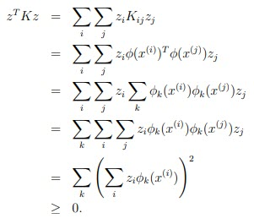
Kernels - SVM
Kernel matrix:
Consider Kernel matrix: in which
is arbitrary vector and is k-th element of vector
Kernel matrix must be semi-positive defined.

Slide 30

Kernels - SVM
Mercer theorem:

Slide 31
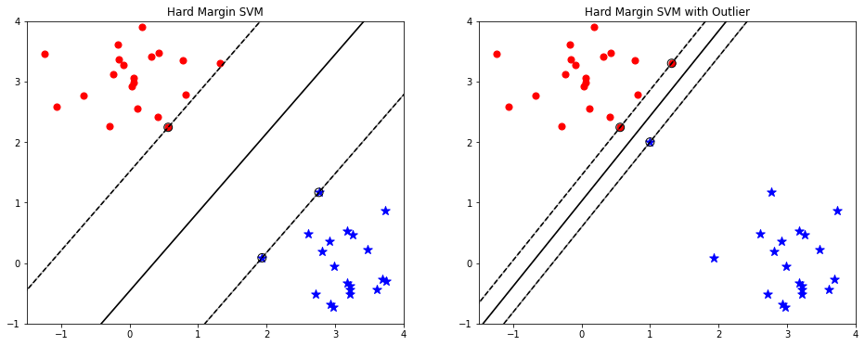
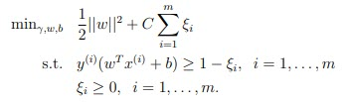
Soft margin SVM
Model is unstable when it appears the outliers that narrow down the boundary.
To make our algorithms stable even the outliers or non-linear separable data. We reformulate our optimization:

Slide 32

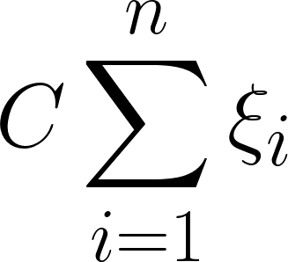
Soft margin SVM
We accept the the boundary less than 1. In this case the boundary is
Paying the cost function a fee is
The parameter C controls the relative weighting between twin goals: making the margin large or and make sure each example has functional margin near 1.

Slide 33

Soft margin SVM
We accept the the boundary less than 1. In this case the boundary is
Paying the cost function a fee is
The parameter C controls the relative weighting between twin goals: making the margin large or and make sure each example has functional margin near 1.
The value of C:
C big: The regularization impose to become more important. The misclassification points are not allowed quite far from boundary.
C small: Margin is allowed larger and accept misclassification points are go further to the boundary.

Slide 34
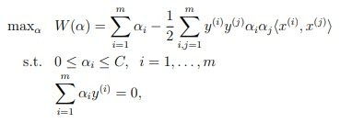

Soft margin SVM
Lagrange function:
By take derivation according to w and b. Solving the equations equal zero and replace them back to get the dual form of problem:
KKT dual-complementary:

Slide 35
SVM - Practice
SVM practice

Slide 36
References
https://phamdinhkhanh.github.io/deepai-book/ch_ml/index_SVM.html
https://machinelearningcoban.com/2017/04/09/smv/
https://www.analyticsvidhya.com/blog/2017/09/understaing-support-vector-machine-example-code/
https://towardsdatascience.com/support-vector-machine-introduction-to-machine-learning-algorithms-934a444fca47
https://see.stanford.edu/materials/aimlcs229/cs229-notes3.pdf
https://www.datacamp.com/community/tutorials/svm-classification-scikit-learn-python
https://www.freecodecamp.org/news/svm-machine-learning-tutorial-what-is-the-support-vector-machine-algorithm-explained-with-code-examples/

Slide 37
Thanks you, Ask me a question

