Slide 1
From Raw Data to
Business Decisions
ApexPlanet Sales Analytics — Final Presentation
Data Analytics Internship · Tasks 1-4 Synthesis

Slide 2
Objective
ApexPlanet asked a simple question: what does our sales data actually tell us — and what should we do about it? This presentation synthesizes four stages of analysis into one validated business narrative.
01
02
03
04
Data Wrangling
EDA & BI
Deep-Dive & Dashboard
Statistical Validation
Cleaned 1,000 transactions — fixed missing values and a duplicate-ID bug
Found Electronics drives 36% of revenue via SQL + statistical exploration
RFM segmentation revealed where retention effort should focus
Hypothesis tests proved which patterns are real — and which aren't
2

Slide 3
Step 1 — Data Wrangling
Foundation: a clean, validated dataset
20 missing ages, 13 missing cities
Imputed transparently, flagged for downstream exclusion
1,000
9 orders sharing one duplicate ID
rows, zero nulls,
zero duplicate keys
Reassigned unique IDs — each was a genuinely distinct sale
1,000 rows validated end-to-end
Analysis-ready output that every subsequent step depends on
Zero nulls, zero duplicate keys, totals reconciled
3

Slide 4
Step 2 — EDA & Business Intelligence
What the data revealed once it was clean
Electronics = 36.4% of total revenue from just 2 products (Mobile, Laptop)
Customer age shows ~zero correlation with spend (r ≈ 0.00) across every measure
Bengaluru has the highest average order value of any city (₹153,882)
SQL analysis across a normalized 3-table database answered 7 business questions
4

Slide 5
Step 3 — Core KPIs Defined
Five metrics chosen to track revenue, customer value, and customer health
₹1,39,399
₹1,47,201
5.5%
47.4%
36.4%
Avg Order Value
CLV (proxy)
Repeat Purchase Rate
Top-20% Revenue Share
Electronics Contribution
Why these five
• AOV & CLV: are we growing via more customers or bigger baskets?
• Repeat Purchase Rate: is this business acquisition- or loyalty-driven?
• Revenue Concentration: how dependent are we on top spenders?
• Category Contribution: are we over-reliant on one product line?
5

Slide 6
Step 3 — Deep-Dive: Customer Segmentation (RFM)
947 customers scored on Recency, Frequency, and Monetary value
Segment | % Customers | % Revenue | Avg Spend
Loyal / High-Value | 33.1% | 53.5% | ₹238,194
At Risk (high value, inactive) | 12.9% | 19.9% | ₹227,923
New / Low-Spend | 24.8% | 9.1% | ₹53,737
Low Engagement | 25.2% | 8.8% | ₹51,543
Champions | 4% | 8.7% | ₹318,186
Key finding: 122 “At Risk” customers have proven high spend (₹227,923 avg) but haven't ordered in ~316 days — the highest-ROI win-back target.
6

Slide 7
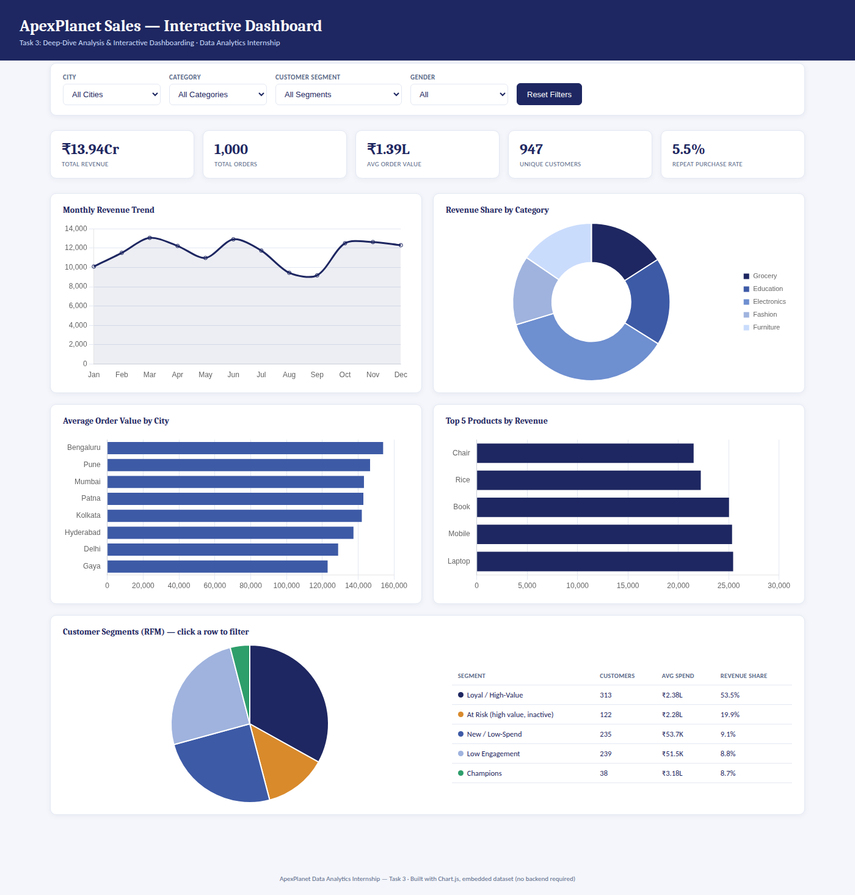
Step 3 — Live Interactive Dashboard
Filterable by City, Category, Segment, and Gender — built for stakeholders to self-serve
7

Slide 8
Step 4
Statistical Validation
Before recommending action, we pressure-tested the “obvious” assumptions
3 hypotheses · t-test, chi-squared, ANOVA · p-values & confidence intervals
8

Slide 9
Hypothesis Test Results
Hypothesis | Test | p-value | Result
Gender affects Average Order Value | Welch's t-test | 0.495 | Not significant
City is associated with Category preference | Chi-squared | 0.207 | Not significant
Unit Price differs across Categories | One-way ANOVA | 0.836 | Not significant
What this means
All three tests came back statistically non-significant (p > 0.05). This is a genuinely useful result — it means gender, city, and category-level pricing are not real differentiators of customer spending in this data.
Read together with the RFM segmentation (Step 3), the evidence consistently points to one conclusion: purchasing behavior here is explained by customer engagement patterns — recency and spend history — not by demographics or geography.
9

Slide 10
Conclusions
1
Revenue is concentrated, not fragile
Top 20% of customers generate 47.4% of revenue — significant, but not extreme
2
Retention, not acquisition, is the gap
Only 5.5% of customers are repeat buyers; 122 “At Risk” customers represent ~₹2.78Cr in dormant revenue
3
Demographics don't predict spend
Gender, city, and category pricing all failed statistical significance tests
4
Electronics wins on volume, not price
36% of revenue comes from more orders, not premium pricing (Hypothesis 3)
10

Slide 11
Call to Action
Launch a win-back campaign targeting the 122 “At Risk” customers — highest-ROI recovery opportunity identified
✓
Build a retention program for “Loyal / High-Value” customers (313 people, 53.5% of revenue)
✓
Do not invest in gender- or city-based targeting — not statistically supported by this data
✓
Track the 5 core KPIs monthly via the live dashboard to catch shifts early
✓
Prioritize Electronics volume growth (promotions, stock, ad spend) over price changes
✓
11

Slide 12
Thank You
Questions & Discussion
Full analysis, code, and live dashboard available on GitHub

