Slide 1
Mutual Fund Analytics
Bluestock Fintech — N100 Financial Intelligence Platform
Capstone Project I | Days 1–7 | June 2026

Slide 2
Problem Statement & Objectives
India's mutual fund industry has grown to ₹81+ Lakh Crore AUM with 26 Cr+ folios. Challenge: No unified analytics view across fund performance, investor demographics, SIP trends, and risk metrics. Project Objectives: 1. Build a complete ETL pipeline ingesting 10 datasets into a structured SQLite DB. 2. Perform EDA and Performance Analytics across 40 fund schemes. 3. Compute VaR, CVaR, Rolling Sharpe, Sector HHI, and a Fund Scorecard. 4. Deliver a live interactive Streamlit Dashboard + PDF Report.

Slide 3
Data Sources & Datasets
fund_master.csv
40 schemes with scheme metadata, expense ratios, risk grades
nav_history.csv
Daily NAV data for all schemes (2020–2026)
investor_transactions.csv
32,778 investor transactions (SIP/Lumpsum/Redemption)
scheme_performance.csv
Risk metrics: Sharpe, Alpha, Beta, Max Drawdown
portfolio_holdings.csv
Stock-level holdings with sector & weight for equity funds
aum_by_fund_house.csv
Monthly AUM snapshots by fund house (2022–2025)
benchmark_indices.csv
NIFTY50, NIFTY100, NIFTY_MIDCAP150, BSE_SMALLCAP
category_inflows.csv
Monthly net inflows by fund category
industry_folio_count.csv
Total industry folio count over time
monthly_sip_inflows.csv
Aggregate monthly SIP industry data

Slide 4
Architecture & Tech Stack
RAW DATA
10 CSV Datasets (data/raw/)
ETL
data_cleaning.py → SQLAlchemy → SQLite (bluestock_mf.db)
ANALYTICS
EDA (Seaborn/Plotly) | Performance (SciPy) | Risk (NumPy)
DASHBOARD
Streamlit + Plotly — 4-page interactive web app
OUTPUTS
Notebooks (.ipynb) | CSVs | PNGs | PPTX | Final Report

Slide 5
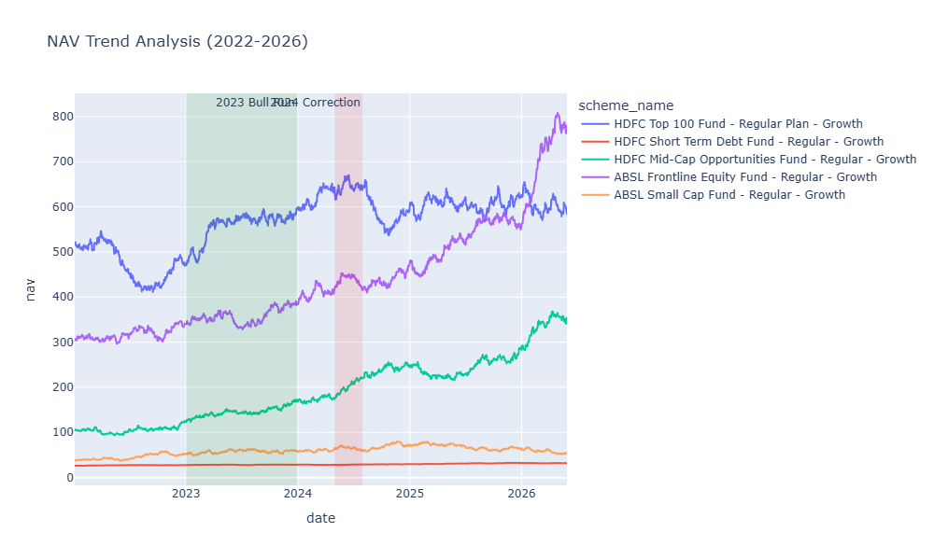
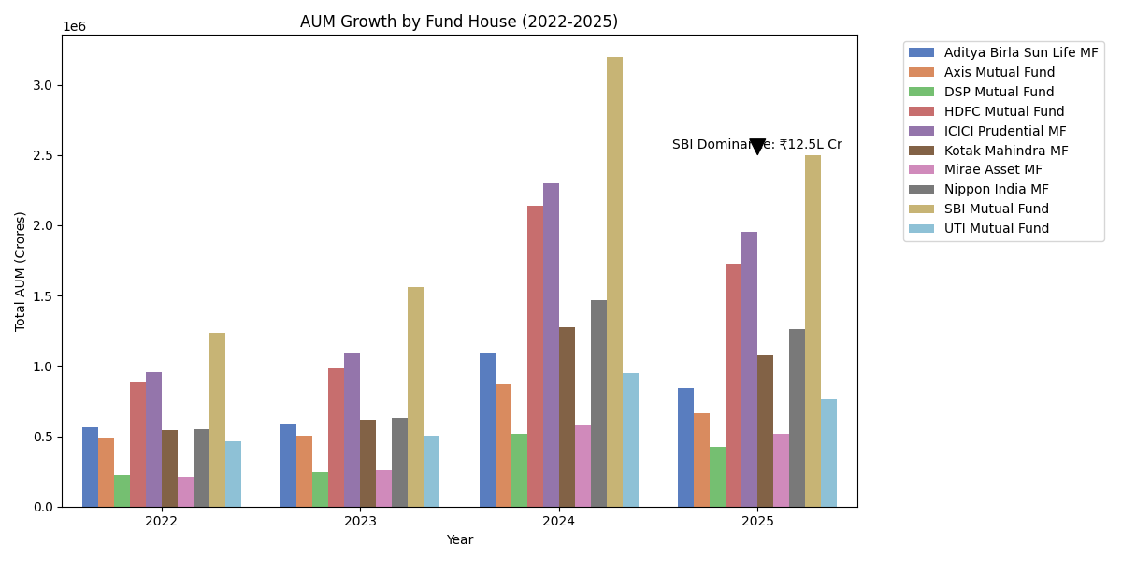
EDA Highlights — NAV & AUM
NAV trend shows a strong 2023 bull run. SBI Mutual Fund dominates AUM at ₹12.5L+ Cr.

Slide 6
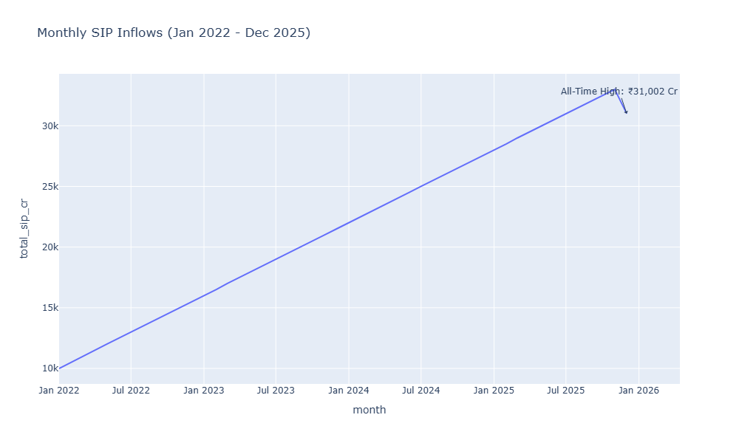
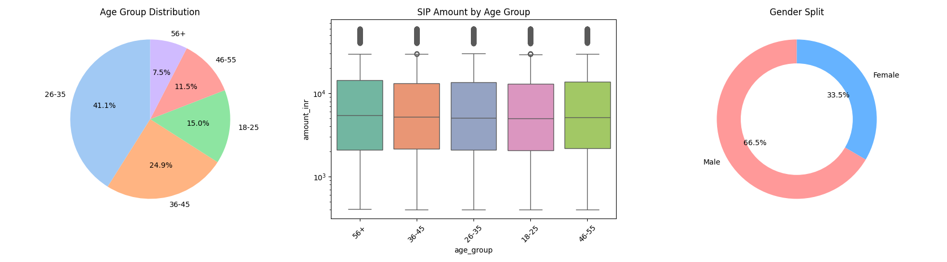
EDA Highlights — Investors & SIP
SIP inflows hit an all-time high of ₹31,002 Cr in Dec 2025. Millennials drive the majority of new SIP accounts.

Slide 7
Fund Performance Metrics
CAGR (3yr)
Best: Axis Small Cap 22.4% | Category Avg: 14.2%
Sharpe Ratio
Best: Mirae Asset Large Cap 1.085 | Rf = 6.5% (RBI Repo)
Sortino Ratio
Penalises only downside volatility — more robust for asymmetric returns
Alpha (Annualised)
Top alpha generators are predominantly Small/Mid Cap funds vs NIFTY100
Beta
Large Cap funds: β ≈ 0.85–1.05 | Small Cap: β ≈ 1.2–1.5
Max Drawdown
Worst drawdown: Axis Small Cap -51.7% (COVID crash reference)

Slide 8
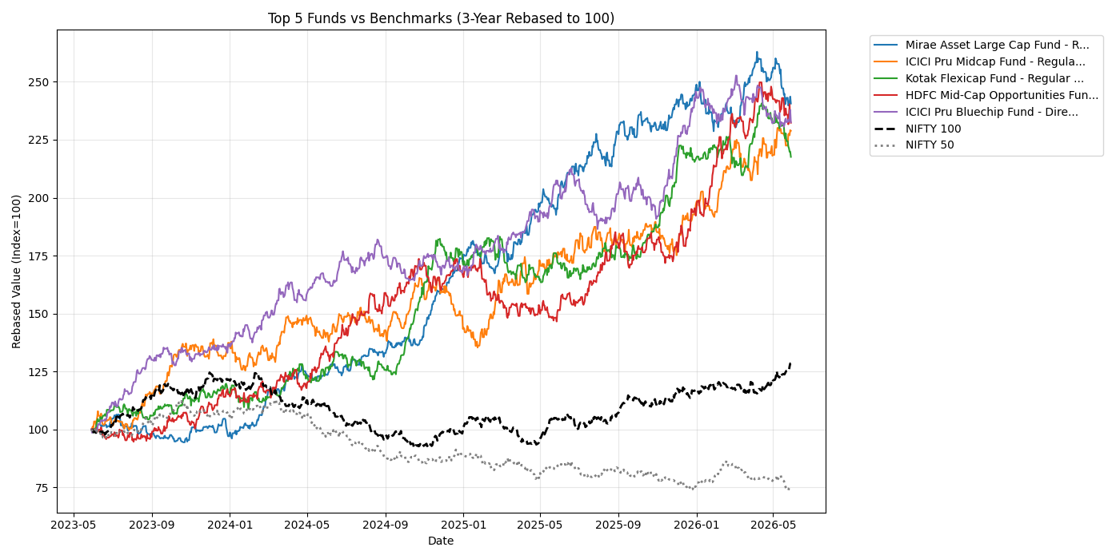
Benchmark Comparison & Scorecard
Fund Scorecard (0–100)
30% — 3yr CAGR Rank 25% — Sharpe Rank 20% — Alpha Rank 15% — Expense Ratio (inv.) 10% — Max Drawdown (inv.)

Slide 9
Streamlit Dashboard — Industry & Performance Pages
Page 1: Industry Overview • KPI Cards: AUM, SIP, Folios, Schemes • AUM Trend Line + AMC Bar Chart
Page 2: Fund Performance • Risk vs Return Scatter (Bubble = Score) • Sortable Fund Scorecard Table • NAV Trend with Fund Selector
Dashboard is live at: python -m streamlit run dashboard/app.py

Slide 10
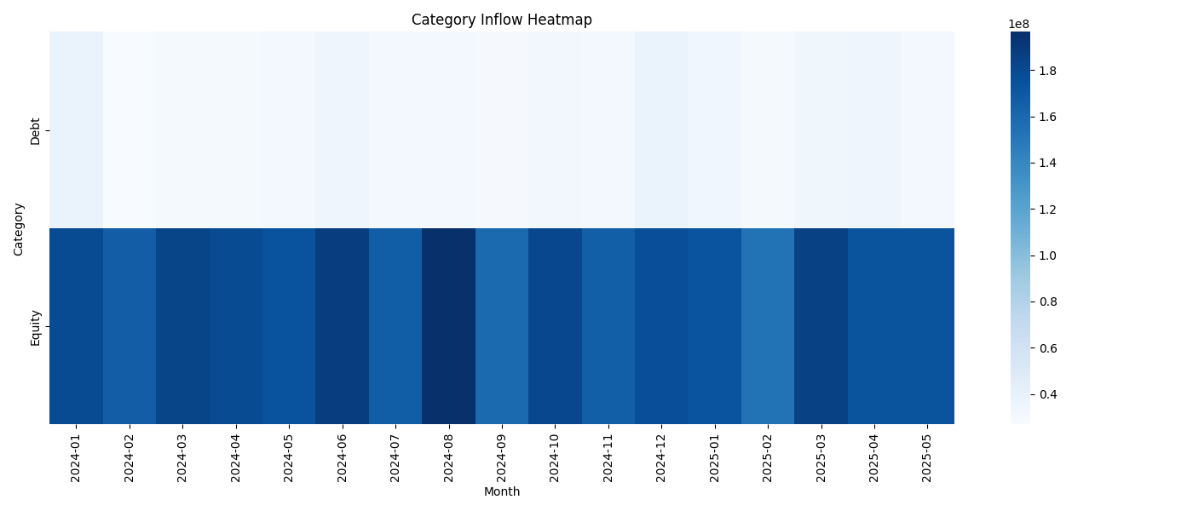
Streamlit Dashboard — Investor & Market Trend Pages
Page 3: Investor Analytics • Transaction Amounts by State • SIP/Lumpsum/Redemption Split Donut • Age Group vs Average SIP Amount
Page 4: SIP & Market Trends • Dual-Axis: SIP Inflows vs NIFTY 50 • Category Inflow Heatmap • Top 5 Categories by Net Inflow

Slide 11
Key Findings & Recommendations
1. SBI Mutual Fund commands 15%+ of total AUM — concentration risk for the industry.
2. SIP culture is booming — monthly SIP inflows grew 3× between Jan 2022 and Dec 2025.
3. Mirae Asset Large Cap delivers the best risk-adjusted returns (Sharpe: 1.085).
4. ~18% of SIP investors show irregular payment gaps (> 35 days) — at-risk of lapsing.
5. Small Cap funds carry the highest VaR, up to -1.9% daily at the 95% confidence level.
6. T30 cities still dominate 68% of SIP inflows; B30 penetration needs targeted campaigns.
Recommendation: Moderate risk investors should prioritise Mirae Asset Large Cap & Kotak Flexicap.
Recommendation: Investors in High-VaR funds should ensure a 3yr+ investment horizon.

Slide 12
Thank You
Bluestock Fintech — Capstone Project I: Mutual Fund Analytics
GitHub: github.com/binod01nep/MutualFundAnalytics
Dashboard: python -m streamlit run dashboard/app.py

