Slide 1
CSS: Cascade, Selectors, and Positioning
CSS is fundamental for web developers. It allows you to control styles, layout, and element placement.
By: Binod Maharjan

Slide 2
Content
Understanding the CSS Cascade
Combining CSS Selector
CSS Positioning
Practical Positioning Examples

Slide 3

Understanding the CSS Cascade
Stylesheet Origin
Importance
Specificity
Styles are prioritized as follows:
Specificity is calculated based on selector types. It determines which styles are applied when conflicts arise.
Browser defaults
User styles
Inline styles
Author styles
!important rules
ID selectors
Class/attribute selectors
Element selectors

Slide 4


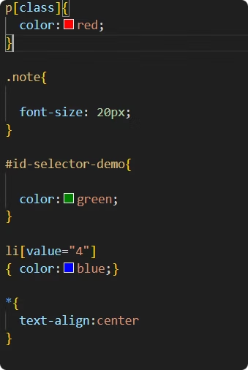



Combining CSS Selectors
Element Selectors
Example: `p`, `h1`, `div`
Class Selectors
Example: `.my-class`
ID Selectors
Example: `#my-id`
Attribute Selectors
class selector
Example: `[type="text"]`
Example: .my-class{
color :red;
}
Combining Selectors
Example: `div p`, `ul > li`, `a + p`

Slide 5

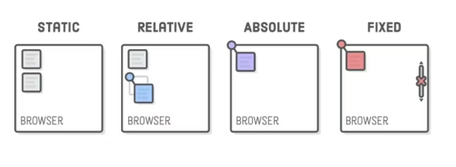
CSS Positioning
Static
Relative
Default behavior. Elements flow normally.
Example:position:static;
Offset from its normal position.
Example position:relative;
Absolute
Fixed
Relative to the nearest positioned ancestor.
Example position:absolute;
Relative to the viewport, stays in place during scroll.
Example position:fixed;

Slide 6
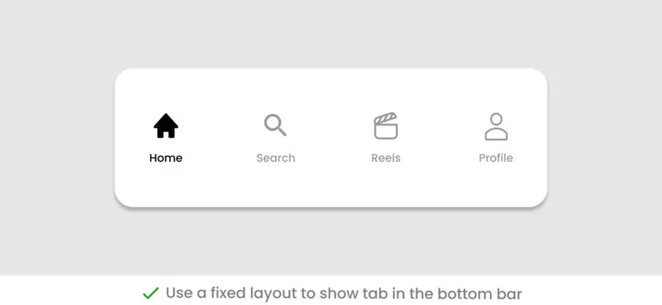
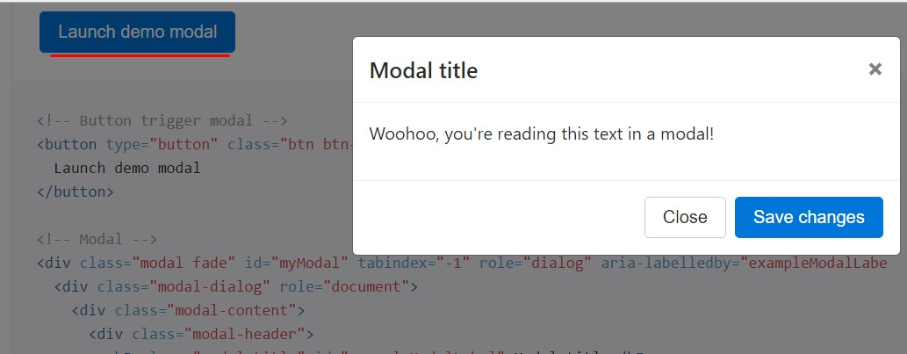
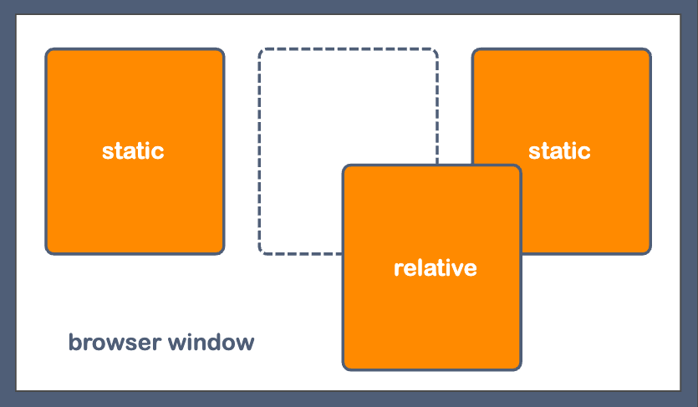
Practical Positioning Examples
Fixed Navigation Bar
Keeps the navigation visible while scrolling.
Modal with Absolute Positioning
Overlays content on top of the page.
Relative Positioning Adjustments
Fine-tunes element placement.

Slide 7
Conclusion
Cascade- Importance – Inline styles and !important rules win.
Specificity – More specific selectors beat general ones.
Combining CSS selectors- Combining CSS selectors means using more than one selector together to target specific HTML elements.
CSS positioning controls how elements are placed on a page using the position property.

Slide 8
Any Questions???

