Slide 1

Logistic Regression to Deep Networks and Transfer Learning
https://github.com/bostdiek/IntroToMachineLearning
Data for the lecture today can be found at
https://drive.google.com/file/d/1VjsNU6OwjHI-0vQqBAW517-0HFHj6PGx/view?usp=sharing

Slide 2
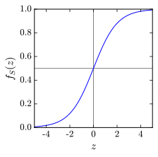
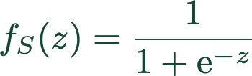




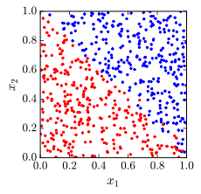
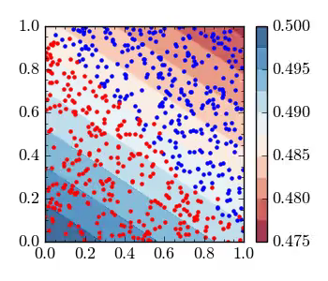



Logistic Regression
What if we are trying to predict a class, not a number?
What is ?
Large + values of
Minimize the loss with respect to
Boundary at
Large - values of

Slide 3
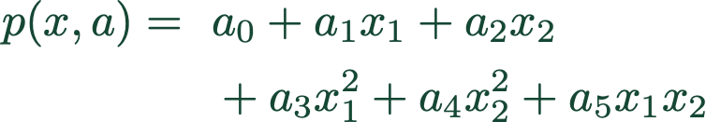
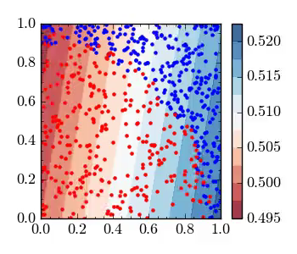
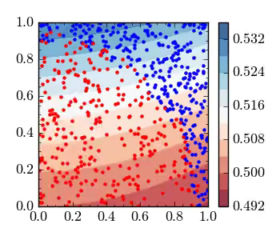
Logistic Regression
What if there is a shape in the data?

Slide 4

Regression Review
Can use nearly the same process for fitting a curve (predicting a number) or classification
Minimize a defined cost function
Easy to add parameters if shape is unknown — worry about over-fitting
If many inputs and complicated shapes, number of parameters necessary grows very quickly

Slide 5
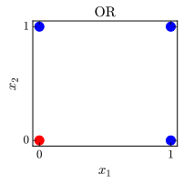

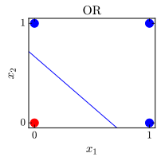
Neural Networks
OR
x1 x2 y
0 0 0
0 1 1
1 0 1
1 1 1

Slide 6
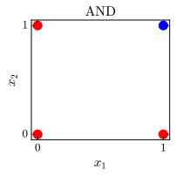
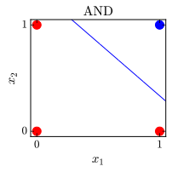

Neural Networks
AND
x1 x2 y
0 0 0
0 1 0
1 0 0
1 1 1

Slide 7
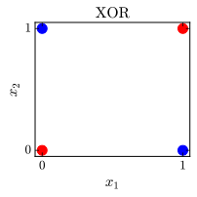

Neural Networks
OR
x1 x2 y
0 0 0
0 1 1
1 0 1
1 1 1
AND
x1 x2 y
0 0 0
0 1 0
1 0 0
1 1 1
XOR
x1 x2 y
0 0 0
0 1 1
1 0 1
1 1 0
This system cannot produce XOR
(cannot make a two sided cut)

Slide 8
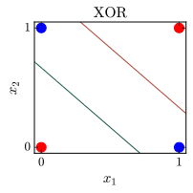
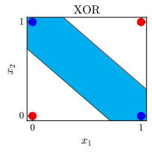
Neural Networks
XOR
x1 x2 y
0 0 0
0 1 1
1 0 1
1 1 0
AND
-20
20
-15
-15
15
NOT AND
-15
XOR
20
15
20
OR
x1 x2 OR NOT AND XOR
0 0 0 1 0
0 1 1 1 1
1 0 1 1 1
1 1 1 0 0

Slide 9
Neural Networks
AND
XOR
x1 x2 y
0 0 0
0 1 1
1 0 1
1 1 0
-20
20
-15
-15
15
NOT AND
-15
XOR
20
15
20
OR
Simple example showing that neural network can access ‘high-level’ functions

Slide 10
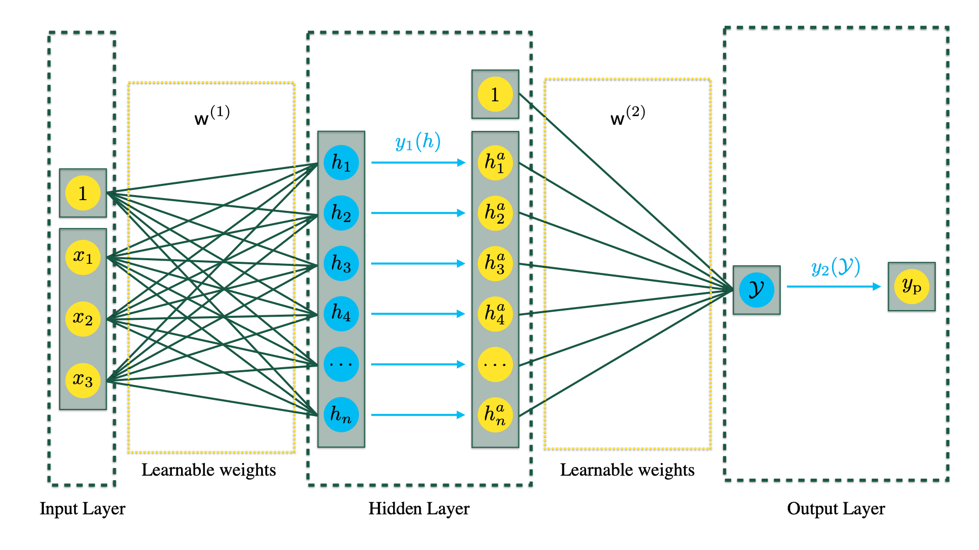
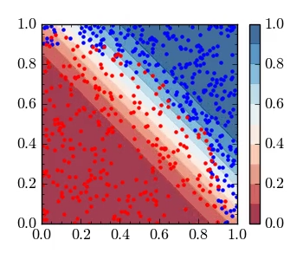
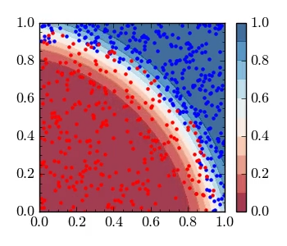
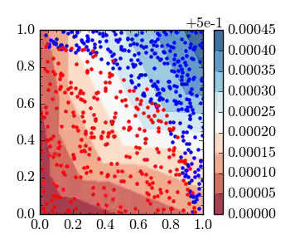
Neural Networks
Don’t add more inputs, let machine find own shape
Ability to learn ‘any’ function
More nodes/hidden layers allows for more complex features

Slide 11
Deep learning uses raw inputs, with many hidden layers to let the machine come up with its own features.
How deep can we go before running into problems?

Slide 13

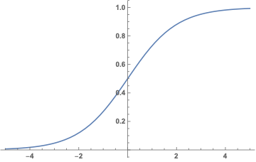
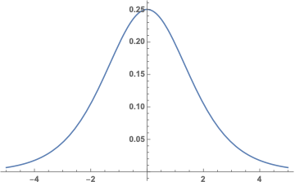

Disappearing Gradient
Sigmoid
Derivative
Chain rule for gradient of network involves multiple factors of the derivative multiplied together
(0.25)⁴ = 0.0039
Deep networks with Sigmoid activations have exponentially hard time training early layers

Slide 14
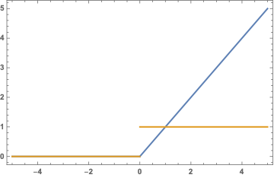
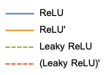
Disappearing Gradient
Sigmoid
Using the Rectified Linear Unit (ReLU) solves this problem.
ReLU(x) = {0 if x <=0, x if x >0}
Still has nonlinearity which allows network to learn complicated patterns
Nodes can die (derivative always 0 so cannot update)

Slide 15
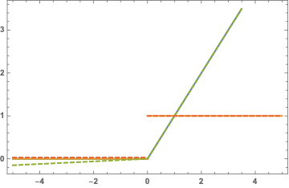
Disappearing Gradient
Sigmoid
Leaky Rectified Linear Unit (LeakyReLU) solves this problem.
LeakyReLU(x) = {alpha*x if x <=0, x if x >0}
I have never had to use this in practice

Slide 16
Transfer Learning
Pre-trained networks for image classification are readily available
https://keras.io/applications/
What if we want to do something with images, but not classification (using the same categories)?

Slide 17
Transfer Learning
Get rid of the “classification part”
Keep the features
Freeze the layers so that the features don’t change

Slide 18
Transfer Learning
New network
New network has small number of trainable weights, can train with limited resources
“Preprocess” our data

Slide 19

Transfer Learning
Deep learning lets the network learn features, rather than human engineering
Adding more layers allows for more complex features
Deeper networks use different activations
Transfer learning uses features learned from one task on a related task
Example
https://github.com/AlexEMG/DeepLabCut
Exercise Notebook
Train a network on simulated data, but want to apply it to real data

