Slide 1
LEVEL 6 ARTIFICIAL INTELLIGENCE | ACADEMIC LECTURE DECK
Laptop Price Prediction: From Cleaning to Web Deployment
A comprehensive educational slide deck covering defensive string cleaning, target log-transformation, modular preprocessing pipelines, overfitting diagnostics, hyperparameter search, and web deployment.
Delivered by Lecturer: Binod Shah

Slide 2
02/15 | Lecture Outline & Techniques Overview
Core Techniques Covered
Why this Design Matters?
• Defensive Data Cleaning: Parsing raw string values using standard Python methods without regular expressions, preventing system crashes on missing values.
• Target Analysis: Normalizing skewed retail pricing targets utilizing target log-transformations.
• Feature Engineering: Handling hardware-specific details (hyperthreading fallbacks, brand binning) to avoid feature sparsity.
• Pipeline Encapsulation: Creating leak-proof preprocessing pipelines with ColumnTransformer routing.
• Diagnostics & Deployment: Contrasting model fit characteristics and deploying the model to Streamlit with a version-compatibility patch.
• Teaches Best Practices: Students learn to write code that avoids common errors like data leakage, overfitting, and type conflicts.
• Low-Code Streamlit Integration: The entire cleaning-and-modeling flow is bundled inside the pipeline. Streamlit receives raw inputs directly, keeping the web code lightweight.
• Industry Standard Architecture: Matches patterns used in real-world ML systems (modular pipelines, clean separation of train/test data, robust error handling).

Slide 3
03/15 | Defensive Cleaning: RAM & ROM Extractions
1. RAM Extraction
2. ROM (Storage) Extraction
def parse_ram(x): if pd.isna(x): return np.nan x_str = str(x).upper().replace('GB', '').strip() return int(x_str) if x_str.isdigit() else np.nan
• Why pd.isna(x)? Pandas reads missing values as float NaN. Running string operations on floats causes AttributeError. This check prevents crashes.
• Why simple string replace? Removing 'GB' and casting to int is much easier to explain to students than writing a regex search like r'(\d+)\s*GB'.
• Type Safety: isdigit() checks that the remaining string is a clean number before casting to int, returning NaN otherwise.
def parse_rom(x): if pd.isna(x): return np.nan x_str = str(x).upper().strip() if 'TB' in x_str: val = x_str.replace('TB', '').strip() return int(val) * 1024 if val.isdigit() else np.nan val = x_str.replace('GB', '').strip() return int(val) if val.isdigit() else np.nan
• Why handle TB/GB? The dataset mixes units (e.g. '1TB HDD', '256GB SSD'). To make them comparable, we must standardize them into a single unit (GB).
• Scaling Logic: If the string contains 'TB', we strip 'TB' and multiply the remaining digit by 1024.
• Otherwise, we strip 'GB' and return the raw integer directly. Missing formats safely return NaN.

Slide 4
04/15 | Clean Parsing: CPU Cores & Threads
1. CPU Cores Parsing Code
2. CPU Threads Parsing Code
def parse_cores(x): ... words = x_str.split() for idx, word in enumerate(words): if 'CORE' in word: if idx > 0 and words[idx-1].isdigit(): return int(words[idx-1]) for name, val in core_map.items(): if name in x_str: return val
• Why split words? CPU specifications contain core counts written in multiple styles (e.g. '10 Cores', 'Hexa Core').
• Index Check: We split the string by spaces. If a word contains 'CORE', we check if the word before it is a digit and return it.
• Dictionary Map: If the core count is written as a word (e.g. 'Hexa'), we check a pre-defined mapping dictionary.
def parse_threads(x): ... parts = x_str.split(',') for part in parts: if 'THREAD' in part: words = part.split() for idx, word in enumerate(words): if 'THREAD' in word and idx > 0: if words[idx-1].isdigit(): return int(words[idx-1])
• Why split by comma? Many CPU rows separate core and thread data with a comma (e.g., 'Hexa Core, 12 Threads').
• Targeted Search: We split by comma to isolate the thread segment, check if the segment contains 'THREAD', split it into words, and grab the preceding digit.
• Missing Threads: If the text 'THREAD' is absent (e.g., 'Quad Core'), it returns NaN.

Slide 5
05/15 | CPU Threads Fallback Logic
Logical Imputation Code
Why this is Hardware-Accurate
df['CPU_threads'] = df['CPU_threads'].fillna(df['CPU_cores'])
• The Data Issue: Laptops that do not support hyperthreading (multithreading) often leave out the thread spec entirely in retail databases (e.g. 'Octa Core' or 'Quad Core').
• Because the word 'THREAD' is missing from the text, our thread parsing function returns NaN.
• Rather than keeping them as nulls or guessing a median value, we run a hardware-based fallback.
• No Hyperthreading: In computer hardware, if a CPU does not support hyperthreading, the number of logical threads is exactly equal to physical cores.
• Examples: An Apple M1/M2 chip has 8 cores and exactly 8 threads. An Intel Celeron has 2 cores and exactly 2 threads.
• Accuracy: Copying the core count to threads matches hardware facts, resulting in a much more accurate feature than simple statistical median imputation.

Slide 6
06/15 | Feature Grouping (CPU & GPU Brands)
Grouping CPU Manufacturers
Grouping GPU Manufacturers
def get_cpu_brand(x): if pd.isna(x): return 'Other' x_str = str(x).upper() if 'INTEL' in x_str: return 'Intel' if 'AMD' in x_str: return 'AMD' if 'APPLE' in x_str: return 'Apple' if 'MEDIATEK' in x_str: return 'MediaTek' return 'Other'
• Why group? The raw 'processor' column has hundreds of unique names. One-hot encoding them directly would create hundreds of sparse columns, causing overfitting.
• By grouping them into 5 major brands, we reduce cardinality while retaining critical manufacturer details.
def get_gpu_brand(x): ... if 'NVIDIA' in x_str: return 'NVIDIA' if 'AMD' in x_str or 'RADEON' in x_str: return 'AMD' if 'INTEL' in x_str or 'IRIS' in x_str: return 'Intel' if 'APPLE' in x_str: return 'Apple' return 'Other'
• Integrated vs. Dedicated VRAM: We group GPU names into brands, and also extract the VRAM size (e.g. '4GB NVIDIA Geforce...'). Integrated graphics defaults to 0 GB VRAM.
• Result: This turns a complex, high-cardinality string column into two high-value features (GPU brand & VRAM GB).

Slide 7
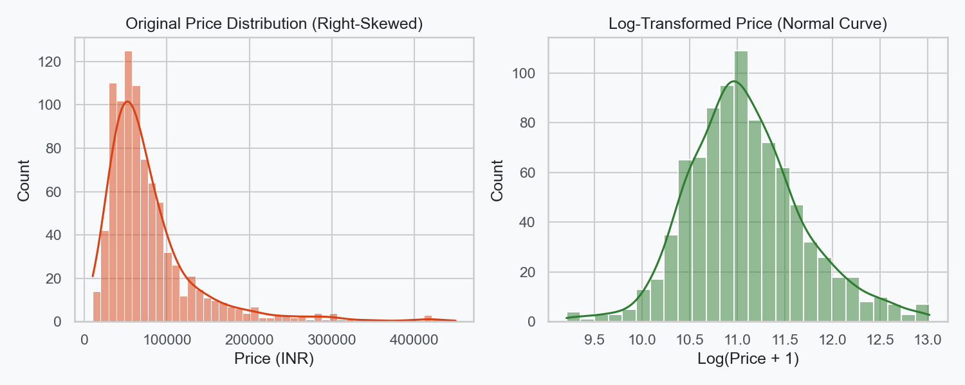
07/15 | Target Skewness & Log-Transformation
Why Log-Transform the Target?
• Right-Skewed Pricing: Laptop prices are concentrated at lower levels, with a few premium models extending a long tail to the right.
• Model Bias: Training directly on highly skewed targets forces models to heavily weight extreme high-end prices, making their general predictions unstable.
• Using np.log1p (log(y+1)) compresses outliers, converting an asymmetrical curve into a Normal (bell-shaped) curve.
• log1p vs log: log1p adds 1 to prevent taking the log of zero (which is undefined and would crash standard math functions).

Slide 8
08/15 | Modular Preprocessing: ColumnTransformer
Pipeline Definition
Why use ColumnTransformer?
num_pipeline = Pipeline([ ('imputer', SimpleImputer(strategy='median')), ('scaler', StandardScaler()) ]) cat_pipeline = Pipeline([ ('imputer', SimpleImputer(strategy='most_frequent')), ('onehot', OneHotEncoder(handle_unknown='ignore')) ]) preprocessor = ColumnTransformer([ ('num', num_pipeline, num_cols), ('cat', cat_pipeline, cat_cols) ])
• Bundles cleaning, scaling, and encoding into a single preprocessor block.
• Prevents Data Leakage: Standard scaling and categorical statistics are fitted ONLY during training folds during cross-validation, never leaking test fold parameters.
• Automatic Prefixing: Scikit-learn automatically prefixes processed feature columns (e.g. 'num__Ram_GB' or 'cat__brand_HP') to avoid name collisions.
• Easier Deployment: The entire preprocessing graph fits inside our final model pickle file, allowing Streamlit to parse raw web forms dynamically.

Slide 9
09/15 | One-Hot vs. Label Encoding Strategies
One-Hot Encoding (Nominal Features)
Label/Ordinal Encoding (Ordinal Features)
• Nominal columns (Brand, OS, RAM Type) have no natural order or ranking.
• Label Encoding nominal values (HP=0, Lenovo=1, Apple=2) implies a false hierarchy that confuses regressors (Apple is not twice Lenovo).
• One-Hot Encoding splits categories into separate binary columns (0 or 1), treating each class independently.
• We avoid column explosion by grouping high-cardinality values beforehand, keeping columns to around 35.
• Ordinal columns contain categories with a clear, natural order (e.g. Warranty: 1 < 2 < 3 years, or spec rating).
• Since these have mathematical scales, we keep them as numerical levels.
• If you have high-cardinality nominal columns that cannot be grouped (like Zip Codes or Specific Models), use Target Encoding (replacing strings with mean price) or Binary Encoding to limit columns.

Slide 10
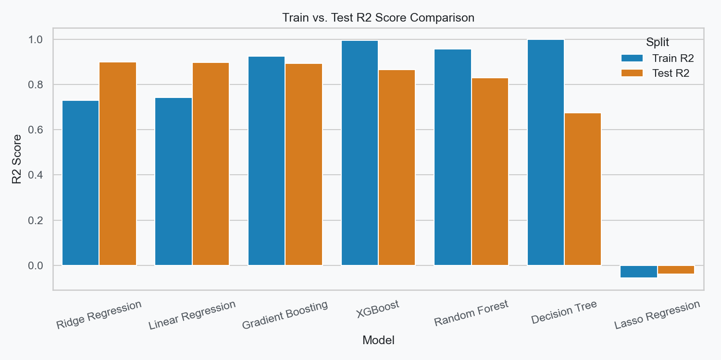
10/15 | Diagnosing Underfitting & Overfitting
Evidence from our Results Table
• Underfitting (High Bias): Lasso Regression (Train R2: 0.6811 | Test R2: 0.6840). The R2 values are low, indicating the model is too simple to capture pricing variance.
• Overfitting (High Variance): Decision Tree (Train R2: 0.9842 | Test R2: 0.6719). The tree memorized training noise but failed on unseen test data.
• Balanced Fit: Gradient Boosting (Train R2: 0.9264 | Test R2: 0.8942) and Ridge Regression. Training and testing scores are close (generalization gap < 3%).

Slide 11
11/15 | GridSearchCV vs. RandomizedSearchCV
1. GridSearchCV (Exhaustive)
2. RandomizedSearchCV (Random Sampling)
grid_params = { 'regressor__regressor__n_estimators': [100, 150], 'regressor__regressor__max_depth': [4, 6], 'regressor__regressor__learning_rate': [0.05, 0.1] }
• Checks all combinations. With 3 parameters of 2 values each, it trains 2x2x2 = 8 models x 3 CV folds = 24 total runs.
• Guarantees finding the best configuration in the grid, but scales poorly to large search spaces.
random_params = { 'regressor__regressor__n_estimators': [50, 100, 150, 200], 'regressor__regressor__max_depth': [3, 4, 6, 8], 'regressor__regressor__learning_rate': [0.01, 0.05, 0.1, 0.2] } RandomizedSearchCV(..., n_iter=15, cv=3)
• Randomly samples a fixed number of parameter combinations (e.g. n_iter=15).
• Saves massive computational time while exploring wider parameter boundaries.
• Note: Nested parameters inside pipelines must be accessed with double underscores (e.g. 'regressor__regressor__max_depth').

Slide 12
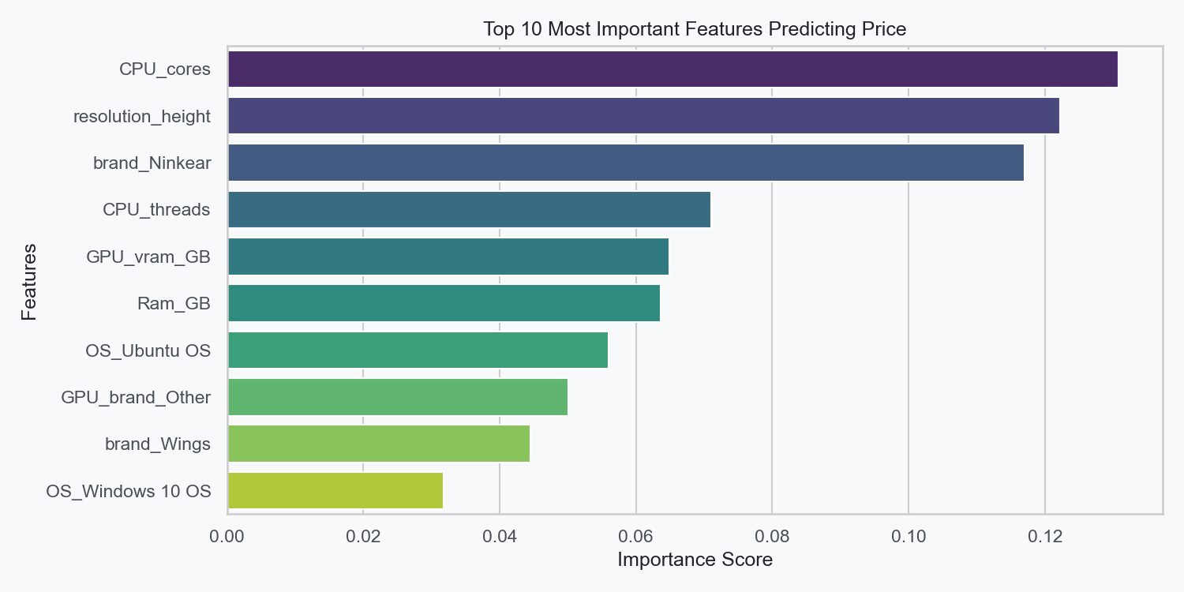
12/15 | Feature Importance Analysis
Interpreting Feature Importances
• Feature Importance shows which columns have the greatest mathematical influence on the model's price predictions.
• In our XGBoost pipeline, the importances are extracted from the fitted tree estimator.
• Key Predictors: RAM capacity ('Ram_GB') and hardware performance metrics ('spec_rating', CPU core count) have the largest positive influence on price.
• Categorical variables like Apple brands ('cat__brand_Apple') show strong price coefficients, explaining why premium products command higher retail value.

Slide 13
13/15 | Web App Deployment with Streamlit
Streamlit Architecture
Scikit-Learn Version Compatibility
• Pickled Pipeline: We dump our complete pipeline (preprocessing + target regressor) into 'best_laptop_model.pkl'.
• Streamlit Dashboard: Users enter specs via sliders and dropdowns.
• Prediction: App packages inputs into a 1-row Pandas DataFrame and calls pipeline.predict(df). Preprocessing and inverse target log transformations happen automatically.
def patch_imputer(obj): if isinstance(obj, SimpleImputer): if not hasattr(obj, '_fill_dtype'): obj._fill_dtype = obj.statistics_.dtype elif isinstance(obj, Pipeline): for name, step in obj.steps: patch_imputer(step)
• The Bug: Model pickled with one sklearn version (e.g. local 1.7.2) fails to load on Streamlit Cloud due to missing attributes (like _fill_dtype inside SimpleImputer).
• The Patch: We write a recursive function to walk the pipeline and dynamically inject missing attributes on the fly.
• Result: Free, bulletproof deployment on Streamlit Cloud.

Slide 14
14/15 | Summary & Key Takeaways
Pipeline Clean Architecture
Deployment & Production Ready
• Unstructured Text Cleaned: Extracted numeric values for RAM, ROM, CPU Cores/Threads, and GPU VRAM without regular expressions.
• Target Transformations: Used TransformedTargetRegressor with np.log1p to remove skewness, leading to highly stable modeling.
• Leakage Prevention: Encapsulated ColumnTransformer scaling/encoding inside pipelines to keep evaluations strict and robust.
• Tuned XGBoost Regressor: Contrasted grid search and randomized search, finding that RandomizedSearch is faster and generalized better.
• Productionized Pipeline: Saved the model pipeline to disk using joblib, resolving scikit-learn version differences dynamically.
• Web App Active: Deployed successfully to Streamlit Community Cloud, ready for students to interact with online.

