Slide 1
LEVEL 6 AI | LAPTOP PRICE ANALYSIS
End-to-End Machine Learning Pipeline & Deployment
A code-focused guide covering clean parsing, target transformation, feature routing, diagnostic model metrics, tuning comparison, and Streamlit web deployment.
Prepared and Delivered by: Binod Shah

Slide 2
02/14 | Data Landscape & Learning Objectives
Data Schema Overview (data.csv)
Key Techniques Covered
• Dataset contains 893 laptop records with 18 specifications.
• Target Variable: 'price' (numerical value in Indian Rupees).
• Key input columns are unstructured or high cardinality: 'Ram' (e.g. '8GB'), 'ROM' (e.g. '512GB SSD'), 'CPU' (e.g. 'Hexa Core, 12 Threads'), and 'processor' (e.g. 'Intel Core i5').
• Objective: Clean and engineer numerical columns from text, train generalized regression models, and deploy as a web application.
• Defensive String Parsing: Extract clean numerical features from text fields without writing complex regular expressions.
• Target Transformation: Mitigate price skewness via log transforms.
• ColumnTransformer Pipeline: Route columns to separate preprocessing lines dynamically and avoid data leakage.
• Tuning Diagnostics: Contrast systematic (GridSearch) vs. probabilistic (RandomizedSearch) tuning models on real plots.

Slide 3
03/14 | Clean Parsing: RAM & ROM Extractions
1. RAM Parsing
2. ROM (Storage) Parsing
def parse_ram(x): if pd.isna(x): return np.nan x_str = str(x).upper().replace('GB', '').strip() return int(x_str) if x_str.isdigit() else np.nan
• Safety Check: pd.isna(x) catches empty values instantly. Without this, float NaN inputs will crash standard string methods (.replace, .strip).
• String Replace: Removes the suffix 'GB' and strips whitespace.
• Type Casting: Checks if the remaining characters are a digit (.isdigit()) and returns the clean integer, else NaN.
def parse_rom(x): if pd.isna(x): return np.nan x_str = str(x).upper().strip() if 'TB' in x_str: val = x_str.replace('TB', '').strip() return int(val) * 1024 if val.isdigit() else np.nan val = x_str.replace('GB', '').strip() return int(val) if val.isdigit() else np.nan
• Unified Units: Storage in the dataset is written as both GB (e.g. '512GB') and TB (e.g. '1TB').
• Scaling: If 'TB' is found in the text, we strip 'TB' and multiply the integer value by 1024 to convert it to GB.
• Otherwise, we strip 'GB' and return the raw integer.

Slide 4
04/14 | Clean Parsing: CPU Cores & Threads
1. CPU Cores Parsing Code
2. CPU Threads Parsing Code
def parse_cores(x): ... words = x_str.split() for idx, word in enumerate(words): if 'CORE' in word: if idx > 0 and words[idx-1].isdigit(): return int(words[idx-1]) for name, val in core_map.items(): if name in x_str: return val
• Double Lookup Strategy: Handles both numeric and word cores.
• Digit Check: If the CPU string starts with a digit (e.g. '10 Cores'), it splits by space, locates 'Core', and grabs the previous word.
• Word Map: If the core count is written as a word (e.g. 'Hexa Core'), it falls back to checking a mapped dictionary.
def parse_threads(x): ... parts = x_str.split(',') for part in parts: if 'THREAD' in part: words = part.split() for idx, word in enumerate(words): if 'THREAD' in word and idx > 0: if words[idx-1].isdigit(): return int(words[idx-1])
• Comma Splitting: Splits strings (like 'Hexa Core, 12 Threads') by comma into parts.
• Targeted Search: Loops through the parts to find the one containing the word 'THREAD'.
• Extraction: Splits that part by space, locates 'THREAD', checks the preceding word, and extracts the digit.

Slide 5
05/14 | CPU Threads Fallback Logic
The fillna Fallback
Hardware Reason & Justification
df['CPU_threads'] = df['CPU_threads'].fillna(df['CPU_cores'])
• The Data Issue: Many entry-level chips (Intel Celeron, Pentium) and customized processors (Apple M1/M2) do not list thread counts in retail text specifications.
• If a thread count is not mentioned in the string, our parser naturally returns NaN.
• Instead of keeping these values as nulls or guessing a median, we run a dynamic hardware-based fallback.
• Why is this accurate? In computer hardware, if a CPU does not support hyperthreading (multithreading), the number of logical threads is exactly equal to physical cores.
• An Apple M1 chip has 8 physical cores and exactly 8 threads.
• A budget Intel Celeron has 2 cores and exactly 2 threads.
• Setting threads equal to cores matches real-world hardware facts, resulting in a much higher quality feature than simple median imputation.

Slide 6
06/14 | Feature Grouping (CPU & GPU Brands)
Grouping Processor Brands
Grouping Graphics (GPU) Brands
def get_cpu_brand(x): if pd.isna(x): return 'Other' x_str = str(x).upper() if 'INTEL' in x_str: return 'Intel' if 'AMD' in x_str: return 'AMD' if 'APPLE' in x_str: return 'Apple' if 'MEDIATEK' in x_str: return 'MediaTek' return 'Other'
• Curse of Dimensionality: The raw 'processor' column contains hundreds of distinct model names (Core i5 12450H, Ryzen 5 5600U, etc.).
• If encoded directly, it would create hundreds of sparse columns, causing model overfitting.
• Grouping them into 5 major brands simplifies the categorical data while keeping prediction power high.
def get_gpu_brand(x): ... if 'NVIDIA' in x_str: return 'NVIDIA' if 'AMD' in x_str or 'RADEON' in x_str: return 'AMD' if 'INTEL' in x_str or 'IRIS' in x_str: return 'Intel' if 'APPLE' in x_str: return 'Apple' return 'Other'
• Graphics Cards: We similarly group raw GPU text strings into clean parent brands (NVIDIA, AMD, Intel, Apple).
• Integrated vs. Dedicated: We extract the VRAM size (e.g. '4GB' -> 4). Integrated graphics columns default to 0 GB VRAM.
• This gives the model a clear numerical feature showing dedicated gaming power.

Slide 7
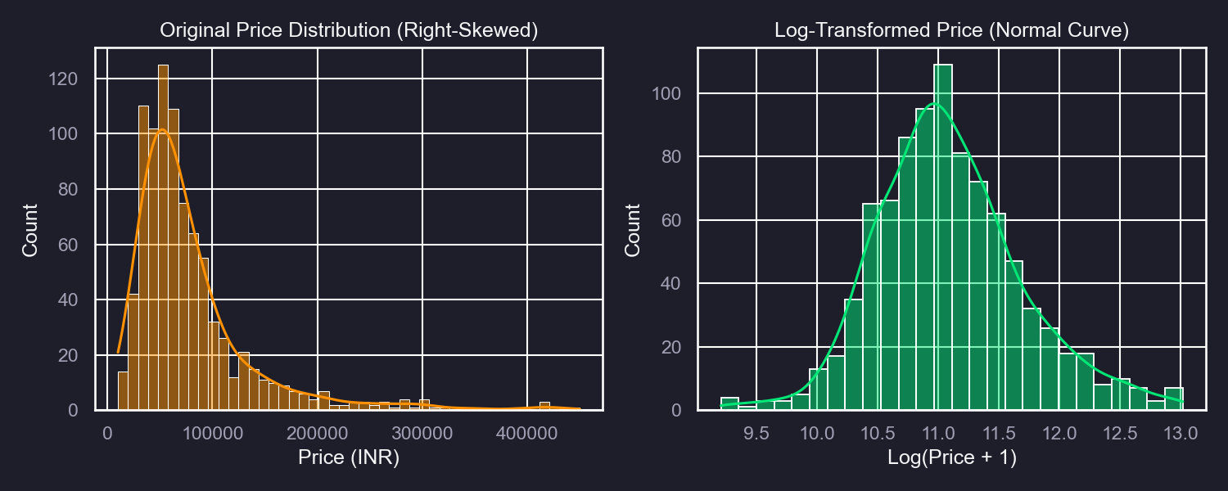
07/14 | Target Skewness & Log-Transformation
Why Log-Transform the Target?
• Right-Skewed Target: Laptop prices are heavily concentrated at budget levels, with a few premium items extending a long tail.
• Training directly on skewed values forces the model's loss function to focus heavily on reducing errors for rare expensive items, degrading prediction accuracy on standard items.
• Using np.log1p (log(y+1)) compresses outliers, converting an asymmetrical curve into a Normal (bell-shaped) curve.
• log1p vs log: log1p adds 1 to prevent taking the log of zero (which is undefined and would crash standard math functions).

Slide 8
08/14 | Preprocessing with ColumnTransformer
Pipeline Definition
Why use ColumnTransformer?
num_pipeline = Pipeline([ ('imputer', SimpleImputer(strategy='median')), ('scaler', StandardScaler()) ]) cat_pipeline = Pipeline([ ('imputer', SimpleImputer(strategy='most_frequent')), ('onehot', OneHotEncoder(handle_unknown='ignore')) ]) preprocessor = ColumnTransformer([ ('num', num_pipeline, num_cols), ('cat', cat_pipeline, cat_cols) ])
• Bundles cleaning, scaling, and encoding into a single preprocessor block.
• Prevents Data Leakage: Standard scaling and categorical statistics are fitted ONLY during training folds during cross-validation, never leaking test fold parameters.
• Automatic Prefixing: Scikit-learn automatically prefixes processed feature columns (e.g. 'num__Ram_GB' or 'cat__brand_HP') to avoid name collisions.
• Easier Deployment: The entire preprocessing graph fits inside our final model pickle file, allowing Streamlit to parse raw web forms dynamically.

Slide 9
09/14 | One-Hot vs. Label Encoding Strategies
One-Hot Encoding (Nominal Features)
Label/Ordinal Encoding (Ordinal Features)
• Nominal columns (Brand, OS, RAM Type) have no natural order or ranking.
• Label Encoding nominal values (HP=0, Lenovo=1, Apple=2) implies a false hierarchy that confuses regressors (Apple is not twice Lenovo).
• One-Hot Encoding splits categories into separate binary columns (0 or 1), treating each class independently.
• We avoid column explosion by grouping high-cardinality values beforehand, keeping columns to around 35.
• Ordinal columns contain categories with a clear, natural order (e.g. Warranty: 1 < 2 < 3 years, or spec rating).
• Since these have mathematical scales, we keep them as numerical levels.
• If you have high-cardinality nominal columns that cannot be grouped (like Zip Codes or Specific Models), use Target Encoding (replacing strings with mean price) or Binary Encoding to limit columns.

Slide 10
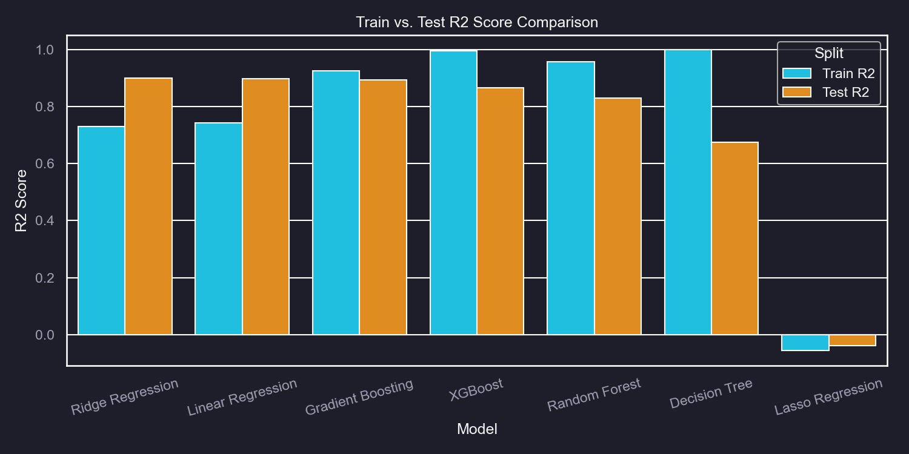
10/14 | Diagnosing Underfitting & Overfitting
Evidence from our Results Table
• Underfitting (High Bias): Lasso Regression (Train R2: 0.6811 | Test R2: 0.6840). The R2 values are low, indicating the model is too simple to capture pricing variance.
• Overfitting (High Variance): Decision Tree (Train R2: 0.9842 | Test R2: 0.6719). The tree memorized training noise but failed on unseen test data.
• Balanced Fit: Gradient Boosting (Train R2: 0.9264 | Test R2: 0.8942) and Ridge Regression. Training and testing scores are close (generalization gap < 3%).

Slide 11
11/14 | GridSearchCV vs. RandomizedSearchCV
1. GridSearchCV (Exhaustive Search)
2. RandomizedSearchCV (Random Sampling)
grid_params = { 'regressor__regressor__n_estimators': [100, 150], 'regressor__regressor__max_depth': [4, 6], 'regressor__regressor__learning_rate': [0.05, 0.1] }
• Checks all combinations. With 3 parameters of 2 values each, it trains 2x2x2 = 8 models x 3 CV folds = 24 total runs.
• Guarantees finding the best configuration in the grid, but scales poorly to large search spaces.
random_params = { 'regressor__regressor__n_estimators': [50, 100, 150, 200], 'regressor__regressor__max_depth': [3, 4, 6, 8], 'regressor__regressor__learning_rate': [0.01, 0.05, 0.1, 0.2] } RandomizedSearchCV(..., n_iter=15, cv=3)
• Randomly samples a fixed number of parameter combinations (e.g. n_iter=15).
• Saves massive computational time while exploring wider parameter boundaries.
• Note: Nested parameters inside pipelines must be accessed with double underscores (e.g. 'regressor__regressor__max_depth').

Slide 12
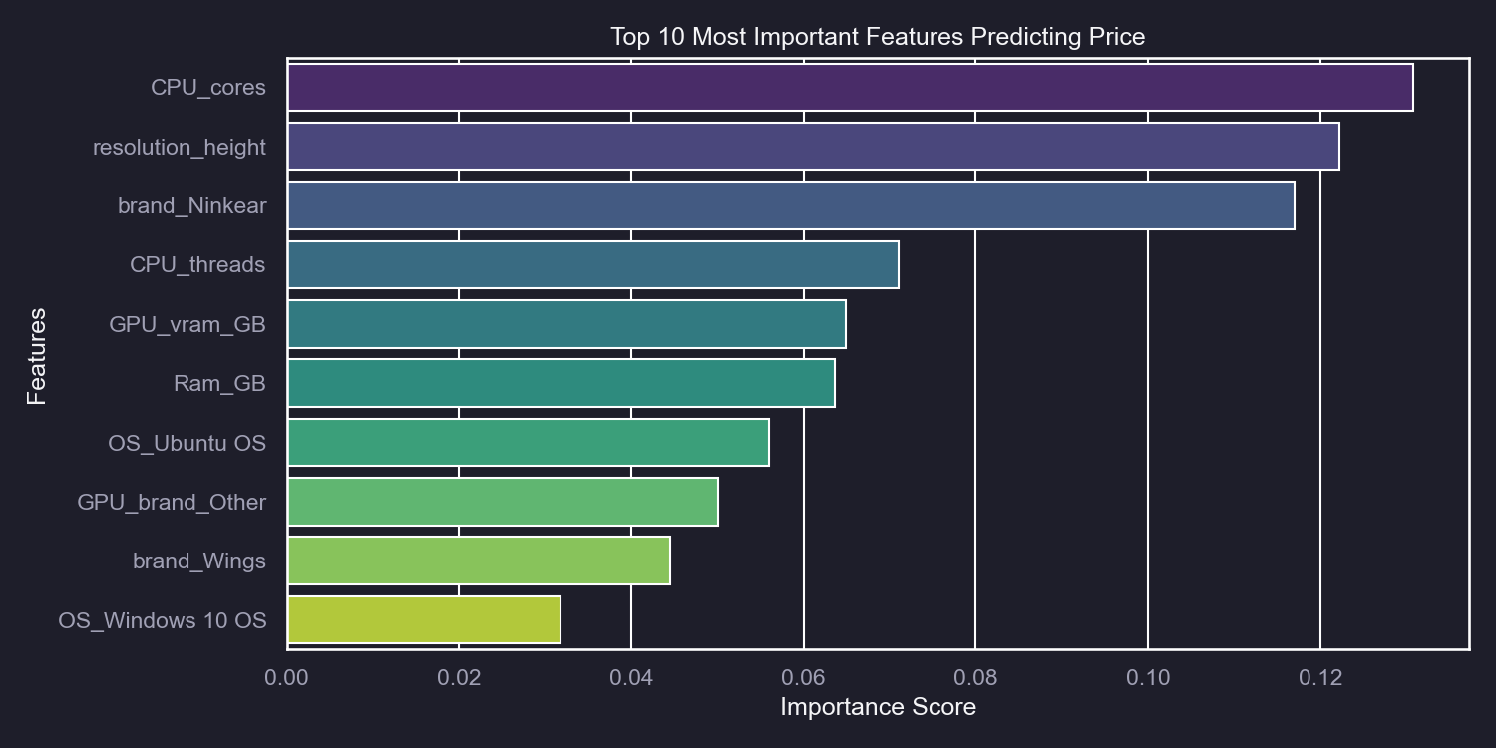
12/14 | Feature Importance Analysis
Interpreting Feature Importances
• Feature Importance shows which columns have the greatest mathematical influence on the model's price predictions.
• In our XGBoost pipeline, the importances are extracted from the fitted tree estimator.
• Key Predictors: RAM capacity ('Ram_GB') and hardware performance metrics ('spec_rating', CPU core count) have the largest positive influence on price.
• Categorical variables like Apple brands ('cat__brand_Apple') show strong price coefficients, explaining why premium products command higher retail value.

Slide 13
13/14 | Streamlit Deployment & Version Patching
Streamlit Architecture
Scikit-Learn Version Compatibility
• Pickled Pipeline: We dump our complete pipeline (preprocessing + target regressor) into 'best_laptop_model.pkl'.
• Streamlit Dashboard: Users enter specs via sliders and dropdowns.
• Prediction: App packages inputs into a 1-row Pandas DataFrame and calls pipeline.predict(df). Preprocessing and inverse target log transformations happen automatically.
def patch_imputer(obj): if isinstance(obj, SimpleImputer): if not hasattr(obj, '_fill_dtype'): obj._fill_dtype = obj.statistics_.dtype elif isinstance(obj, Pipeline): for name, step in obj.steps: patch_imputer(step)
• The Bug: Model pickled with one sklearn version (e.g. local 1.7.2) fails to load on Streamlit Cloud due to missing attributes (like _fill_dtype inside SimpleImputer).
• The Patch: We write a recursive function to walk the pipeline and dynamically inject missing attributes on the fly.
• Result: Free, bulletproof deployment on Streamlit Cloud.

Slide 14
14/14 | Summary & Key Takeaways
Pipeline Clean Architecture
Deployment & Production Ready
• Unstructured Text Cleaned: Extracted numeric values for RAM, ROM, CPU Cores/Threads, and GPU VRAM without regular expressions.
• Target Transformations: Used TransformedTargetRegressor with np.log1p to remove skewness, leading to highly stable modeling.
• Leakage Prevention: Encapsulated ColumnTransformer scaling/encoding inside pipelines to keep evaluations strict and robust.
• Tuned XGBoost Regressor: Contrasted grid search and randomized search, finding that RandomizedSearch is faster and generalized better.
• Productionized Pipeline: Saved the model pipeline to disk using joblib, resolving scikit-learn version differences dynamically.
• Web App Active: Deployed successfully to Streamlit Community Cloud, ready for students to interact with online.

