Slide 1
Zookeeper YouTube

Slide 2
Zookeeper Standalone Installation
Zookeeper Server (localhost:2181)
Terminal - 1

Slide 3
Zookeeper Standalone Installation
Zookeeper Server (localhost:2181)
Terminal - 1
Zookeeper
Client
Terminal - 2

Slide 4
Zookeeper Standalone Installation
Zookeeper Server (localhost:2181)
Terminal - 1
Zookeeper
Client
Java Code
Terminal - 2

Slide 5
Zookeeper Cluster (Ensemble) Installation
Zookeeper Cluster
Zookeeper Server (localhost:2181)
Zookeeper Server (localhost:2182)
Zookeeper Server (localhost:2183)
Zookeeper Server (localhost:2184)
Zookeeper Server (localhost:2185)
Zookeeper as a cluster of servers also referred to as Ensemble for high availability.
If N is the total number of servers in the ensemble, quorum should be at-least N/2. There should be at least one server that intersects in the quorum.
For instance, if N=5 is the number of servers in the ensemble and N/2 >= 3 is the quorum, Zookeeper can tolerate up to 2 server failures.
Quorum is the minimum number of servers that should be up and running for Zookeeper to function normally.

Slide 6
Zookeeper Cluster (Ensemble) Installation
Zookeeper Cluster
Leader
Zookeeper Server (localhost:2181)
Follower
Follower
Follower
Follower
Zookeeper Server (localhost:2182)
Zookeeper Server (localhost:2183)
Zookeeper Server (localhost:2184)
Zookeeper Server (localhost:2185)
When Zookeeper runs as an ensemble, one of the servers is elected as a leader. The other servers act as followers.
The leader is responsible for processing all writes and it sequences write operations and establishes the order of operations to be applied to followers.
+ The Leader is responsible for accepting all incoming state changes (Write request) from the clients and replicate them to itself and to the followers.
+ Read requests are load balanced between all followers and leader.

Slide 7
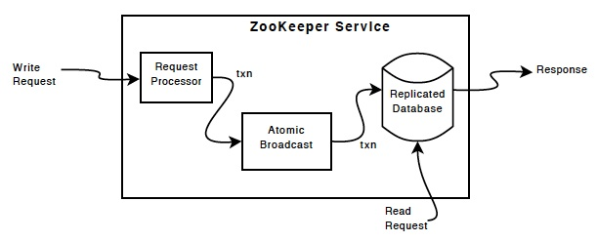
Zookeeper Cluster (Ensemble) Installation
Zookeeper Cluster
Leader
Zookeeper Server (localhost:2181)
Data Sync
Follower
Follower
Follower
Follower
Zookeeper Server (localhost:2182)
Zookeeper Server (localhost:2183)
Zookeeper Server (localhost:2184)
Zookeeper Server (localhost:2185)

Slide 8
Zookeeper Cluster (Ensemble) Installation
Zookeeper Cluster
Zookeeper Server (localhost:2181)
Zookeeper Server (localhost:2182)
Zookeeper Server (localhost:2183)
Zookeeper Server (localhost:2184)
Zookeeper Server (localhost:2185)
Zookeeper
Client
Java Code

Slide 9
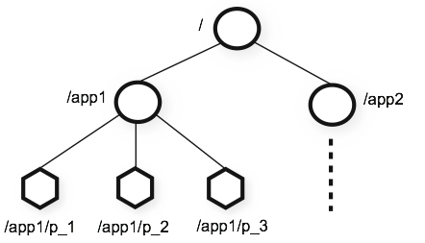
Zookeeper Data Model : ZNode
Apache Zookeeper, It is a library that enables coordination in distributed systems. These are some of the distributed systems coordination problems that zookeeper solves:
Work Distribution
Configuration Management
Distributed Monitoring
Distributed Locks
Group membership
Leader Selection
Generate Distributed Sequence
Znode is there with Zookeeper to solve these enterprise use case easily.
ZooKeeper uses a hierarchical data structure called znodes to store and manage data in a distributed system.
These znodes are similar to files and directories in a
traditional file system, but with additional features for coordination and synchronization.
By using znodes and their associated operations, ZooKeeper can effectively solve various distributed system challenges.

Slide 10
Zookeeper Data Model : ZNode
+ Znodes are the fundamental abstraction provided by Zookeeper to represent a node in a tree-like structure.
+ A znode can store (1) data in the form of a byte array (key-value) and it can have (2) child nodes.
There are 5 different types of znodes:
Persistent znodes: These znodes remain permanent in Zookeeper even when the client that created it dies. The only way of deleting such nodes is by explicitly invoking delete API.
Ephemeral znodes: These znodes are transient in the sense that they remain in Zookeeper only during the active session of the client that created the znode. When the session expires or the client dies, the ephemeral nodes are automatically deleted.
Sequential znodes: When the client requests for the creation of a sequential znode, Zookeeper automatically appends an incrementing sequence number to the path. This helps in determining the order of the creation of znodes.
3. Ephemeral Sequential znodes
4. Persistent Sequential znodes
5. TTL (time to live) Znodes
1. Value
2. Child Info
node
1. Value
2. Child Info
1. Value
2. Child Info
node
node
1. Value
2. Child Info
node
1. Value
2. Child Info
node

Slide 11
Zookeeper Data Model : ZNode
1. ** Persistent znode **
Syntax /path '<data>'
create /mydata "Binod Suman"
Update Node
set /mydata 'Binod'
get /mydata -> Binod
Create child node:
Syntax
create /parent/path/subnode/path '<data>'
Get ChildNodeNumber
getAllChildrenNumber /mydata
-R to show the child nodes recursely
ls -R /mydata
2. ** Create Ephemerals Znode **
Syntax
create -e /path '<data>'
create -e /ephe "Ephemeral node"
create -e /ephe2 "Ephemeral node 2"
To show only Ephemerals node
> getEphemerals
Ephemerals inside the persistent node
create -e /mydata/ephe3 "Ephemeral node 2"
3. ** Sequential Persistent node **
[zk: localhost:2181(CONNECTED) 19] create -s /seq 'First'
Created /seq0000000004
[zk: localhost:2181(CONNECTED) 20] create -s /seq 'Second'
Created /seq0000000005

