Slide 1
Solar versus wind power
A re-analysis of Dugstad, Hoel and Lindhjem (2026): replication, preference heterogeneity and a formal comparison of the technologies
Green text = added after the report submitted on 31 October 2026: the pooled mixed-logit block tests and the R code I promised to present at this examination
Binod · Oral examination · 13 November 2026

Slide 2
The study, the data and the model
Original paper: a discrete choice experiment on preferences for solar versus wind power (Samfunnsøkonomen, 2026); data from Innlandet county
Data: 775 respondents (solar) and 788 (wind), eight choice tasks each: 6,200 and 6,304 observations
Each task: a development alternative or "no development" (status quo); attributes: production, number of plants, nature protection, distance, visibility, and an annual bill reduction for 10 years
Model in willingness-to-accept (WTA) space:
U(alternative) = σ · (B − Σ wₖ Xₖ) + ε U(status quo) = σ · w_SQ + ε
Every w is a money value: NOK per household and year; σ is the cost scale

Slide 3
What I did, and the R scripts
Step | R scripts
Verify published figures; replicate the mixed logit | a3_published.R, 09_policy.R, 03_replicate_anders.R
Heterogeneity: MNL ladder, full-covariance mixed logit | 02_mnl_ladder.R, 04_mixed_mvn.R
Latent classes and hybrid choice | 06_latent_class.R, 06b_lc3_constrained.R, 07_hybrid.R
Status quo and exclusion rules | 10_robustness.R
Technologies: pooled latent class and pooled MNL | 05_pooled_lc.R, 12_pooled_mnl_scale.R
Technologies: pooled mixed logit with block tests | 11_pooled_mixed.R, 15_pooled_scaled.R, 13_pooled_summary.R
Policy: cost per kWh and acceptance curves | 09_policy.R, 14_curves.R
Green text = added after the 31 October submission

Slide 4
Verification of the published results
Figure 6 (cost per kWh) is reproduced exactly from Table A.3: 12 of 12 scenarios, maximum difference 0 øre/kWh
Inconsistency 1: the worked example for wind (Table A.6) uses the 57,000-household coefficient (17.16 øre/kWh); Figure 6 uses the 38,000-household coefficient (17.62 øre/kWh)
Inconsistency 2: the solar status quo value is NOK 3,822 in the text and NOK 3,872 in Table A.3
The replication script has a block labelled "Figure 8", divided by an unexplained constant (13.88). The article has no Figure 8; I did not use that block
Green text = added after the 31 October submission

Slide 5
R code: Figure 6 recomputed from Table A.3
R code, as promised for the oral examination
H <- 4100; KWH <- 600e6
ore <- function(z, lev, visible) 100 * (z$sq - sum(z$w[lev]) - if (visible) z$view else 0) * H / KWH * 100
09_policy.R, lines 15 and 20. The constants 4,100 and 600,000,000 are those of the published replication script
The function turns the status quo constant, minus the WTA of the scenario’s features and of visibility, into øre per kWh
Output of the script: "max absolute difference: 0 ore/kWh" over the twelve scenario-and-visibility combinations
Wind: P6 without visibility 9.2 øre/kWh; solar 3.3
Green text = added after the 31 October submission

Slide 6
Replication of the mixed logit
 | Solar: published | Solar: replication | Wind: published | Wind: replication
Log-likelihood | −2536.4 | −2531.3 | −2065.2 | −2054.7
BIC | 5,335 | 5,324.6 | 4,392 | 4,371.9
Parameters | 30 | 30 | 30 | 30
Same WTA-space specification, 500 instead of 2,000 draws; it follows the specification and Apollo structure of the replication package, written into my own scripts
Better log-likelihood than published, same qualitative conclusions; several weakly identified means (production, plants) differ
Published wind standard errors are much smaller than my robust ones: status quo mean 0.703 against 5.70 (units of 100 NOK)
Green text = added after the 31 October submission

Slide 7
Observed heterogeneity: the MNL ladder
Status quo shifters improve the MNL fit strongly (likelihood-ratio p < 10⁻²² in both samples)
Fullest MNL: age raises the status quo WTA by NOK 1,359 per decade (solar, t = 3.5) and 1,369 (wind, t = 3.0); women by 2,258 (t = 1.8) and 3,307 (t = 2.2)
Education and income: no systematic effects (|t| ≤ 0.8); cost sensitivity does not vary with income
Exposure is not significant in this rung (t = −1.3 and −1.1) because the attitude variables absorb it
Attitudes raise the fit much more, but they are potentially endogenous

Slide 8
R code: the full-covariance mixed logit
R code, as promised for the oral examination
r[["b_sq"]] <- m_sq + l11 * xi1
r[["b_nop"]] <- m_nop + l21 * xi1 + l22 * xi2
r[["b_d1"]] <- m_d1 + l31 * xi1 + l32 * xi2 + l33 * xi3
r[["b_view"]] <- m_view + l41 * xi1 + l42 * xi2 + l43 * xi3 + l44 * xi4
r[["b_cost"]] <- exp(m_cost + l51 * xi1 + l52 * xi2 + l53 * xi3 + l54 * xi4 + l55 * xi5)
04_mixed_mvn.R, lines 37 to 41 (function rc_M2)
Five correlated dimensions: status quo, no protection, distance below 1 km, visibility, and the log of the cost scale; the l-parameters are the Cholesky factor of the covariance
xi1 to xi5 are standard normal draws (MLHS); the model was estimated in stages and converges for both technologies
BIC 5,320 solar and 4,388 wind, against published 5,335 and 4,392 and my replication 5,325 and 4,372
Green text = added after the 31 October submission

Slide 9
Latent classes and compensation
Class | Solar | Wind
Cost-responsive traders | 25.4% | 15.3%
Cost-ignorers | 36.9% | 27.9%
Status-quo-only | 37.8% | 56.8%
BIC: LC3 (LC2 with attitudes) | 4,990 (5,553) | 3,882 (4,349)
Traders respond to attributes and cost; cost-ignorers respond to attributes but not to compensation; status-quo-only choose "no development" about 99% of the time
Trader cost coefficient fixed at its two-class value: the unrestricted wind model collapsed toward a second cost-ignorer class
Trader classes are small and imprecise: no strong policy conclusions from class-specific WTAs

Slide 10
Hybrid choice: concern about nature
One latent "concern about nature" with five ordered indicators; it shifts the status quo constant
Exposure to possible development raises the status quo WTA through the latent concern: about NOK 5,891 (solar) and 14,927 (wind)
Environmental-organisation membership: about NOK 8,290 and 8,586
Age has a clear positive effect in the wind sample; education and income do not
Associations, not causal effects: attitudes may partly rationalise earlier choices; the hybrid likelihood cannot be compared with choice-only models

Slide 11
The status quo is not stable
Sample (simple MNL, NOK per household-year) | Wind | Solar
All respondents | 13,084 | 2,749
After the paper’s protest rule | 3,274 | −3,644
Protected-value reasons not treated as protest | 7,439 | −1,706
All always-status-quo respondents removed | −6,945 | −8,884
The protest rule removes 21.4% of the solar and 29.6% of the wind sample; the protected-value statement is 19.4% and 23.7% of the always-status-quo respondents
No protection, distance below 1 km and visibility are basically stable across screens; the status quo is not
Not comparable with the mixed-logit constants

Slide 12
Solar vs wind: pooled MNL and latent class
Test | LR | df | p-value
MNL: all eleven WTAs equal (scale free) | 43.4 | 11 | 9.2 × 10⁻⁶
MNL: status quo term equal | 29.7 | 1 | 5.1 × 10⁻⁸
MNL: other ten WTAs equal | 13.7 | 10 | 0.19
MNL: scale equal | 0.7 | 1 | 0.41
Latent class: technology-specific constants | 45.9 | 2 | 1.1 × 10⁻¹⁰
Latent class: ten trader WTAs equal | 21.7 | 10 | 0.016
In the pooled MNL the main difference is the status quo constant, not the ten attribute valuations; the scale does not differ

Slide 13
Pooled mixed logit: the design
NEW since the 31 October submission
One likelihood for both samples: solar value = θ, wind value = θ + x, for all 34 parameters of the full-covariance model
All x free = the two separate models on the same 250 draws (68 parameters)
A hypothesis fixes one block of x at zero: scale (6), covariance (10), attribute means (10), status quo constant (1), shifters (7), all (34)
Every test is a likelihood-ratio test between nested models
ths <- sapply(pn, gv); thw <- ths + sapply(paste0("x_", pn), gv)
G <- list(scale = c("m_cost", "l55", "l51", "l52", "l53", "l54"),
restr <- switch(base, U = character(0), all = pn, unlist(G[[base]]))
fixed <- if (length(restr)) paste0("x_", restr) else character(0)
11_pooled_mixed.R, lines 57, 26, 34 and 44
Green text = added after the 31 October submission

Slide 14
Pooled mixed logit: convergence
NEW since the 31 October submission
First round invalid: the model with equal shifters (−4557.14) fitted better than the model containing it (−4568.42); those tests were discarded
Restart from the best solution: unrestricted −4552.42, still below the restricted scale model (−4552.39)
Parameter scaling in the optimiser (same model, draws and likelihood): −4552.17, above every restricted model, in 2,523 instead of 3,323 minutes
SCf <- function(b) setNames(ifelse(abs(b) > 5, 10, 1), names(b))
estimate_settings = list(maxIterations = 400, scaling = SCf(st[setdiff(names(st), fixed)]))
15_pooled_scaled.R, lines 9 and 14 (inside the replacement string)
Green text = added after the 31 October submission

Slide 15
Pooled mixed logit: likelihood-ratio tests
NEW since the 31 October submission
Restriction (reference: log-lik. −4552.2) | LR | df | p | p (Holm)
Cost scale equal | 0.4 | 6 | 1.00 | 1.00
Taste covariance equal | 26.8 | 10 | 0.0028 | 0.0084
Ten attribute means equal | 41.1 | 10 | 1.1 × 10⁻⁵ | 4 × 10⁻⁵
Status quo constant equal | 41.0 | 1 | 1.5 × 10⁻¹⁰ | 8 × 10⁻¹⁰
Seven status quo shifters equal | 9.9 | 7 | 0.19 | 0.38
Everything equal (joint test) | 139.3 | 34 | 1.1 × 10⁻¹⁴
Differ: status quo constant, attribute means, taste covariance. Do not differ: cost scale, status quo shifters
Unlike the pooled MNL, the mixed logit also finds differences in the attribute valuations
Green text = added after the 31 October submission

Slide 16
R code: how the tests are computed
NEW since the 31 October submission (R code, as promised for the oral examination)
cat("Unrestricted model must have the highest likelihood; check:", all(sapply(M, function(m) m$maximum) <= M$U$maximum + 1e-6), "\n")
LLU <- M$U$maximum; kU <- nfree(M$U)
tst <- do.call(rbind, lapply(jobs[-1], function(j) { x <- 2 * (LLU - M[[j]]$maximum); d <- kU - nfree(M[[j]]); data.frame(restriction = lab[[j]], LR = round(x, 1), df = d, p = signif(pchisq(x, d, lower.tail = FALSE), 2)) }))
tst$p_Holm <- NA; tst$p_Holm[tst$restriction != lab[["all"]]] <- signif(p.adjust(ps, "holm"), 2)
13_pooled_summary.R, lines 10, 15, 16 and 18; the output of the first line is "check: TRUE"
LR = 2 × (log-likelihood unrestricted − restricted), compared with a chi-square with the difference in parameters; Holm correction for the five single-block tests
Green text = added after the 31 October submission

Slide 17
What this means, in plain words
NEW since the 31 October submission
The pull toward "no development" is stronger for wind: NOK 11,013 against 1,947 per household-year for a reference respondent
Households want different compensation for specific features: nearby plants (< 1 km) matter more for wind (+10,331), unprotected nature (wind minus solar: −4,020) and visibility (−4,290) more for solar
Tastes move together differently across people in the two samples
Money motivates people to the same degree: no evidence that the cost scale differs
BIC prefers the model with everything equal (9,564 against 9,746); the likelihood-ratio tests reject it. I report both
Point estimates only: no standard errors (see limits)
Green text = added after the 31 October submission

Slide 18
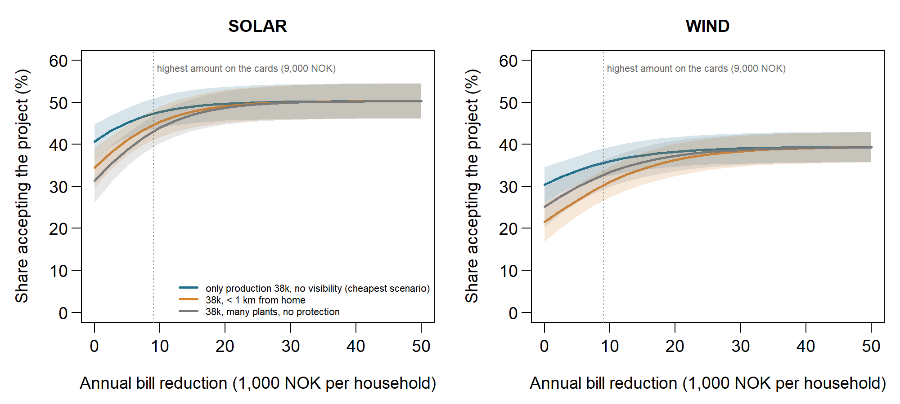
Policy: cost per kWh and acceptance curves
Wind has a higher cost per kWh than solar in the published model, the baseline MNL, my replication and the full-covariance model. Scenario P6 without visibility: solar 3.3 and wind 9.2 øre/kWh (paper); my replication 3.6 and 9.4
Cheapest scenario (P6), population-weighted: at NOK 9,000 acceptance is 47.0% (solar) and 35.5% (wind); at NOK 50,000 only 50.0% and 39.2%. Above NOK 9,000 is extrapolation

Slide 19
Conclusions and limits
Conclusions
The published ranking and Figure 6 are reproducible
No protection, proximity and visibility are stable; the status quo is not
Solar and wind differ in the status quo constant, attribute means and taste covariance, not in cost scale
Many respondents do not trade off impacts against compensation: report class shares and acceptance curves
Limits
Pooled mixed-logit standard errors are unreliable (covariance matrix not positive definite): the tests use likelihoods only
One set of 250 draws; no repeat with another seed
No bootstrap of standard errors
Bayesian model did not converge; attitudes may rationalise choices
Green text = added after the 31 October submission

Slide 20
Thank you! Questions?

