Slide 1
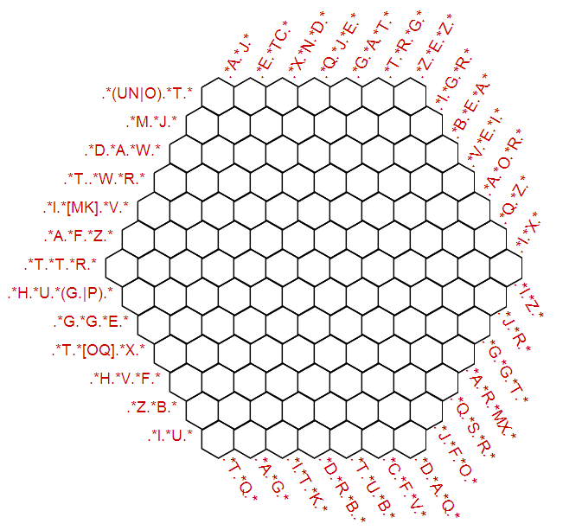
Generating regular expression grosswords
Authors: Joosep Rõõmusaare University of Tartu Indrek Loolaid University of Tartu Code: https://github.com/binoternary/regex-crossword-generator https://github.com/joosep/regex-crossword Demo: http://joosep.github.io/regex-crossword/
References: [1] http://www.i-programmer.info/news/144-graphics-and-games/5450-can-you-do-the-regular-expression-crossword.html/ [2] https://github.com/Jimbly/regex-crossword [3] http://nbviewer.ipython.org/url/norvig.com/ipython/xkcd1313.ipynb
Project for Text Algorithms course
Introduction
Our project was inspired by the a regex crossword that was part of the 2013 MIT Mystery Hunt [1] (and the Text Algorithms course exam)
It was fun, but it didn’t last for very long and we wanted to solve more puzzles like this.
Purpose of the project
Luckily the user interface to solve such a
crossword has already been created [2].
Our goal was to modify that interface so that
we can provide it with other regular
expressions as hints.
And related to that we needed a way to
generate those regular expressions.
Methods and results
The original crossword application was
modified to take as a paramater the URL of a
JSON with the regular expressions for hints.
To generate the regular expressions we
attempted base our regex generation on an
existing solution of generating a regex based
on a list of strings that it should match and a
list of strings it shouldn’t [3].
However this approach didn’t work very well
and needs improving to produce puzzles of
good quality.
An example of one such not very challenging
crossword is on the right.

