Slide 1

CSDA304
Business Modelling & Applied Analytics Using R
Sa
by Sunu Fathima

Slide 2
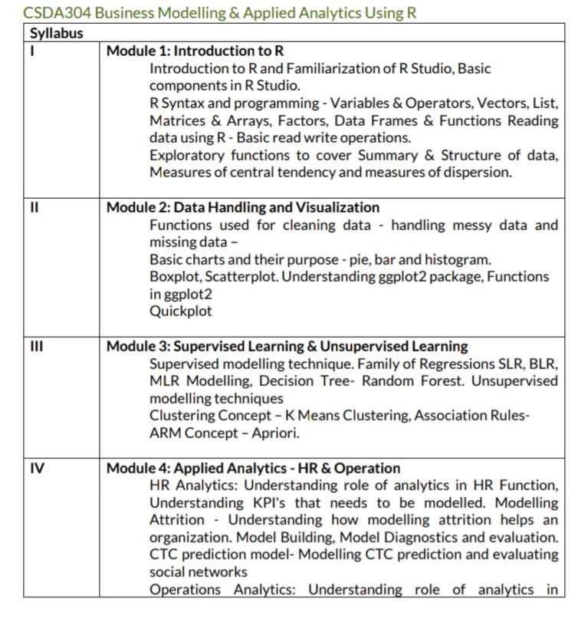
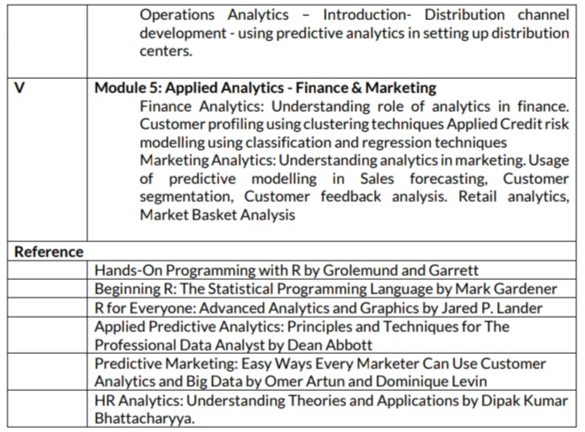

Slide 3
Introduction to R Programming
R is a powerful open-source programming language and software environment for statistical computing and graphics. Widely used in academia and industry, R provides a vast ecosystem of packages and tools for data analysis, visualization, and machine learning.

Slide 4

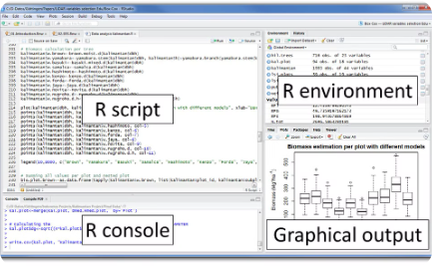
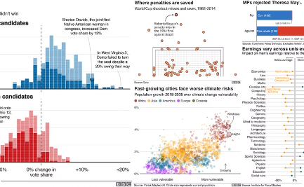
What is R?
A Programming Language
Flexible and Extensible
Powerful Data Visualization
R provides a flexible and extensible environment, allowing users to write custom functions and packages to suit their specific needs. This makes it a versatile tool for a wide range of data-driven applications.
R is a powerful, open-source programming language designed for statistical computing and data analysis. It is widely used in academia and industry for its robust statistical capabilities and extensive library of packages.
R excels at data visualization, offering a wide range of plotting and graphing capabilities. Users can create high-quality, publication-ready plots and charts to present their data and findings effectively.

Slide 5



Why use R?
Data Analysis
Data Visualization
Open-Source
R is a powerful tool for statistical computing and data analysis, making it a popular choice for researchers, data scientists, and analysts.
R has extensive capabilities for creating high-quality, customizable data visualizations, from simple plots to complex infographics.
R is an open-source programming language, meaning it is free to use and has a large, supportive community of developers constantly improving and expanding its capabilities.

Slide 6
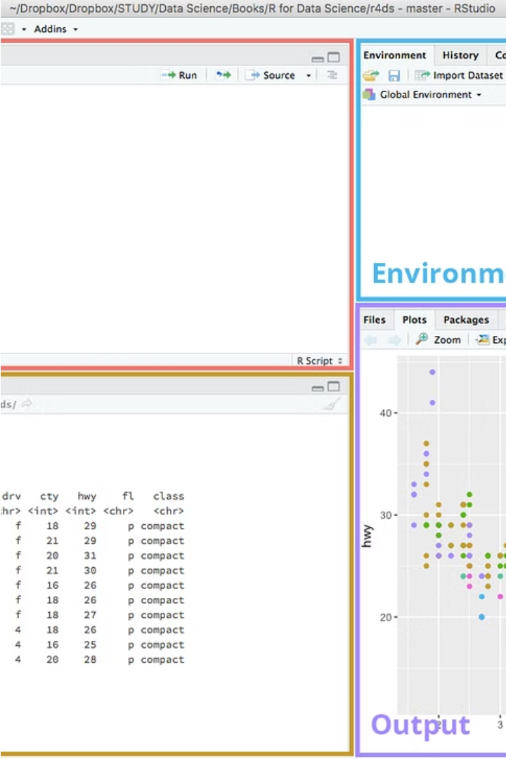
R Environment and Interfaces
R can be accessed through various interfaces, including the command-line interface, Integrated Development Environments (IDEs) like RStudio, and web-based platforms like Shiny. These interfaces offer features like code editing, debugging, and package management.

Slide 7
R Data Types and Structures
1
Numeric Data
2
Character Data
R handles both integers and floating-point numbers with high precision, allowing for complex mathematical operations and statistical analysis.
R can work with text data, including strings, characters, and factors, enabling text processing, NLP, and data manipulation.
3
Logical Data
4
Data Structures
R's logical data type represents true/false values, enabling conditional logic, decision making, and data filtering in your programs.
R provides powerful data structures like vectors, matrices, arrays, data frames, and lists to organize and manipulate your data effectively.

Slide 8
R Variables and Operators
Variables
Naming Conventions
In R, variables are used to store data values. They can hold numbers, text, or even complex data structures like lists or arrays.
R variable names should be descriptive and follow best practices like starting with a letter, using camelCase, and avoiding special characters.
Arithmetic Operators
Logical Operators
R supports standard arithmetic operators like +, -, *, /, and % (modulus). These can be used to perform mathematical calculations on numeric variables.
R also has logical operators like ==, !=, >, <, >=, <= that allow you to compare values and make decisions in your code.

Slide 9




R Functions and Control Structures
Functions
R functions allow you to encapsulate and reuse code. They take inputs, perform operations, and return outputs, making your code more modular and easier to maintain.
Control Structures
R provides various control structures like if-else statements, for/while loops, and switch statements to add logic and flow to your code, enabling you to make decisions and iterate over data.
Function Parameters
Functions in R can have both required and optional parameters, allowing you to make your functions more flexible and adaptable to different use cases.
Function Scope
R has function scoping rules that determine how variables are accessed within a function, ensuring that your code is organized and avoids naming conflicts.

Slide 10
R Packages and Libraries
Expanding Functionality
The CRAN Repository
R's base package provides a robust set of features, but you can further extend its capabilities by installing additional packages and libraries. These external resources unlock a world of specialized tools and functionalities.
The Comprehensive R Archive Network (CRAN) is the primary repository for R packages, hosting thousands of freely available, user-contributed packages covering a wide range of applications and analyses.

Slide 11



R Data Analysis and Modeling
Statistical Analysis
Data Visualization
Machine Learning
R's powerful statistical modeling capabilities allow researchers to uncover insights and relationships within complex datasets using advanced techniques like regression, ANOVA, and time series analysis.
R's rich ecosystem of visualization packages, including ggplot2, enable the creation of stunning, informative plots and graphics to communicate findings and tell compelling data stories.
R's extensive machine learning libraries, such as caret and randomForest, equip data scientists with the tools to build and deploy predictive models for a wide range of applications.

Slide 12
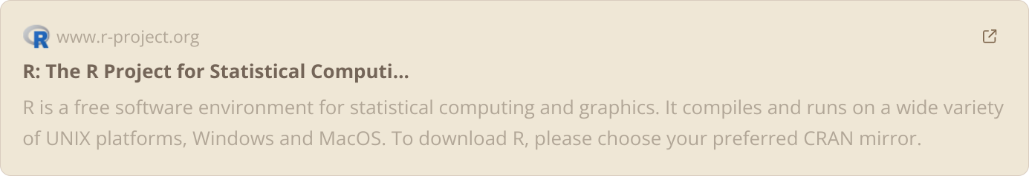

Slide 13
THANK YOU

