Slide 1
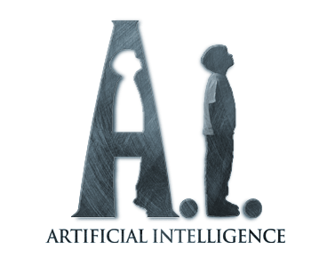
ARTIFICIAL INTELLIGENCE
BY:Binoy Panchiwala (2K14/SE/054)

Slide 2
HISTORY OF A.I.
The name Artificial Intelligence was coined in 1956 by John McCarthy
Computer Science development progressed after World War II with the
increased computing power and major improvements in the design of
the machines

Slide 3
Alan Turing and "The Turing Test"
He wrote a paper in 1950 arguing for the possibility of creating
intelligent machines
In the Turing Test, a human converses with an unseen party and if
the human believes he is talking to another human when he is really
talking to a machine, the machine passes

Slide 4
Newell and Simon created a problem solving program called Logic
Theorist that attempted to solve problems with the accepted rules of
logic
John McCarthy proposed that a study called "The Dartmouth Summer
Research Project On Artificial Intelligence" be done based on his belief that intelligence can be described so that a machine could be made to replicate it

Slide 5
Hubert Dreyfus says that nearly all initial work in AI concerned one of these three areas
Language Translation: an early leader, but in the late 50's programs that could do a decent job of translating technical documents existed
Problem Solving: most work revolved around the work of Newell,Shaw and Simon on the General Problem Solver
Pattern Recognition: computers that could interpret Morse code and read handwriting in different styles were built

Slide 6
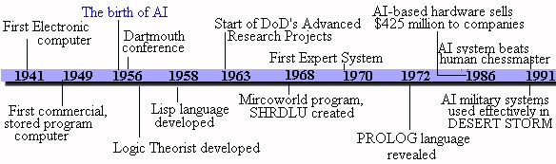
HISTORY OF A.I.

Slide 7
What is A.I.?
Science & Engineering of creating machinery that can carry out tasks such as perception, reasoning, & learning
Artificial computer programmed to “think”

Slide 8
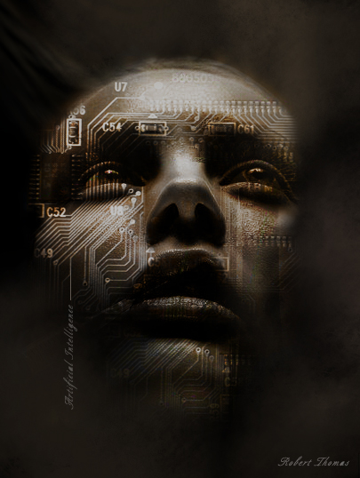

Slide 9
Comparisons between human and computer intelligence
Normal humans have the same intellectual mechanisms and that differences in intelligence are related to ‘quantitative biochemical and physiological conditions’, but computer programs have plenty of speed and memory but their abilities correspond to the intellectual mechanisms that program designers understand well enough to put in programs.
Whenever people do better than computers on some task or computers use a lot of computation to do as well as people, this demonstrates that the program designers lack understanding of the intellectual mechanisms required to do the task efficiently.

Slide 10
A.I. GAME SIMULATION
Arthur Samuel wrote the first checkers-playing program in 1963.
It is best known for defeating Robert Nealey in 1963
Deep Blue (the computer built by IBM engineers) defeated the world's
human chess champion, Gary Kasparov, in a 6 match tournament in 1997

Slide 11
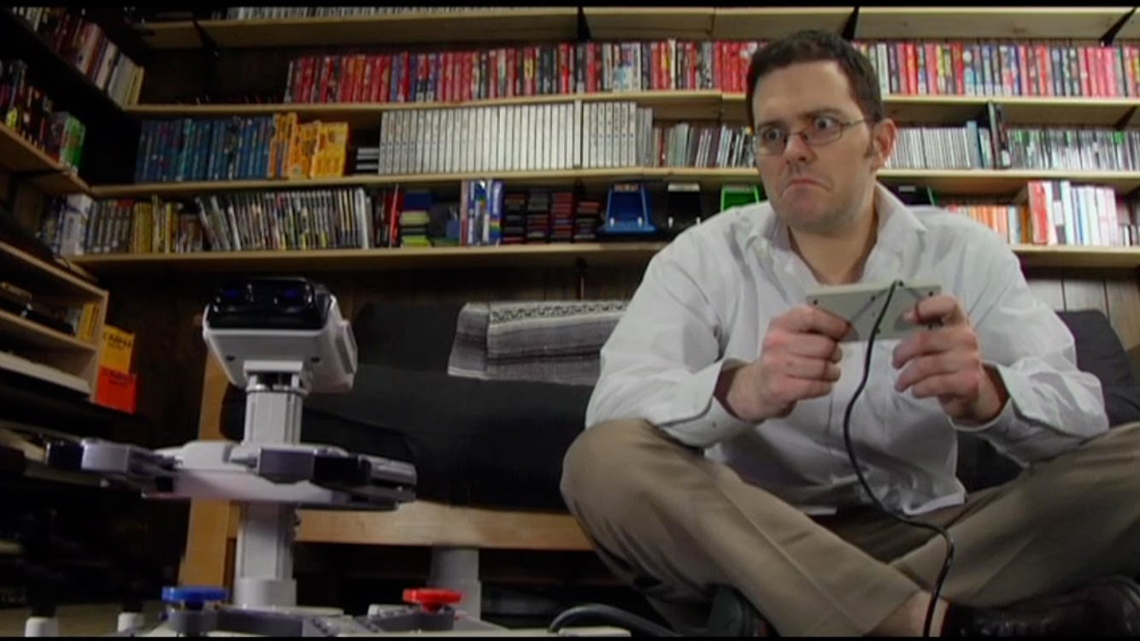
Try to imagine

Slide 12
How is A.I. used today?
Calculators
Digital Cameras
Pet robots
Defense systems

Slide 13
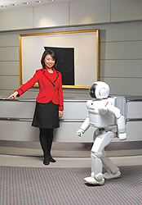
ASIMO(advanced step innovative mobility) ROBOT

Slide 14
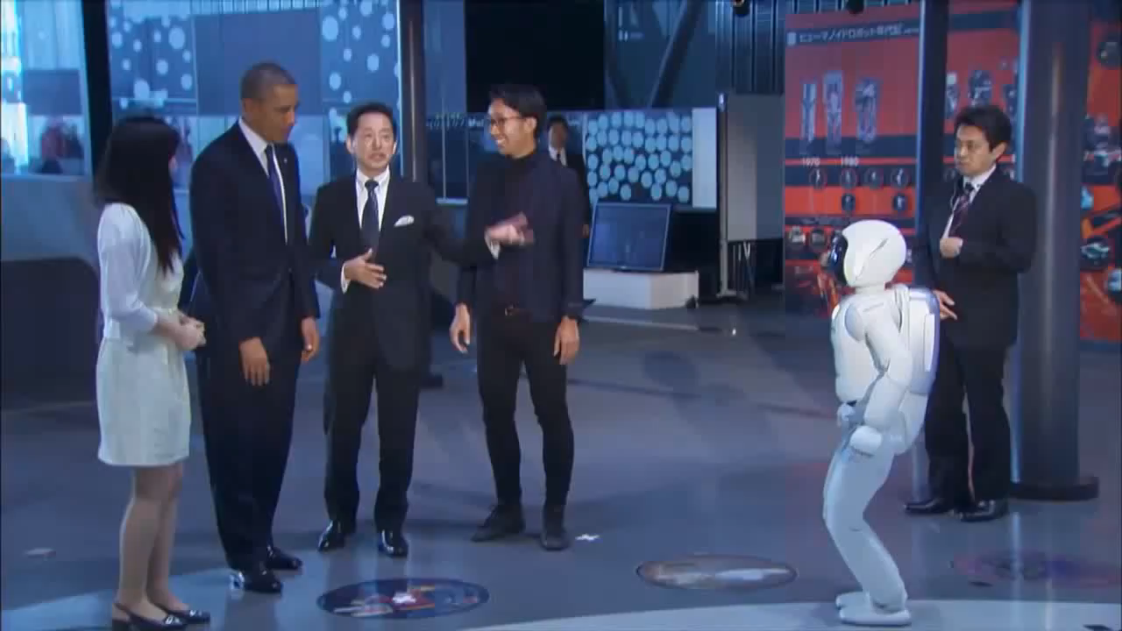

Slide 15
A.I. in the Military
Defense Strategy
Sonar sounds
Security
Voice recognition
Safety
  Autonomous Buggies
  Aerial Vehicles

Slide 16
(con’t)
Radar programs
Modern helicopters
Pilot control
Automatic landing on carriers

Slide 17
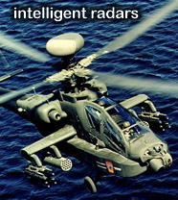
SDI’s “e” evolutionary algorithm in modern helicopters

Slide 18
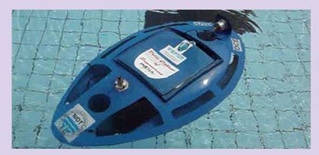
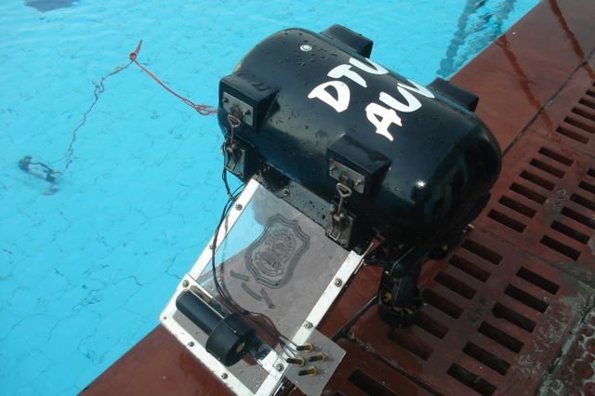
Autonomous under water vehicle(D.T.U)

Slide 19
FUTURE SCOPE OF A.I
In the next 10 years technologies in narrow fields such as speech recognition will continue to improve and will reach human levels.
In 10 years AI will be able to communicate with humans in unstructured English using text or voice.
We will recreate some parts of the human (animal) brain in silicon. The feasibility of this is demonstrated by tentative hippocampus experiments in rats There are two major projects aiming for human brain simulation, CCortex and IBM Blue Brain.

Slide 20
Summary
A.I. will continue to expand in many different fields but we feel the most important is defense
As a leader of the public, safety is a priority and should be invested in

Slide 21


