Slide 1

Business venture to maximize revenue
Abstract
In an over-crowded city like Bengaluru in India, coming up with a food venture is like a double-edged sword. On one hand we see a high number of restaurants and eateries which would mean a high competition and on the other hand an increasing population in the IT capital of India would mean an opportunity to venture into a profitable business.
Introduction
As one seeks to venture into a profitable food business, the success and failure of the venture would depend on the present competition in the area, type of the venue, footfall in the neighborhood. Data Science with ML can help uncover and segment a city (like Bengaluru) to answer and identify areas which are similar in nature and the opportunity cost to venture into a specific type of food business is low and the returns can be high. This analysis is primarily targeted towards individuals / groups who would like to venture into a food business and would like to know details which give them an upper hand before start of any business.

Slide 2
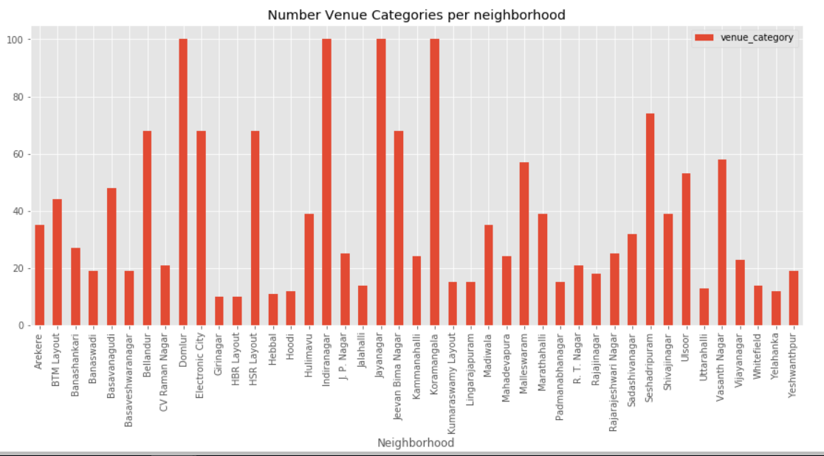
Number of venues per neighborhood

Slide 3
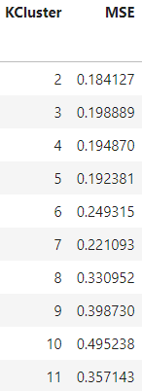
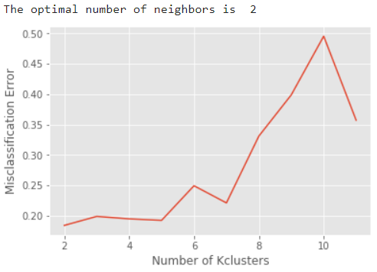

Slide 4
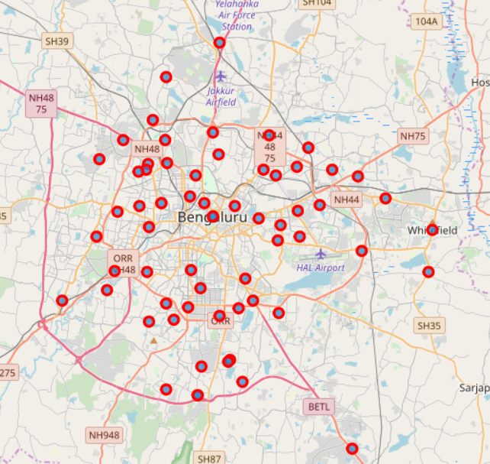
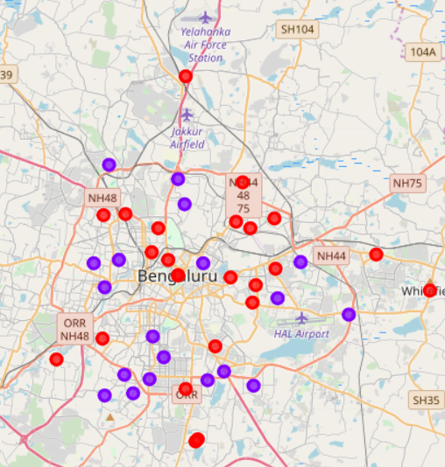

Slide 5
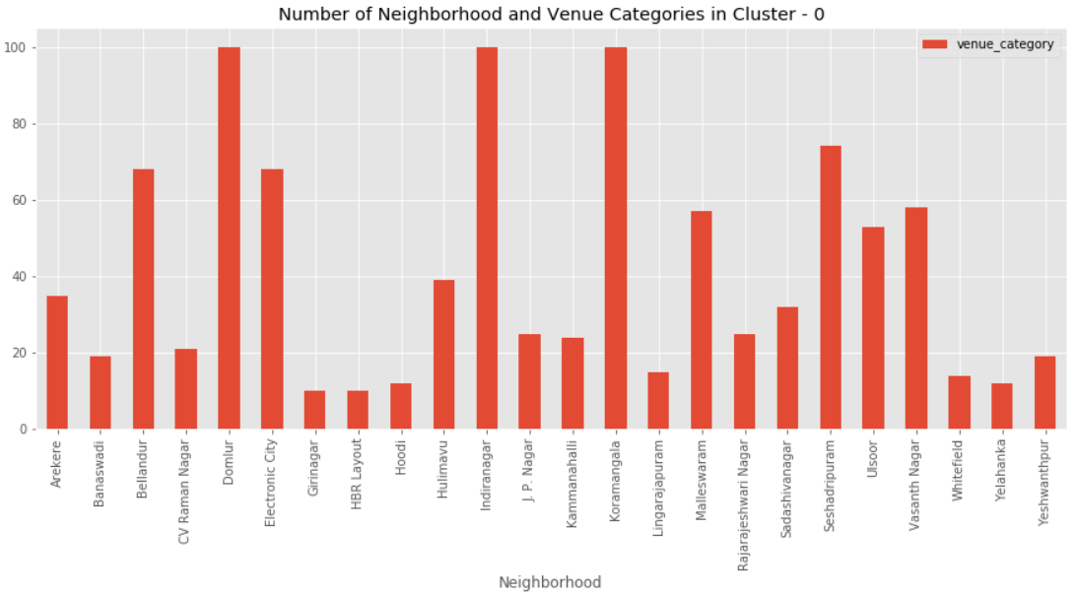
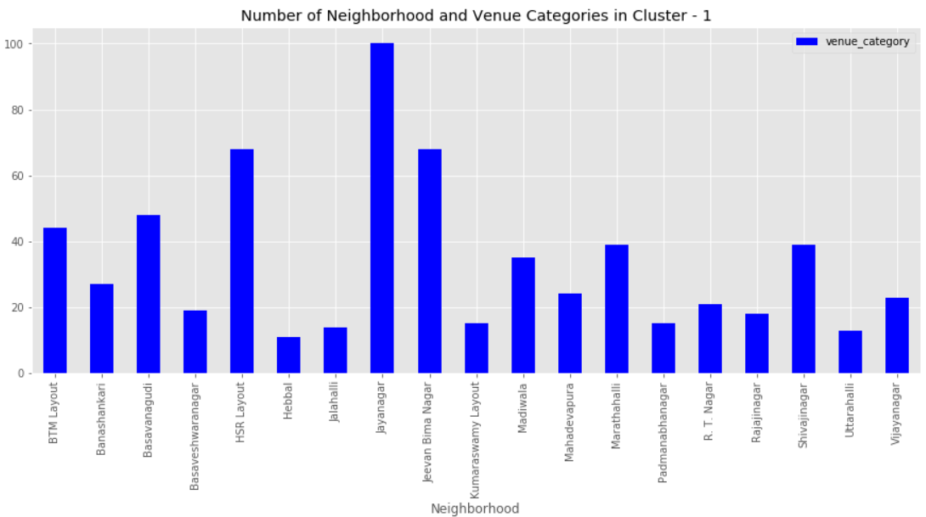

Slide 6
