Slide 1
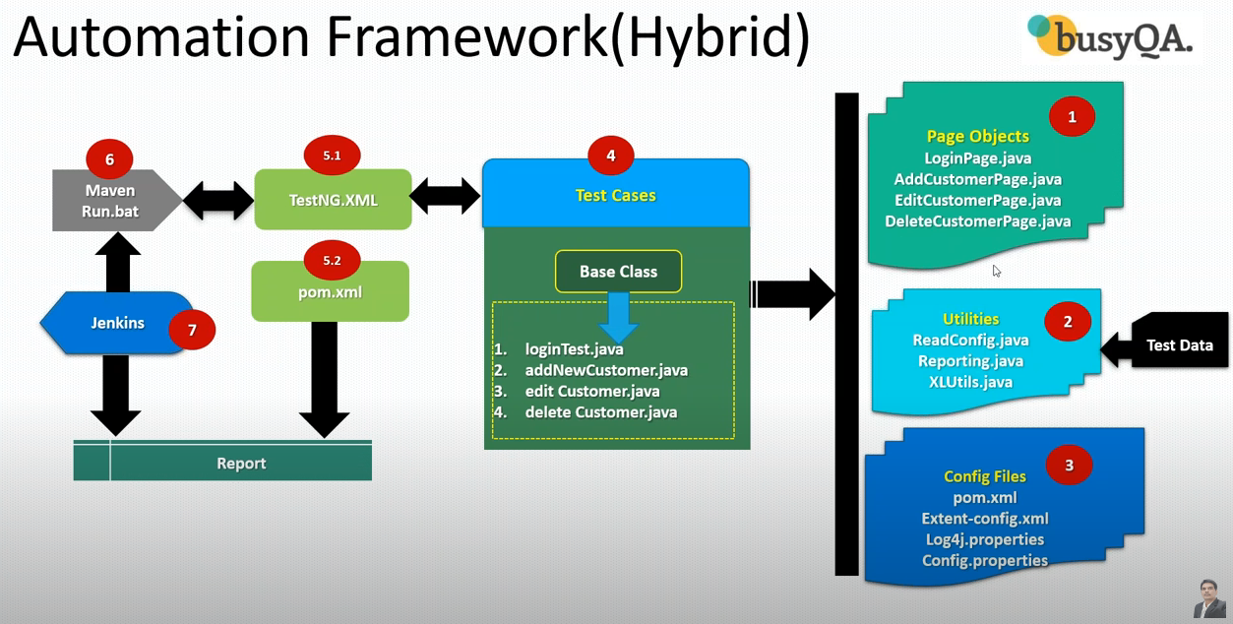
1,2,3,4 – Implantation/Development 5.1, 5.2 – Execution 6,7 – Continuous integration
https://www.youtube.com/watch?v=M4Ye3SKT46g&list=PLUDwpEzHYYLsmuyHqL44P2GqU1FHrutZu
https://github.com/pavanoltraining/inetbankingV1/blob/master/src/test/java/com/inetbanking/pageObjects/AddCustomerPage.java
Notes:
https://www.youtube.com/watch?v=M4Ye3SKT46g&list=PLUDwpEzHYYLsmuyHqL44P2GqU1FHrutZu

Slide 2
URL : https://demo.guru99.com/v4/
User ID: mngr164225
Password : jahetAp
STAGES :
Implementation
Execution
Maintenance

Slide 3
Phase -1:Implementation
Create Maven Project
Update pom.xml
Create Page Objects
Create Basic Test Case
Add Logs to test case
Read common values from the properties file
Run test case on the desired browser
Add extent report
Create Data Driven test case
Adding new test case

Slide 4
Phase-2: Execution
Run test cases with Maven pom.xml
Run test cases through Maven CLI (Command Line Interface)
Run test cases using run.bat
Run test cases using Jenkins(using bat file)

Slide 5
Phase-3: Maintenance
Creating repository in GITHUB
Commit the project code in local repository
Push the project code to GITHUB remote repository from local GIT repository

Slide 6
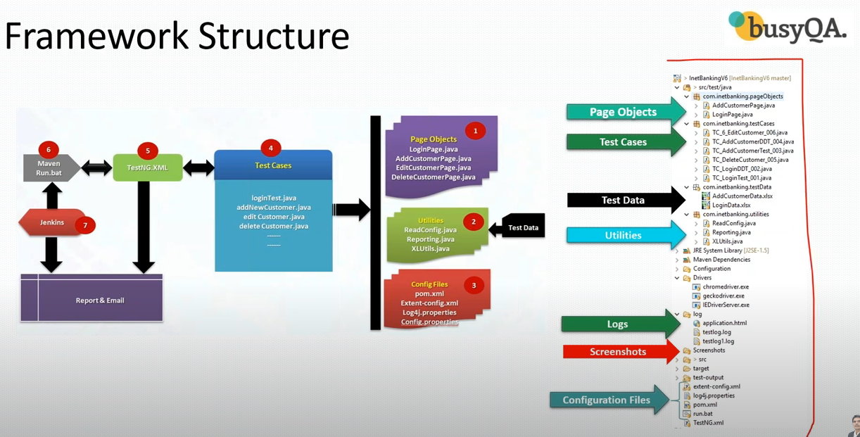

Slide 7
Maven and POM.XML
We can download dependencies from this site:https://mvnrepository.com

Slide 8
Test Case
Setup() – all prerequisite @BeforeClass
Test @Test
Teardown @AfterClass

Slide 9
Base Class
Setup() and TearDown() will be in Base Class
All methods which are common for all test cases.
And all the test case class will extend base class.

Slide 10
log4j
log4.jar – add through pom.xml dependency
log4j.properties
Add following lines in base class
Public static Logger logger
logger= Logger.getLogger("ebanking"); PropertyConfigurator.configure("log4J.properties");

Slide 11
Properties
config.properties
Util file – ReadConfig.java to read values from config.properties
System.getProperty(“user.dir”) -- only in java classes
./ for home directory -- in java classes and in properties

Slide 12
Run test case on desired browser
Through testing.xml parameters

Slide 13
Extent report
Jars – pom.xml
extent.-config.xml – configuration file
Listener class – Reporting.java – utility files
Add entry in testng.xml file

Slide 14
Data driven test
Apache po Jars
XLS File (Test data)
XLUtils.java
@DataProvider

Slide 15
New Test case
Page class
Test case

Slide 16
Execution using pom.xml
testNG.xml
POM.xml with the plugin
Plugin – 1) maven-compiler-plugin 2) maven-surefire-plugin
Pom.xml – Run as Maven Test
Error : No compiler is provided in this environment. Perhaps you are running JRE

Slide 17
Run test cases through Maven CLI – command prompt
Install maven – Apache Maven 3.6.0
Download zip file
Command prompt
Cd E:\NAS-Backup\Document\Training\Automation\Selenium_Projects\Hybrid_Framework
Mvn clean install

Slide 18
Run test cases through run.bat
Create run.bat file contains
Cd E:\NAS-Backup\Document\Training\Automation\Selenium_Projects\Hybrid_Framework
Mvn clean install

Slide 19
Run through Jenkins(Continuous Integration)
Maven – Build Tool, Jenkins, Git, GitHub
Open source web-based application
Download link https://Jenkins.io/download/
https://www.jenkins.io/download/thank-you-downloading-windows-installer-stable/
http://localhost:8080 to launch Jenkins
We can execute using freestyle project (run.bat)
Execute project using Maven(pom.xml)

Slide 20
Jenkins URL : http://localhost:8080/
Pre-requisite : JAVA_HOME configuration in Jenkins
Dashboard->Manage Jenkins->Global Tool Configuration->JDK
Name : myJDK
JAVA_HOME C:\Program Files\Java\jdk-10.0.2\
New-item-> provide name of the project-> Maven Project-OK
Go to build section->specify path of pom.xml and goals as shown in picture
Go to Dash board -> you can see new item(project) is created.

Slide 21
Git -> GitHub or BitBucket
Commit – eclipse/intellij to Git
Push – git to github
Pull – github to git
Local repo (git)
Remote repo (github)
Install git in your local system
https://git-scm.com/download/win
https://github.com/ signup
https://github.com/binoyktym/inetBankingV1.git

Slide 22
Git commands
git init – create an empty git repo – local repo
git remote add origin https://github.com/binoyktym/inetBankingV1.git
git status – what are files ready to commit in git repo .. Local
Gi
git add –A – add all files to the staging area
Git config –global user.name “binoyktym”
Git config –global user.email ai_ktym@yahoo.com
Git commit –m “this is my first commit”

