Slide 1

Extensions Chart

Slide 2

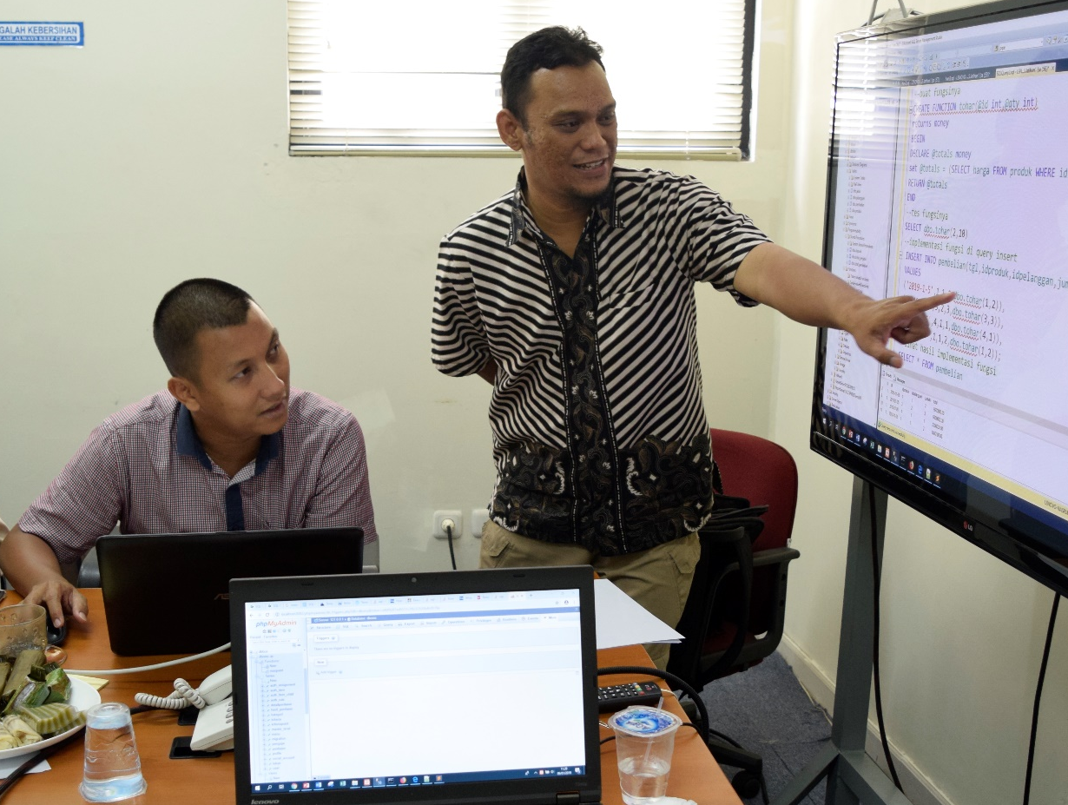


Nasrul, S.Pd.I, S.Kom, M.Kom
Dosen Tetap STT Nurul Fikri
Instruktur IT NF Computer
Mentor MSIB Fullstack Web Developer Kampus Merdeka
Instruktur IT Sekolah Programmer YBM PLN
Instruktur IT Fast Com
nasrul99@gmail.com
youtube.com/@nasrultutorial

Slide 3
Pokok Bahasan
Membuat Dashboard Aplikasi
Menggunakan Extension Chart
Membuat Grafik Lingkar
Membuat Grafik Batang

Slide 4
Buat Controller Baru (Dashboard)

Slide 5
Buat Fungsi Index di DashbordController
<?php namespace App\Http\Controllers; use App\Http\Controllers\Controller; use Illuminate\Http\Request; use App\Models\Produk; //panggil model use Illuminate\Support\Facades\DB; // jika pakai query builder use Illuminate\Database\Eloquent\Model; //jika pakai eloquent class DashboardController extends Controller { public function index() { return view('dashboard.index’); } }

Slide 6
Buat Route di routes/web.php
use App\Http\Controllers\DashboardController;
Route::get('dashboard', [DashboardController::class,'index']);

Slide 7
Buat Menu di admin/sidebar.blade.php
<aside id="sidebar" class="sidebar">
<ul class="sidebar-nav" id="sidebar-nav">
<li class="nav-item">
<a class="nav-link " href="{{ url('dashboard') }}">
<i class="bi bi-grid"></i>
<span>Dashboard</span>
</a>
</li><!-- End Dashboard Nav -->

Slide 8
Buat File grafik_stok_barang.blade.php
di views/dashboard – Grafik Batang
<!-- Bar Chart -->
<canvas id="barChart" style="max-height: 400px;"></canvas>
<script>
//ambil data nama nama dan stok dari DashboardController di fungsi index
var lbl = [@foreach($ar_stok as $s) '{{ $s->nama }}', @endforeach];
var stk = [@foreach($ar_stok as $s) {{ $s->stok }}, @endforeach];
document.addEventListener("DOMContentLoaded", () => {
new Chart(document.querySelector('#barChart'), {
type: 'bar',
data: {
labels: lbl,
datasets: [{
label: 'Grafik Stok Barang',
//data: [65, 59, 80, 81, 56, 55, 40],
data: stk,

Slide 9
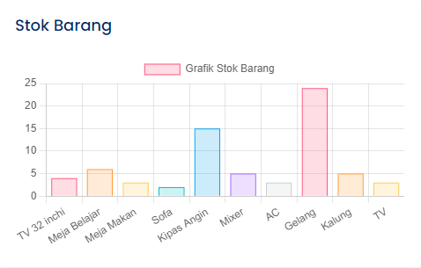
Tampilan Grafik Batang
Notes:
http://localhost:8000/dashboard

Slide 10
Buat File grafik_jumlah_barang.blade.php
di views/dashboard – Grafik Pie
<!-- Pie Chart -->
<canvas id="pieChart" style="max-height: 400px;"></canvas>
<script>
//ambil data nama jenis dan jumlah produk per jenis
//dari DashboardController di fungsi index
var lbl2 = [@foreach($ar_jumlah as $j) '{{ $j->nama }}', @endforeach];
var jml = [@foreach($ar_jumlah as $j) {{ $j->jumlah }}, @endforeach];
document.addEventListener("DOMContentLoaded", () => {
new Chart(document.querySelector('#pieChart'), {
type: 'pie',
data: {
labels: lbl2,
datasets: [{
label: 'Jumlah Produk',
//data: [300, 50, 100],
data: jml,

Slide 11
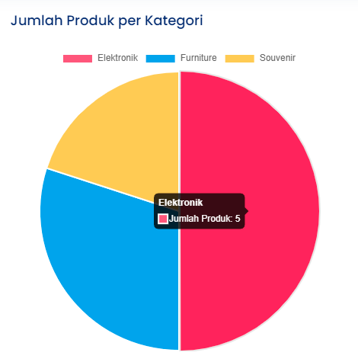
Tampilan Grafik Pie
Notes:
http://localhost:8000/dashboard

Slide 12
Referensi
https://laravel.com/
Notes:
Referensi web diakses terakhir melalui websitenya pada bulan Juli 2023.

