Slide 1

Extensions
Barcode

Slide 2
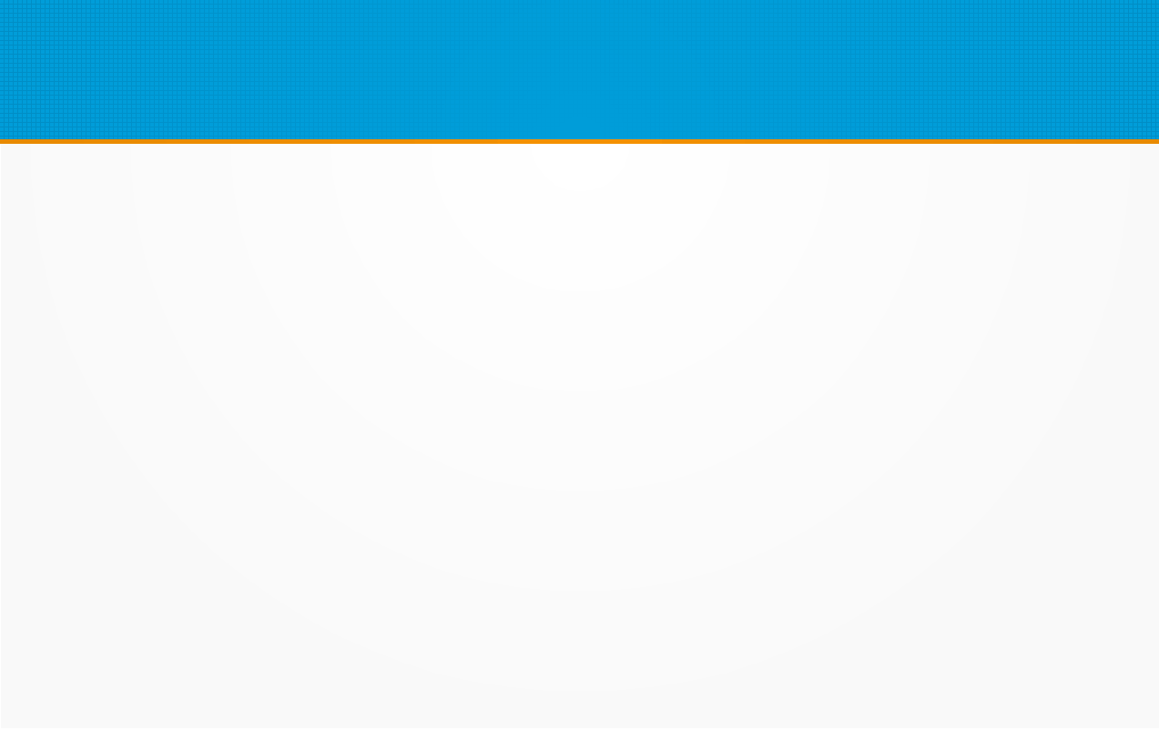
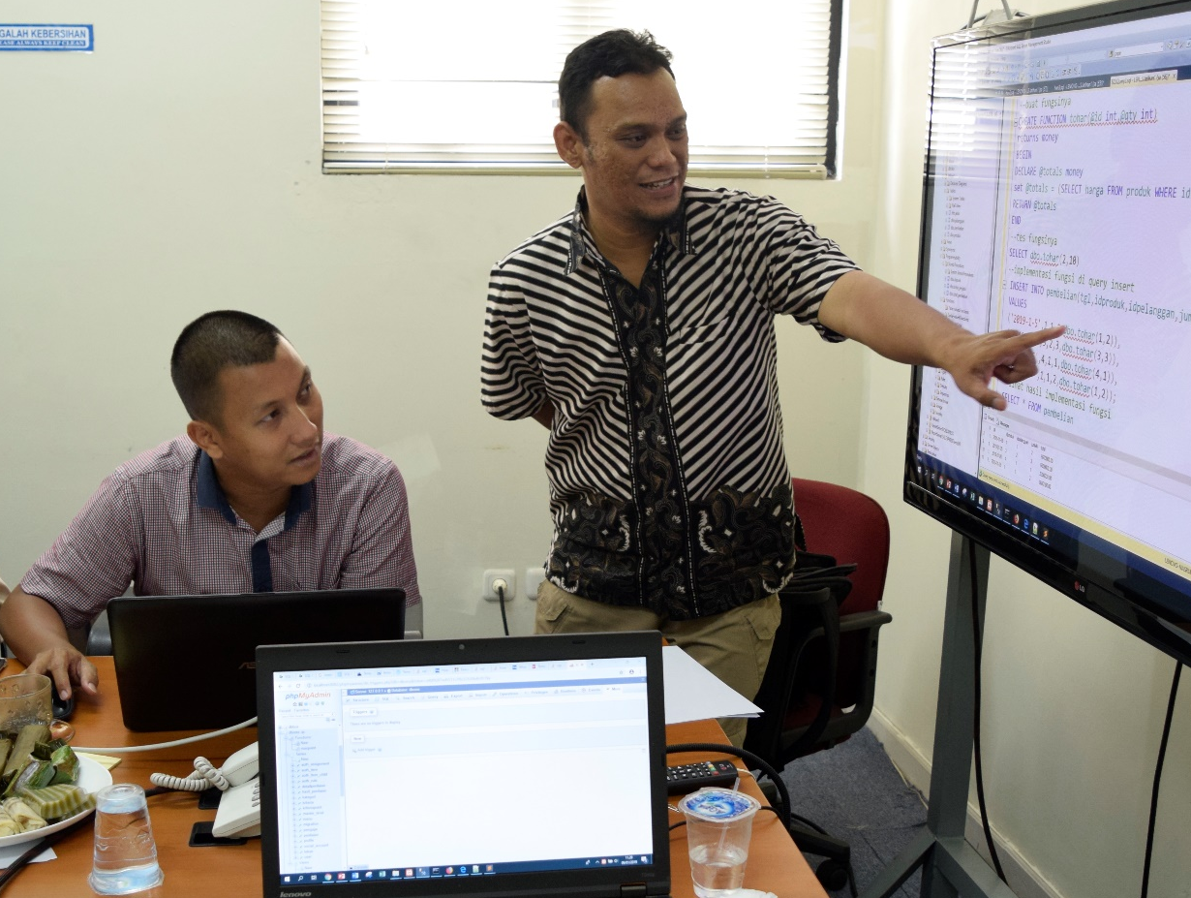


Nasrul, S.Pd.I, S.Kom, M.Kom
Dosen Tetap STT Nurul Fikri
Instruktur IT NF Computer
Mentor MSIB Fullstack Web Developer Kampus Merdeka
Instruktur IT Sekolah Programmer YBM PLN
Instruktur IT Fast Com
nasrul99@gmail.com
youtube.com/@nasrultutorial

Slide 3
Pokok Bahasan
Membuat view
Generate Barcode
Installasi & Konfigurasi Extensions Barcode

Slide 4
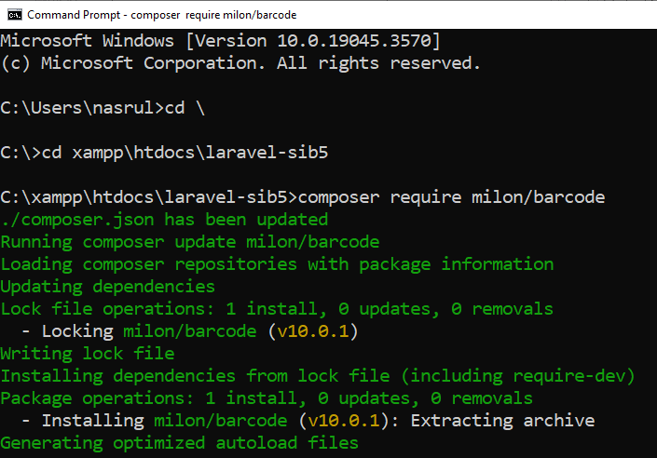
Install Extensions Barcode

Slide 5
Konfigurasi
Konfigurasi di config/app.php
'providers' => ServiceProvider::defaultProviders()->merge([
//-------------tambahan---------------- Milon\Barcode\BarcodeServiceProvider::class,
])->toArray(),
'aliases' => Facade::defaultAliases()->merge([
//--------tambahan-----------
'DNS1D' => Milon\Barcode\Facades\DNS1DFacade::class,
'DNS2D' => Milon\Barcode\Facades\DNS2DFacade::class,
])->toArray(),

Slide 6
Membuat Barcode di Halaman Asset Index
<tbody>
@foreach($ar_asset as $a)
<tr>
<td>{{ $no++ }}</td>
<td>{{ $a->nama }}</td>
<td>{!! DNS1D::getBarcodeHTML('$ '. $a->id, 'C39') !!}</td>
<td>{{ $a->kategori->nama }}</td>

Slide 7
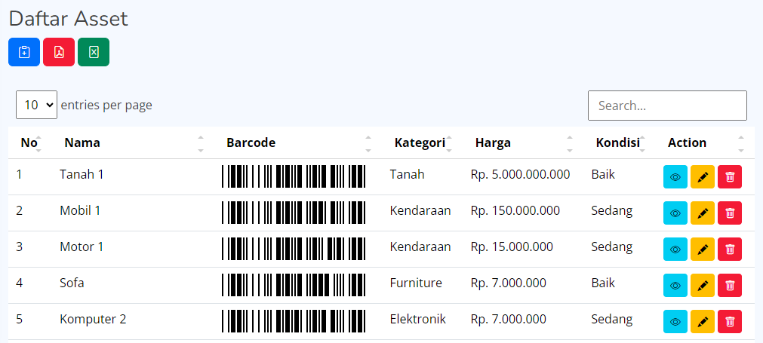
Tampilan Barcode di Halaman Asset Index

Slide 8
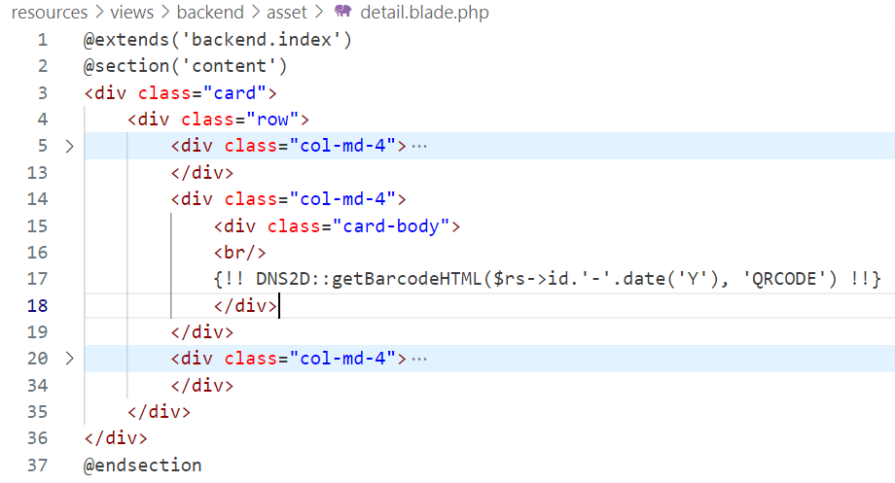
Membuat Barcode di Halaman Asset Detail

Slide 9
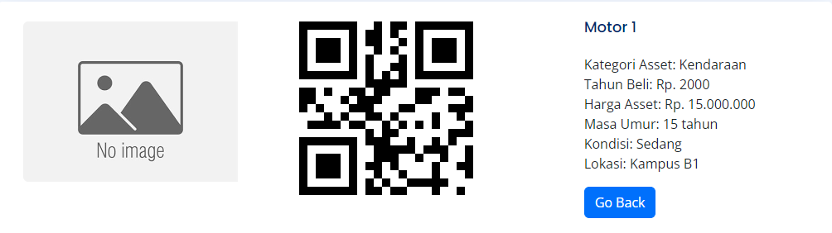
Tampilan Barcode di Halaman Asset Detail

Slide 10
Referensi
https://laravel.com/
https://github.com/milon/barcode
https://www.positronx.io/how-to-quickly-generate-barcode-in-laravel-application/
Modul Laravel Framework, Nasrul, NF Computer, 2022
Notes:
Referensi web diakses terakhir melalui websitenya pada bulan November 2023.

