Slide 1
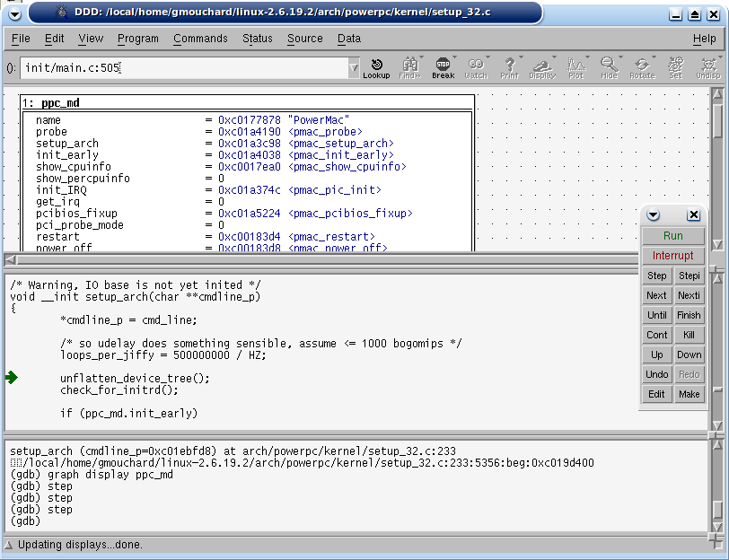
GDB Debugger
arm7tdmi
TCP/IP
GDB Server
Memory
Bridge
RAM
ARM7TDMI
ARM7TDMI
Application
ELF
Loader

