Slide 1
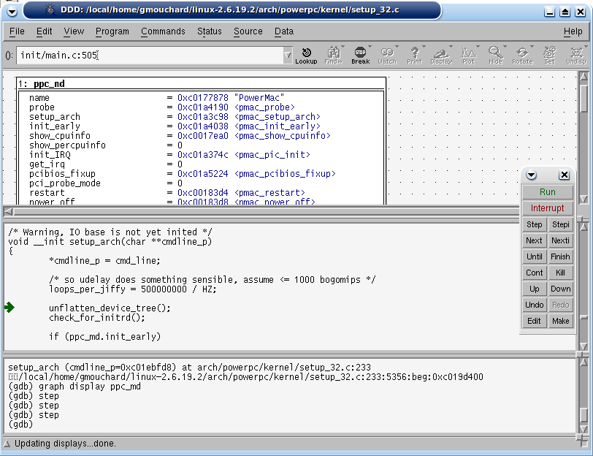
GDB Debugger
arm966e_s
TCP/IP
GDB Server
Memory
Bridge
RAM
ARM966E/S
ARM966E/S
Application
CP15
TCM
ELF
Loader

