Slide 1
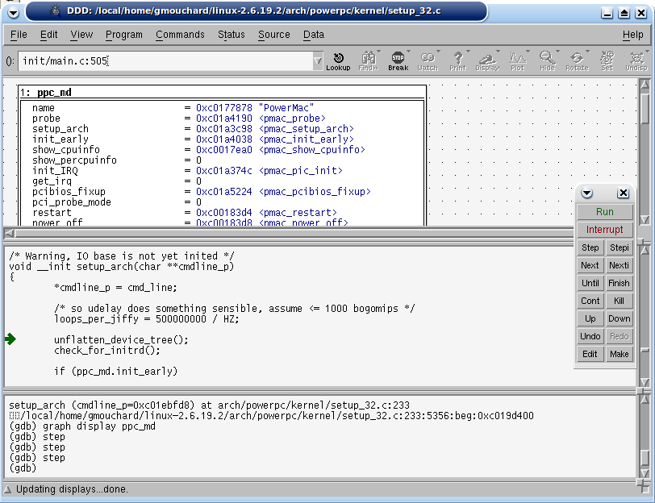
GDB Debugger
avr32emu
TCP/IP
GDB Server
Memory
Router
RAM
AVR32A
********* CUBIC FUNCTIONS ***********
Solutions: 2.000000 6.000000 2.500000
Solutions: 2.500000
Solutions: 1.635838
Solutions: 13.811084
Solutions: -9.460302 0.152671 -0.692369
Solutions: -9.448407 0.260617 -0.812210
Solutions: -9.436449 0.348553 -0.912103
Solutions: -9.424429 0.424429 -1.000000
Solutions: -9.412344 0.492017 -1.079673
Solutions: -9.400195 0.553459 -1.153264
Solutions: -9.387980 0.610110 -1.222131
Solutions: -9.375698 0.662891 -1.287194
Solutions: -9.363348 0.712463 -1.349115
Solutions: -9.350930 0.759317 -1.408387
Solutions: -9.403823 0.143722 -0.739899
Solutions: -9.391702 0.248536 -0.856834
Solutions: -9.379515 0.334813 -0.955298
Solutions: -9.367262 0.409653 -1.042391
Solutions: -9.354942 0.476534 -1.121592
Solutions: -9.342554 0.537465 -1.194911
Solutions: -9.330097 0.593732 -1.263635
Solutions: -9.317570 0.646216 -1.328647
Solutions: -9.304971 0.695554 -1.390583
Solutions: -9.292300 0.742220 -1.449920
Solutions: -9.346609 0.135604 -0.788995
Solutions: -9.334251 0.237275 -0.903023
Solutions: -9.321825 0.321825 -1.000000
Solutions: -9.309330 0.395565 -1.086235
AVR32
Application
AVR32
Target to Host
System Calls
ELF
Loader
Host OS API
Host Operating System:
Linux
Windows
Mac OS X
Host
File system

