Slide 1
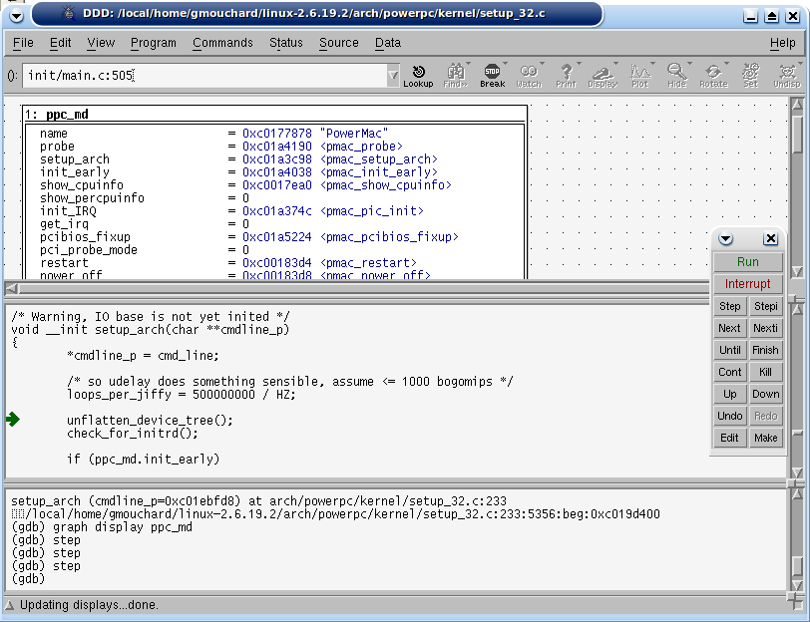
GDB Debugger
Embedded-ppc-g4-board
TCP/IP
GDB Server
Front Side Bus
Chipset
(MPC107)
Flash Mem.
(AM29LVXXXX)
Flash Ctrl
DMA
ROM
OS
+
Applications
RAM
ELF
Loader
EPIC
G3/G4
PCI Ctrl
G3/G4
PCI Bus
TCP/IP
PCI
Stub
External Tool:
Co-Simulation Environment
In-house industrial simulation framework
Testbench
…

